Slide 1
Routing with SAT
By: Roger Pujol Torramorell

Slide 2
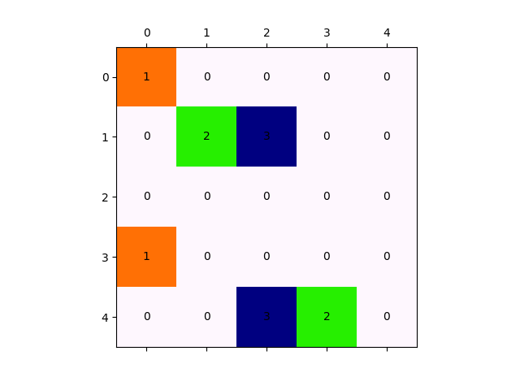
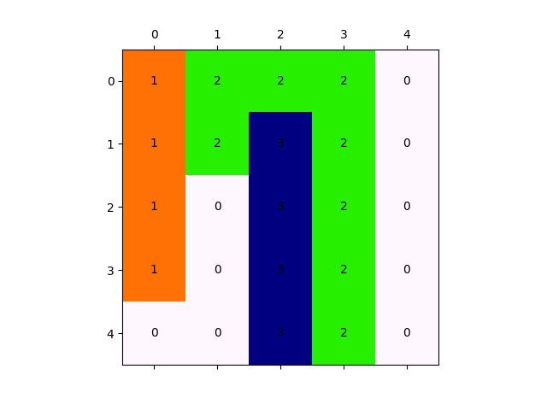
The problem
2D Grid
Pairs of dots
Connect all pairs without creating any short circuit among them

Slide 3
SAT (Pseudo Boolean)
Python3.7 for the encoding of the problem to Pseudo Boolean
PBlib to encode the Pseudo Boolean into actual SAT
Minisat as the SAT solver
Python3 to post-process the results

Slide 4
PB: Variables
One 2D grid of Boolean variables for each pair of dots
Each grid indicates the dots and their connection for a particular pair
Basically 3D grid with axes X, Y and P where P is the id of a pair of dots.

Slide 5
PB: Constraints (informal)
Force the dots from each pair to be 1
Force that all the positions in the 2D grid (X,Y) can only have one pair level set to 1
Force that the initial dots have exactly one neighbour set to 1
Force that all positions without initial dots:
If 1 then have exactly two neighbours set to 1
Else 0

Slide 6
PB: Constraints
For each dot D in pair:
D = 1
C_{left_of_D} + C_{above_of_D} + C_{right_of_D} + C_{under_of_D} = 1
For each position in the X,Y axis being C cell and k the last pair id:
C₁ + C₂ + … + C_{k} ≤ 1
For each position C in the 3D grid (excluding the initial dots)
C_{left_of_C} + C_{above_of_C} + C_{right_of_C} + C_{under_of_C} + 3¬C ≥ 2
C_{left_of_C} + C_{above_of_C} + C_{right_of_C} + C_{under_of_C} + 3¬C ≤ 2

Slide 7
Problems
This gives a not optimum solution.
This encoding ensures connections between pairs of dots but also there might be cycles without any dot.
Can be solved in a simple post processing
Both problems can be solved by optimizing

Slide 8
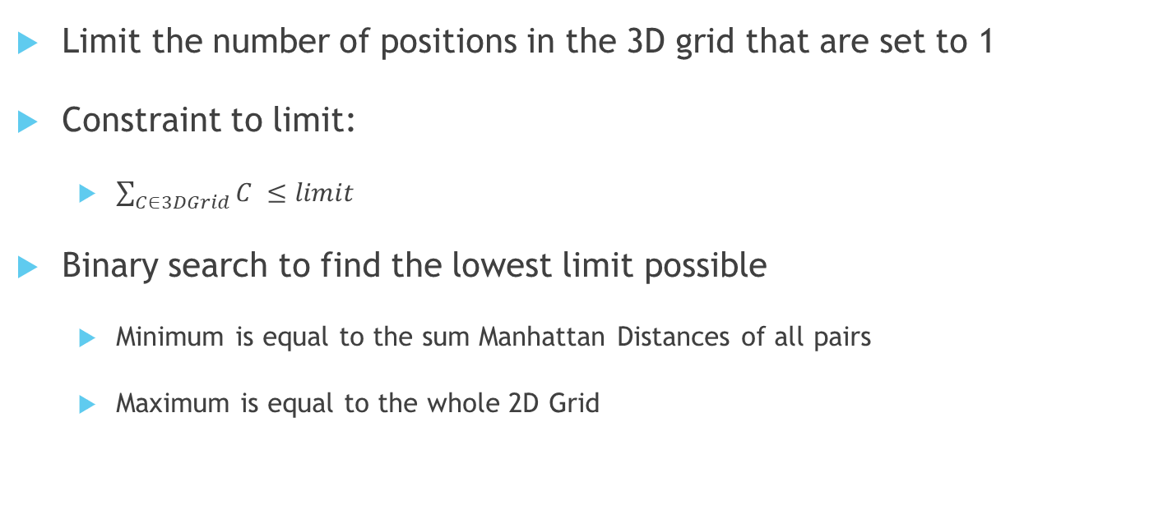
Optimization
Limit the number of positions in the 3D grid that are set to 1
Constraint to limit:
$\sum_{C∈3DGrid}{C} ≤limit$
Binary search to find the lowest limit possible
Minimum is equal to the sum Manhattan Distances of all pairs
Maximum is equal to the whole 2D Grid

Slide 9
Example

Slide 10
Example
* #variable= 75 #constraint= 151
1 x1 >= 1;
1 x4 >= 1;
+1 x2 +1 x6 = 1;
+1 x3 +1 x5 +1 x9 = 1;
…
-1 x1 -1 x26 -1 x51 >= -1;
…
-1 x26 -1 x32 -1 x36 +3 ~x31 >= -2;
+1 x26 +1 x32 +1 x36 +3 ~x31 >= 2;
…

Slide 11
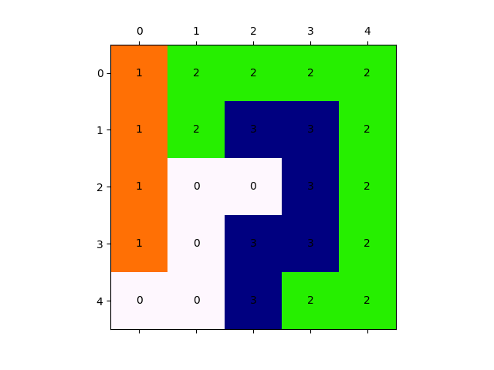
Example

Slide 12
Example Optimization
Cost=25…SAT
Cost=14…UNSAT
Cost=19…SAT
Cost=16...SAT
Cost=15...UNSAT
Best SAT solution Cost=16
Constraint added to limit (limit=16):
-1 x1 -1 x2 -1 x3 … -1 x73 -1 x74 -1 x75>= -16;

Slide 13
Example Optimization

Slide 14
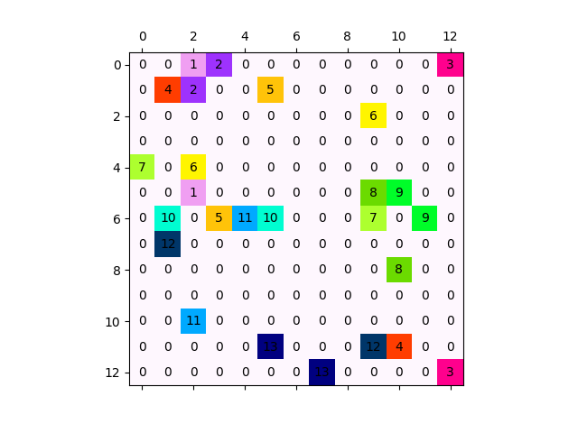
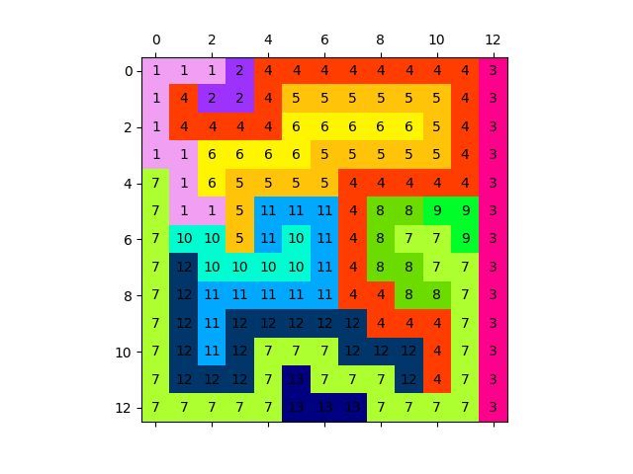
Other Examples (1/3)

Slide 15
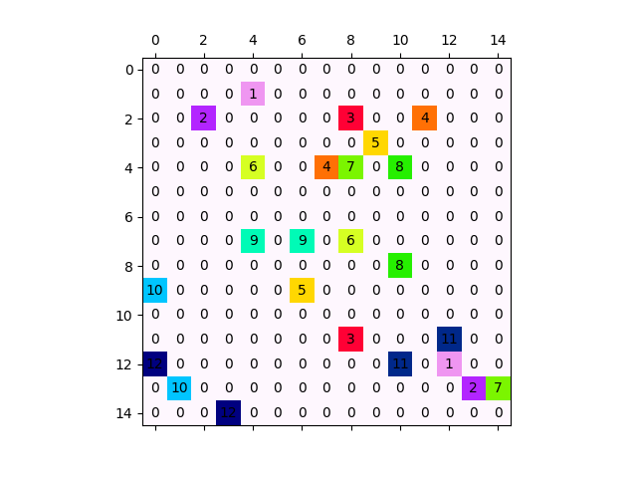
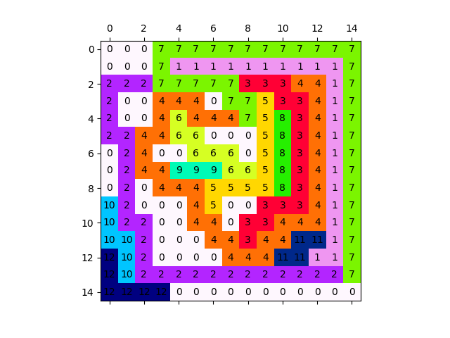
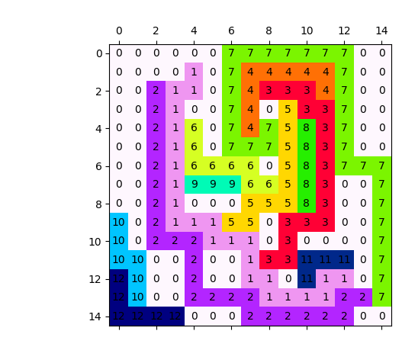
Other Examples (2/3)

Slide 16
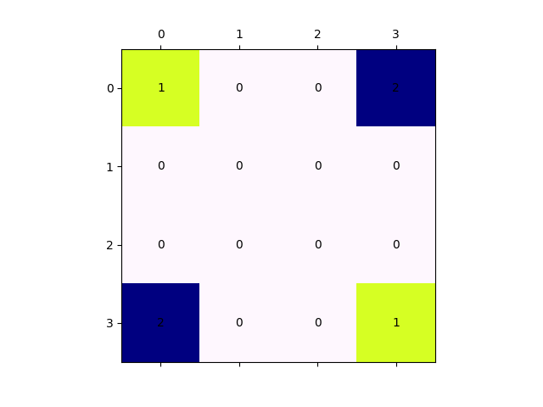
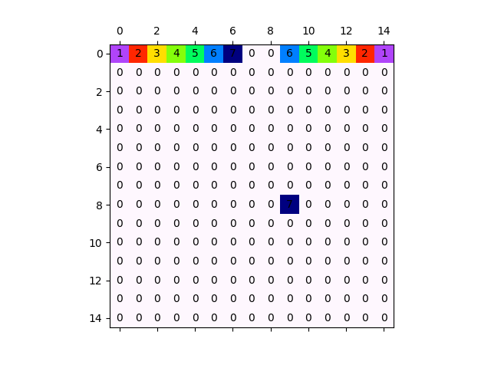
Other Examples (3/3)

Slide 17
Demo
Give me an input
We run the program
We check the output

