Slide 1
CS 220: Recursion The Art of Self Reference
Meena Syamkumar
Michael Doescher

Slide 2
Part 2 of 3 - Data Structures
Lists and Dictionaries

Slide 3
Part 2 of 3 - Data Structures
Lists and Dictionaries
CSV and JSON

Slide 4
Part 2 of 3 - Data Structures
Lists and Dictionaries
CSV and JSON
Objects and References

Slide 5
Part 2 of 3 - Data Structures
Lists and Dictionaries
CSV and JSON
Objects and References
Fancy Functions
Recursion
Generators
Functions are Objects

Slide 6
Part 2 of 3 - Data Structures
Lists and Dictionaries
CSV and JSON
Objects and References
Fancy Functions
Recursion
Generators
Functions are Objects

Slide 7
Part 2 of 3 - Data Structures
Lists and Dictionaries
CSV and JSON
Objects and References
Fancy Functions
Recursion
Generators
Functions are Objects
Files
Errors

Slide 8
Goal: use self-reference is a meaningful way
Hofstadter's Law: “It always takes longer than you expect, even when you take into account Hofstadter's Law.”
(From Gödel, Escher, Bach)
good advice for CS assignments!
“Dialectical Materialism is materialism that involves dialectic.”
https://en.wikipedia.org/wiki/Circular_definition

Slide 9
Goal: use self-reference is a meaningful way
Hofstadter's Law: “It always takes longer than you expect, even when you take into account Hofstadter's Law.”
(From Gödel, Escher, Bach)
good advice for CS assignments!
“Dialectical Materialism is materialism that involves dialectic.”
“The Marxist theory (adopted as the official philosophy of the Soviet communists) that political and historical events result from the conflict of social forces and are interpretable as a series of contradictions and their solutions. The conflict is believed to be caused by material needs.”
https://en.wikipedia.org/wiki/Circular_definition

Slide 10
Goal: use self-reference is a meaningful way
Hofstadter's Law: “It always takes longer than you expect, even when you take into account Hofstadter's Law.”
(From Gödel, Escher, Bach)
mountain: “a landmass that projects conspicuously above its surroundings and is higher than a hill”
hill: “a usually rounded natural elevation of land lower than a mountain”
(Example of unhelpful self reference from Merriam-Webster dictionary)
https://en.wikipedia.org/wiki/Circular_definition

Slide 11
Overview: Learning Objectives
Recursive definitions and recursive information
What is a recursive definition/structure?
Arbitrarily vs. infinitely
Recursive code
What is recursive code?
Why write recursive code?
Where do computers keep local variables for recursive calls?
What happens to programs with infinite recursion?
Read Think Python
Ch 5: “Recursion” through “Infinite Recursion”
Ch 6: “More Recursion” through end

Slide 12
What is Recursion?
Recursive definitions
Contain the term in the body
Dictionaries, mathematical definitions, etc
A number x is a positive even number if:

Slide 13
What is Recursion?
Recursive definitions
Contain the term in the body
Dictionaries, mathematical definitions, etc
A number x is a positive even number if:
x is 2
OR
x equals another positive even number plus two

Slide 14
What is Recursion?
Recursive definitions
Contain the term in the body
Dictionaries, mathematical definitions, etc
Recursive structures may refer to structures of the same type
data structures or real-world structures
rows = [
[“A”,[1,2]],
[“B”,[3,4,5]],
[“C”,[6,7]]
]
rows
“A”
“B”
“C”
1
2
3
4
5
6
7

Slide 15

Recursive structures are EVERYWHERE!
files
{
“name”: “alice”,
“grade”: “A”,
“score”: 96,
“exams”: {
“midterm”: {“points”:94,
“total”:100},
“final”: {“points”: 98,
“total”: 100}
}
}
directories
nature
files
formats

Slide 16
Example: Trees (Finite Recursion)
Term: branch
Def: wooden stick, with an end splitting into other branches, OR terminating with a leaf
?

Slide 17
Example: Trees (Finite Recursion)
Term: branch
?
?
Def: wooden stick, with an end splitting into other branches, OR terminating with a leaf
?

Slide 18
Example: Trees (Finite Recursion)
Term: branch
?
?
Def: wooden stick, with an end splitting into other branches, OR terminating with a leaf

Slide 19
Example: Trees (Finite Recursion)
Term: branch
?
?
?
?
?
Def: wooden stick, with an end splitting into other branches, OR terminating with a leaf

Slide 20
Example: Trees (Finite Recursion)
Term: branch
Def: wooden stick, with an end splitting into other branches, OR terminating with a leaf

Slide 21
Example: Trees (Finite Recursion)
Term: branch
Def: wooden stick, with an end splitting into other branches, OR terminating with a leaf
trees are arbitrarily large:
recursive case allows
indefinite growth
arbitrarily != infinitely

Slide 22
Example: Trees (Finite Recursion)
Term: branch
Def: wooden stick, with an end splitting into other branches, OR terminating with a leaf
trees are arbitrarily large:
recursive case allows
indefinite growth
trees are finite:
eventual base case
allows completion
arbitrarily != infinitely

Slide 23
base case (leaf)
recursive case (branch)

Slide 24
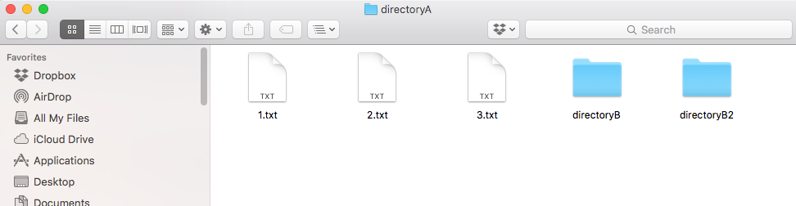
Example: Directories (aka folders)
Term: directory
recursive because def contains term
Def: a collection of files and directories

Slide 25
Example: Directories (aka folders)
Term: directory
recursive because def contains term
Def: a collection of files and directories
file system tree

Slide 26
Example: Directories (aka folders)
Term: directory
recursive because def contains term
Def: a collection of files and directories
file system tree

Slide 27
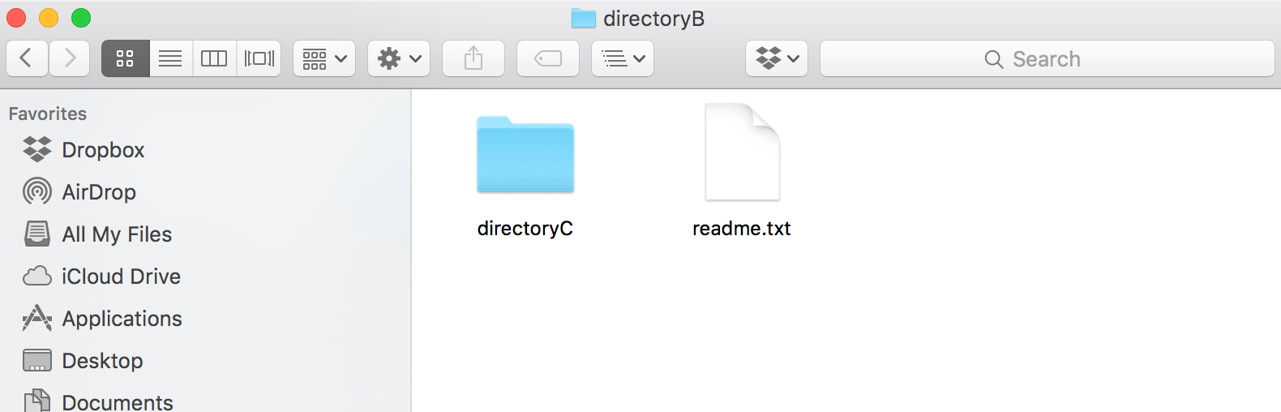
Example: Directories (aka folders)
Term: directory
recursive because def contains term
Def: a collection of files and directories
file system tree

Slide 28
Example: Directories (aka folders)
Term: directory
recursive because def contains term
Def: a collection of files and directories
file system tree

Slide 29

Example: Directories (aka folders)
Term: directory
recursive because def contains term
Def: a collection of files and directories
file system tree

Slide 30
Example: Directories (aka folders)
Term: directory
recursive because def contains term
Def: a collection of files and directories
file system tree

Slide 31
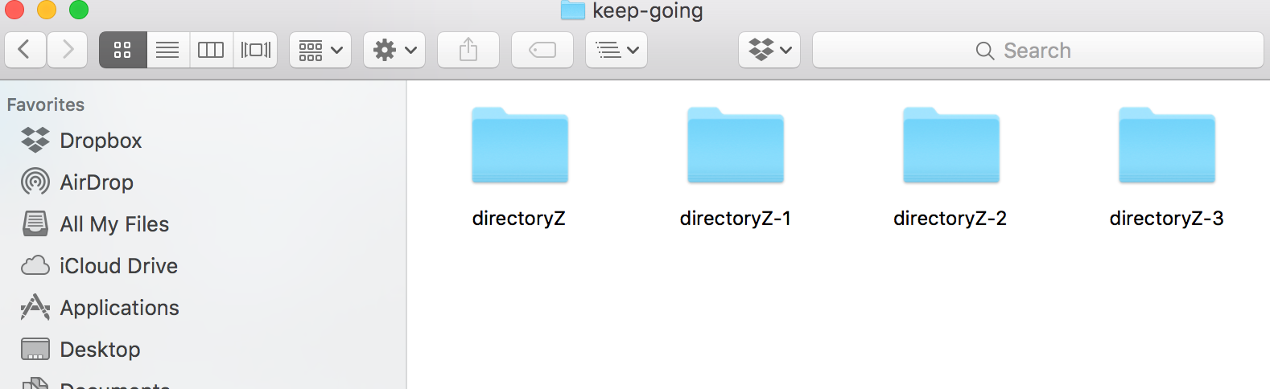
Example: Directories (aka folders)
Term: directory
recursive because def contains term
Def: a collection of files and directories
file system tree

Slide 32
Example: Directories (aka folders)
Term: directory
recursive because def contains term
Def: a collection of files and directories
file system tree

Slide 33
Example: (simplified) JSON Format
Example JSON Dictionary:
{
“name”: “alice”,
“grade”: “A”,
“score”: 96
}

Slide 34
Example: (simplified) JSON Format
Example JSON Dictionary:
{
“name”: “alice”,
“grade”: “A”,
“score”: 96
}
Term: json-dict Def: a set of json-mapping's

Slide 35
Example: (simplified) JSON Format
Example JSON Dictionary:
{
“name”: “alice”,
“grade”: “A”,
“score”: 96
}
Term: json-dict Def: a set of json-mapping's

Slide 36
Example: (simplified) JSON Format
Example JSON Dictionary:
{
“name”: “alice”,
“grade”: “A”,
“score”: 96
}
Term: json-dict Def: a set of json-mapping's
Term: json-mapping Def: a json-string (KEY) paired with a json-string OR json-number OR json-dict (VALUE)
keys
values

Slide 37
Example: (simplified) JSON Format
Example JSON Dictionary:
{
“name”: “alice”,
“grade”: “A”,
“score”: 96
}
Term: json-dict Def: a set of json-mapping's
Term: json-mapping Def: a json-string (KEY) paired with a json-string OR json-number OR json-dict (VALUE)
recursive self reference isn’t always direct!

Slide 38
Example: (simplified) JSON Format
Example JSON Dictionary:
{
“name”: “alice”,
“grade”: “A”,
“score”: 96,
“exams”: {
“midterm”: 94,
“final”: 98
}
}
Term: json-dict Def: a set of json-mapping's
Term: json-mapping Def: a json-string (KEY) paired with a json-string OR json-number OR json-dict (VALUE)

Slide 39
Example: (simplified) JSON Format
Example JSON Dictionary:
{
“name”: “alice”,
“grade”: “A”,
“score”: 96,
“exams”: {
“midterm”: {“points”:94,
“total”:100},
“final”: {“points”: 98,
“total”: 100}
}
}
Term: json-dict Def: a set of json-mapping's
Term: json-mapping Def: a json-string (KEY) paired with a json-string OR json-number OR json-dict (VALUE)

Slide 40
Example: (simplified) JSON Format
Example JSON Dictionary:
{
“name”: “alice”,
“grade”: “A”,
“score”: 96,
“exams”: {
“midterm”: {“points”:94,
“total”:100},
“final”: {“points”: 98,
“total”: 100}
}
}
Term: json-dict Def: a set of json-mapping's
Term: json-mapping Def: a json-string (KEY) paired with a json-string OR json-number OR json-dict (VALUE)

Slide 41
Overview: Learning Objectives
Recursive information
What is a recursive definition/structure?
Arbitrarily vs. infinitely
Recursive code
What is recursive code?
Why write recursive code?
Where do computers keep local variables for recursive calls?
What happens to programs with infinite recursion?

Slide 42
Recursive Code
What is it?
A function that calls itself (possible indirectly)
call
f
g
h
call
call

Slide 43
Recursive Code
What is it?
A function that calls itself (possible indirectly)
call
def f():
# other code
f()
# other code
g
h
call

Slide 44
Recursive Code
What is it?
A function that calls itself (possible indirectly)
def g():
# other code
h()
# other code
def h():
# other code
g()
# other code
def f():
# other code
f()
# other code

Slide 45
Recursive Code
What is it?
A function that calls itself (possible indirectly)
Motivation: don’t know how big the data is before execution
Need either iteration or recursion
In theory, these techniques are equally powerful

Slide 46
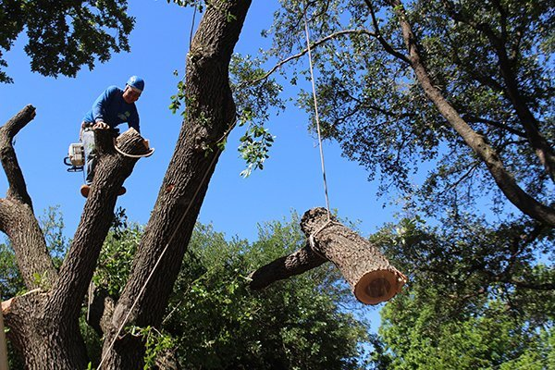
Recursive Code
What is it?
A function that calls itself (possible indirectly)
Motivation: don’t know how big the data is before execution
Need either iteration or recursion
In theory, these techniques are equally powerful
Why recurse? (instead of always iterating)
in practice, often easier
recursive code corresponds to recursive data
reduce a big problem into a smaller problem
https://texastreesurgeons.com/services/tree-removal/

Slide 47
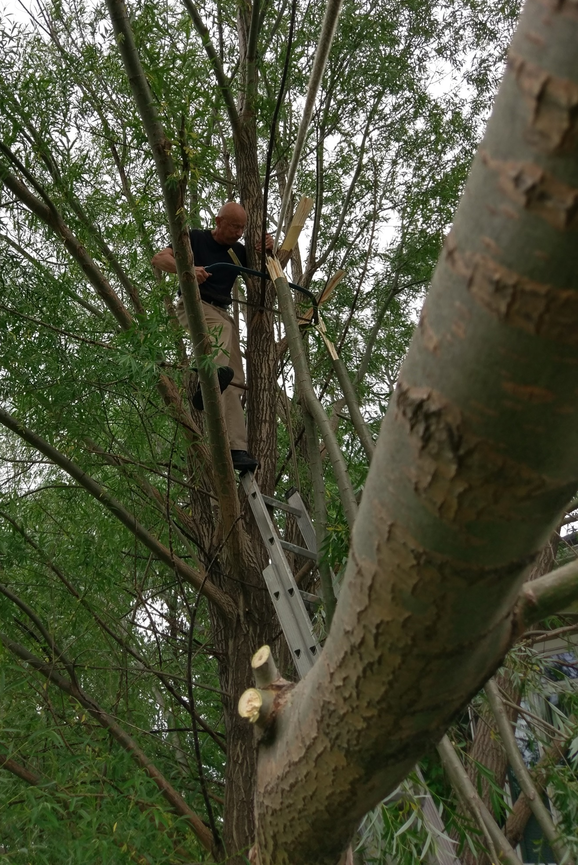

Slide 48
Recursive Student Counting
eager CS 220 students
in the front row
wise and benevolent
teacher wearing a top hat
Example from https://courses.cs.washington.edu/courses/cse143/17au/

Slide 49
Recursive Student Counting
Imagine:
A teacher wants to know how many students are in a column. What should each student ask
the person behind them?
Constraints:
It is dark, you can’t see the back
You can’t get up to count
You may talk to adjacent students
Mic is broken (students in back can't hear from front)
How many students
are in this column?
Example from https://courses.cs.washington.edu/courses/cse143/17au/

Slide 50
Recursive Student Counting
Strategy: reframe question as “how many students are behind you?”
how many are behind you?
Example from https://courses.cs.washington.edu/courses/cse143/17au/

Slide 51
Recursive Student Counting
Strategy: reframe question as “how many students are behind you?”
Reframing is the hardest part
how many are behind you?
Example from https://courses.cs.washington.edu/courses/cse143/17au/

Slide 52
Recursive Student Counting
Strategy: reframe question as “how many students are behind you?”
Process: if nobody is behind you: say 0 else: ask them, say their answer+1
how many are behind you?
Example from https://courses.cs.washington.edu/courses/cse143/17au/

Slide 53
Recursive Student Counting
Strategy: reframe question as “how many students are behind you?”
Process: if nobody is behind you: say 0 else: ask them, say their answer+1
how many are behind you?
how many are behind you?
Example from https://courses.cs.washington.edu/courses/cse143/17au/

Slide 54
Recursive Student Counting
how many are behind you?
Strategy: reframe question as “how many students are behind you?”
Process: if nobody is behind you: say 0 else: ask them, say their answer+1
how many are behind you?
how many are behind you?
how many are behind you?
how many are behind you?
Example from https://courses.cs.washington.edu/courses/cse143/17au/

Slide 55
Recursive Student Counting
20
Strategy: reframe question as “how many students are behind you?”
Process: if nobody is behind you: say 0 else: ask them, say their answer+1
how many are behind you?
how many are behind you?
how many are behind you?
how many are behind you?
Example from https://courses.cs.washington.edu/courses/cse143/17au/

Slide 56
Recursive Student Counting
20
Strategy: reframe question as “how many students are behind you?”
Process: if nobody is behind you: say 0 else: ask them, say their answer+1
21
how many are behind you?
how many are behind you?
how many are behind you?
Example from https://courses.cs.washington.edu/courses/cse143/17au/

Slide 57
Recursive Student Counting
20
Strategy: reframe question as “how many students are behind you?”
Process: if nobody is behind you: say 0 else: ask them, say their answer+1
21
22
23
24
Example from https://courses.cs.washington.edu/courses/cse143/17au/

Slide 58
Recursive Student Counting
20
Strategy: reframe question as “how many students are behind you?”
Process: if nobody is behind you: say 0 else: ask them, say their answer+1
21
22
23
24
Aha! Clearly there must
be 25 students in this
column
Example from https://courses.cs.washington.edu/courses/cse143/17au/

Slide 59
Recursive Student Counting
20
Strategy: reframe question as “how many students are behind you?”
Process: if nobody is behind you: say 0 else: ask them, say their answer+1
Observations:
Each student runs the same “code”
Each student has their own “state”
21
22
23
24
Aha! Clearly there must be 25 students in this column
Example from https://courses.cs.washington.edu/courses/cse143/17au/

Slide 60
Practice: Reframing Factorials
N! = 1 x 2 x 3 x … x (N-2) x (N-1) x N

Slide 61
Example: Factorials
1. Examples:
3. Recursive Definition:
1! = 1
2! = 1*2 = 2
3! = 1*2*3 = 6
4! = 1*2*3*4 = 24
5! = 1*2*3*4*5 = 120
4. Python Code:
def fact(n):
pass # TODO
2. Self Reference:
Goal: work from examples to get to recursive code

Slide 62
Example: Factorials
1. Examples:
3. Recursive Definition:
1! = 1
2! = 1*2 = 2
3! = 1*2*3 = 6
4! = 1*2*3*4 = 24
5! = 1*2*3*4*5 = 120
4. Python Code:
def fact(n):
pass # TODO
2. Self Reference:
look for patterns that allow
rewrites with self reference

Slide 63
Example: Factorials
1. Examples:
3. Recursive Definition:
1! = 1
2! = 1*2 = 2
3! = 1*2*3 = 6
4! = 1*2*3*4 = 24
5! = 1*2*3*4*5 = 120
4. Python Code:
def fact(n):
pass # TODO
2. Self Reference:
look for patterns that allow
rewrites with self reference

Slide 64
Example: Factorials
1. Examples:
3. Recursive Definition:
1! = 1
2! = 1*2 = 2
3! = 1*2*3 = 6
4! = 1*2*3*4 = 24
5! = 1*2*3*4*5 = 120
4. Python Code:
def fact(n):
pass # TODO
2. Self Reference:
1! =
2! =
3! =
4! =
5! = 4! * 5

Slide 65
Example: Factorials
1. Examples:
3. Recursive Definition:
1! = 1
2! = 1*2 = 2
3! = 1*2*3 = 6
4! = 1*2*3*4 = 24
5! = 1*2*3*4*5 = 120
4. Python Code:
def fact(n):
pass # TODO
2. Self Reference:
1! =
2! =
3! =
4! =
5! = 4! * 5

Slide 66
Example: Factorials
1. Examples:
3. Recursive Definition:
1! = 1
2! = 1*2 = 2
3! = 1*2*3 = 6
4! = 1*2*3*4 = 24
5! = 1*2*3*4*5 = 120
4. Python Code:
def fact(n):
pass # TODO
2. Self Reference:
1! =
2! =
3! =
4! = 3! * 4
5! = 4! * 5

Slide 67
Example: Factorials
1. Examples:
3. Recursive Definition:
1! = 1
2! = 1*2 = 2
3! = 1*2*3 = 6
4! = 1*2*3*4 = 24
5! = 1*2*3*4*5 = 120
4. Python Code:
def fact(n):
pass # TODO
2. Self Reference:
1! =
2! = 1! * 2
3! = 2! * 3
4! = 3! * 4
5! = 4! * 5

Slide 68
Example: Factorials
1. Examples:
3. Recursive Definition:
1! = 1
2! = 1*2 = 2
3! = 1*2*3 = 6
4! = 1*2*3*4 = 24
5! = 1*2*3*4*5 = 120
4. Python Code:
def fact(n):
pass # TODO
2. Self Reference:
1! = 1
2! = 1! * 2
3! = 2! * 3
4! = 3! * 4
5! = 4! * 5
don’t need a pattern
at the start

Slide 69
Example: Factorials
1. Examples:
3. Recursive Definition:
1! = 1
2! = 1*2 = 2
3! = 1*2*3 = 6
4! = 1*2*3*4 = 24
5! = 1*2*3*4*5 = 120
convert self-referring examples
to a recursive definition
4. Python Code:
def fact(n):
pass # TODO
2. Self Reference:
1! = 1
2! = 1! * 2
3! = 2! * 3
4! = 3! * 4
5! = 4! * 5

Slide 70
Example: Factorials
1. Examples:
3. Recursive Definition:
1! = 1
2! = 1*2 = 2
3! = 1*2*3 = 6
4! = 1*2*3*4 = 24
5! = 1*2*3*4*5 = 120
1! is 1
4. Python Code:
def fact(n):
pass # TODO
2. Self Reference:
1! = 1
2! = 1! * 2
3! = 2! * 3
4! = 3! * 4
5! = 4! * 5

Slide 71
Example: Factorials
1. Examples:
3. Recursive Definition:
1! = 1
2! = 1*2 = 2
3! = 1*2*3 = 6
4! = 1*2*3*4 = 24
5! = 1*2*3*4*5 = 120
1! is 1 N! is ???? for N>1
4. Python Code:
def fact(n):
pass # TODO
2. Self Reference:
1! = 1
2! = 1! * 2
3! = 2! * 3
4! = 3! * 4
5! = 4! * 5

Slide 72
Example: Factorials
1. Examples:
3. Recursive Definition:
1! = 1
2! = 1*2 = 2
3! = 1*2*3 = 6
4! = 1*2*3*4 = 24
5! = 1*2*3*4*5 = 120
1! is 1 N! is (N-1)! * N for N>1
4. Python Code:
def fact(n):
pass # TODO
2. Self Reference:
1! = 1
2! = 1! * 2
3! = 2! * 3
4! = 3! * 4
5! = 4! * 5

Slide 73
Example: Factorials
1. Examples:
3. Recursive Definition:
1! = 1
2! = 1*2 = 2
3! = 1*2*3 = 6
4! = 1*2*3*4 = 24
5! = 1*2*3*4*5 = 120
1! is 1 N! is (N-1)! * N for N>1
4. Python Code:
def fact(n):
pass # TODO
2. Self Reference:
1! = 1
2! = 1! * 2
3! = 2! * 3
4! = 3! * 4
5! = 4! * 5

Slide 74
Example: Factorials
1. Examples:
3. Recursive Definition:
1! = 1
2! = 1*2 = 2
3! = 1*2*3 = 6
4! = 1*2*3*4 = 24
5! = 1*2*3*4*5 = 120
1! is 1 N! is (N-1)! * N for N>1
4. Python Code:
def fact(n):
if n == 1:
return 1
2. Self Reference:
1! = 1
2! = 1! * 2
3! = 2! * 3
4! = 3! * 4
5! = 4! * 5

Slide 75
Example: Factorials
1. Examples:
3. Recursive Definition:
1! = 1
2! = 1*2 = 2
3! = 1*2*3 = 6
4! = 1*2*3*4 = 24
5! = 1*2*3*4*5 = 120
1! is 1 N! is (N-1)! * N for N>1
4. Python Code:
def fact(n):
if n == 1:
return 1
p = fact(n-1)
return n * p
2. Self Reference:
1! = 1
2! = 1! * 2
3! = 2! * 3
4! = 3! * 4
5! = 4! * 5

Slide 76
Example: Factorials
1. Examples:
3. Recursive Definition:
1! = 1
2! = 1*2 = 2
3! = 1*2*3 = 6
4! = 1*2*3*4 = 24
5! = 1*2*3*4*5 = 120
1! is 1 N! is (N-1)! * N for N>1
4. Python Code:
def fact(n):
if n == 1:
return 1
p = fact(n-1)
return n * p
2. Self Reference:
1! = 1
2! = 1! * 2
3! = 2! * 3
4! = 3! * 4
5! = 4! * 5
Let’s “run” it!

Slide 77
Tracing Factorial
fact(n=4)
somebody
called fact(4)
def fact(n):
if n == 1:
return 1
p = fact(n-1)
return n * p
Note, this is not a stack frame!
We're tracing code line-by-line.
Boxes represent which invocation.

Slide 78
Tracing Factorial
fact(n=4)
if n == 1:
def fact(n):
if n == 1:
return 1
p = fact(n-1)
return n * p

Slide 79
Tracing Factorial
fact(n=4)
if n == 1:
def fact(n):
if n == 1:
return 1
p = fact(n-1)
return n * p

Slide 80
Tracing Factorial
fact(n=4)
if n == 1:
fact(n=3)
def fact(n):
if n == 1:
return 1
p = fact(n-1)
return n * p

Slide 81
Tracing Factorial
fact(n=4)
if n == 1:
fact(n=3)
if n == 1:
def fact(n):
if n == 1:
return 1
p = fact(n-1)
return n * p

Slide 82
Tracing Factorial
fact(n=4)
if n == 1:
fact(n=3)
if n == 1:
def fact(n):
if n == 1:
return 1
p = fact(n-1)
return n * p

Slide 83
Tracing Factorial
fact(n=4)
if n == 1:
fact(n=3)
if n == 1:
def fact(n):
if n == 1:
return 1
p = fact(n-1)
return n * p
fact(n=2)

Slide 84
Tracing Factorial
fact(n=4)
if n == 1:
fact(n=3)
if n == 1:
def fact(n):
if n == 1:
return 1
p = fact(n-1)
return n * p
fact(n=2)
if n == 1:

Slide 85
Tracing Factorial
fact(n=4)
if n == 1:
fact(n=3)
if n == 1:
def fact(n):
if n == 1:
return 1
p = fact(n-1)
return n * p
fact(n=2)
if n == 1:

Slide 86
Tracing Factorial
fact(n=4)
if n == 1:
fact(n=3)
if n == 1:
def fact(n):
if n == 1:
return 1
p = fact(n-1)
return n * p
fact(n=2)
if n == 1:
fact(n=1)

Slide 87
Tracing Factorial
fact(n=4)
if n == 1:
fact(n=3)
if n == 1:
def fact(n):
if n == 1:
return 1
p = fact(n-1)
return n * p
fact(n=2)
if n == 1:
fact(n=1)
if n == 1:

Slide 88
Tracing Factorial
fact(n=4)
if n == 1:
fact(n=3)
if n == 1:
def fact(n):
if n == 1:
return 1
p = fact(n-1)
return n * p
fact(n=2)
if n == 1:
fact(n=1)
if n == 1:
return 1

Slide 89
Tracing Factorial
fact(n=4)
if n == 1:
fact(n=3)
if n == 1:
def fact(n):
if n == 1:
return 1
p = fact(n-1)
return n * p
fact(n=2)
if n == 1:
p = 1
fact(n=1)
if n == 1:
return 1

Slide 90
Tracing Factorial
fact(n=4)
if n == 1:
fact(n=3)
if n == 1:
def fact(n):
if n == 1:
return 1
p = fact(n-1)
return n * p
fact(n=2)
if n == 1:
p = 1
return 2
fact(n=1)
if n == 1:
return 1

Slide 91
Tracing Factorial
fact(n=4)
if n == 1:
fact(n=3)
if n == 1:
p = 2
def fact(n):
if n == 1:
return 1
p = fact(n-1)
return n * p
fact(n=2)
if n == 1:
p = 1
return 2
fact(n=1)
if n == 1:
return 1

Slide 92
Tracing Factorial
fact(n=4)
if n == 1:
fact(n=3)
if n == 1:
p = 2
return 6
def fact(n):
if n == 1:
return 1
p = fact(n-1)
return n * p
fact(n=2)
if n == 1:
p = 1
return 2
fact(n=1)
if n == 1:
return 1

Slide 93
Tracing Factorial
fact(n=4)
if n == 1:
p = 6
fact(n=3)
if n == 1:
p = 2
return 6
def fact(n):
if n == 1:
return 1
p = fact(n-1)
return n * p
fact(n=2)
if n == 1:
p = 1
return 2
fact(n=1)
if n == 1:
return 1

Slide 94
Tracing Factorial
fact(n=4)
if n == 1:
p = 6
return 24
fact(n=3)
if n == 1:
p = 2
return 6
def fact(n):
if n == 1:
return 1
p = fact(n-1)
return n * p
fact(n=2)
if n == 1:
p = 1
return 2
fact(n=1)
if n == 1:
return 1

Slide 95
Tracing Factorial
fact(n=4)
if n == 1:
p = 6
return 24
fact(n=3)
if n == 1:
p = 2
return 6
def fact(n):
if n == 1:
return 1
p = fact(n-1)
return n * p
fact(n=2)
if n == 1:
p = 1
return 2
fact(n=1)
if n == 1:
return 1

Slide 96
Tracing Factorial
fact(n=4)
if n == 1:
p = 6
return 24
fact(n=3)
if n == 1:
p = 2
return 6
def fact(n):
if n == 1:
return 1
p = fact(n-1)
return n * p
fact(n=2)
if n == 1:
p = 1
return 2
fact(n=1)
if n == 1:
return 1
How does Python keep
all the variables separate?

Slide 97
Tracing Factorial
fact(n=4)
if n == 1:
p = 6
return 24
fact(n=3)
if n == 1:
p = 2
return 6
def fact(n):
if n == 1:
return 1
p = fact(n-1)
return n * p
fact(n=2)
if n == 1:
p = 1
return 2
fact(n=1)
if n == 1:
return 1
How does Python keep
all the variables separate?
frames to the rescue!

Slide 98
Deep Dive: Invocation State
In recursion, each function invocation has its own state, but multiple invocations share code.

Slide 99
Deep Dive: Invocation State
In recursion, each function invocation has its own state, but multiple invocations share code.
Variables for an invocation exist in a frame
variables
frame:

Slide 100
Deep Dive: Invocation State
In recursion, each function invocation has its own state, but multiple invocations share code.
Variables for an invocation exist in a frame
the frames are stored in the stack
variables
frame:
stack:
active

Slide 101
Deep Dive: Invocation State
In recursion, each function invocation has its own state, but multiple invocations share code.
Variables for an invocation exist in a frame
the frames are stored in the stack
one invocation is active at a time: its frame is on the top of stack
variables
pop!
frame:
stack:
active

Slide 102
Deep Dive: Invocation State
In recursion, each function invocation has its own state, but multiple invocations share code.
Variables for an invocation exist in a frame
the frames are stored in the stack
one invocation is active at a time: its frame is on the top of stack
if a function calls itself, there will be multiple frames at the same time for the multiple invocations of the same function
variables
fact
frame:
stack:
fact
fact
fact
global

Slide 103
Deep Dive: Runtime Stack
def fact(n):
if n == 1:
return 1
p = fact(n-1)
return n * p
call fact(3)
Current
Runtime Stack
global
0
1
2
3
4
5
6
time

Slide 104
Deep Dive: Runtime Stack
def fact(n):
if n == 1:
return 1
p = fact(n-1)
return n * p
Current
Runtime Stack
fact
n=3
new, active frame
global
global
0
1
2
3
4
5
6
time

Slide 105
Deep Dive: Runtime Stack
def fact(n):
if n == 1:
return 1
p = fact(n-1)
return n * p
fact
n=3
p=
global
global
0
1
2
3
4
5
6
time

Slide 106
Deep Dive: Runtime Stack
def fact(n):
if n == 1:
return 1
p = fact(n-1)
return n * p
fact
n=2
fact
n=3
p=
fact
n=3
p=
global
global
global
0
1
2
3
4
5
6
time

Slide 107
Deep Dive: Runtime Stack
def fact(n):
if n == 1:
return 1
p = fact(n-1)
return n * p
fact
n=2
p=
fact
n=3
p=
fact
n=3
p=
global
global
global
0
1
2
3
4
5
6
time

Slide 108
Deep Dive: Runtime Stack
def fact(n):
if n == 1:
return 1
p = fact(n-1)
return n * p
fact
n=1
fact
n=2
p=
fact
n=2
p=
fact
n=3
p=
fact
n=3
p=
fact
n=3
p=
global
global
global
global
0
1
2
3
4
5
6
time

Slide 109
Deep Dive: Runtime Stack
def fact(n):
if n == 1:
return 1
p = fact(n-1)
return n * p
fact
n=1
return 1 (base case)
fact
n=2
p=
fact
n=2
p=
fact
n=3
p=
fact
n=3
p=
fact
n=3
p=
global
global
global
global
0
1
2
3
4
5
6
time

Slide 110
Deep Dive: Runtime Stack
def fact(n):
if n == 1:
return 1
p = fact(n-1)
return n * p
fact
n=1
return 1 (base case)
fact
n=2
p=
fact
n=2
p=
fact
n=2
p=
fact
n=3
p=
fact
n=3
p=
fact
n=3
p=
fact
n=3
p=
global
global
global
global
global
0
1
2
3
4
5
6
time

Slide 111
Deep Dive: Runtime Stack
def fact(n):
if n == 1:
return 1
p = fact(n-1)
return n * p
fact
n=1
return 1 (base case)
fact
n=2
p=
fact
n=2
p=
fact
n=2
p=1
fact
n=3
p=
fact
n=3
p=
fact
n=3
p=
fact
n=3
p=
global
global
global
global
global
0
1
2
3
4
5
6
time

Slide 112
Deep Dive: Runtime Stack
def fact(n):
if n == 1:
return 1
p = fact(n-1)
return n * p
fact
n=1
return 1 (base case)
fact
n=2
p=
fact
n=2
p=
fact
n=2
p=1
return 2 (n*p)
fact
n=3
p=
fact
n=3
p=
fact
n=3
p=
fact
n=3
p=
global
global
global
global
global
0
1
2
3
4
5
6
time

Slide 113
Deep Dive: Runtime Stack
def fact(n):
if n == 1:
return 1
p = fact(n-1)
return n * p
fact
n=1
return 1 (base case)
fact
n=2
p=
fact
n=2
p=
fact
n=2
p=1
return 2 (n*p)
fact
n=3
p=
fact
n=3
p=
fact
n=3
p=
fact
n=3
p=
fact
n=3
p=
global
global
global
global
global
global
0
1
2
3
4
5
6
time

Slide 114
Deep Dive: Runtime Stack
def fact(n):
if n == 1:
return 1
p = fact(n-1)
return n * p
fact
n=1
return 1 (base case)
fact
n=2
p=
fact
n=2
p=
fact
n=2
p=1
return 2 (n*p)
fact
n=3
p=
fact
n=3
p=
fact
n=3
p=
fact
n=3
p=
fact
n=3
p=2
global
global
global
global
global
global
0
1
2
3
4
5
6
time

Slide 115
Deep Dive: Runtime Stack
def fact(n):
if n == 1:
return 1
p = fact(n-1)
return n * p
fact
n=1
return 1 (base case)
fact
n=2
p=
fact
n=2
p=
fact
n=2
p=1
return 2 (n*p)
fact
n=3
p=
fact
n=3
p=
fact
n=3
p=
fact
n=3
p=
fact
n=3
p=2
return 6 (n*p)
global
global
global
global
global
global
0
1
2
3
4
5
6
time

Slide 116
Deep Dive: Runtime Stack
def fact(n):
if n == 1:
return 1
p = fact(n-1)
return n * p
fact
n=1
return 1 (base case)
fact
n=2
p=
fact
n=2
p=
fact
n=2
p=1
return 2 (n*p)
fact
n=3
p=
fact
n=3
p=
fact
n=3
p=
fact
n=3
p=
fact
n=3
p=2
return 6 (n*p)
global
global
global
global
global
global
global
0
1
2
3
4
5
6
time

Slide 117
“Infinite” Recursion Bugs
What happens if:
def fact(n):
if n == 1:
return 1
p = fact(n-1)
return n * p

Slide 118
“Infinite” Recursion Bugs
What happens if:
factorial is called with a negative number?
-1
def fact(n):
if n == 1:
return 1
p = fact(n-1)
return n * p
never
terminates

Slide 119
“Infinite” Recursion Bugs
What happens if:
factorial is called with a negative number?
we forgot the “n == 1” check?
3
def fact(n):
if n == 1:
return 1
p = fact(n-1)
return n * p
fact
n=2
fact
n=3
global

Slide 120
“Infinite” Recursion Bugs
What happens if:
factorial is called with a negative number?
we forgot the “n == 1” check?
fact
n=-1
fact
n=0
3
fact
n=1
def fact(n):
if n == 1:
return 1
p = fact(n-1)
return n * p
fact
n=2
fact
n=3
global

Slide 121
“Infinite” Recursion Bugs
What happens if:
factorial is called with a negative number?
we forgot the “n == 1” check?
fact
n=-1
fact
n=0
3
fact
n=1
def fact(n):
if n == 1:
return 1
p = fact(n-1)
return n * p
fact
n=2
fact
n=3
never
terminates
global

Slide 122
Coding Demos

Slide 123
Demo 1: Pretty Print
Goal: format nested lists of bullet points
Input:
The recursive lists
Output:
Appropriately-tabbed items
Example: >>> pretty_print([“A”, [“1”, “2”, “3”,], “B”, [“4”, [“i”, “ii”]]]) *A *1 *2 *3 *B *4 *i *ii

Slide 124
Demo 2: Recursive List Search
Goal: does a given number exist in a recursive structure?
Input:
A number
A list of numbers and lists (which contain other numbers and lists)
Output:
True if there’s a list containing the number, else False
Example: >>> contains(3, [1,2,[4,[[3],[8,9]],5,6]]) True >>> contains(12, [1,2,[4,[[3],[8,9]],5,6]]) False

Slide 125
Conclusion: Review Learning Objectives

Slide 126
Learning Objectives: Recursive Information
What is a recursive definition/structure?
Definition contains term
Structure refers to others of same type
Example: a dictionary contains dictionaries (which may contain...)
recursive case
base case

Slide 127
Learning Objectives: Recursive Code
What is recursive code?
Function that sometimes itself (maybe indirectly)
Why write recursive code?
Real-world data/structures are recursive; intuitive for code to reflect data
Where do computers keep local variables for recursive calls?
In a section of memory called a “frame”
Only one function is active at a time, so keep frames in a stack
What happens to programs with infinite recursion?
Calls keep pushing more frames
Exhaust memory, throw StackOverflowError

Slide 128
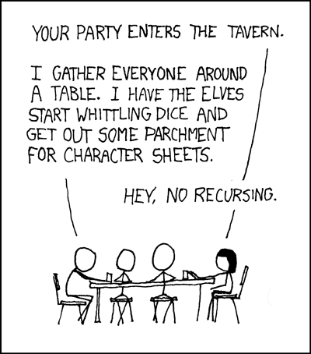
Questions?
https://xkcd.com/244/

