Slide 1
Coding Basics
Fourth Annual Penn Cytomics Workshop
Nov-Dec, 2019

Slide 2
r syntax

Slide 3
Comments
The # symbol indicates the beginning of a comment.
# This is a comment
x = 1 # This is another comment
There are no multi-line comments (/* … */

Slide 4
Spaces and blank lines (‘white space’)
They don’t matter
# These are equivalent
x=1
x = 1
x = 1
Except in obvious places
name = ‘Bill’
name = ‘Bi ll’
na me = ‘Bill’

Slide 5
Semicolons
They’re optional
# these are equivalent
x = 1
x = 1;
Unless you have multiple statements per line:
x = 1; y = 2
But this is rarely a good idea

Slide 6
Long lines
A statement can spill over multiple lines as long as it's clear that the statement is incomplete.
# Good
x = 1 + 2 +
3
# Bad
x = 1 + 2
+ 3
# Ok
x = (1 + 2
+ 3)

Slide 7
Backslashes (\)
These have special meanings (more on this later). For file names, use forward slashes (/) instead. If you must use backslashes, you have to double them:
# Good
C:/My Documents/test.csv
# Bad
C:\My Documents1test.csv
# Ugly (but acceptable)
C:\\My Documents\\test.csv

Slide 8
Capitalization
R is case sensitive
# Two different variables
age = 18
Age = 18
This applies to everything, including functions
sqrt(4) # equal to 2
Sqrt(4) # gives an error
Get in the habit of capitalizing consistently (more on this when we get to stylistic guidelines

Slide 9
Quotes
There are no differences between single and double quotes in R.
# The following are equivalent:
subjectId = ‘MM-0001’
subjectId = “MM-0001”
Sometimes one or the other is more convenient:
label = “Mother’s age”
The way around this is to “escape” the quote:
label = ‘Mother\’s age’
remember the backslashes?

Slide 10
the rstudio desktop

Slide 11

Start RStudio
Launch RStudio (not R!). You should have a desktop (or dock) icon like this one:

Slide 12
Rstudio tabs
Console for quick interactive work
Editor for writing programs may be missing if this is the first time you're using RStudio
Environment currently defined variables
History tracks commands issued so far
Files manipulate files
Plots this is where plots appear
Packages manage your R add-ons
Help information about R things
others...

Slide 13
Configuring RStudio
Pick Tools > Global Options > General
Uncheck: restore .RData into workspace at startup
Set to “never:”: Save workpace to .RData on exit
You can also set the appearance to suit your taste, and adjust code
editing, display, and code editing tools.
More on this when we discuss style, and how to let RStudio help you to write nice code.

Slide 14
the rstudio console

Slide 15
Working in the Console
Try entering some expressions:
1 + 1
(2 + 3) / 2
What is the “[1]”? Try
runif(12)

Slide 16
Creating variables
Assign some variables
x = 1
y = 2
Look at the environment tab: do you see these variables?
Look at the history tab: do you see your commands?

Slide 17
Auto-completion and help
Type sqr and hit tab (or Enter)
Type a left paren: note the automatic parenthesis
Assign ageAtScreening = 19
Type age and hit tab (or Enter)
The RStudio editor and console search your Environment for matches, using (by default) 3 or more characters.

Slide 18
Try using the arrow keys
Change the value of ageAtScreening to 18 using the arrow keys
To clear the console, use Edit > Clear Console or Ctrl-L

Slide 19
Plotting
Try
plot(cars)
Try “zoom”, “Export”, “Clear All”
Possible error: figures margins too large
The “Plots” tab is too small. Stretch it a little

Slide 20
What’s cars?
Try
cars

Slide 21
Ok, so where did it come from?
Try
find(‘cars’)
Note the quotes around the name

Slide 22
Other environments
In the Environment tab, pick "package:datasets”
Try opening, double clicking
Promises?
Environments are searched in order
Return to the global environment
While you're there, try the list vs grid button on the right

Slide 23
Copying to your Environment
Try
myCars = cars
Check the global environment. Notice that you can expand and browse.
and yes, that’s how you copy a dataset (or a data frame)

Slide 24
More plotting
Try
boxplot(cars)
Try the arrows to navigate between plots.
Try Clear All.

Slide 25
Errors

Slide 26
Unexpected something
Try each of the following
1 + , 2
x = (1 + 2))

Slide 27
Incomplete statement
Try the following
x = 2 *
Use Esc to force the current statement to end

Slide 28
Object not found
Try the following
x = 1 # lowercase x
X # Uppercase X
Often, it’s a capitalization issue.
How do you figure out the correct name?

Slide 29
Could not find function
Try the following
SQRT(2)
But now, start typing SQR and look for a hint…
Rstudio checks for other capitalizations that might match what you’re looking for.

Slide 30
Bad arguments to operator (or function)
Try the following
‘1’ + 1

Slide 31
Investigating Errors
Look for clues in the error message: what part of the line is it complaining about?
Look for the obvious: capitalization, extra parens/brackets/braces, extra commas
Did you put quotes where they're not needed? or forget them?
Try breaking down a complex statement into its individual parts, especially individual variables. use copy/paste
Sometimes (when source'ing functions) an unmatched parenthesis can cause an error to be reported many lines later. These can be hard to spot.
It gets easier with practice!

Slide 32
the rstudio editor

Slide 33

Using files
Pick File > New > R Script, or pick “R Script in the icon.
# A simple example
data(cars)
boxplot(cars$dist)
title('Stopping distance (ft)')
boxplot(cars$speed)
title('Speed (mph)')
And save it (File > Save or Ctrl-S)
Note : autoindent, syntax coloring, parenthesis matching

Slide 34
Running code in the editor
simpleExample.R
#
# a simple example program to illustrate the use of the editor
#
data(cars)
boxplot(cars$dist)
title('Stopping distance (ft)')
boxplot(cars$speed)
title('Speed (mph)')
Method 1: Code > Run Region > Run All
Method 2: highlight the lines, press Ctrl-Enter (or click the Run button in the upper right of the editor)
Method 3: cursor anywhere in a line, press Ctrl-Enter (execute as single line)
Method 4: press the Source button in the upper right of the editor
Method 5: Check the "Source on Save button, press Ctrl-S"

Slide 35
Modify your program
add axis labels
# a simple example
data(cars)
boxplot(cars$dist, ylab = “Distance”)
title('Stopping distance (ft)')
boxplot(cars$speed, ylab = “Speed (mph)”)
title('Speed (mph)')
Re-run

Slide 36
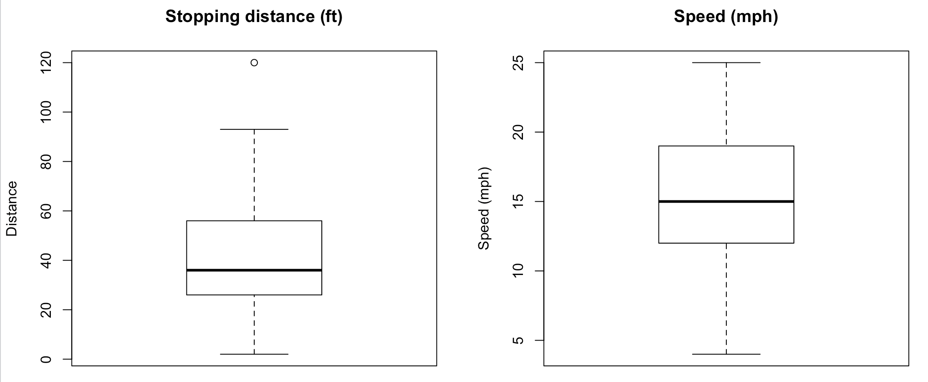
Modify your program 2
add the par() statement
# a simple example
par(mfrow = c(1, 2)) # <- add this
data(cars)
boxplot(cars$dist, ylab = “Distance”)
title('Stopping distance (ft)')
boxplot(cars$speed, ylab = “Speed (mph)”)
title('Speed (mph)')

Slide 37
Other forms for handling datasets
#
# a simple example program showing use of attach
#
data(cars)
attach(cars)
boxplot(dist)
title('Stopping distance (ft)')
boxplot(speed)
title('Speed (mph)')

Slide 38
Other forms for handling datasets
#
# a simple example program showing use of with
#
with(cars, {
boxplot(dist)
title('Stopping distance (ft)')
boxplot(speed)
title('Speed (mph)')
})

Slide 39
Other forms for handling datasets
#
# a simple example program showing use of with,
# with clearer indenting
#
with(cars, {
boxplot(dist)
title('Stopping distance (ft)')
boxplot(speed)
title('Speed (mph)')
}
)

Slide 40
Editor vs Console
Most R programmers heavily use both the editor and the console
The console to experiment and try things
The editor to accumulate the stuff that's worth keeping

Slide 41
Getting help inside the editor
Type-ahead
try typing tit
select title from the list, press TAB
Function argument help
with the cursor inside the parens, press TAB again
you should see a list of arguments, with the first one selected
press TAB again
the editor fills in the argument, waiting for a value. Type ‘abc’, then a comma
press TAB again
notice that the next argument is selected, the first having been consumed

Slide 42
Accessing the Help information
Can be accessed from the console or from the editor Tab key
Can be accessed directly in the Help tab
Incremental search for commands and functions
Search within a help page
Navigation arrows
Help home, search engine and keywords (try csv)

Slide 43
Using the Help information
Help is often useless unless you already know what you want
Examples!
Look at the help for boxplot
See Also and Examples can provide hints for what to look for
google is great for this
google first, then help to drill in

Slide 44
The Files tab
Navigating directories
Basic file operations
The "..." to open a navigation tree

Slide 45
working with r projects

Slide 46
Projects in RStudio
A folder (aka directory) with a .Proj file in it
Nice way to keep stuff from different projects separate
Easy to switch between projects
RStudio remembers what files were open, etc.
RStudio resets the environment when you switch projects

Slide 47
Accessing a project
File > New Project
Pick Existing directory ( = folder)
If you can find tools that we worked with before, you can select it

Slide 48
r experiments

Slide 49
Creating And Displaying Variables
In the console: Entering the name of a variable in the console will cause it to display its contents.
Try
x = 12
x

Slide 50
The assignment (=) operator
In the beginning, in S, there was x <- 1
You could also do x -> 1
As a shortcut you could also do x _ 1 (but not anymore!)
R eventually replaced the underscore by x = 1
There is actually a very subtle difference between them.
Most people use = now, but you will find <- in older code, S+ code and in the help files.

Slide 51
Examples of assignments
# these are equivalent
x <- 10
10 -> x
x = 10

Slide 52
Multiple assignments
And you can do the following:
x = y = 0
You can do this too:
x <- 0 -> y
But don’t

Slide 53
Character Values
There is no difference between single and double quotes (as we’ve pointed out before):
x = “Hello”
x
x = ‘Hello’
x

Slide 54
Variable types
The same variable can be character in one place and numeric in another
x = ‘Hello’
x
x = 12
x

Slide 55
More number things
Try
2 / 0
-2 / 0
2 / Inf
Inf + 1
Inf - Inf

Slide 56
Missing Values
NA denotes a missing value
x = NA
x
x + 1

