Slide 1
Washing machine-Current sensor
Cciot Project
Kushang
Sriram
Adithi
Koustubh

Slide 2
AIM
To detect washing machine’s state and
to check if it is ON or OFF by
monitoring the current.
WHY
The laundry infrastructure is plagued by delays as the residents are unaware of whether the machines are in active use. This solution aims to solve this problem by tracking the state of the machines and providing residents with useful data regarding the machines

Slide 3

How are we monitoring the current?
We are monitoring the current using a SCT013 current sensor. This
CURRENT TRANSFORMER sensor works on the principle
of electromagnetic induction.
This sensor is wounded around the wire from the switch board.
Our project can monitor two washing machines at a time.
Sensor Sensitivity : 1V /15 Amps

Slide 4
Other specifications
ESP8266 microcontroller board.
Thingspeak used as dashboard to display current values using MQTT protocol.
The built-in ADC of the ESP8266 might not provide the required precision or resolution. Using an external ADC like the ADS1115 allows us to achieve higher resolution and accuracy in measurements
ADS-1115 and ESP8266 communicate using an I2C interface. ESP8266 has built in WiFi to transmit data to a remote server. It is powered directly from the wall outlet, hence no need of batteries.

Slide 5
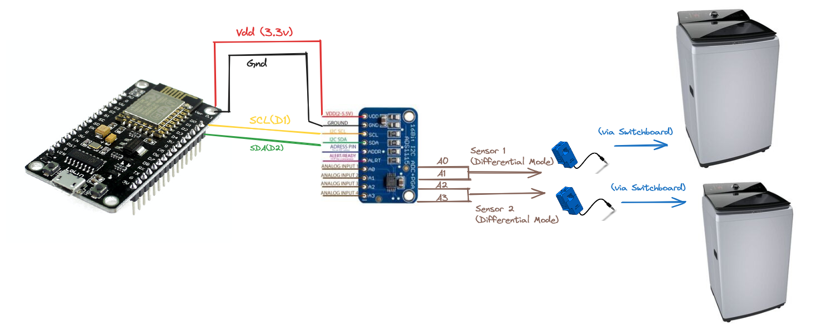
CIRCUIT DIAGRAM

Slide 6
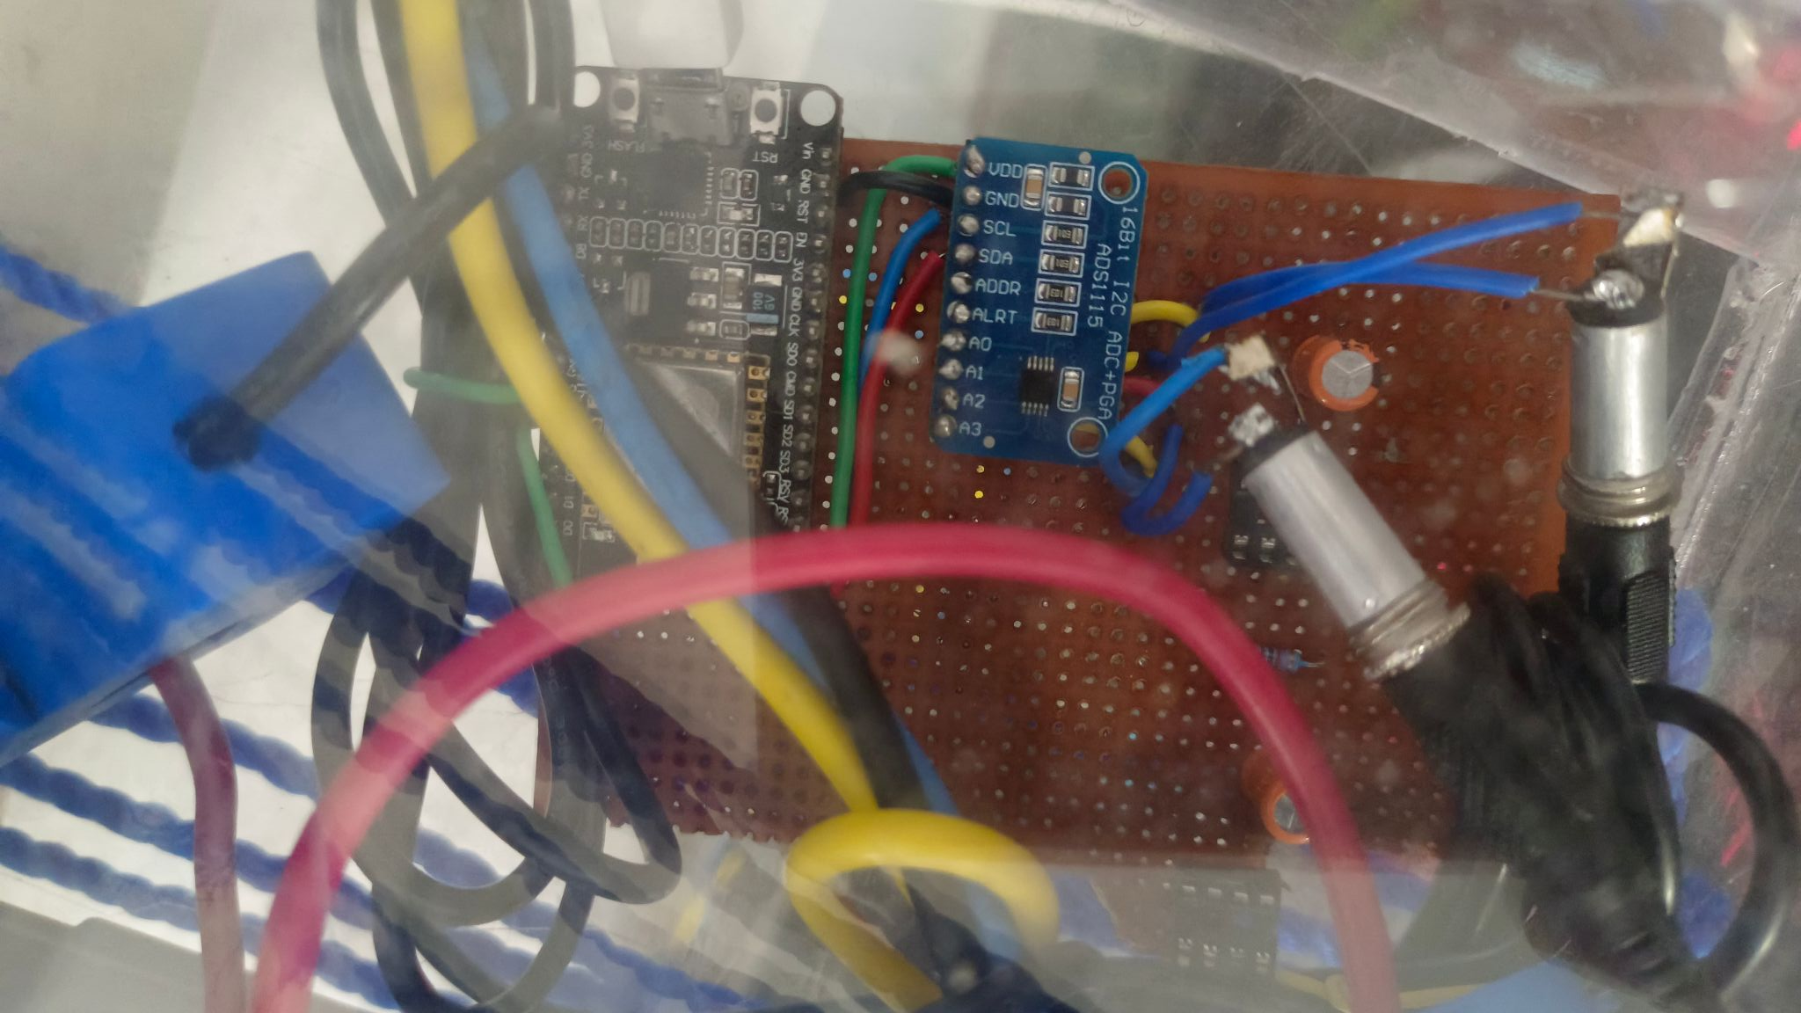
Circuit on PCB

Slide 7
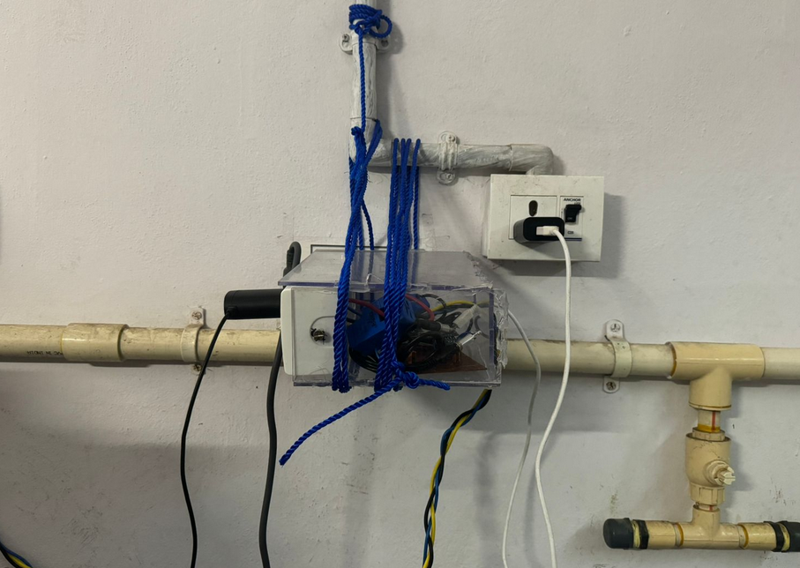

Slide 8
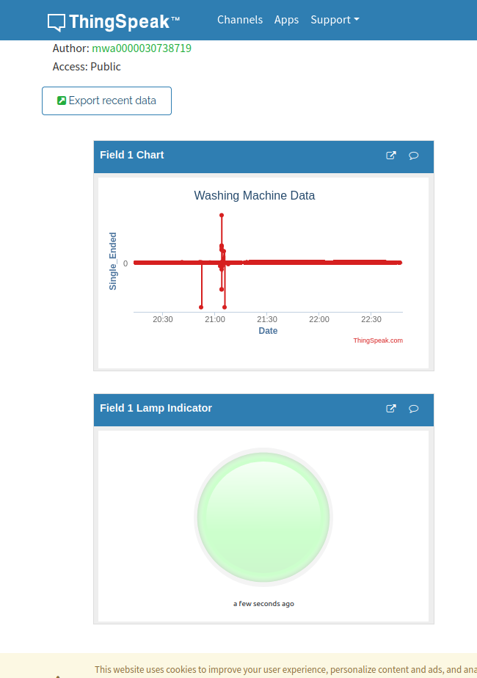
MQTT protocol
MQTT is a lightweight messaging protocol designed for IoT applications with constrained devices and networks.
Publisher-Subscriber Model: Devices publish messages to topics, and other devices subscribe to topics to receive messages.
Broker: Acts as a middleman, receiving messages from publishers and routing them to subscribers based on topic subscriptions.
Topics: Messages are published to hierarchical topics, represented as strings separated by forward slashes ("/").
Software part

Slide 9
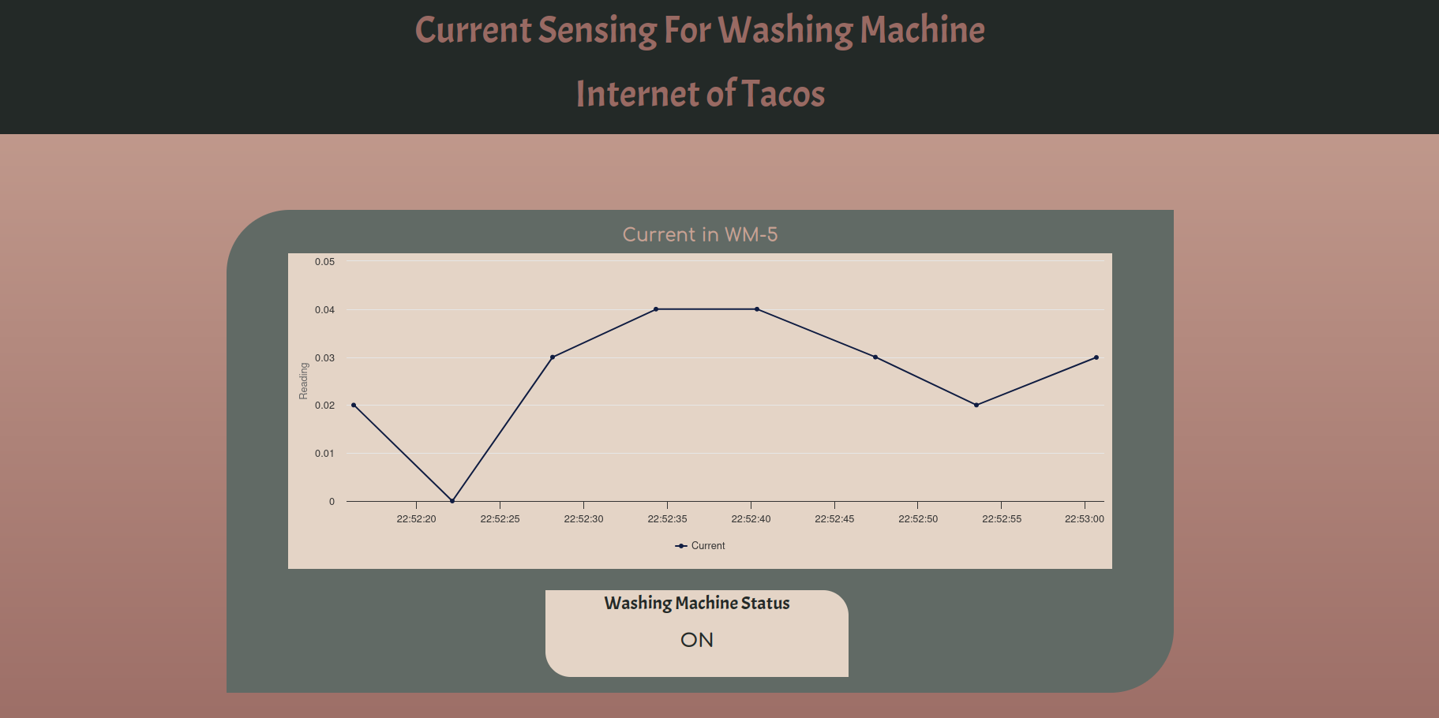
Our website

