Slide 1
Windows IOT Core
Yes, you can run Windows on a Raspberry PI

Slide 2
Why?
Visual Studio (nuff said)
C#
XAML
UWP
Nuget
Frameworks
APIs
Components
Project Rome
Easy to consume Azure services
Azure IoT Device Management
Support for Adafruit products
Cortana support out the box

Slide 3
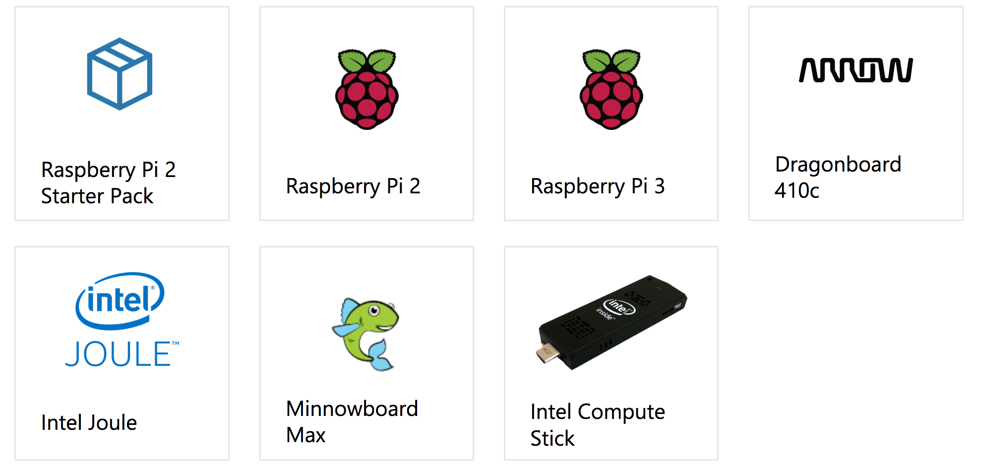
Supported Boards
Also:
Intel Pentium N4200
Intel Celeron N3350
Intel Atom x5-E39xx (formerly Apollo Lake).

Slide 4
Why Not
Hardware Peripherals support can be lacking
Startup time slower than Debian Jessie
You don’t have a Windows 10 PC
You hate Microsoft (haters gonna hate)

Slide 5
Cool bits
Remote deployment over Wi-Fi
Remote Administration via Webpage
Auto start apps
Rich Dashboard
Powershell/SSH support
GPIO
UWP
Entity Framework
MVVM
Asynchronous programming
XAML Animation

Slide 6
Resources
Windows IOT Core Home
https://developer.microsoft.com/en-us/windows/iot
https://github.com/ms-iot/samples
Hackster
https://www.hackster.io/windowsiot

Slide 7
Demo Time
GPIO demo
Rosie
Cognitive Services Integration
Slack integration
Telephony Integration

