Slide 1
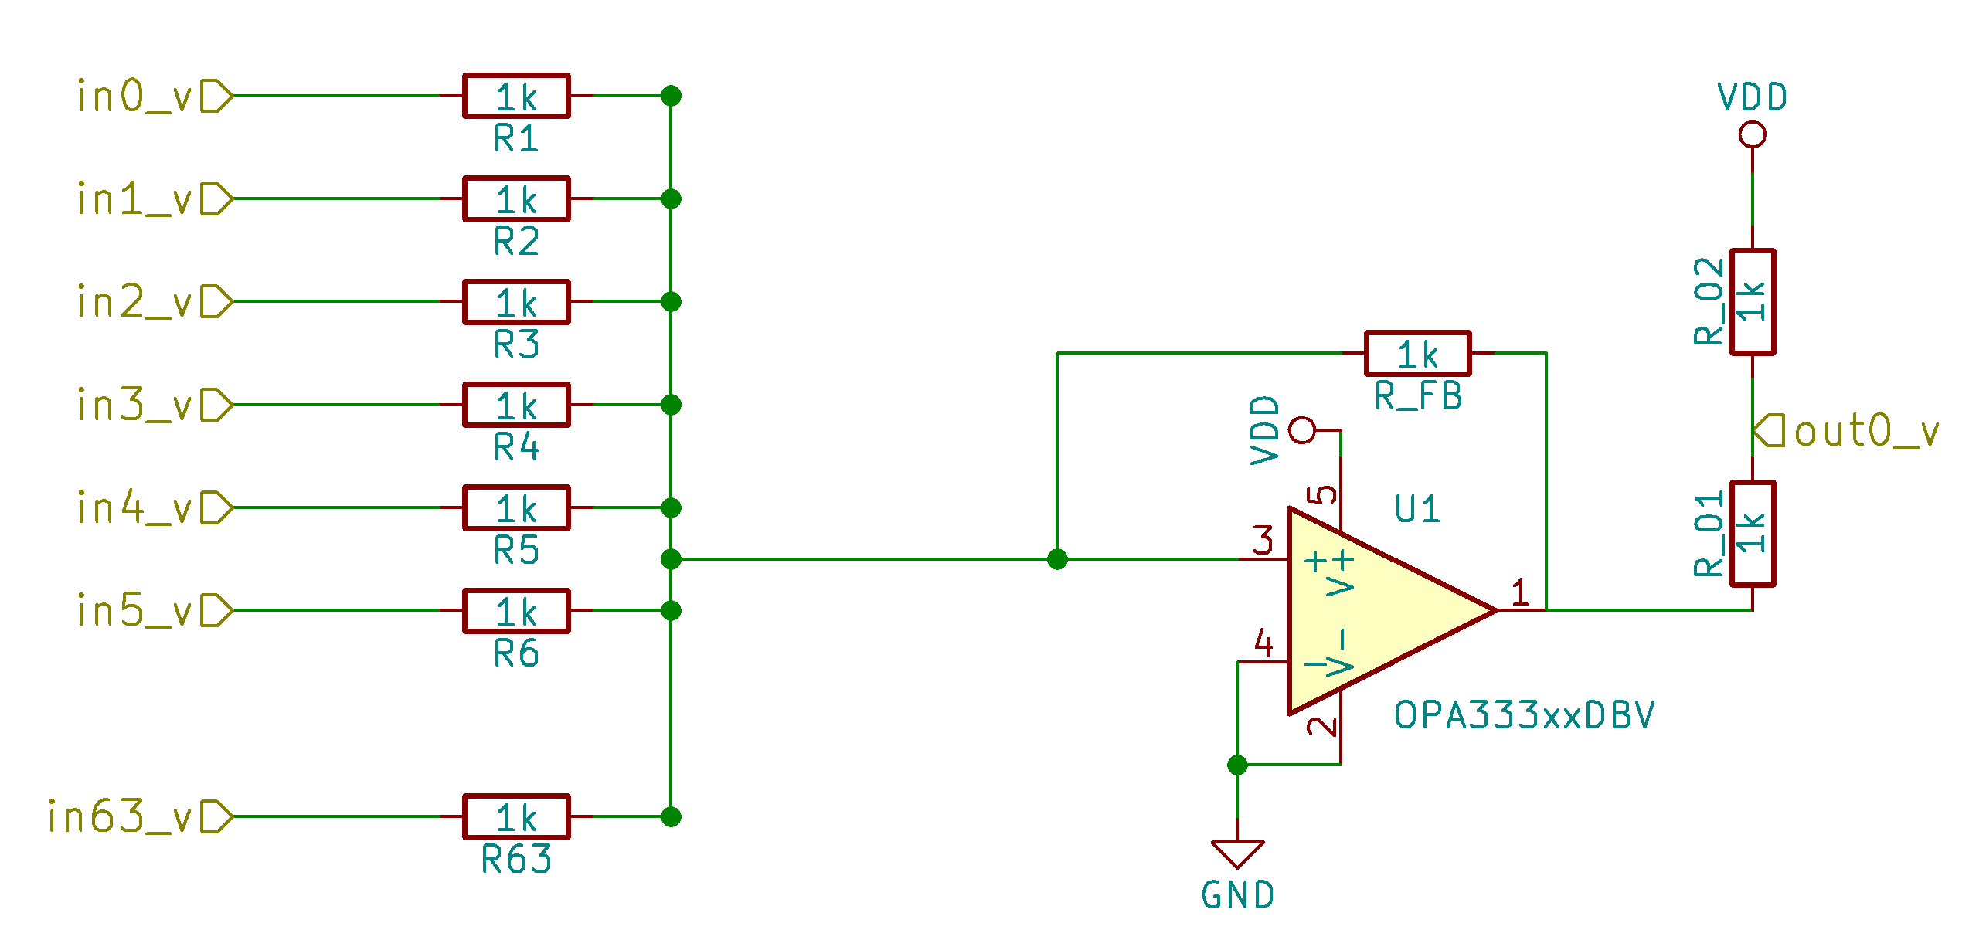
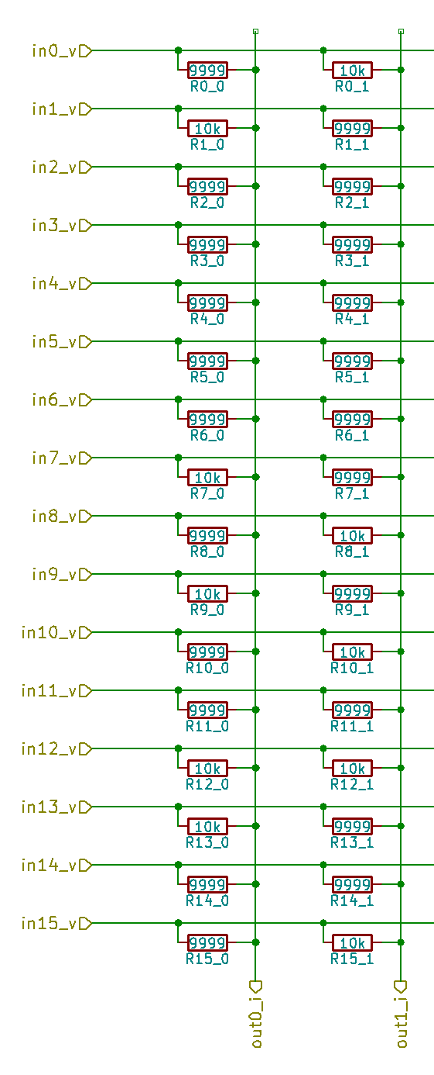
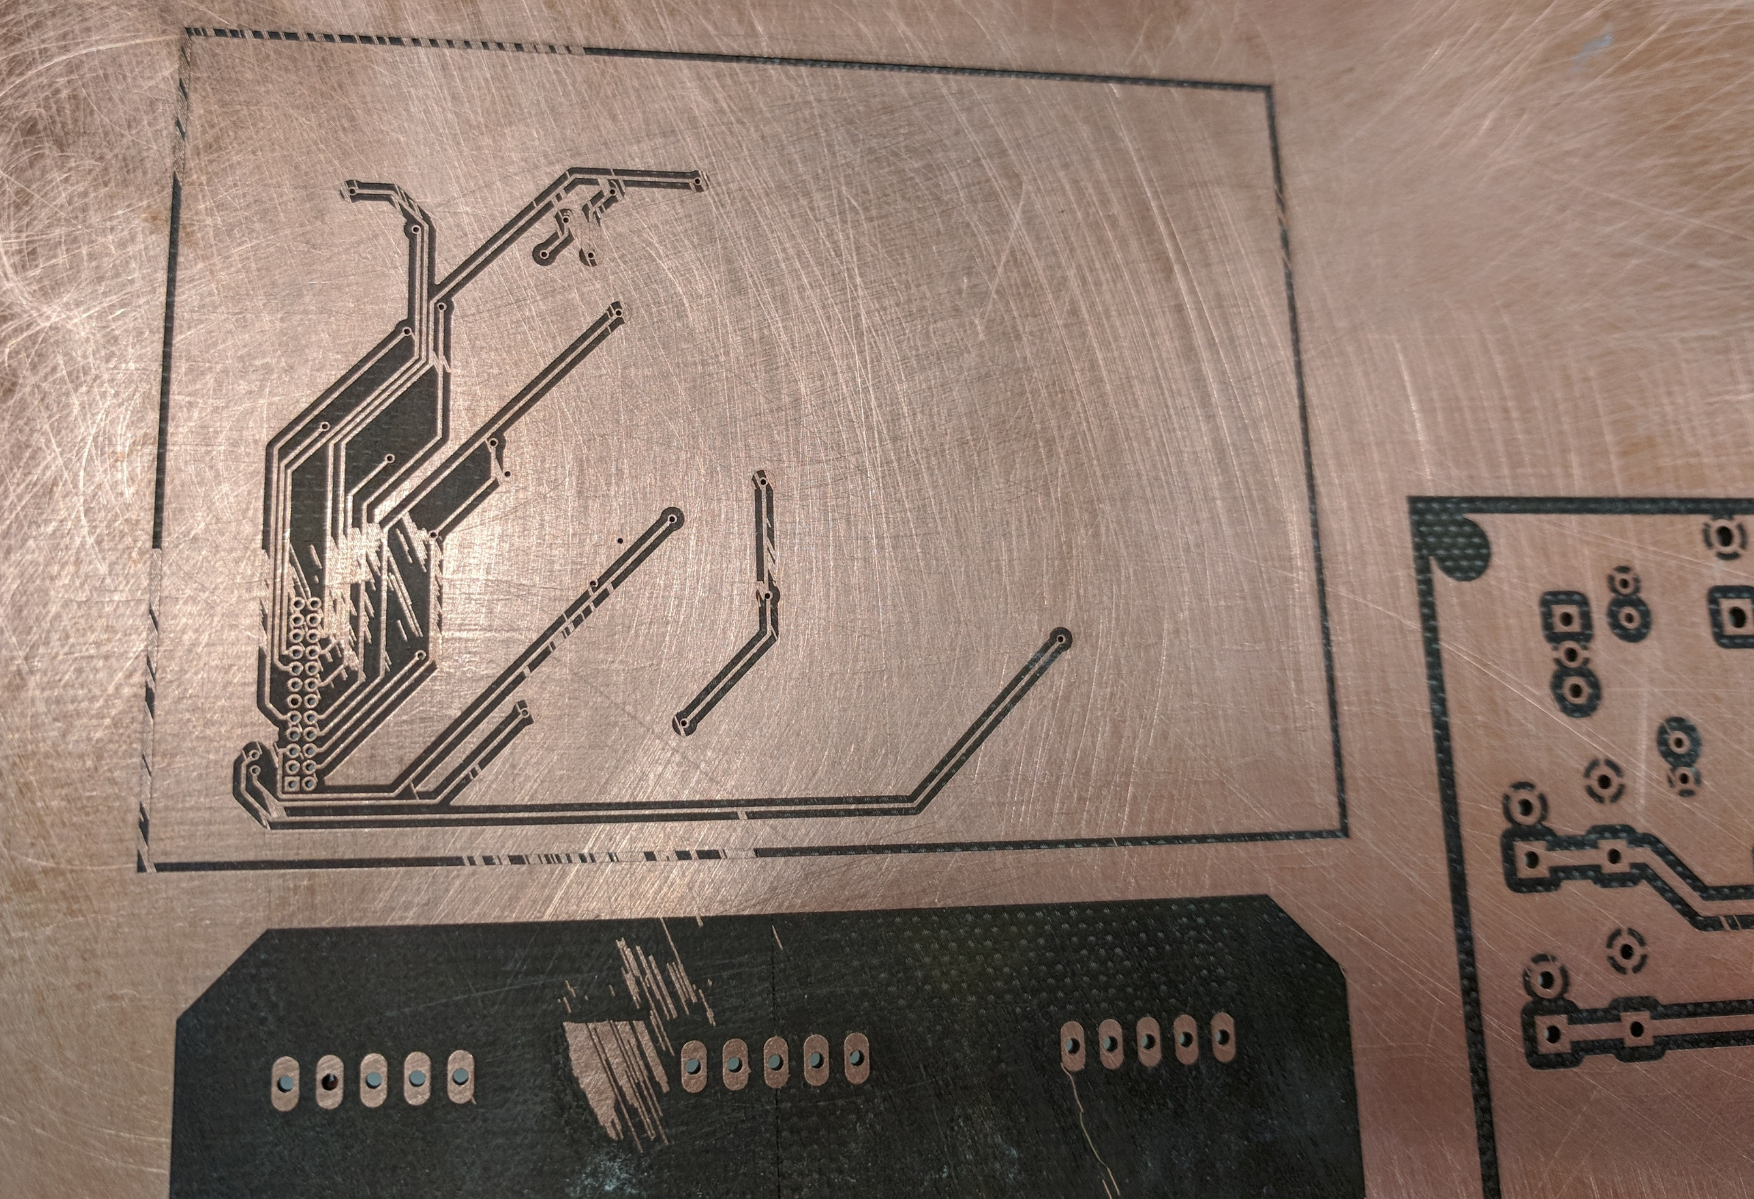
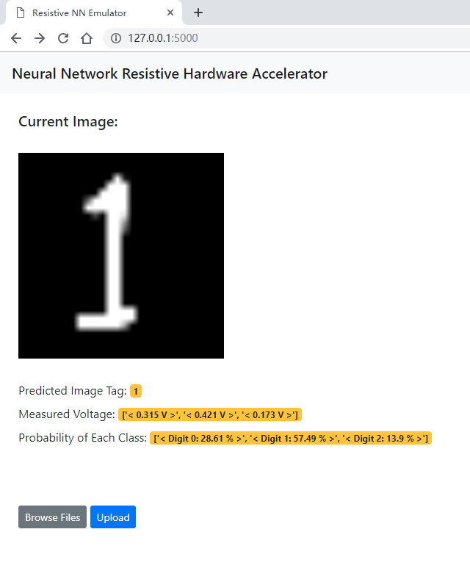




Accelerating Neural Network Inference Computation with Resistive Devices
Team Members: Yunfeng Xin, William Scott, Runfeng Chen, William Trimmer, Zheyuan Xu, Sho Ko
Advisor: Dr. Shimeng Yu
Overview
System Design
Results
Goal: To prototype a hardware based neural network accelerator and to test its functionality.
Includes a MCU, a resistor matrix consisting of three separate resistor columns, and a computer as a website server.
Final implementation able to classify handwritten digits among 0, 1 and 2.
High classification accuracy.
Our design consists of three parts: a PC running a web server for user interaction, a micro-controller unit (MCU) for peripheral processing, and a resistor matrix that emulates an multi-layer perceptron layer in a convolutional neural network.
The Micro-controller
2. The Resistive Matrix
3. The User Interface
The entire system reaches an accuracy of 98.67% on hand-written digit recognition tasks.
PC
Data Visualization
Communicates through USB
MCU
Input Processing
Voltage I/O
Time Consumption:
MCU: 19 us
Resistor Matrix: 70 ns
Raw Image
Inputs 1 - 64
Resistive Matrix
NN Guess
Outputs 1 - 10
Energy Consumption:
MCU: 5 uJ
Resistor Matrix: 1.5 nJ
MCU runs part of a convolutional neural network inference layers and feeds input values
MCU reads the output voltage values as inference results from the resistor matrix
MCU sends the acquired voltage values back to the computer for visualization
Problems
Future Works
Current neural network inference computation consists of a large number of multiplication operations.
The number of multipliers in a CPU is limited.
Multipliers consume time & energy.
Neural network inference computation typically does not need high-precision results offered by CPUs to classify objects.
Resistive neural networks offer faster and lower-power alternative.
Extend the resistor matrix to support convolution layer operations.
More resistance levels can be added to the resistors to improve classification accuracy.
Migrate the system onto a printed circuit board.
Objectives
The system will replace the computation of one fully-connected layer within a convolutional neural network.
The system aims to remain high accuracy after clipping and rounding the inputs and weights.
The system will be benchmarked against the software implementation to show feasibility of the resistive neural network.
References
S. Yu, "Neuro-inspired computing with emerging nonvolatile memorys," in Proceedings of the IEEE, vol. 106, no. 2, pp. 260-285, Feb. 2018.
M. Olivieri, “Design of synchronous and asynchronous variable-latency pipelined multipliers,” IEEE Transactions on Very Large Scale Integration (VLSI) Systems, vol. 9, no. 2, pp. 365–376, 2001.
T. Gokmen and Y. Vlasov, “Acceleration of Deep Neural Network Training with Resistive Cross-Point Devices: Design Considerations,” Frontiers in Neuroscience, vol. 10, p. 1, 2016.

