Slide 1
Education evenings 2016
Practical introduction to groundwater modelling
Computer exercises 00 01 Things to do before the course

Slide 2
Download
Course material at http://tiny.cc/bch_gwmod_2016

Slide 3
Extract
Zipped folder to a location of your choice. Make sure the folder can stay at this location during all three sessions, as we will need to point several programs to the location of executables in the /bch_gwmod_2016/05_software/ subfolder.

Slide 4
Install
GW_Chart
ModelMuse
ModelViewer by executing the installers located in the respective subfolders of /05_software/, and going through the setup. Make sure you select the correct installer for ModelMuse (32 or 64 bit), based on your machine architecture. The remaining subfolders contain executables that do not need to be installed.

Slide 5
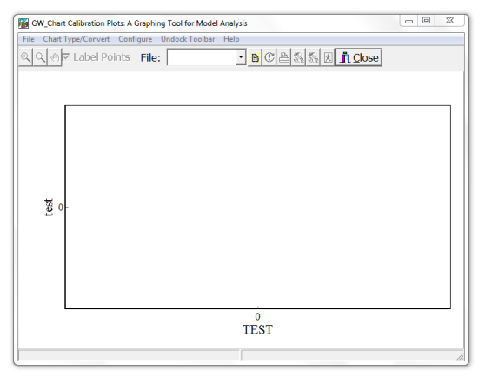
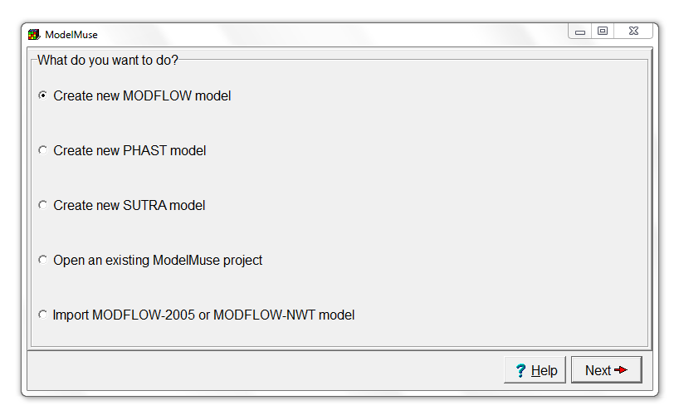
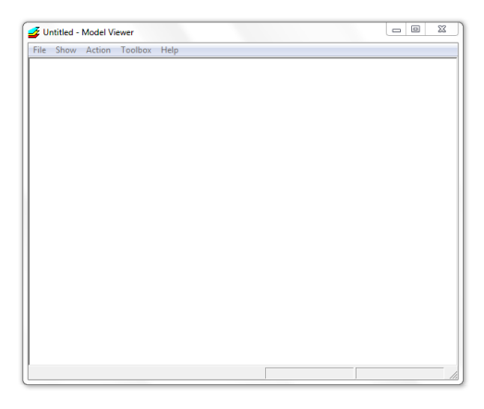
Check
If installation was succesful by starting GW_Chart, ModelMuse and ModelViewer. You should get, respectively, the following starting screens:

Slide 6
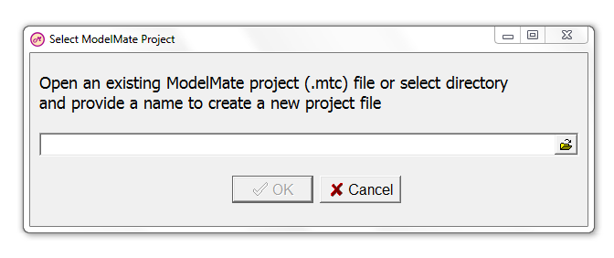
Also check
If ModelMate works correctly by executing /05_software/ModelMate/ ModelMate_1_0_2.exe. You should get the following start screen:

Slide 7
You might want to
Add a shortcut to the /bch_gwmod_2016/ folder on your desktop
Add shortcuts to GW_Chart, ModelMuse and ModelViewer on your desktop
Add a shortcut to ModelMate_1_0_2.exe on your desktop

Slide 8
Education evenings 2016
Practical introduction to groundwater modelling
Computer exercises
00 01 Things to do before the course
Questions? Found an error? Please contact B. Rogiers at brogiers@sckcen.be.

