Slide 1
Education evenings 2016
Practical introduction to groundwater modelling
Computer exercises
02 01 A more complex model

Slide 2
Purpose
In this example, we will
create a more complex model, which uses data from Shapefiles to define the layer boundaries,
use parameters for defining a data set and a model feature, and
use the Observations process in MODFLOW to define head observations and river observations.

Slide 3
About parameters
Uncertain material or boundary condition properties
Parameters in MODFLOW are listed together in the parameter value file
External software (e.g. ModelMate and UCODE) can easily modify this parameter value file, to perform for example sensitivity analysis, parameter estimation or uncertainty quantification.
Working with parameters requires setting up your model in a slightly different way. Think about which parameters you want to include before building your model!

Slide 4
Parameters for data sets vs model features
No mixture possible: either parameters for the whole data set, or no parameters at all!
Parameter value is multiplied by a multiplier array (= data set; 1 everywhere by default), and/or only used in a zone (= data set; False by default).
There is no time-dependency.
Mixture is possible: features with parameters can be combined with similar features without parameters.
Parameter value is multiplied by a multiplier defined for each of the features it relates to.
This multiplier can change with time.

Slide 5
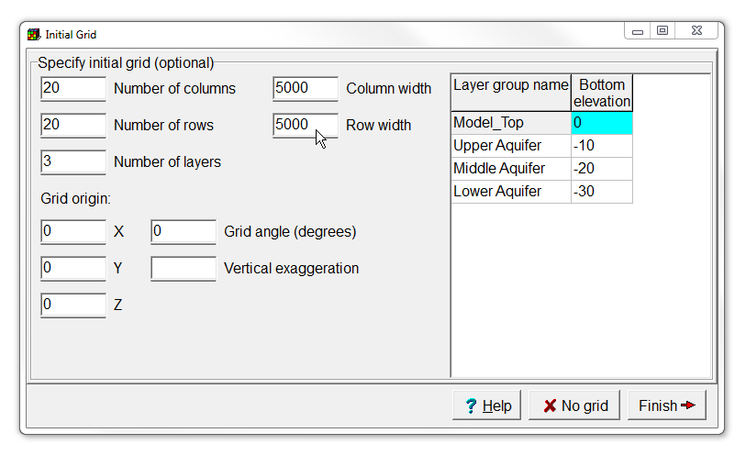
Initial Grid
Start a new model with 20 rows, 20 columns, and 3 layers. Make the rows and columns 5000 metres wide.
You don't need to change the layer elevations now, so click Finish.

Slide 6
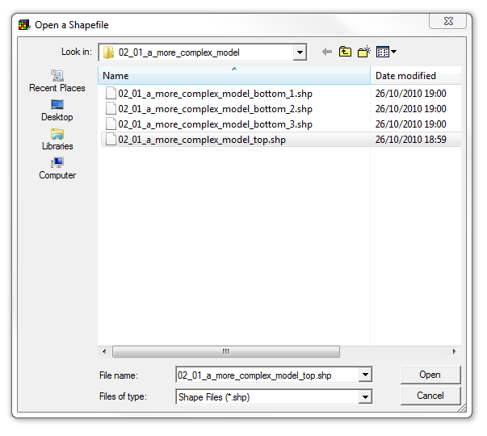
Import shape files (1/4)
Next we will import the layer elevations from shape files.
Select File|Import|Shapefile and select /02_01_a_more_complex_ model/02_01_a_more_ complex_model_top.shp.

Slide 7
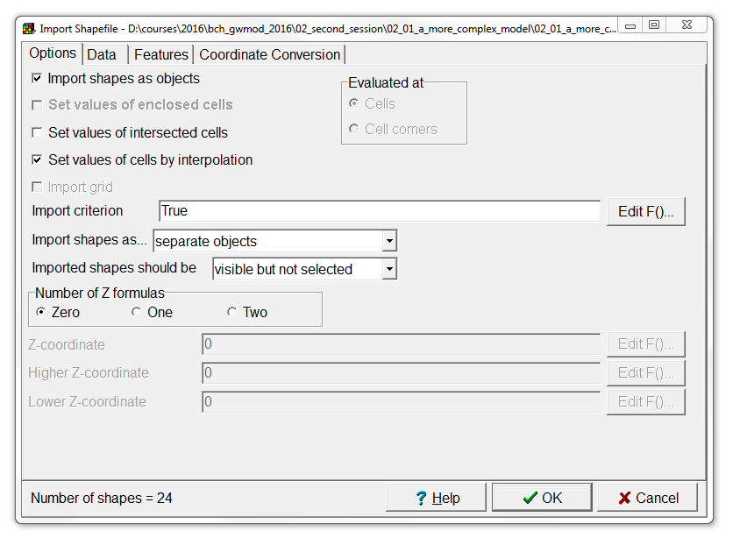
Import shape files (2/4)
Check Set values of cells by interpolation.

Slide 8
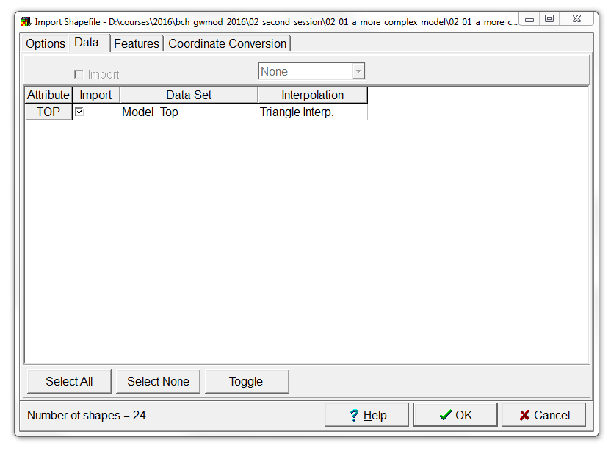
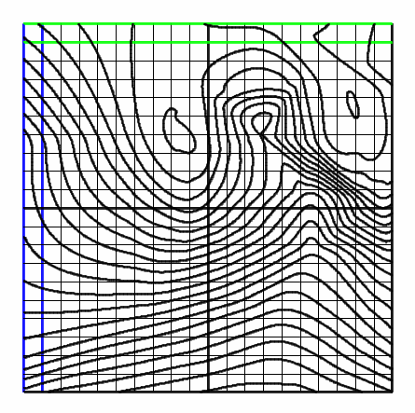
Import shape files (3/4)
On the Data tab, check the Import check box for the TOP attribute,
change the Data Set to Model_Top,
and change the interpolation method to Triangle Interp.
Then click OK.
You should get

Slide 9
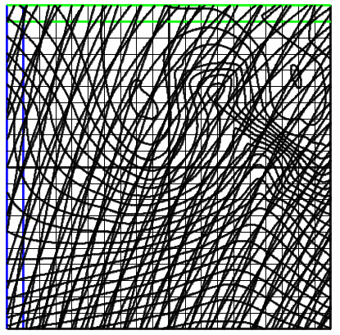
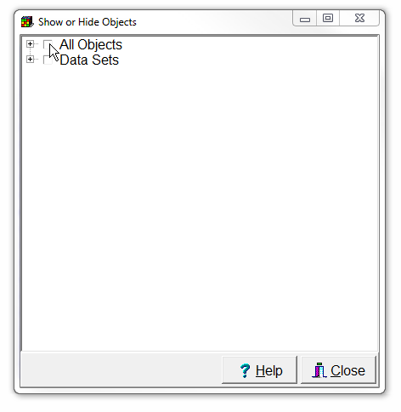
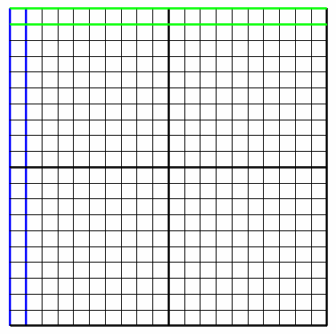
Import shape files (4/4)
Repeat steps 2-4 with the Shapefiles 02_01_a_more_complex_ model_bottom_1.shp, *_bottom_2.shp and *_bottom_3.shp. Use them to set the bottoms of the upper, middle, and lower aquifer respectively.
Then select Object|Show-or Hide Objects and uncheck the check box for "All Objects" to hide all the objects.

Slide 10
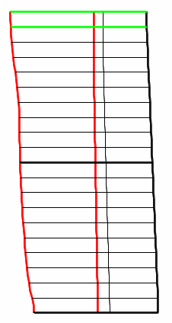
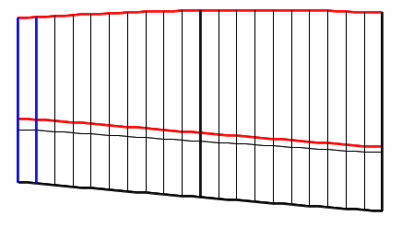
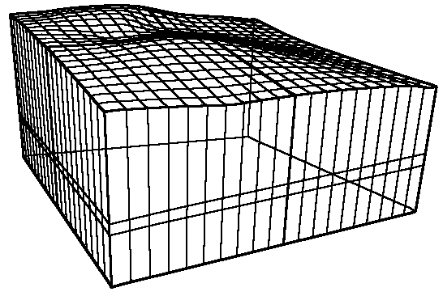
Check layer geometries
Have a look at the front, side and 3D views to see if the layer geometry was set correctly.
Use the grid buttons to reveal more layer details on the 3D view.
Show grid shell
Show side grid
Show top grid
Show front grid

Slide 11
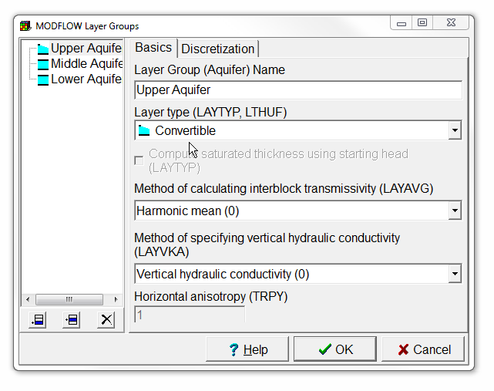
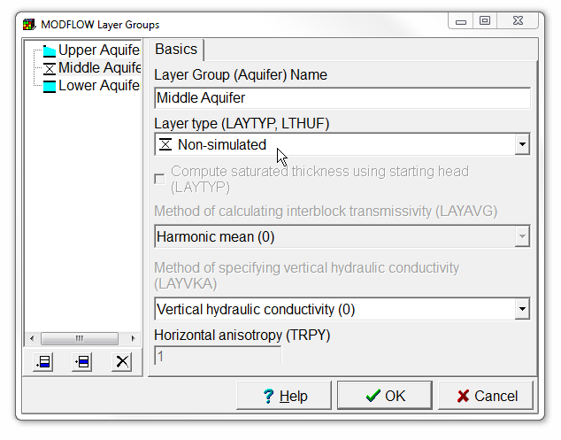
Define layer types
At this point, the elevations of the layers have been defined. The next step is to define the layer types:
Select Model|MODFLOW Layer Groups...
Select the Upper Aquifer and change its layer type to Convertible
Select the Middle Aquifer and change its layer type to Non-simulated (= Quasi-three-dimensional confining bed in MODFLOW) and
click OK.

Slide 12
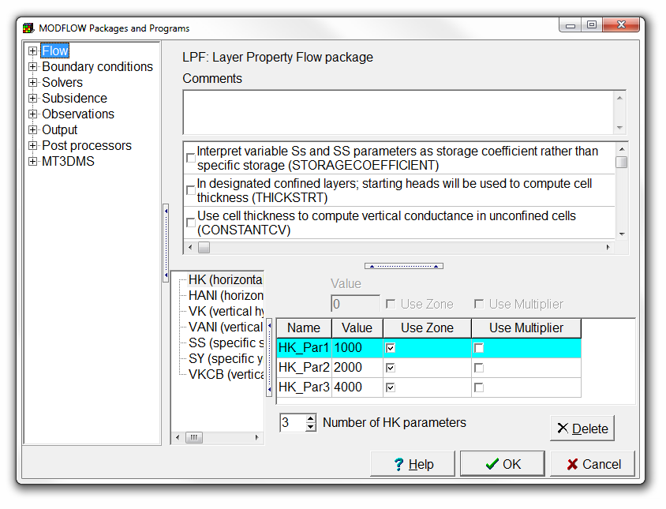
Set Kx with parameters and zones (1/4)
Select Model|MODFLOW Packages and Programs...
The LPF package is active by default. In it change the Number of HK parameters to 3.
Set the values of the parameters to 1000, 2000, and 4000 respectively.
Check the check box for Use Zone for all three parameters,
and then click OK.

Slide 13
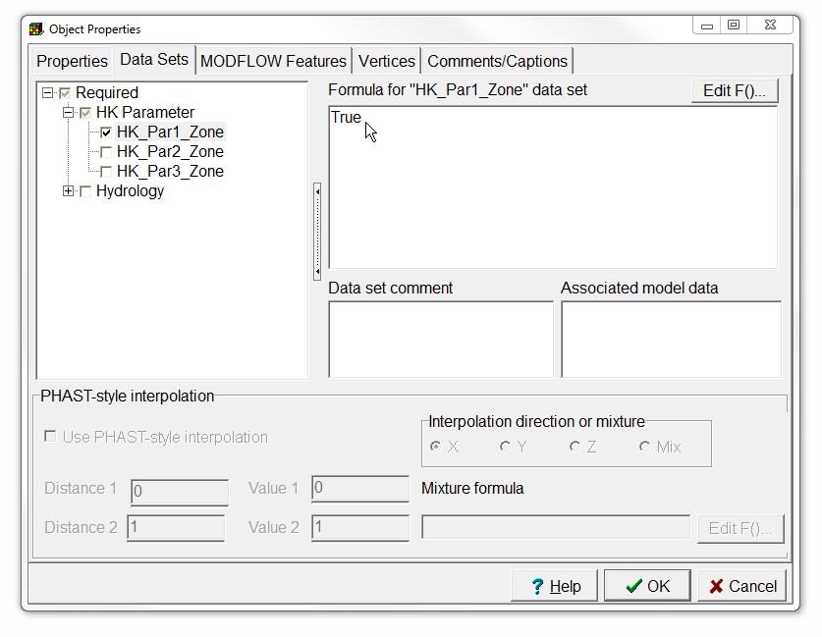
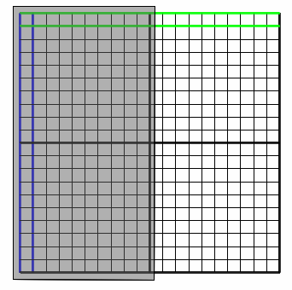

Set Kx with parameters and zones (2/4)
Make sure that layer 1 is the active layer and draw a polygon around the left half of the model.
On the Data Sets tab of the Object Properties dialog box, expand Required|HK Parameter and check the check box for HK_Par1_Zone.
Then set the formula to True and close the dialog box,
and press OK.

Slide 14
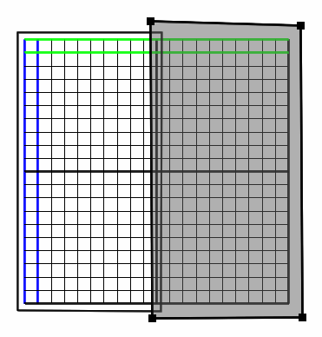
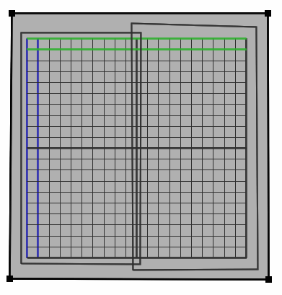

Set Kx with parameters and zones (3/4)
Draw another object on the right half of the model and use it to set HK_Par2_Zone to True.
Change the active layer to layer 3, and draw an object completely surrounding the grid. Use it to set the value of HK_Par3_Zone to True.

Slide 15
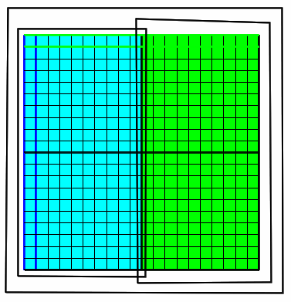
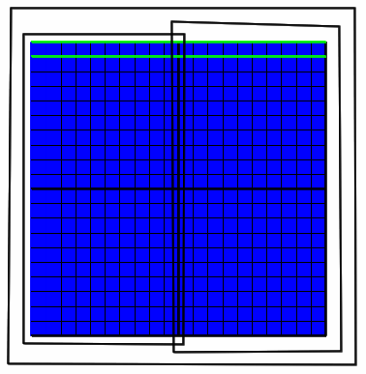

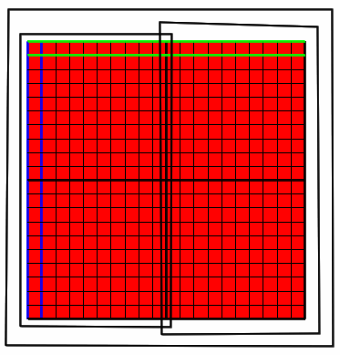
Set Kx with parameters and zones (4/4)
Colour the grid with the Kx data set. ModelMuse will use a formula that reproduces how MODFLOW assigns values to cells.
Try moving one of the objects that set the zones in the first layer, so that the zones overlap.
What is the hydraulic conductivity where the zones overlap?
Use the undo button to move the objects back to their original locations.

Slide 16
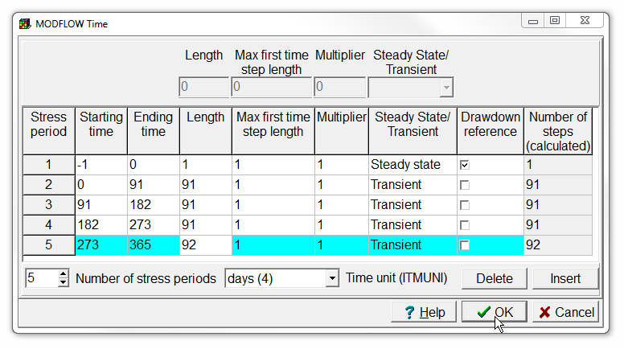
Define MODFLOW stress periods
Next select Model|MODFLOW Time...
and set up the stress periods as shown on the right.
Then click OK.

Slide 17
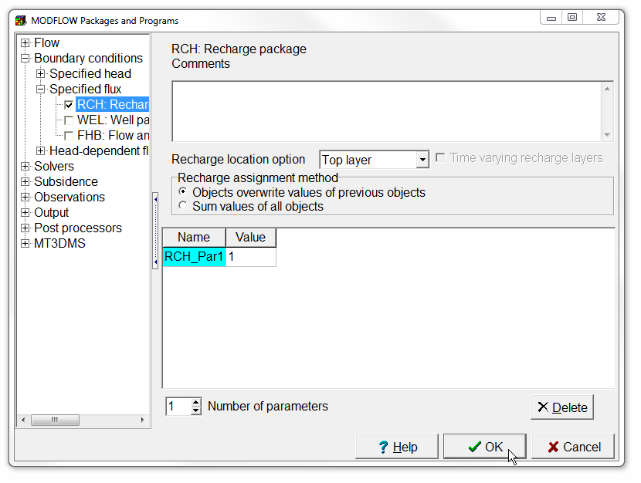
Set Recharge with a parameter and multipliers (1/2)
Select Model|MODFLOW Packages and Programs...,
expand Boundary conditions|Specified flux and check the check box for the Recharge package.
Change the number of parameters to 1,
and set the value of the parameter to 1.
Click OK to close the dialog box.

Slide 18
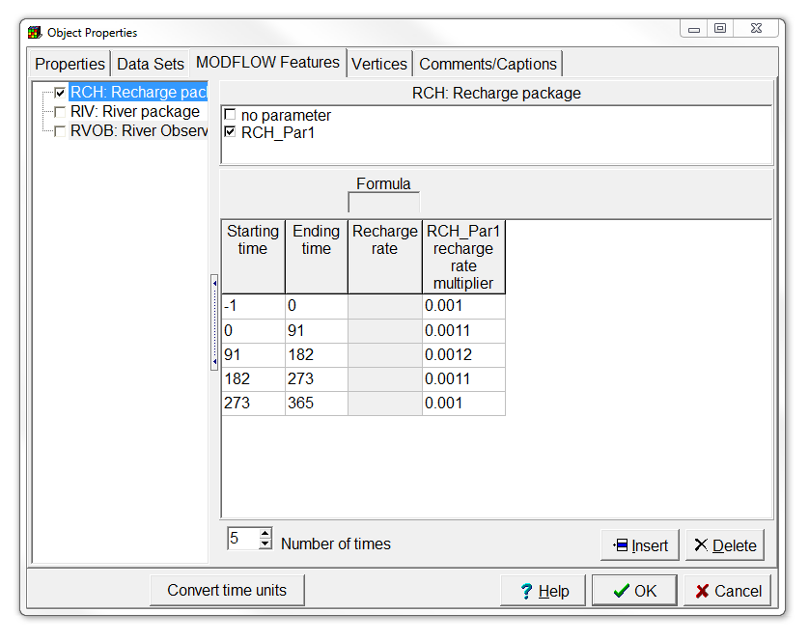
Set Recharge with a parameter and multipliers (2/2)
Hide the existing objects, and draw another object that completely surrounds the grid.
In the Object Properties dialog box, check the checkbox for the Recharge package on the MODFLOW Features tab and check the check box for the recharge parameter RCH_Par1.
This will cause a new column to appear in which you specify the recharge rate multiplier for that parameter. Fill in the rate multipliers as shown on the right.
Then click OK to close the Object Properties dialog box.

Slide 19
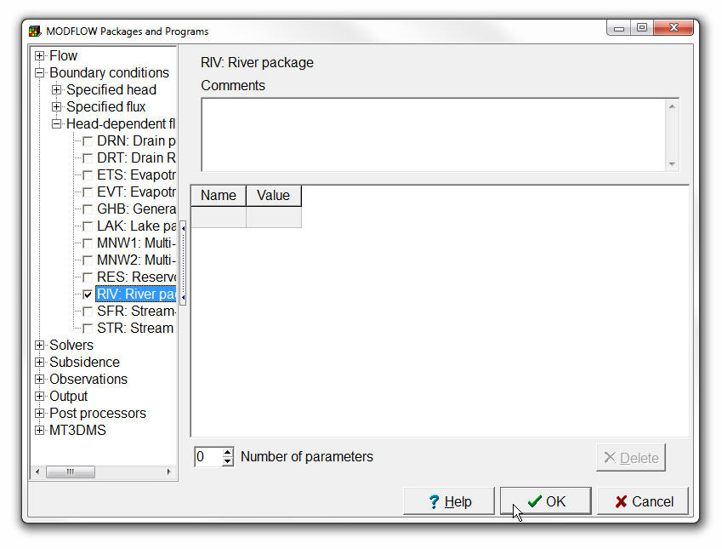
Enable the River package
In this model, all the water leaves through a river. We will now define the river.
Select Model|MODFLOW Packages and Programs...,
expand Boundary conditions|Head-dependent flux and check the check box for the River package.
Then click OK to close the Object Properties dialog box.

Slide 20
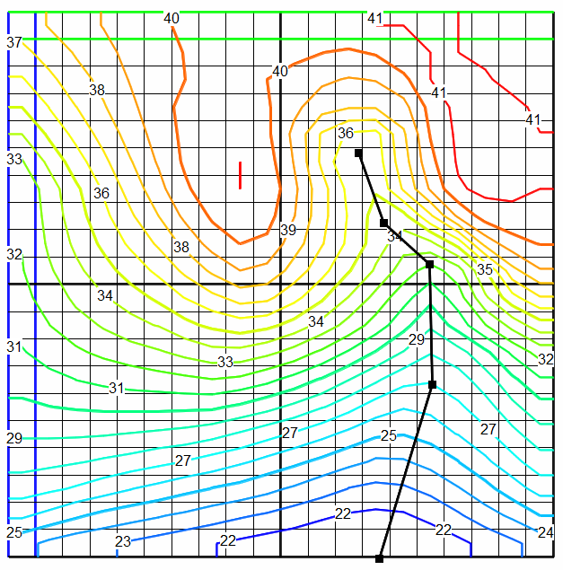
Draw a river
Create polyline object
In order to help see where the river should be located, we will contour the top of the model and then draw the river down the middle of the valley.
Select Data|Color Grid, select none, and click Apply.
Select Contour Data, select the Model_Top data set, and again click Apply.
Then make the top layer the active layer and draw an object as shown on the right.

Slide 21
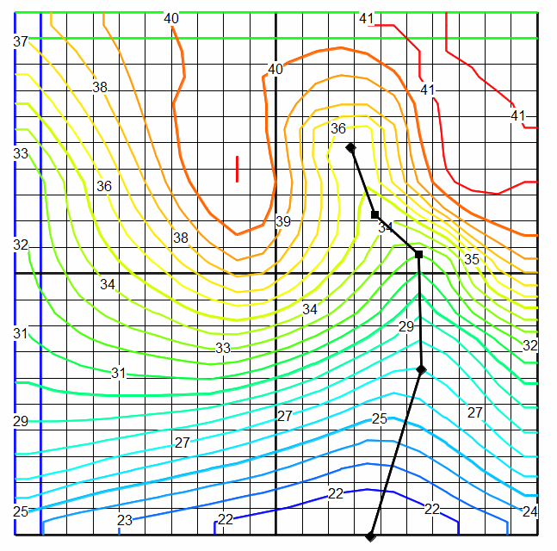
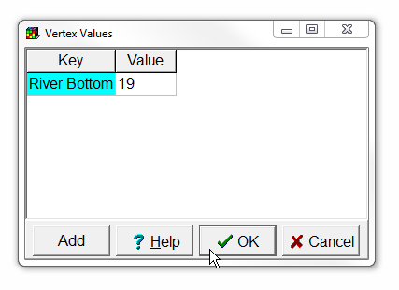
Assign river elevations
Select Object|Edit|Vertex Values and double click on the vertex at the upstream end of the river.
In the Vertex Values dialog box enter "River Bottom" as the key and 19 as the value.
Then click OK. Note that the symbol for the vertex has changed from a square to a diamond.
Repeat the above steps for the two other vertices indicated on the right.
19
16
10

Slide 22
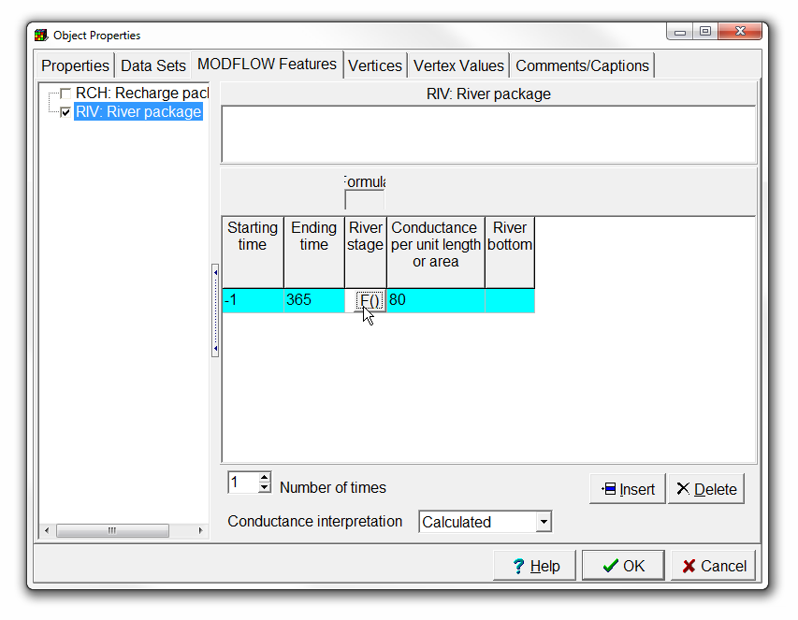
Specify river conductance, bottom and stage formulas (1/2)
At this point we have defined the river elevations but we need to do one more thing to apply them to the river:
Select the Select objects button and double click on the object that defines the river to open the Object Properties dialog box.
On the MODFLOW Features tab, check the check box for the River package and enter -1 as the Starting time, 365 as the Ending time and 80 as the Conductance per unit length.
Select objects

Slide 23
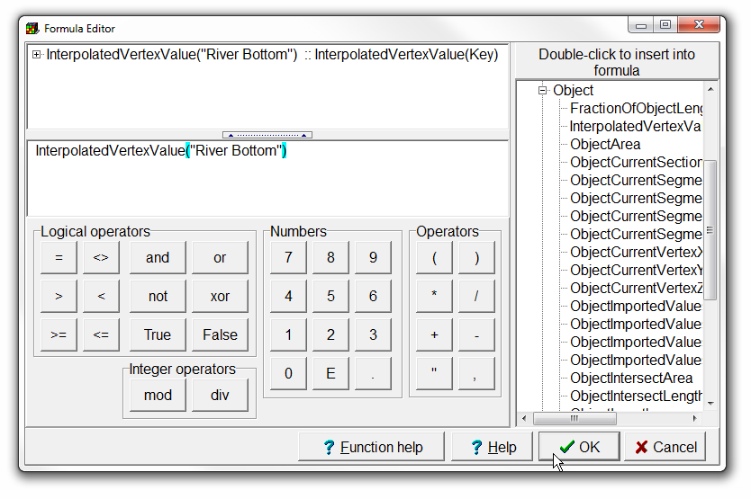
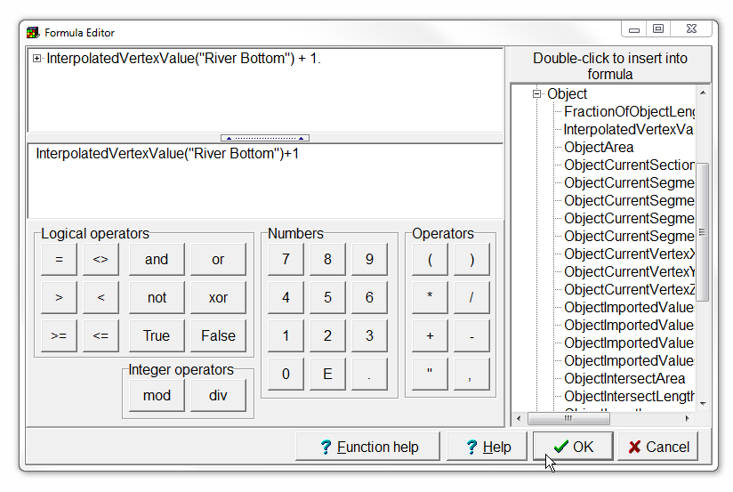
Specify river conductance, bottom and stage formulas (2/2)
Click in the cell in the table where River bottom is defined.
Click on the F() button that appears in the table to open the Formula Editor.
In the list on the right, expand Functions|Object and double click on InterpolatedVertexValue.
The formula will appear on the left. Replace “Key” with “River Bottom”. Be sure to include the quotation marks around “River Bottom”.
Click OK to close the Formula Editor.
Repeat the steps above for setting the formula for the River stage to InterpolatedVertexValue("River Bottom") + 1.
Close the Object Properties dialog box.

Slide 24
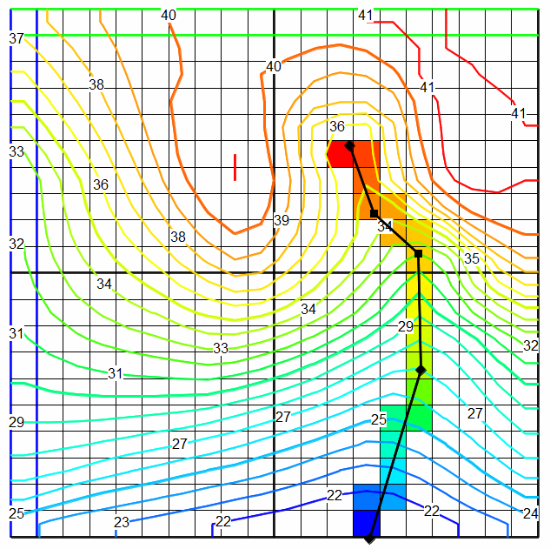
Verify river stage
To verify that the river stage has been assigned correctly, color the grid with the river stage.

Slide 25
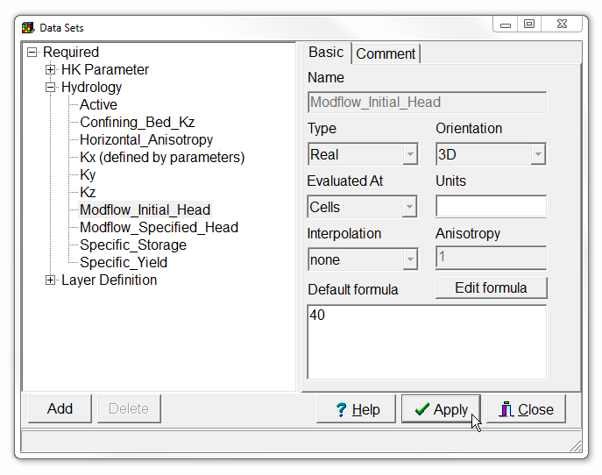
Set initial heads
We still have a few more things we need to do before running the model. First set the initial head.
Select Data|Edit Data Sets..., Expand Required|Hydrology and select Modflow_Initial_Head.
Change the formula to 40 and click Apply.

Slide 26
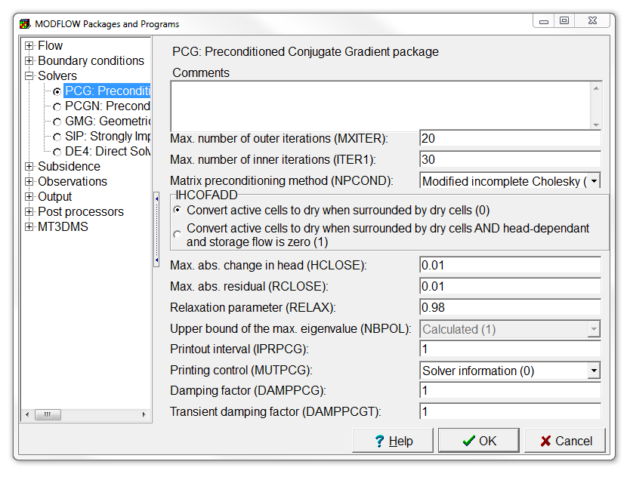
Choose a solver
Select Model|MODFLOW Packages and Programs..., expand Solvers and select the PCG package.
Change both HCLOSE and RCLOSE to 0.01,
and set RELAX to 0.98.

Slide 27
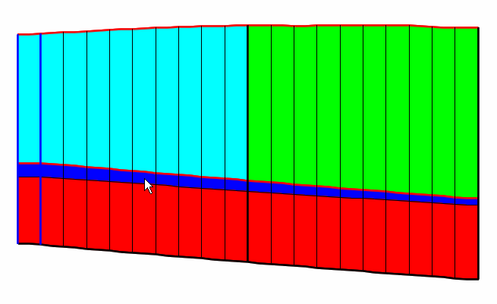
Set confining layer Kz (1/2)
Color the grid with Kz.
Note that in the middle confining layer, Kz is zero and that the formula used to define Kz is Kx/10. That needs to be fixed.
We could use another object to define Kz but in this case, we'll just adjust how Kx is defined.

Slide 28
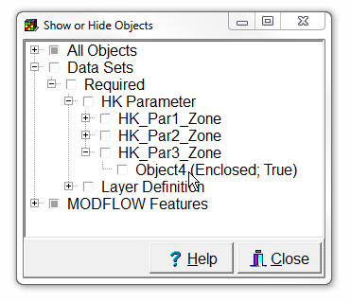
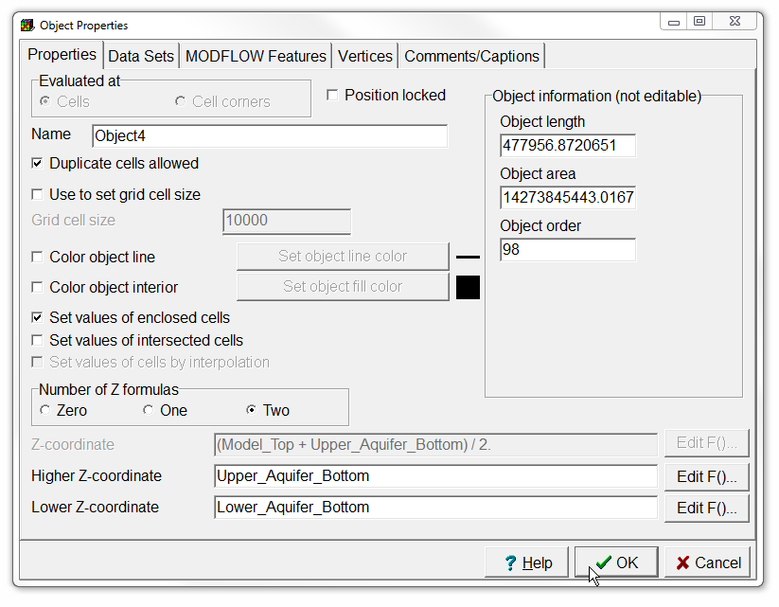
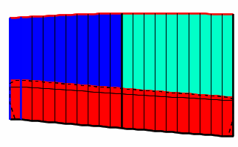
Set confining layer Kz (2/2)
Select Object|Show or Hide Objects, expand Data Sets|Required|HK Parameter|HK_Par3_Zone and double click on the object listed there.
This opens the Object Properties dialog box. This object sets the zone for HK_Par3 to be the bottom layer. Change the formula for the Higher Z coordinate to "Upper_Aquifer_Bottom" so that the object applies to both the middle and lower layers.
Click OK to close the dialog box. Now Kz for the middle layer should be 400.

Slide 29
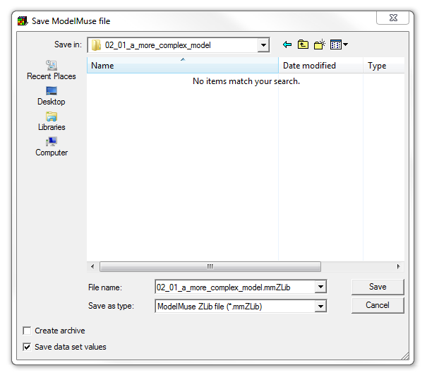
Save model
Select File|Save, and
select the folder ““/02_01_a_more_ complex_model/” and file name “02_01_a_more_complex_model.mmZLib”.
Deselect the Create archive checkbox, and
Save the file.

Slide 30
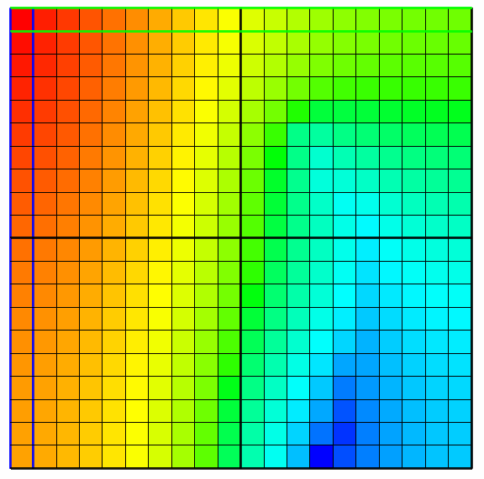
Run model and import results
To check that you've done everything correctly, try running the model now and then import the model results.
The model should run to completion and the final imported heads should look like the ones on the right.

Slide 31
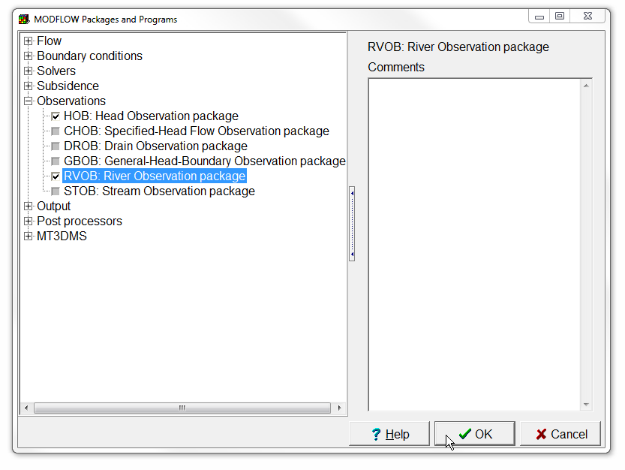
Enable Observation packages
The next thing to do is to define some observations.
Select Model|MODFLOW Packages and Programs... and expand Observations.
Check the check boxes for the Head Observation and River Observation packages.
Then click OK.

Slide 32
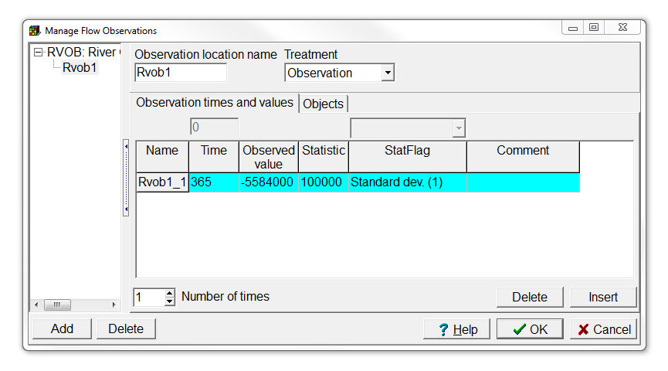
Define river observation (1/5)
The Manage Flow Observations dialog box appears. Select the river observation package and click the Add button.
Change the number of times to 1.
Enter 365 for the Time,
-5584000 for the Observed value (negative sign means that the water is leaving the aquifer and entering the river),
100000 for the Statistic, and
Standard dev. (1) for the StatFlag.
Then click OK.

Slide 33
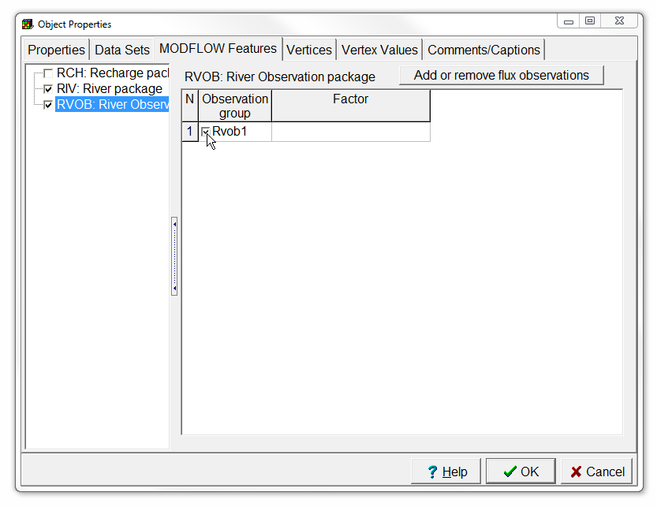
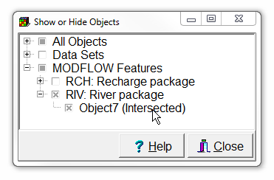
Define river observation (2/5)
Select Object|Show or Hide Objects, expand MODFLOW Features|River package and double click on the object listed there to open the Object Properties dialog box.
On the MODFLOW Features tab, select the river observation package and check the check box for the Rvob1 observation group. You can leave Factor blank for now.
Then press OK.

Slide 34
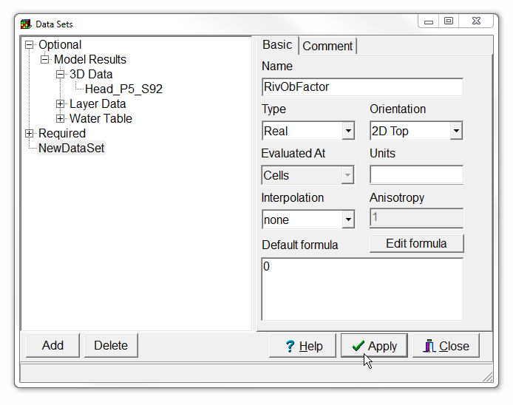
Define river observation (3/5)
The observation doesn't apply to the whole object. If it did, we would just set Factor to 1. Instead, we will create a new data set that will have a value of 1 where the river cells are part of the river observation and 0 everywhere else.
Select Data|Edit Data Sets... and click the Add button.
Change the name of the new data set to RivObFactor.
Note that the Default formula is 0.
Then click the Apply button.

Slide 35
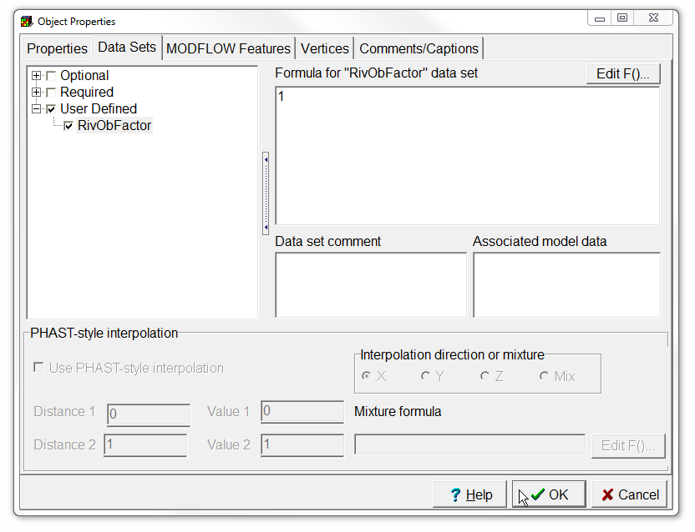
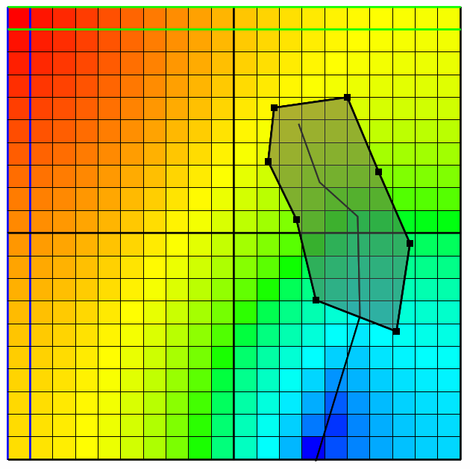
Define river observation (4/5)
Now draw a polygon that surrounds the portion of the river object that extends from the upstream end down through the next to last vertex as illustrated on the right.
In the Object Properties dialog box, go to the Data Sets tab and expand User Defined. Check the check box for RivObFactor and set the formula to 1.
Click OK.

Slide 36
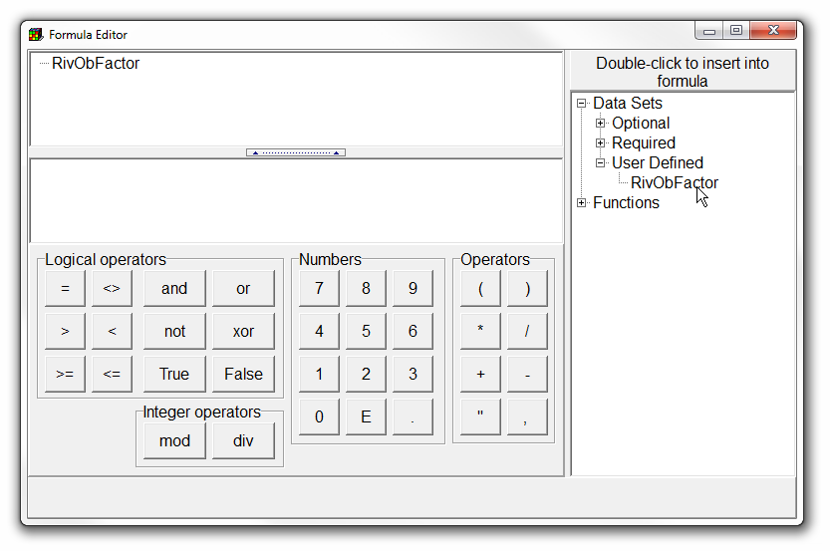
Define river observation (5/5)
Now double-click on the object that defines the river and go back to the River observation on the MODFLOW Features tab.
Change the factor to RivObFactor. Now only those cells for which RivObFactor equals 1 will be part of the observation.

Slide 37
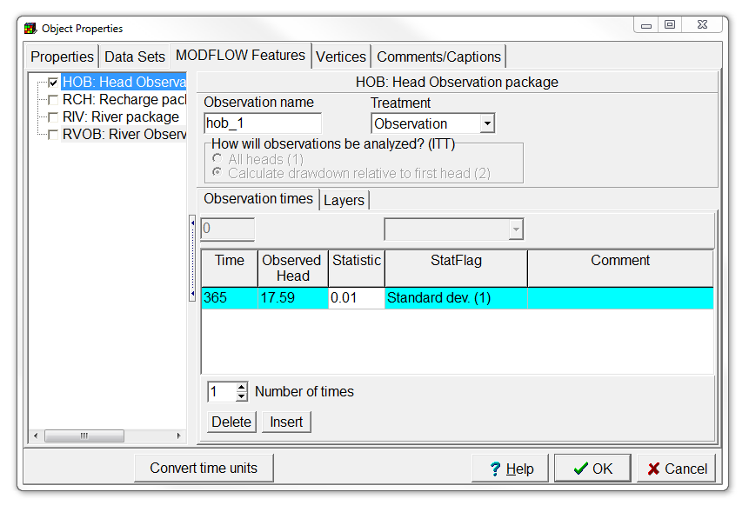
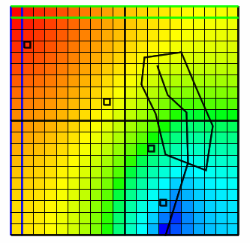
Define head observations (1/2)
Next make sure layer 1 is the active layer and create four point objects as illustrated on the right.
They will define the head observations in this layer. They all define observations at time 365, with a standard deviation of 0.01.
The observed heads at each point are shown next to each object.
Make sure to use observation names “hob_1” to “hob_4”
hob_4: 35.4
hob_3: 29.28
hob_2:
22.68
hob_1: 17.59

Slide 38

Define head observations (2/2)
Next make sure layer 3 is the active layer and create two more point objects as illustrated on the right.
They will define the head observations in the third layer. They again define observations at time = 365, with a standard deviation of 0.01.
The observed heads at each point are shown next to each object.
Make sure to use observation names “hob_5” and “hob_6”
hob_5:
23.28
hob_6:
32.62

Slide 39

Check model performance
You can now run the model.
At the end of the listing file, you can check and see how good the simulated values match the observed ones.

Slide 40
Education evenings 2016
Practical introduction to groundwater modelling
Computer exercises
02 01 A more complex model
Questions? Found an error? Please contact B. Rogiers at brogiers@sckcen.be.

