Slide 1
Education evenings 2016
Practical introduction to groundwater modelling
Computer exercises
02 02 Calibrating the more complex model

Slide 2
Purpose
In this exercise, we will use ModelMate to perform
local sensitivity analysis and
local optimization or calibration
of the parameters we defined in our more complex model, and
import the results back to ModelMuse.

Slide 3
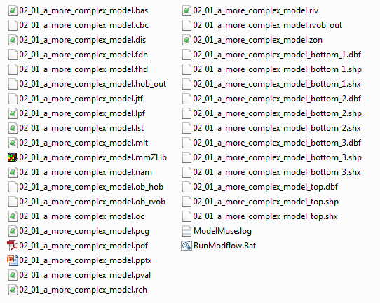

Copy file previous exercise
Copy file “/02_01_a_more_complex_model/02_01_a_more_complex_model.mmZLib” to folder “/02_02_calibrating_the_more_ complex_model/”
Change the file name to “02_02_calibrating_the_more_ complex_model.mmZLib”

Slide 4
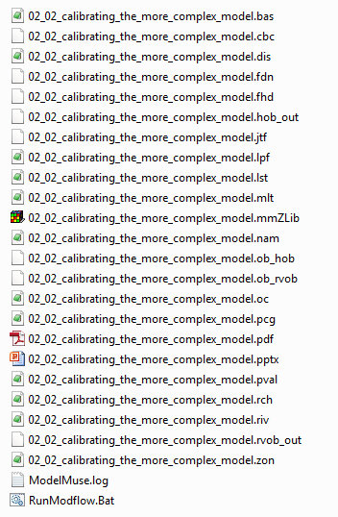
Run MODFLOW again
Open ModelMuse file “02_02_calibrating_the_more_ complex_model.mmZLib”
Press the Run MODFLOW-2005 button, save the name file and execute the model.
Close ModelMonitor, the listing file and the command line window. All necessary files are now available for ModelMate.
Run MODFLOW-2005

Slide 5
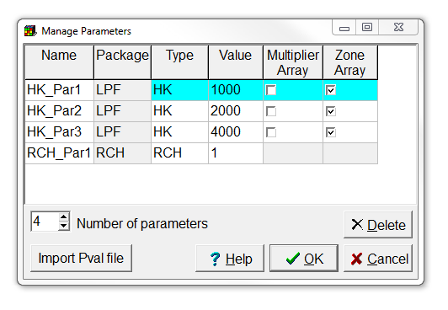
Check model parameters
Select Model|Manage Parameters…
Note that we defined four parameters during the previous exercise:
HK_Par1 defines horizontal hydraulic conductivity in the left half of our first layer
HK_Par2 defines horizontal hydraulic conductivity in the right half of our first layer
HK_Par3 defines horizontal hydraulic conductivity in our third layer, and the vertical hydraulic conductivity of the non-simulated second layer also depends on it
RCH_Par1 is multiplied with the recharge multipliers to obtain the recharge value

Slide 6
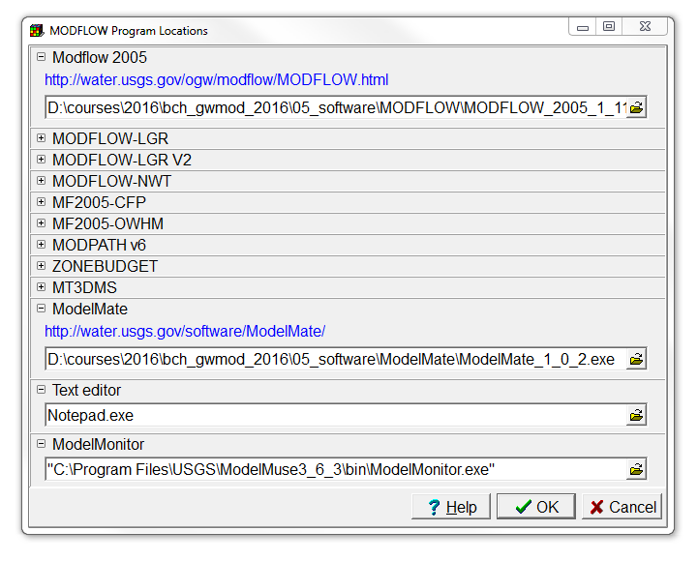
Set ModelMate executable location
Choose Model|MODFLOW Program locations,
fill in the ModelMate executable location “…/bch_gwmod_2016/ 05_software/ModelMate/ ModelMate_1_0_2.exe”, and
click OK.

Slide 7
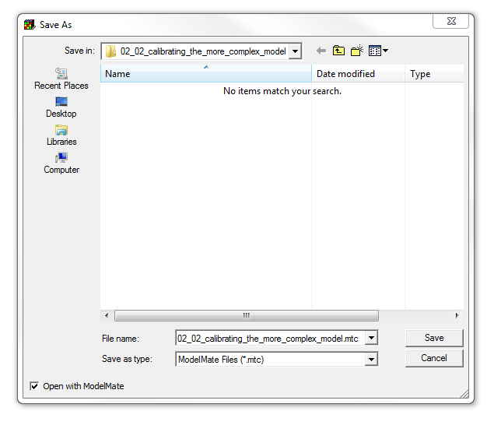
Export ModelMate file
Select File|Export|Export or Update ModelMate File,
use file name “02_02_calibrating_the_more_ complex_model.mtc”,
make sure the Open with ModelMate checkbox is checked,
and press Save.

Slide 8
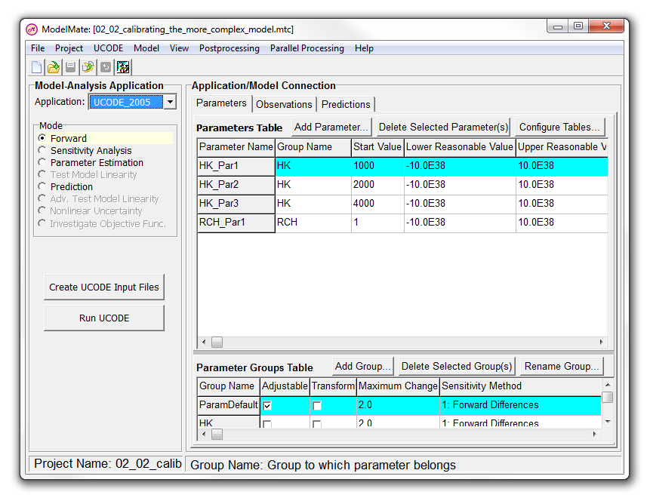
This is what you should get

Slide 9
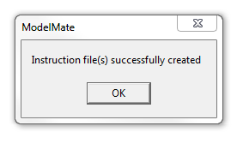
Create instruction files
Note that ModelMuse did not automatically create instruction files allowing UCODE to adjust the parameters and read the simulated equivalents of our observations.
Select Model|Create Instruction Files For Observations Defined In ModelMuse in ModelMate,
and press OK.

Slide 10
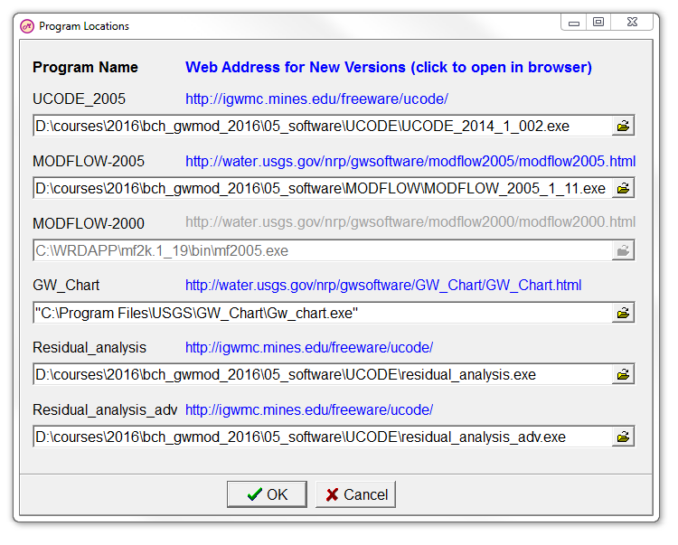
Set program locations
Select Project|Program locations,
and fill in the UCODE_2005, MODFLOW-2005, Residual_analysis, and Residual_analysis_adv program names with the corresponding executables in the /05_software/ folder (as in the image on the right).
For GW_Chart, locate the installation folder of GW_Chart (typically in the C:/Program Files/USGS/ folder), and select the GW_Chart.exe executable.
Then press OK.

Slide 11
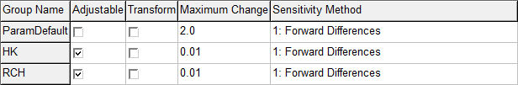
Adjust Parameter Groups Table
In the Parameter Groups Table, deselect Adjustable for ParamDefault, and
select it for HK and RCH. In this way, our hydraulic conductivity and recharge parameters are included in the sensitivity analysis and parameter estimation modes.
Set Maximum Change to 0.01 for both HK and RCH, to limit the size of parameter changes in one parameter-estimation iteration.

Slide 12
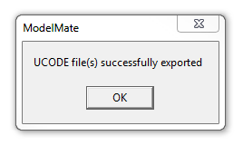
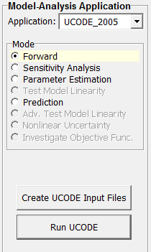
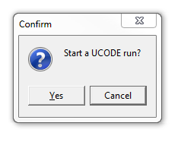
Perform forward simulation
Check if the Forward UCODE mode is selected,
press Create UCODE Input Files,
and click OK.
Then click on the Run UCODE button,
and click Yes to start the UCODE run.

Slide 13
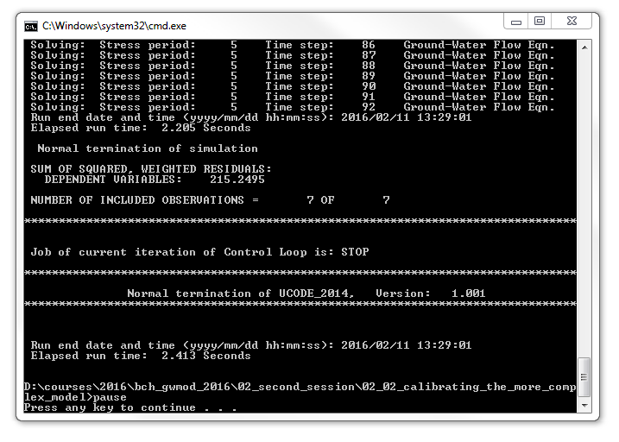
Check normal terminations of codes
In the command line window, check for normal terminations of MODFLOW and UCODE.
Also note the SUM OF SQUARED, WEIGHTED RESIDUALS, which is about 215 with our initial parameter values.
Close the command line window.

Slide 14
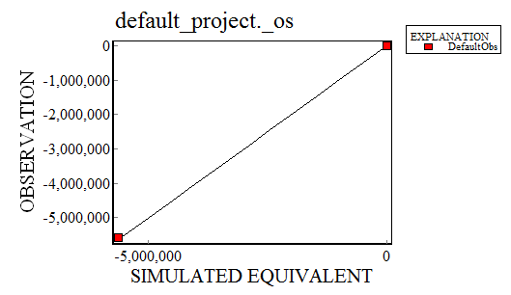
Plot observations vs simulated equivalents (1/2)
Select Postprocessing|GW_Chart, or use the corresponding button to bring up the observed compared to simulated values graph.
Note this plot is not very useful because of the differences in magnitude between the head and river observations.
Start GW_Chart

Slide 15

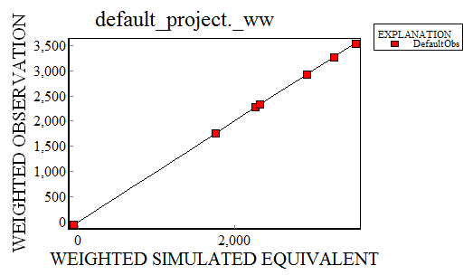
Plot observations vs simulated equivalents (2/2)
Therefore, select Model Fit| default_project._ww in the File: drop-down list.
This displays the weighted observed compared to the weighted simulated values, which is more informative in this case.

Slide 16
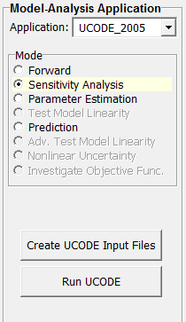
Perform sensitivity analysis
Now select the Sensitivity Analysis mode,
press Create UCODE Input Files,
and click OK.
Then click on the Run UCODE button,
and click Yes to start the UCODE run.

Slide 17
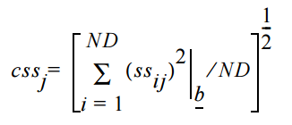
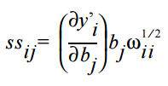
Statistics for sensitivity analysis
sensitivity of the simulated value for the i^{th} observation with respect to the j^{th} parameter
dimensionless scaled sensitivity of the simulated value for the i^{th} observation with respect to the j^{th} parameter
number of observations
sum of squared dimensionless scaled sensitivities
weight of the i^{th} observation
observation index
j^{th} parameter value
composite scaled sensitivity with respect to the j^{th} parameter
everything is evaluated at the same parameter vector b
parameter index

Slide 18
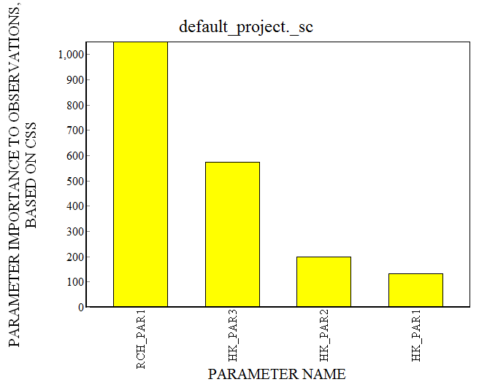
Visualize composite scaled sensitivities
Close the command line window after it has finished,
and launch GW_Chart again.
Now select O-Par Sens Analysis| default_project._sc in the File: drop-down list.
This displays the bar chart of composite scaled sensitivities (indicating parameter importance to all observations).

Slide 19
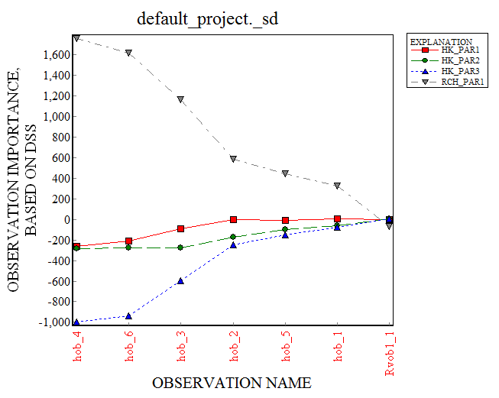
Visualize dimensionless scaled sensitivities
Now select O-Par Sens Analysis| default_project._sc in the File: drop-down list.
This displays the dimensionless scaled sensitivity for each observation by parameter (indicating the effect of each parameter on each observation).

Slide 20
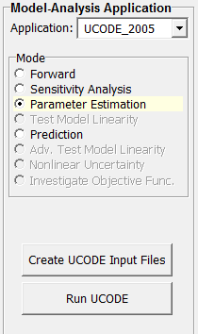
Perform parameter estimation
Now select the Parameter Estimation mode,
press Create UCODE Input Files,
and click OK.
Then click on the Run UCODE button,
and click Yes to start the UCODE run.

Slide 21
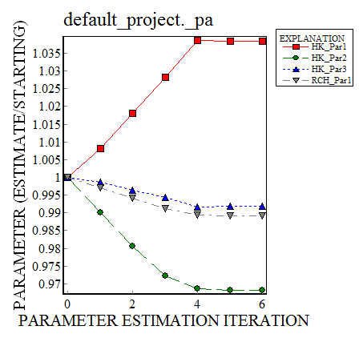
Visualize parameter evolution (1/2)
Close the command line window after it has finished,
and launch GW_Chart again.
Now select Parameter Values| default_project._pa in the File: drop-down list.
This displays the evolution of the different parameters with respect to their initial values.

Slide 22
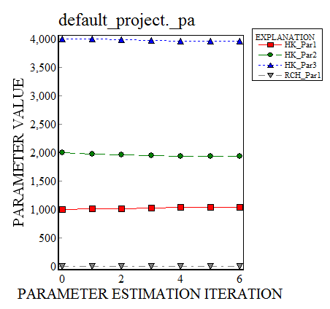
Visualize parameter evolution (2/2)
Deselect the Divide parameter values by their initial values to display the actual evolution of the different parameters.

Slide 23
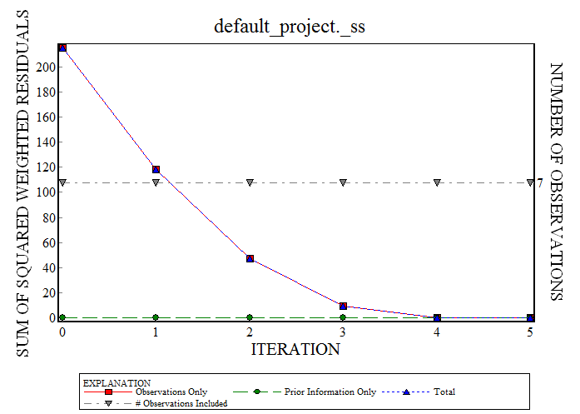
Visualize model performance evolution
Now select Model Fit| default_project._ss in the File: drop-down list.
This displays the sum of squared, weighted residuals for each parameter-estimation iteration.

Slide 24
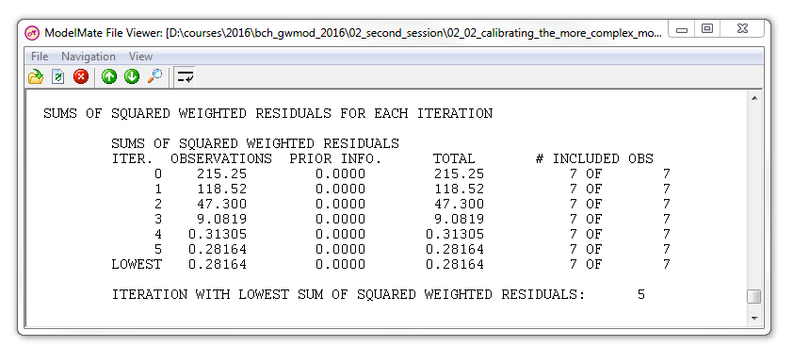
View the UCODE main output file
Select View|UCODE Main Output File,
and scroll down to the bottom of the viewer window.
Just before the end of the file, you should find the table on the right, which also provides the sum of squared weighted residuals for each parameter-estimation iteration.

Slide 25
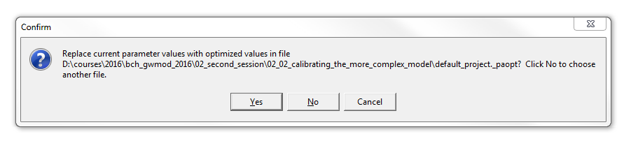
Import calibrated parameters in ModelMate
Select File|Import|Optimized Parameters (_paopt file)…,
confirm replacing the current parameter values by clicking Yes,
and select File|Save Project, or use the corresponding button.
Save File

Slide 26
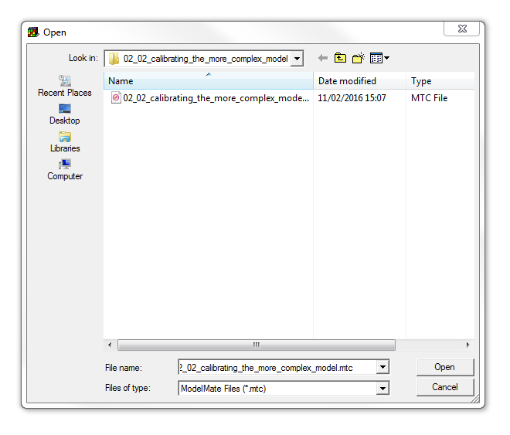
Import calibrated parameters in ModelMuse
Return to the ModelMuse window,
and select File|Import|ModelMate Values.
Choose “02_02_calibrating_the_more_complex_model.mtc”,
and press Open.

Slide 27
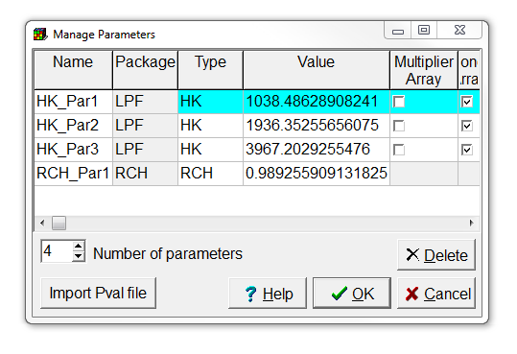
Check if parameters have changed
Select Model|Manage Parameters… to see if the parameter values in ModelMuse have actually been modified.

Slide 28
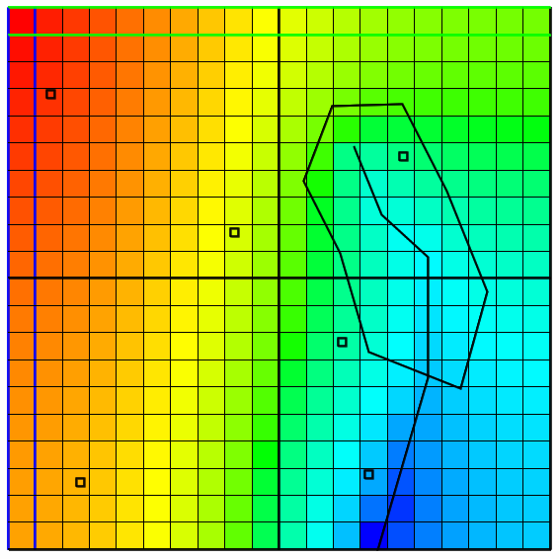
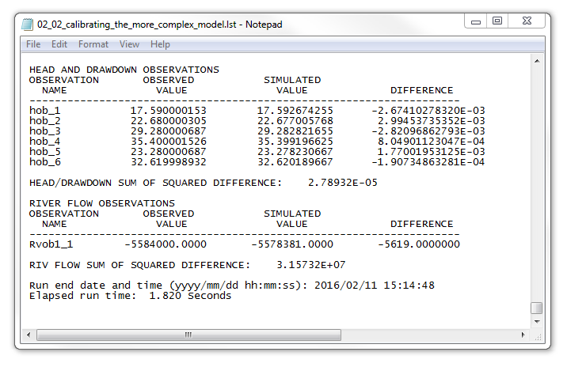
Run model and visualize calibrated results

Slide 29
Education evenings 2016
Practical introduction to groundwater modelling
Computer exercises
02 02 Calibrating the more complex model
Questions? Found an error? Please contact B. Rogiers at brogiers@sckcen.be.

