Slide 1
Education evenings 2016
Practical introduction to groundwater modelling
Computer exercises
03 04 What else?

Slide 2

ModelMuse
Much more functionality to be discovered!
Refer to:
the ModelMuse manual
the ModelMuse videos
the ModelMuse help

Slide 3
ModelMuse and MODFLOW
Many more packages available to use
Compatibility with MODFLOW versions other than the core MODFLOW-2005
MODFLOW-LGR
MODFLOW-NWT
MODFLOW-OWHM
MODFLOW-CFP

Slide 4
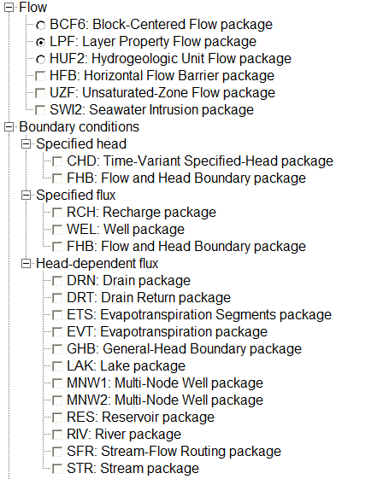
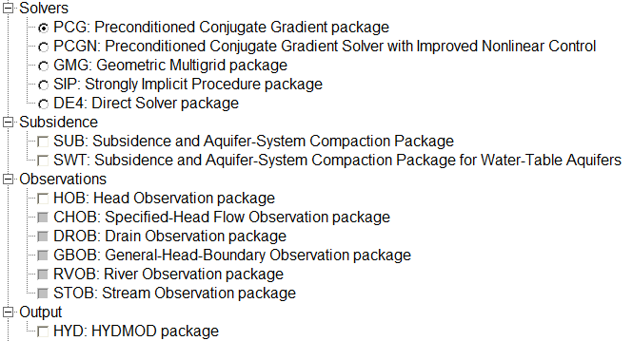
MODFLOW packages
We only used a few…

Slide 5
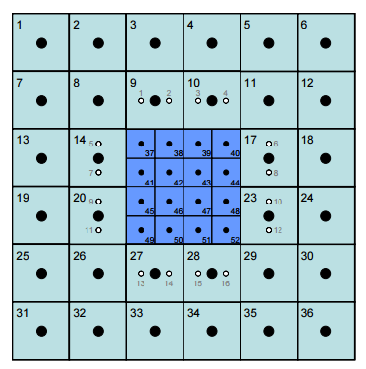
MODFLOW-LGR
MODFLOW-LGR allows smaller parts of a larger model domain to be refined without refining the entire model.

Slide 6
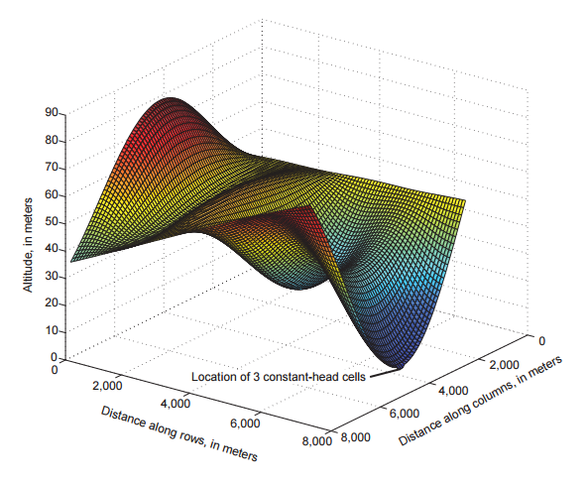
MODFLOW-NWT
MODFLOW-NWT is a Newton-Raphson formulation for MODFLOW-2005 to improve solution of unconfined groundwater-flow problems.
It is intended for solving problems involving drying and rewetting nonlinearities of the unconfined groundwater-flow equation.

Slide 7
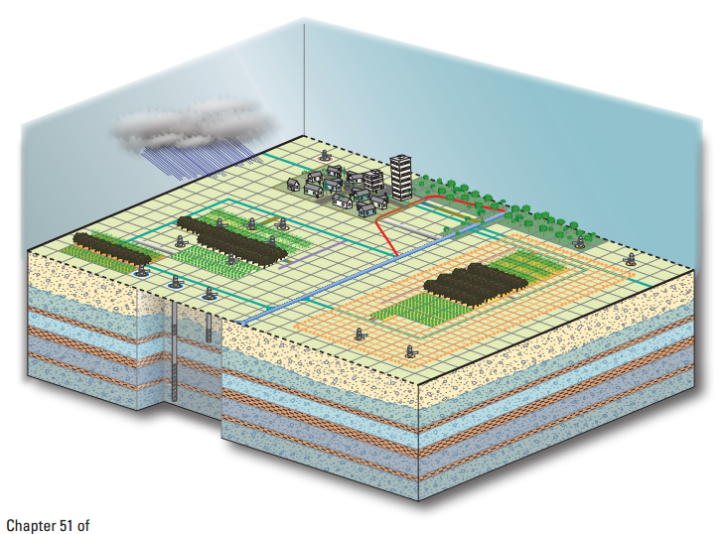
MODFLOW-OWHM
MODFLOW-OWHM, or the One-Water Hydrologic Flow Model, is an integrated hydrologic flow model (IHM).
It is designed for the analysis of a broad range of issues related to the combined use of groundwater and surface water.
It allows the simulation, analysis, and management of human and natural water movement within a physically-based supply-and-demand framework.

Slide 8
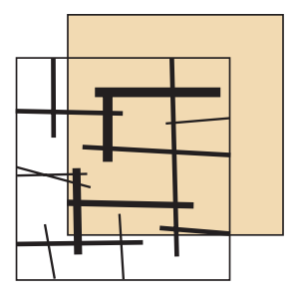
MODFLOW-CFP
MODFLOW-CFP has the ability to simulate turbulent or laminar groundwater flow conditions by:
coupling the traditional groundwater flow equation with formulations for a 1-dimensional discrete network of cylindrical pipes (Mode 1, CFPM1),
inserting a high-conductivity flow layer that can switch between laminar and turbulent flow (Mode 2, CFPM2), or
simultaneously coupling a discrete pipe network while inserting a high-conductivity flow layer that can switch between laminar and turbulent flow (Mode 3, CFPM3).

Slide 9
Beyond the GUI
Several scripting language interfaces to MODFLOW exist, or are in development:
Flopy (python)
Mflab (matlab)
RMODFLOW (R)
These are useful for:
Parameter estimation or uncertainty quantification that goes beyond MODFLOW parameters and/or UCODE algorithms
Geostatistical simulation for e.g. material properties
Quickly converting database information to input files
Reproducible reporting
…

Slide 10
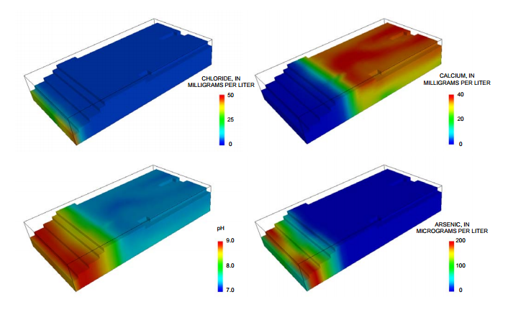
ModelMuse and PHAST
PHAST is a Computer Program for Simulating
Groundwater Flow,
Solute Transport, and
Multicomponent Geochemical Reactions,
for which it uses PHREEQC.

Slide 11
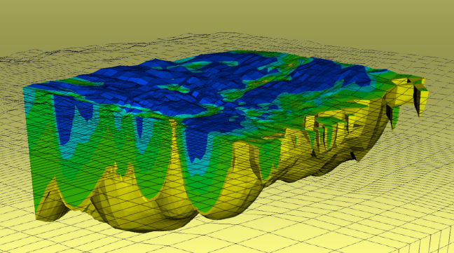
ModelMuse and SUTRA
SUTRA is a model for
saturated-unsaturated,
variable-density ground-water flow,
with solute
or energy transport.

Slide 12
Education evenings 2016
Practical introduction to groundwater modelling
Computer exercises
03 04 What else?
Questions? Found an error? Please contact B. Rogiers at brogiers@sckcen.be.

