Slide 1
Education evenings 2016
Practical introduction to groundwater modelling
Computer exercises
04 03 MODFLOW LGR

Slide 2
Purpose
In this exercise, we will
use the model we designed in the first session,
define a child model to refine the grid locally,
run MODFLOW-LGR,
and visualize the results.

Slide 3
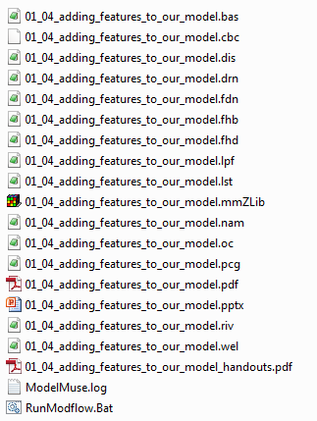

Copy file first session
Copy file “01_04_adding_features_to_our_model.mmZLib” to folder “/04_03_modflow_lgr/”.
Change the file name to “04_03_modflow_lgr.mmZLib”,
and open the file in ModelMuse.

Slide 4
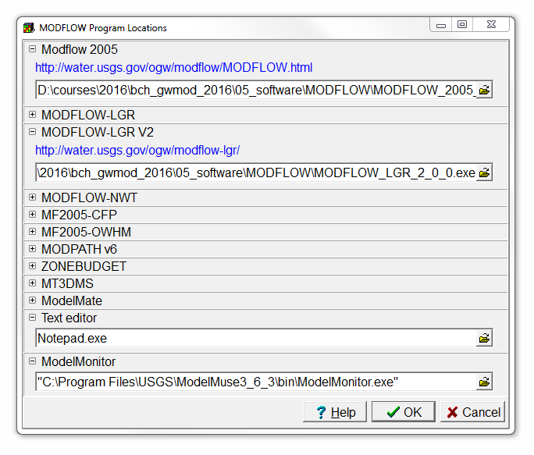
Set MODFLOW-LGR program location
Select Model|MODFLOW Program Locations…,
and set the MODFLOW-LGR V2 path to “/05_software/MODFLOW/MODFLOW_LGR_2_0_0.exe”.
Then click OK.

Slide 5
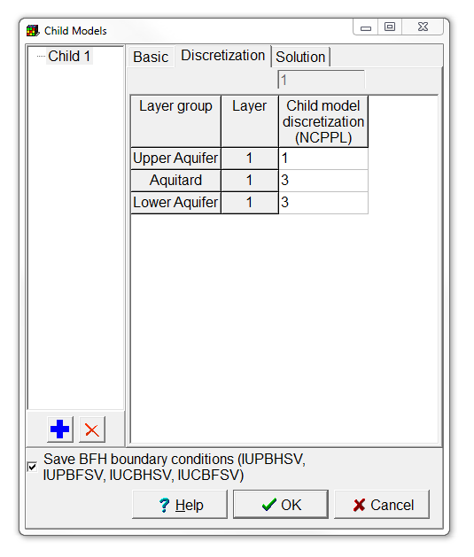
Define child model (1/3)
Select Model|MODFLOW-LGR V2,
and the Child Models dialog box will open.
Add one child model, and switch to the Discretization tab.
Set the Child model discretization for the Aquitard and Lower Aquifer to 3.
Then press OK.

Slide 6
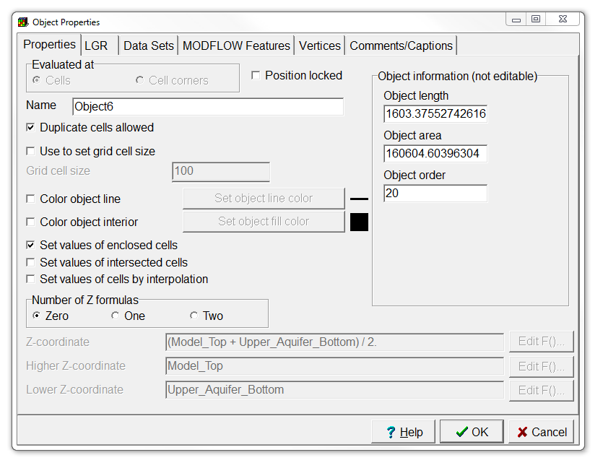
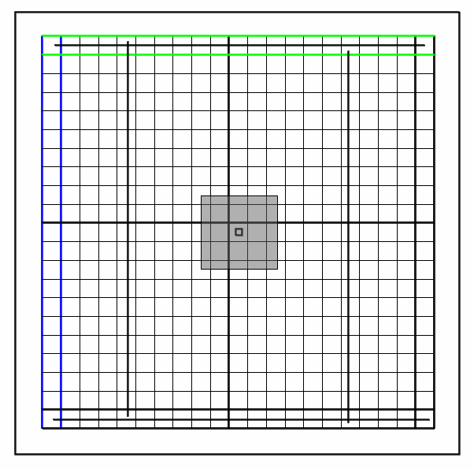
Define child model (2/3)
Now draw a rectangle object surrounding the well in the center of the grid.
In the Object Properties dialog box, set the Number of Z formulas to Zero,
and check the Set values of enclosed cells check box.

Slide 7
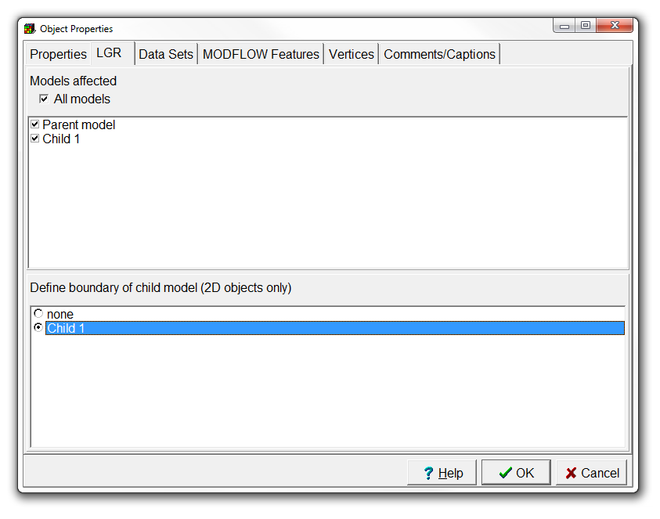
Define child model (3/3)
Switch to the LGR tab,
and select Child 1 for Define boundary of child model.
Press OK,
and hide all objects.

Slide 8
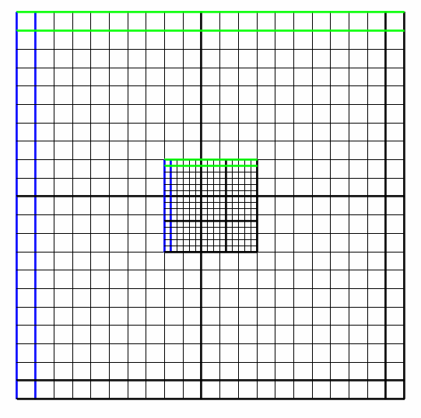
This is what you should get

Slide 9
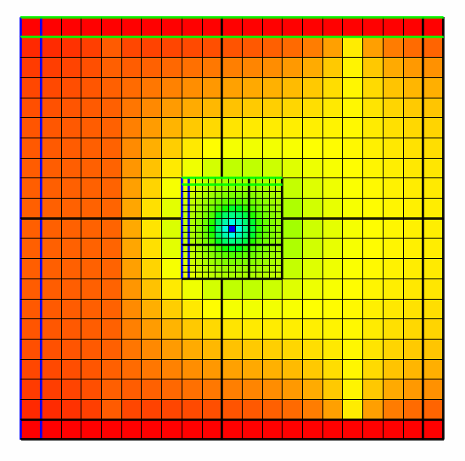
Run model and visualize results
Now save and run the model,
and import the head results of the final time step.
The coloured grid should look like the one on the right.
Change the selected row and column to see the local grid refinement in the front and side view panes.

Slide 10
Education evenings 2016
Practical introduction to groundwater modelling
Computer exercises
04 03 MODFLOW LGR
Questions? Found an error? Please contact B. Rogiers at brogiers@sckcen.be.

