Slide 1
Education evenings 2018
Practical introduction to groundwater modelling
Computer exercises
01 02 Introduction to ModelMuse

Slide 2
Purpose
The following exercise will
get you acquainted with the ModelMuse user interface,
and introduce you to data sets, model features and objects.
We will also have a brief look at
formulas and functions
which can be used to define data sets or model features.

Slide 3
But first …

Slide 4
In ancient Greece and Rome,
the Muses were thought, by some, to provide the inspiration for music, poetry, and the arts. The composers, poets, and other artists, however, still had to do the hard work of tuning that inspiration into an actual work of art. It would be great if ModelMuse could do the same for modelers – provide the key insight required to allow the system to be quickly and effectively modeled. ModelMuse can not do that; it is not smart enough. What it can do is take over some of the mundane parts of the modeling process and make them much easier and faster. By doing so, ModelMuse allows the modeler more time to think, to observe, to analyze, to experiment, and to generate the needed inspiration.
Richard B. Winston, ModelMuse author Winston, R.B., 2009, ModelMuse-A graphical user interface for MODFLOW-2005 and PHAST: U.S. Geological Survey Techniques and Methods 6-A29, 52 p.

Slide 5
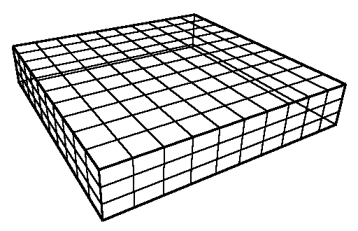
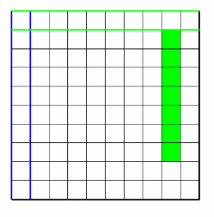
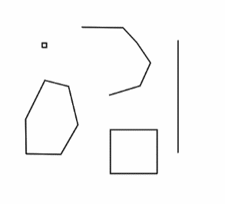
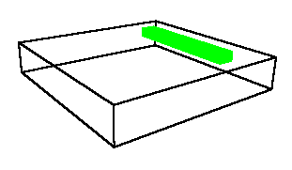
Data sets vs model features vs objects
Provide properties for every cell in the model grid, e.g. Kx, initial head, …
Are set with a default formula
Can be modified locally by objects
Are only defined in certain locations, e.g. river, drain, fixed head, …
Do not have default formulas
Are defined by objects
Can be points, polylines, polygons, straight-lines or rectangles
Can modify data sets locally
Can define model features

Slide 6
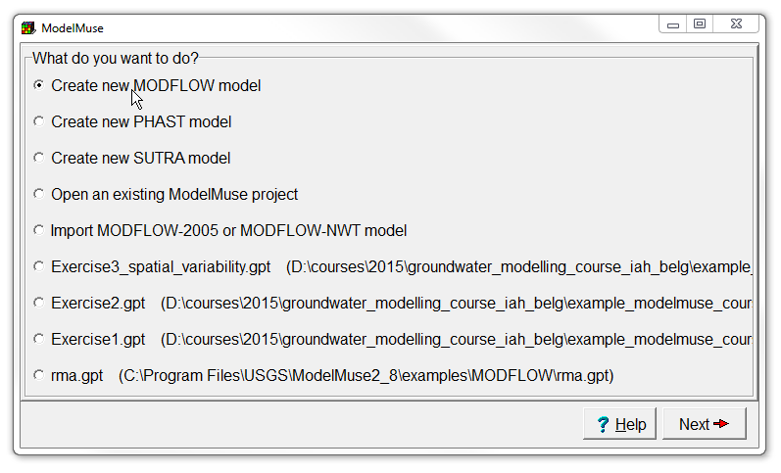
Create new model
Start ModelMuse by double-clicking on its icon.
Choose Create new MODFLOW model and click Next.

Slide 7
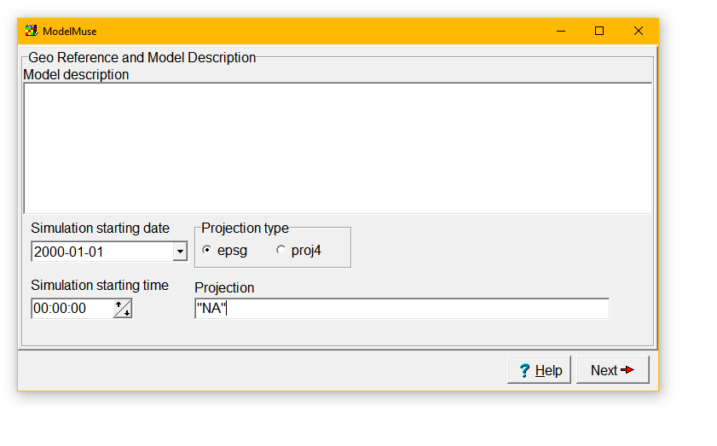
Set the projection
We will not be working with projections in this course, so set Projection to "NA".
Click Next.

Slide 8
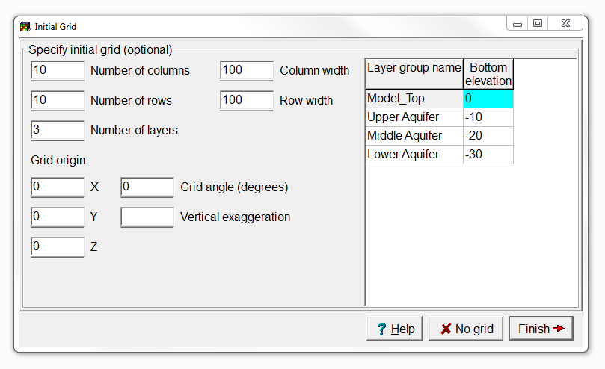
Accept default grid settings
In the Initial Grid window, click Finish.

Slide 9
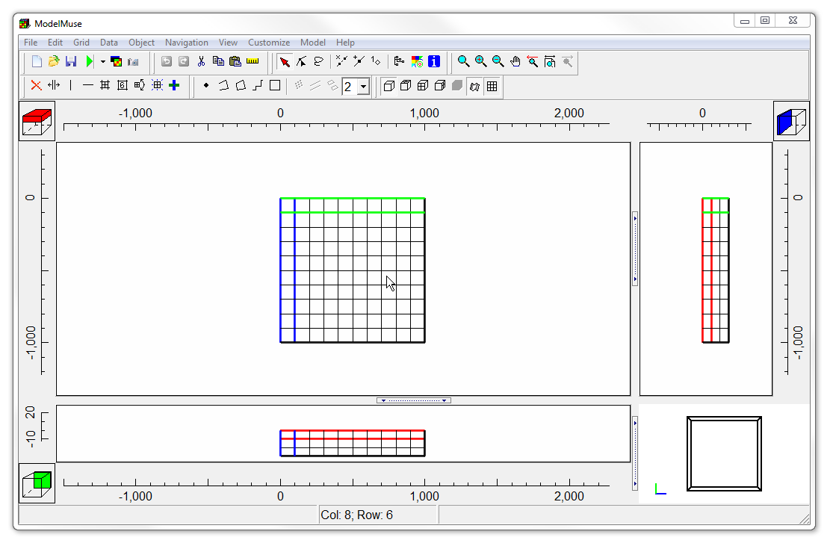
Explore the ModelMuse user interface
Main menu
Selection cubes
Buttons
Side view
Top view
Front view
3D view
Status bar

Slide 10
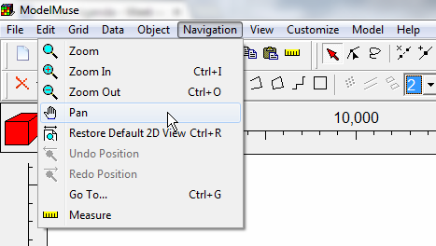
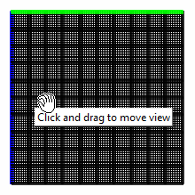
Navigate the grid (1/3)
Select Navigation | Pan and hold the mouse over the grid.
Then drag with the mouse. The grid should move with the mouse.
Note that there is a toolbar button with the same image as the image in the menu. Any menu item with an image has a matching tool bar button.
Move displayed area

Slide 11
Navigate the grid (2/3)
Hold the mouse over the grid and roll the scroll wheel on the mouse, the model should zoom in and out.
Click the Undo change in View button repeatedly until you get back to the original view or just click the Restore default 2D view button.
Click and drag to zoom in
Zoom in
Zoom out
Undo change in View
Redo change in View
Restore default 2D view

Slide 12



Navigate the grid (3/3)
Click or scroll the mouse wheel on the selection cubes to change the shown layer, column, or row.
Alternatively, select two of the three at once, using the Select column, row, or layer button.
Select column, row, or layer

Slide 13
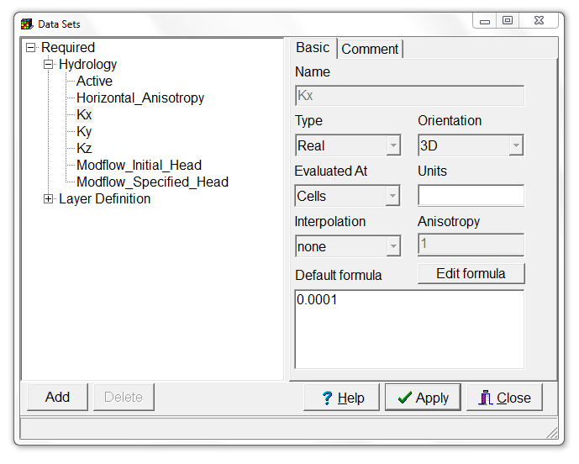
Check data set default formulas
Select Data | Edit Data Sets…,
expand Required | Hydrology, and
check the default values of Active, Horizontal_Anisotropy, Kx, Ky, Kz, Modflow_Initial_Head, and Modflow_Specified_Head.
Click Close to close the Data Sets dialog box.

Slide 14
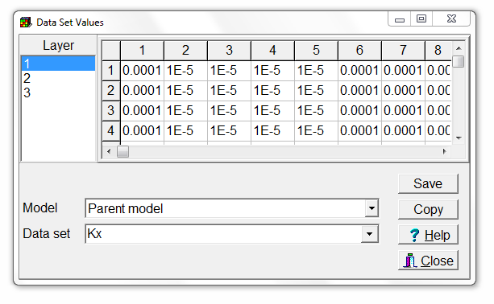
Display data set values
Select Data | Display Data Set Values.
Select Data Sets | Required | Hydrology | Kx,
and check if the values correspond to the default Kx formula.
Press Close to close the Data Set Values dialog box.

Slide 15
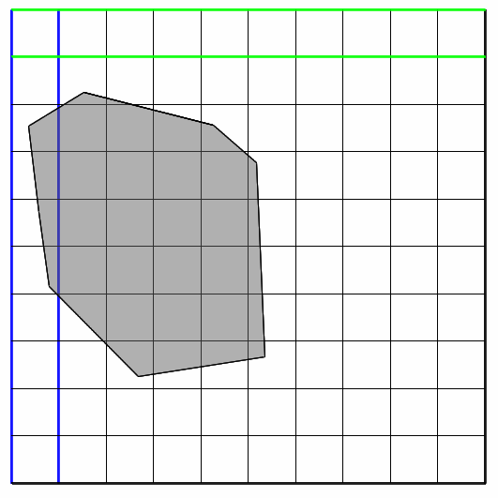
Create object to modify data set
Change the selected layer to layer 1 if layer 1 is not already the selected layer.
Select Object | Create | Polygon, or use the corresponding button.
Click on the top view of the model to start drawing a polygon. Have the polygon surround part of the grid.
When you are finished, double-click and the Object Properties dialog box will appear.
Create polygon object

Slide 16
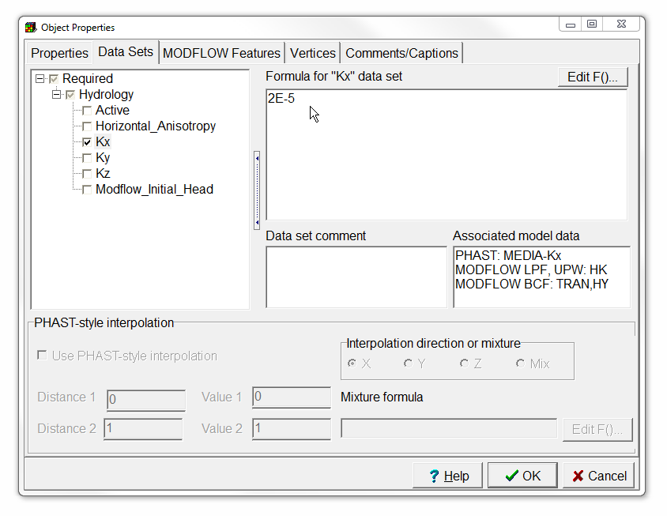
Set object Kx formula
Switch to the Data Sets tab.
Expand Required | Hydrology and check the check box for the Kx data set.
Change the formula for Kx to 2E-5 and then click OK to close the dialog box.

Slide 17
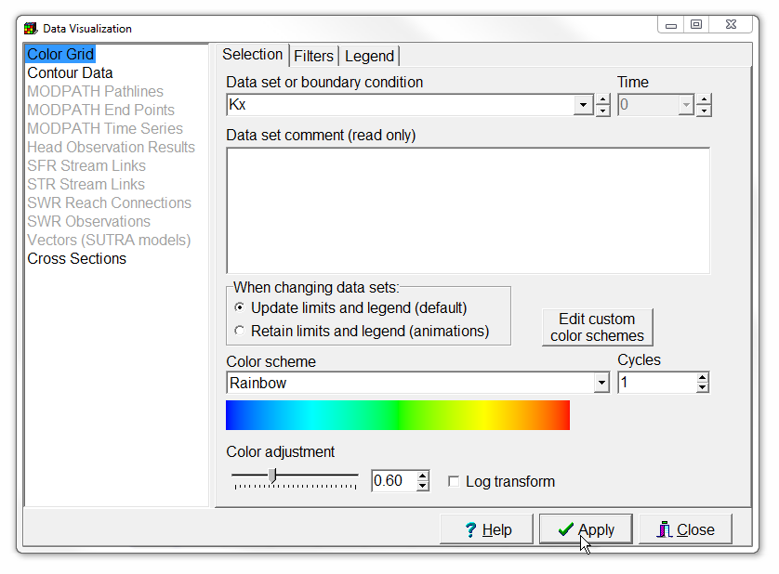
Color grid
Select Data | Data Visualization… or use the corresponding button,
select the Kx data set and
click Apply.
Select Data | Show Grid Or Mesh Values and move the cursor over the grid to see what the different colors represent.
Data visualization

Slide 18
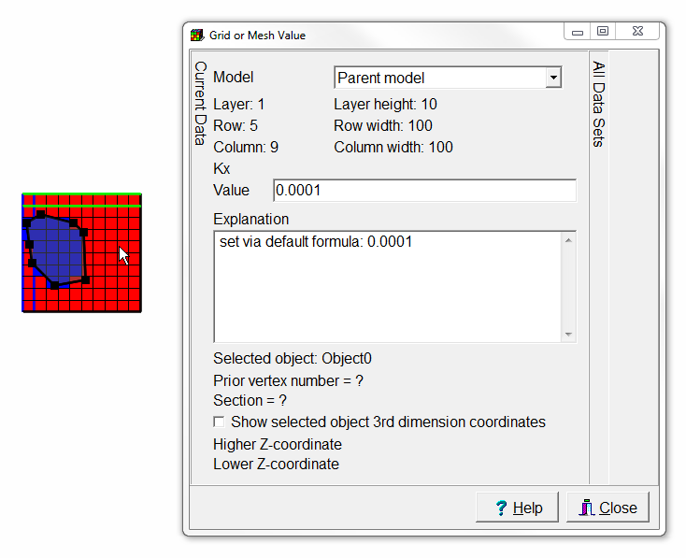
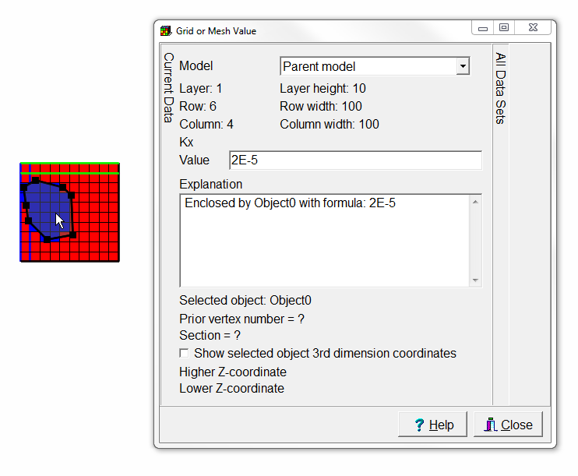
This is what you should get

Slide 19
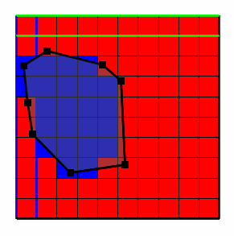
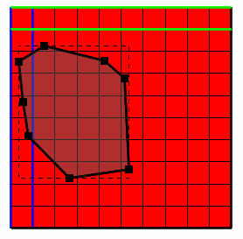

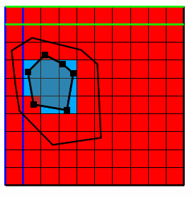
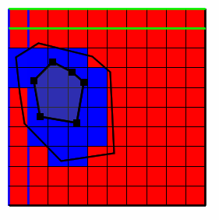
Create object in layer 2
Locate the cube with the red square that indicates the selected layer. Click on the cube below the red square to change the selected layer to layer 2. Did the object you drew before affect Kx on layer 2?
Draw another polygon and use this one to set Kx inside the polygon to 3E-5. Did this polygon affect the values of Kx in layer 2? Did it affect the values of Kx on layer 1?

Slide 20
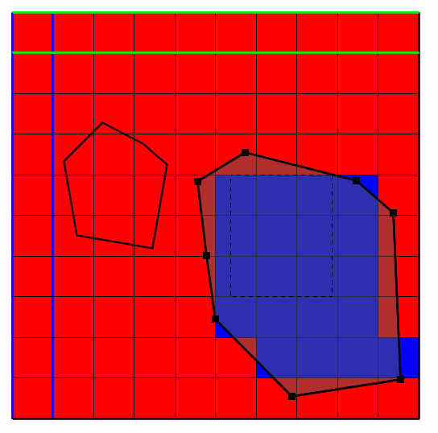
Move objects
Select Object | Select Objects or use the corresponding button,
and click on one of the objects that sets the value of Kx to select that object.
Click on the object again but hold the mouse down and drag the object to a new position. How did moving the object affect Kx?
Select objects

Slide 21
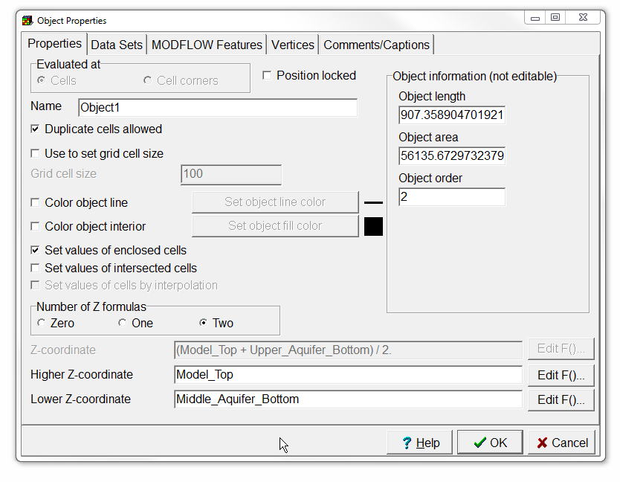
Change Z-coordinates
Double click on the second object to open the Object Properties dialog box.
Change the formulas for the Higher Z-coordinate and Lower Z-coordinate so that they are “Model_Top” and “Middle_Aquifer_Bottom” respectively.
Click OK to close the dialog box. How does this change affect Kx?

Slide 22
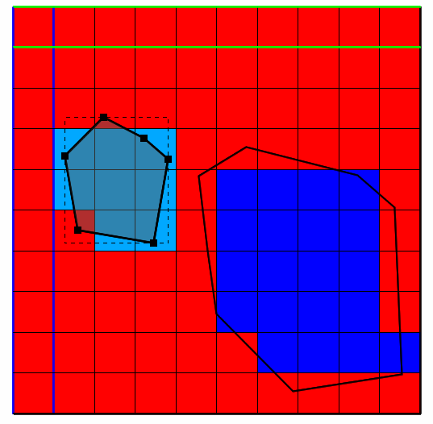
This is what you should get

Slide 23
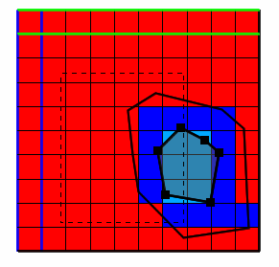
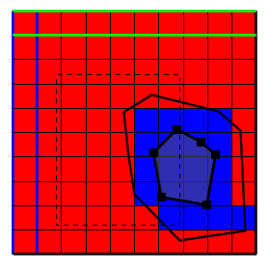
Change object order (1/2)
Drag one of the objects so that it overlaps with the other object. What is the value of Kx in the area of overlap?
Select the second of the two objects. Then right-click and select To Back. How does this affect the value of Kx in the area of overlap between the two objects?

Slide 24
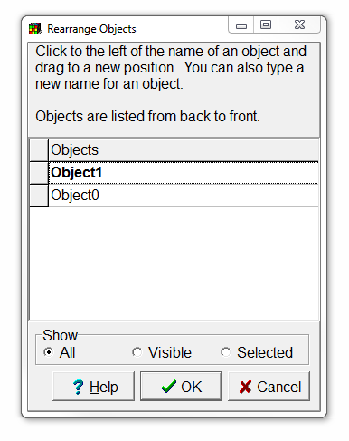
Change object order (2/2)
Note that object order can also be modified by selecting Object | Edit | Rearrange Objects…

Slide 25
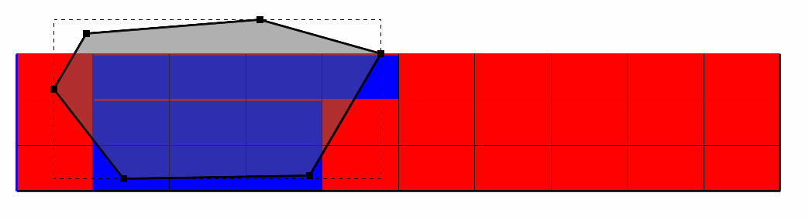
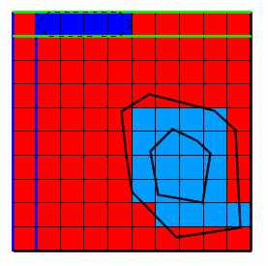
Add a front view object (1/2)
Try drawing a polygon on the front view of the model.
Use this object to set Kx to 1E-5.

Slide 26
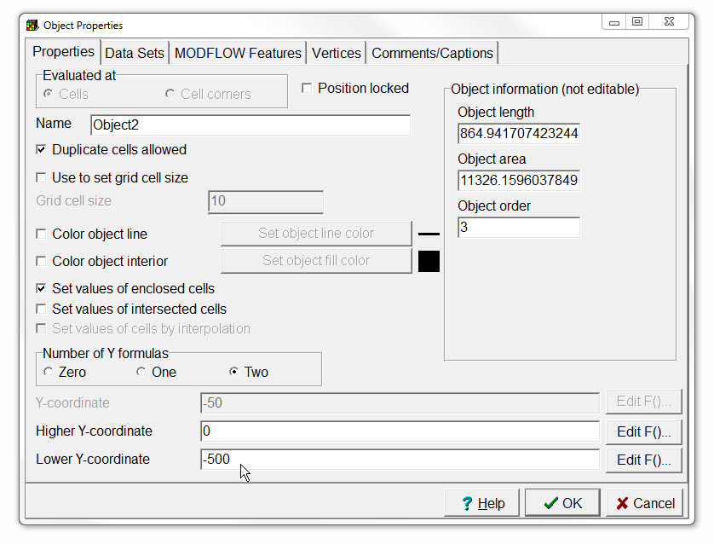
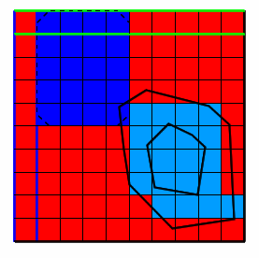
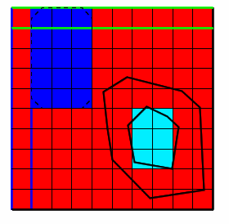
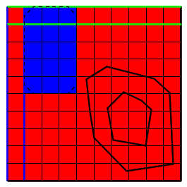

Add a front view object (2/2)
Modify the Lower Y-coordinate to -500 in the Object Properties dialog box.
Then press OK. Are the effects visible in all layers?

Slide 27
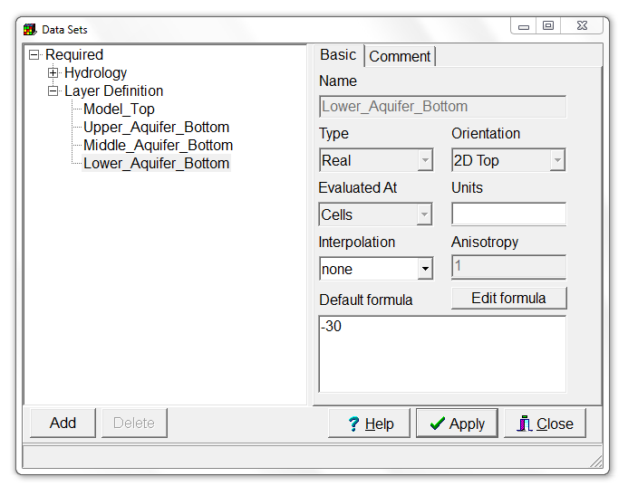
Use formula to change data set (1/2)
Select Data | Edit Data Sets…,
and expand Required | Layer Definition.
Select the Lower_Aquifer_Bottom.
The default formula is -30. Click the Edit formula button to open the Formula Editor.

Slide 28
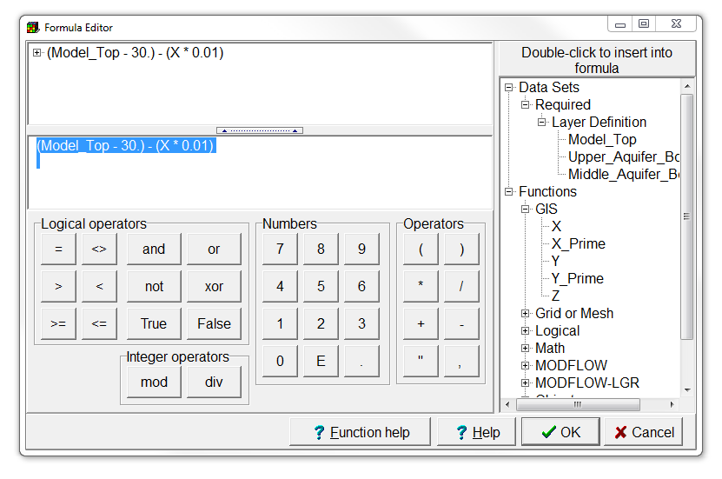
Use formula to change data set (2/2)
On the right, expand Data Sets | Required | Layer Definition, and
Functions | GIS, and
double-click on the Model_Top data set and X function to insert these into the formula.
In the edit window in the middle of the left side of the dialog box, change the formula to “(Model_Top - 30) - (X*0.01)”.

Slide 29
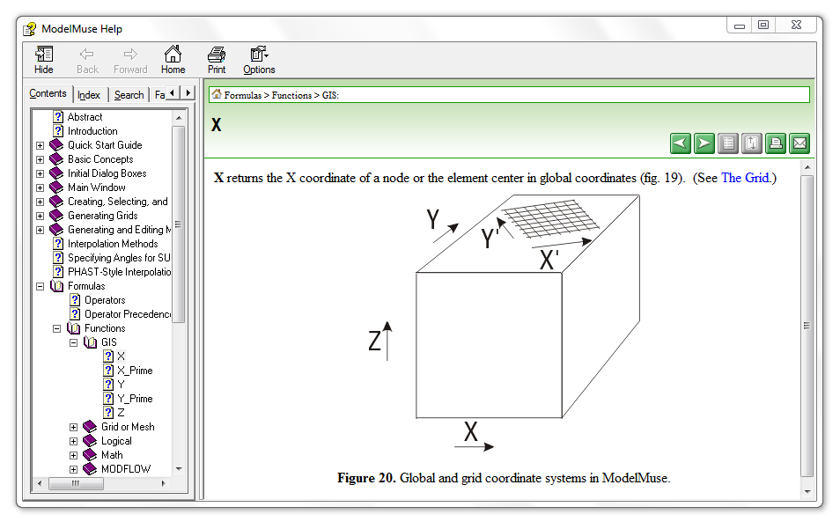
Check function help
Before closing the Formula Editor, select function X again.
Then click on the ? Function Help button. This will display the help for the selected function.
If the online help does not work, enable local help with Help | Use Local Help

Slide 30
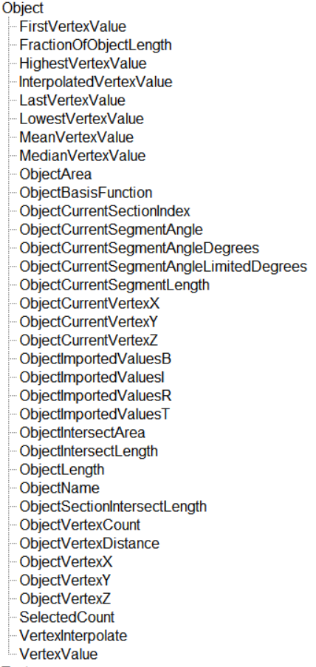
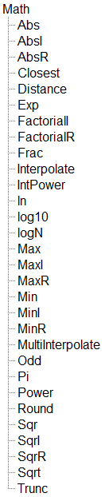

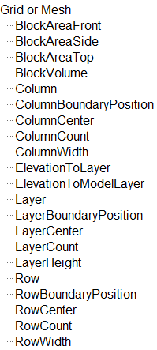
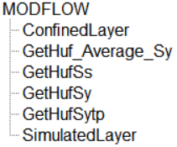
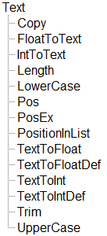
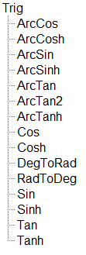

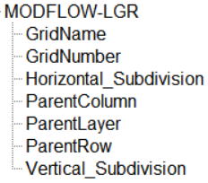
All available Functions

Slide 31
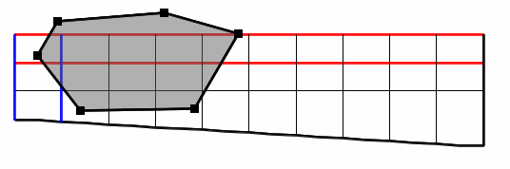
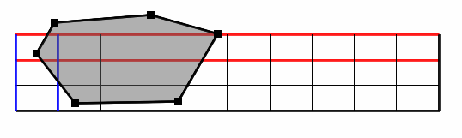
Check lower layer elevation
Press OK and Apply to modify the Aquifer_Bottom formula.
ModelMuse has undo and redo buttons. After closing the Formula Editor and the Data sets dialog box, try clicking them and check the elevation of the lower layer in the front view pane to see if it changed.
Undo
Redo

Slide 32
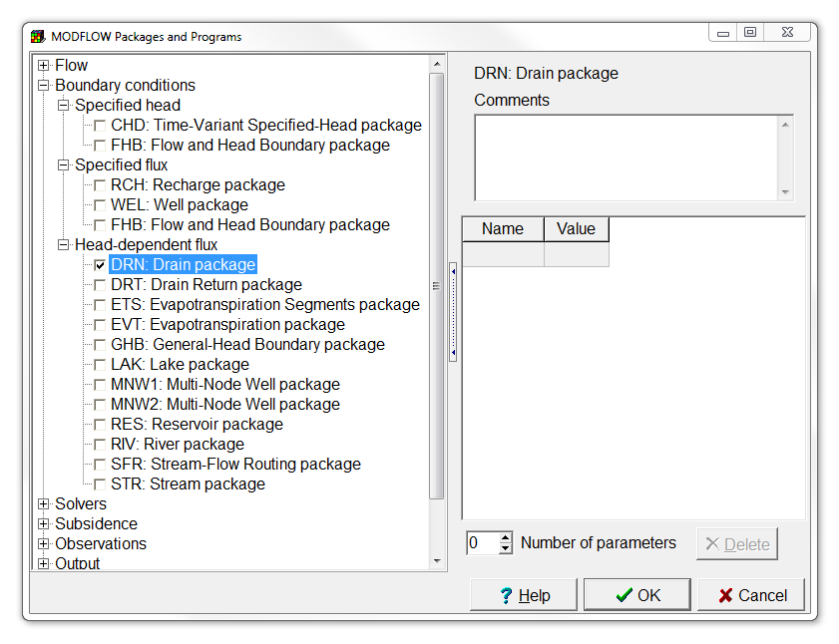
Create object to add model feature (1/2)
Model features can only be added after activating additional packages.
Select Model | MODFLOW Packages and Programs…, and
have a look at some of the possibilities by expanding Boundary conditions.
Check the Drain package check box, and press OK.

Slide 33
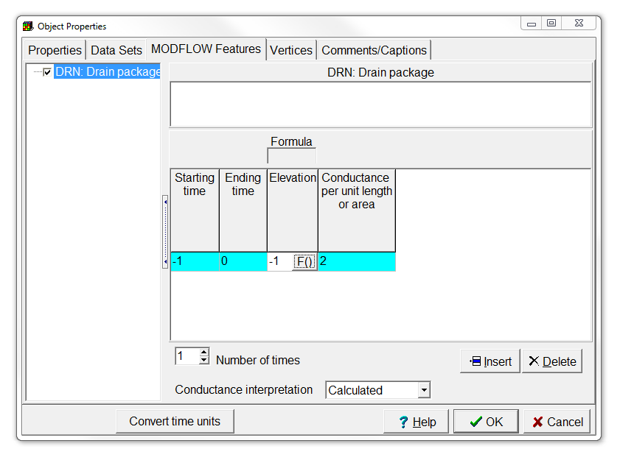
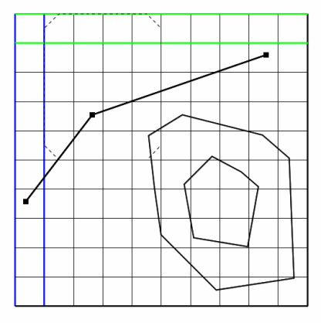
Create object to add model feature (2/2)
Now draw another object on the grid.
In the Object Properties dialog box, go to the MODFLOW Features tab, and select the package you just activated.
Fill in the required feature properties, and press OK to add the model feature.

Slide 34

Find more information in
the ModelMuse manual
the ModelMuse videos
the ModelMuse help

Slide 35
Education evenings 2018
Practical introduction to groundwater modelling
Computer exercises
01 02 Introduction to ModelMuse
Questions? Found an error? Please contact B. Rogiers at brogiers@sckcen.be.

