Slide 1
Education evenings 2018
Practical introduction to groundwater modelling
Computer exercises
01 03 Our first MODFLOW model

Slide 2
Purpose
In this exercise, we will use ModelMuse to set up, run, and visualize the results of a very simple MODFLOW model.
We will also introduce visualizing model output with GW_Chart and Model Viewer.

Slide 3
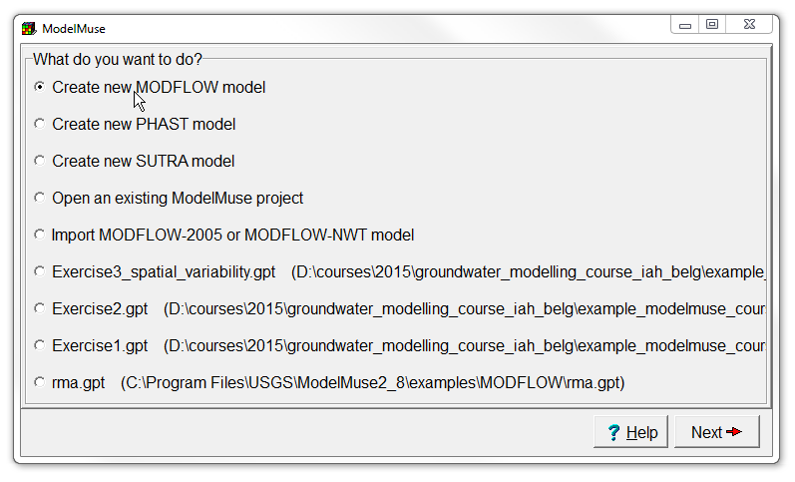
Create new model
Start ModelMuse by double-clicking on its icon.
Choose Create new MODFLOW model and click Next.

Slide 4
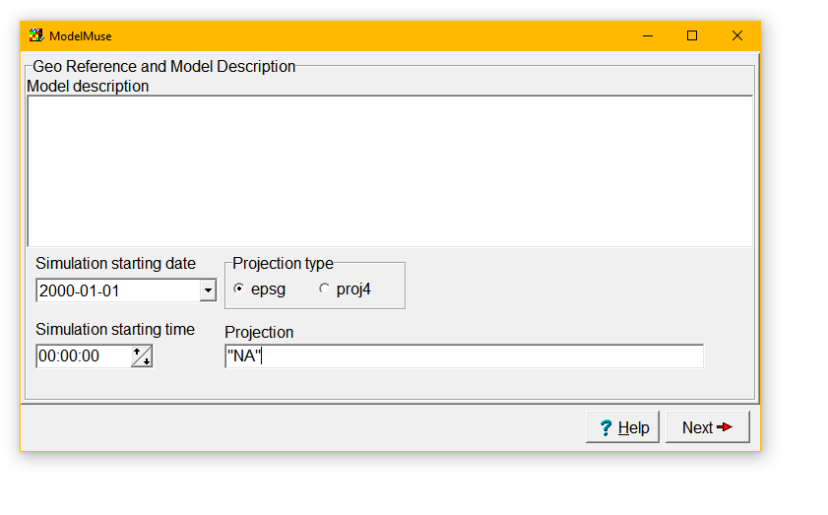
Set the projection
We will not be working with projections in this course, so set Projection to "NA".
Click Next.

Slide 5
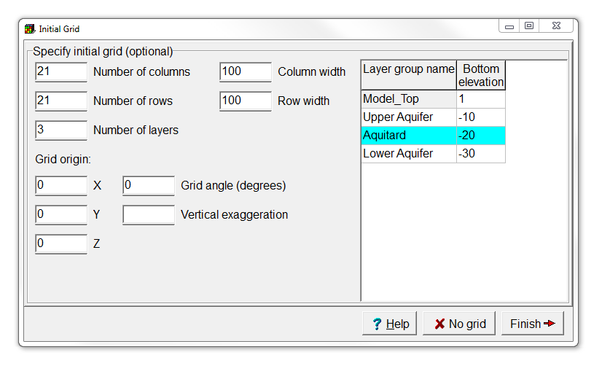
Initialize model grid
Change the number of columns and rows each to 21.
Set the Model_Top to 1,
change the middle layer name to “Aquitard”, and
then click Finish.

Slide 6
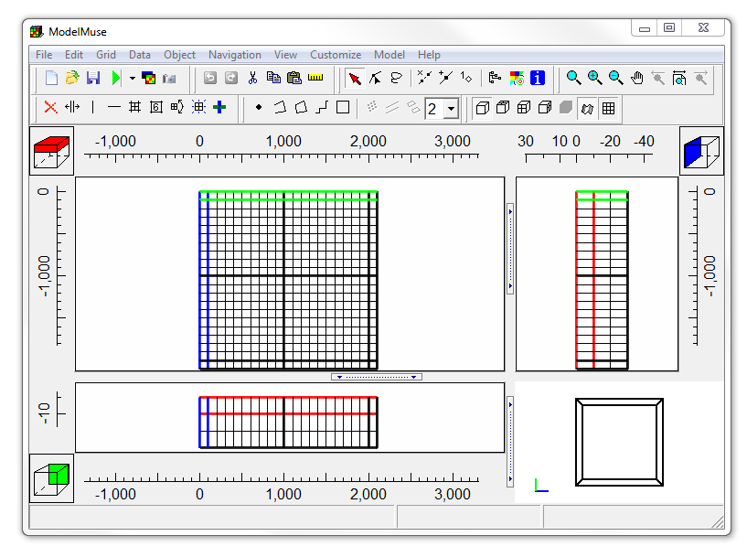
This is what you should get

Slide 7
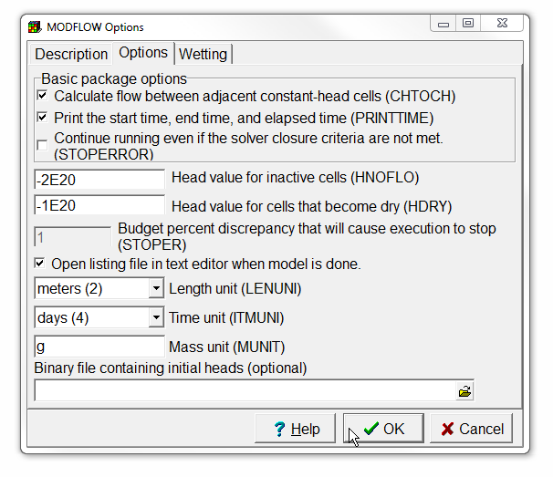
Change model units
Select Model | MODFLOW Options…,
switch to the Options tab,
change the time unit to “days”,
and click OK.

Slide 8
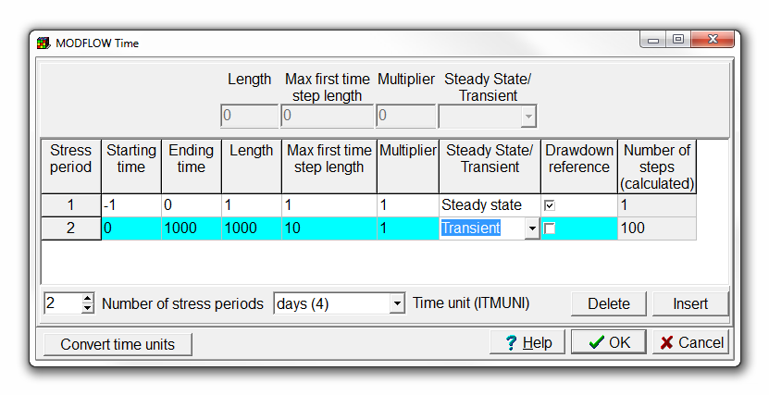
Specify time discretization
Select Model | MODFLOW Time…
Increase the number of stress periods to two,
change Starting time to 0,
Ending time to 1000,
the length of the first time step to 10 and
choose a transient stress period.
Then click OK.

Slide 9
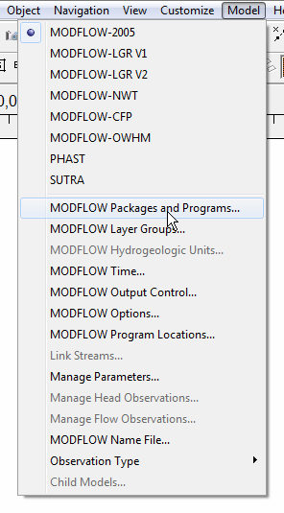
Add well to model (1/4)
The MODFLOW Packages and Programs dialog box is where you activate any of the optional packages in MODFLOW that you want to use. Select Model | MODFLOW Packages and Programs…

Slide 10
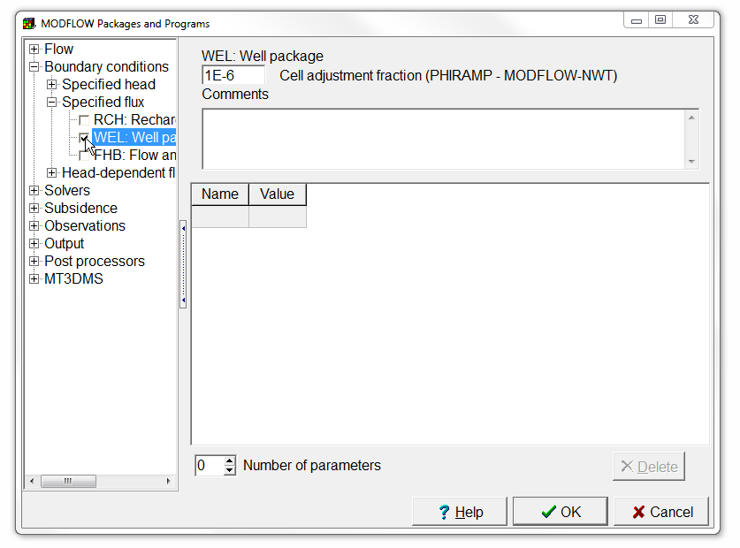
Add well to model (2/4)
The packages are listed in a tree control on the left. To activate a package check the checkbox or radio-button next to its name. Then set any other options for the package in the part of the dialog box to the right of the tree control. Check the check box for the Well package. Then click OK.

Slide 11
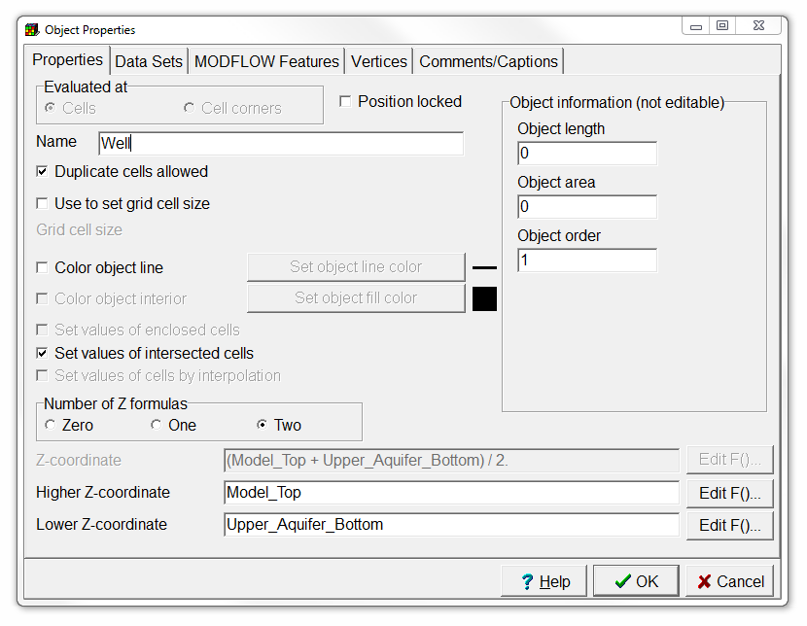
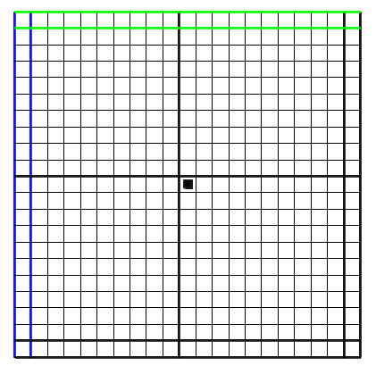
Add well to model (3/4)
Objects are used to specify the locations of things like wells, rivers, and drains. They are also used to set up spatially varying properties of data sets. In this case, we will use an object to define a well. Select Object | Create | Point and then click in the center of the grid (row 11, column 11).
The Object Properties dialog box will appear. Change the object name into “Well”.
Create point object

Slide 12
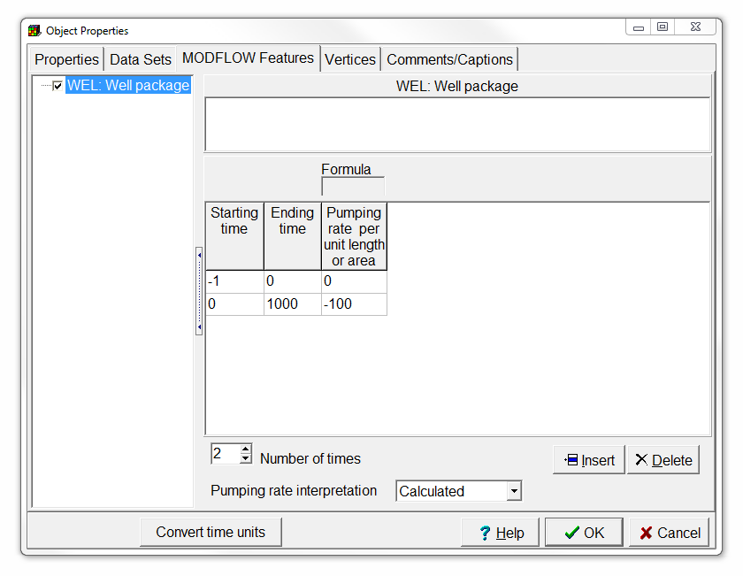
Add well to model (4/4)
Switch to the MODFLOW Features tab.
Check the Well package check box.
Increase the Number of times to 2,
Enter a starting time of -1,
an ending time of 0,
and a pumping rate of 0 for the steady state stress period, and
0, 1000 and -100 for the transient one.
Then click OK.

Slide 13
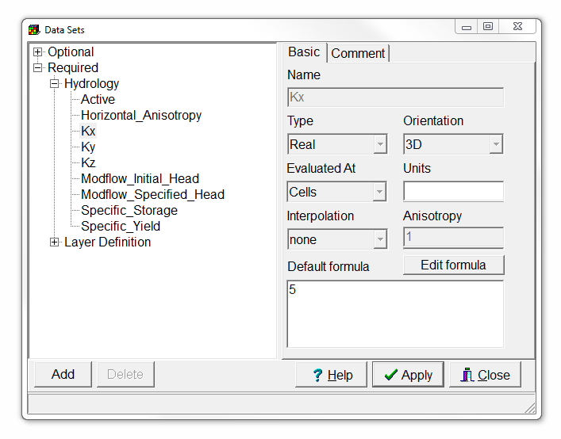
Set default Kx
The aquifer properties, layer elevations and other similar data are specified by data sets. Select Data | Edit Data Sets...
Then select the Kx data set under Required | Hydrology and change its default formula to 5.
Press Apply.

Slide 14
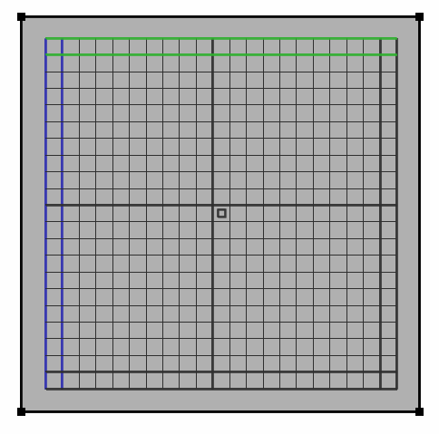
Modify Kx Aquitard (1/3)
Select Object | Create | Rectangle or use the corresponding button, and
draw a rectangle in the top view, surrounding the entire grid.
Create rectangle object

Slide 15
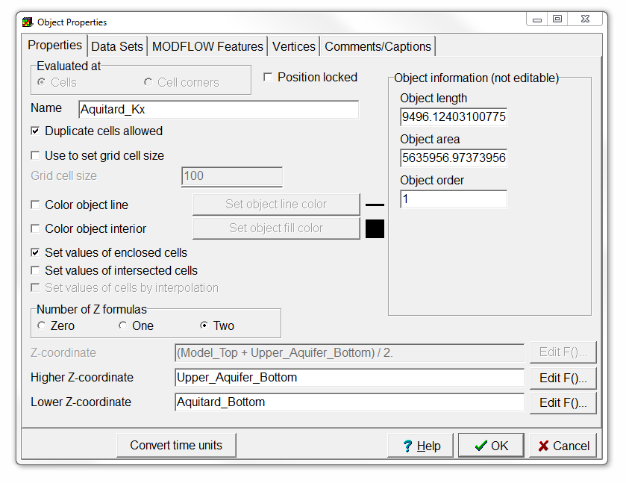
Modify Kx Aquitard (2/3)
In the Object Properties dialog box, change the Higher Z-coordinate to “Upper_Aquifer_Bottom”, and
the Lower Z-coordinate to “Aquitard_Bottom”

Slide 16
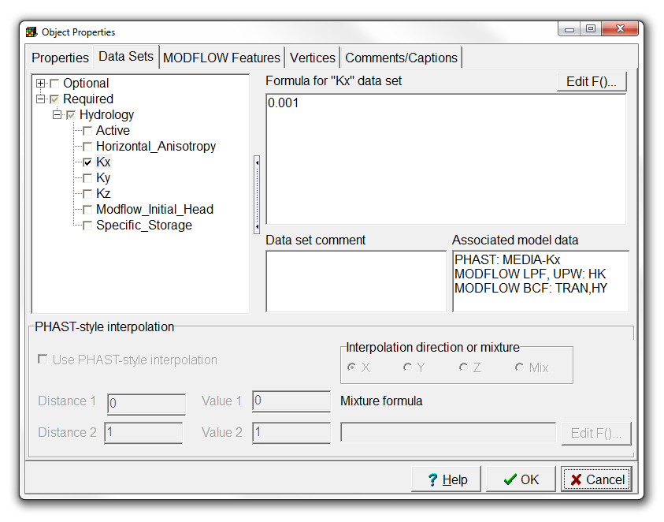
Modify Kx Aquitard (3/3)
Switch to the Data Sets tab, and
change the formula for the Kx data set to 0.001.
Then press OK.

Slide 17
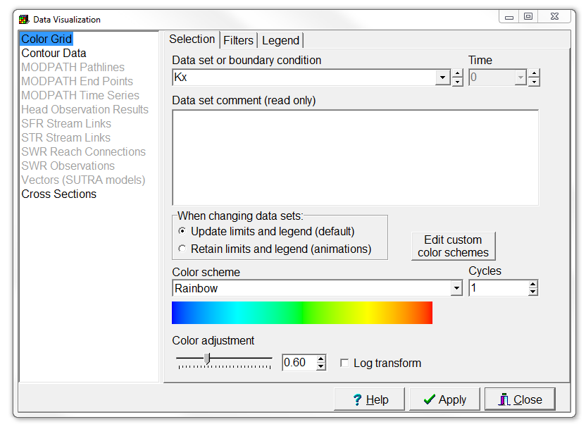
Visualize Kx data set
Choose Data | Data visualization.
Select Color Grid, and the Kx data set and
press Apply.

Slide 18
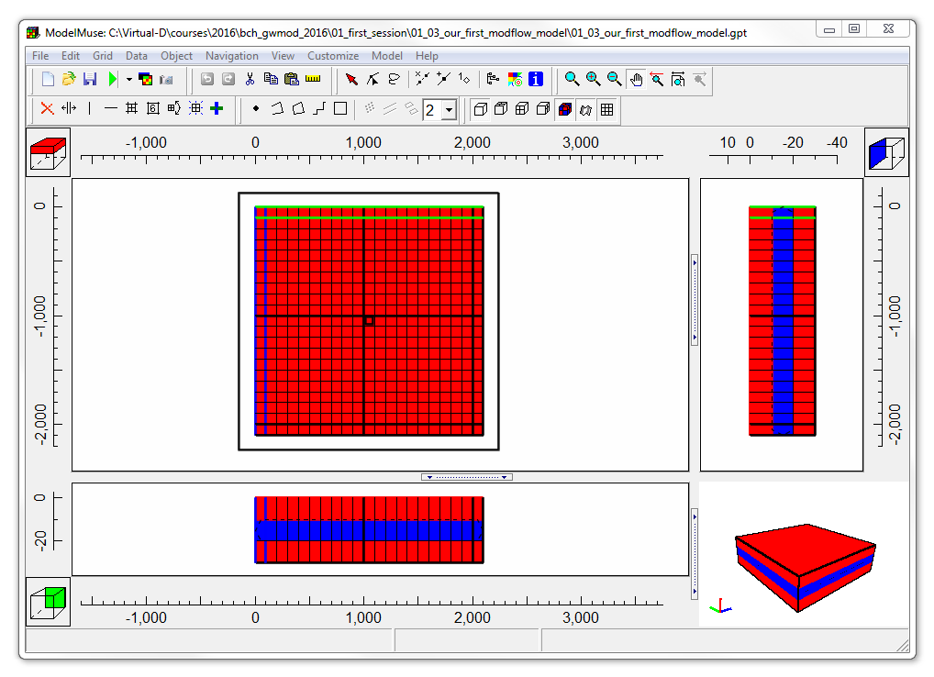
This is what you should get

Slide 19
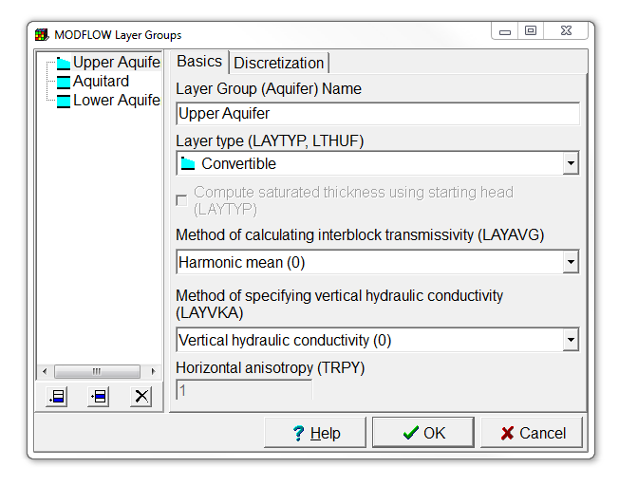
Change layer type
Select Model | MODFLOW Layer Groups…
Change the Upper Aquifer layer type to Convertible,
and then click OK.

Slide 20
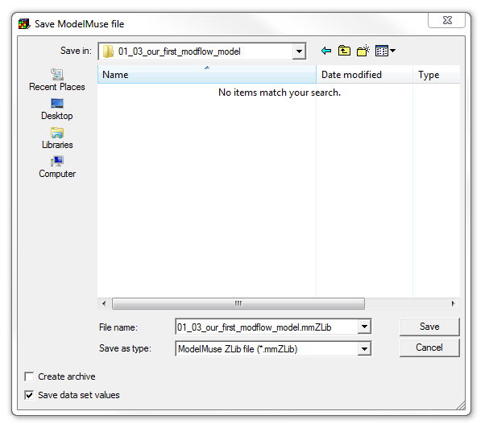
Save model
Select File | Save, and
select the folder ““/01-03_our-first-modflow-model/” and file name “01-03_our-first-modflow-model.mmZLib”.
Deselect the Create archive checkbox, and
Save the file.

Slide 21
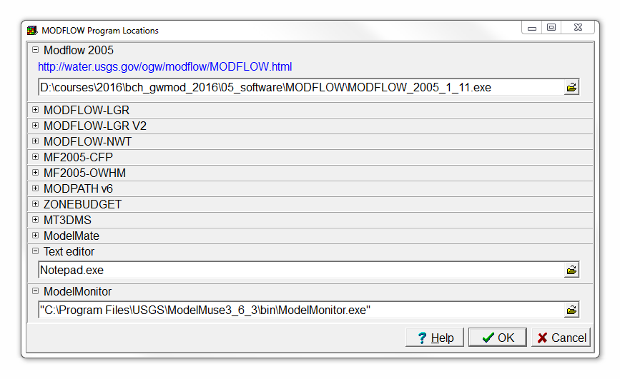
Set MODFLOW executable location
Choose Model | MODFLOW Program locations,
fill in the MODFLOW executable location “…/bch_gwmod-2018/05_software/modflow/modflow-2005-1.12.exe”, and
click OK.

Slide 22
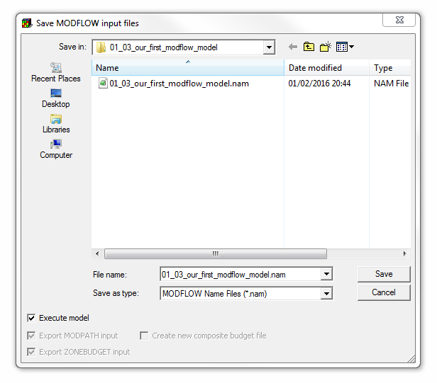
Run model (1/3)
Select File | Export | MODFLOW-2005 Input Files,
select a file name like “/01-03_our-first-modflow-model/ 01-03_our-first-modflow-model.nam”, and
click Save. ModelMuse will create the MODFLOW input files and start running MODFLOW.

Slide 23
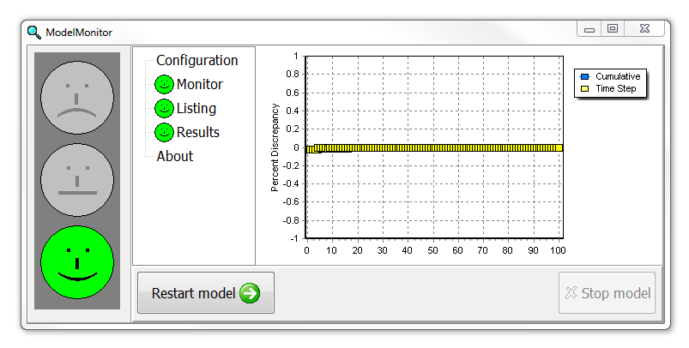
Run model (2/3)
ModelMonitor will graph the percent discrepancy in the budget. If the percent discrepancy is larger than 1%, there is probably a problem with the model. However, smaller percent discrepancies do not guarantee that the model is OK.
Close ModelMonitor when the model is done running.

Slide 24
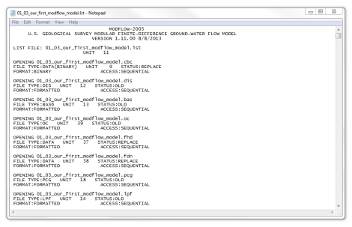
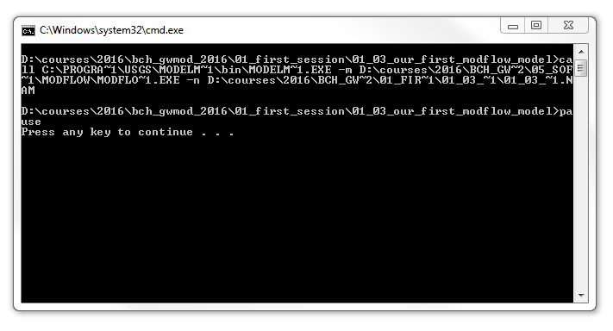
Run model (3/3)
The listing file will be opened in Notepad when you close ModelMonitor. You can close the listing file.
There will also be a command line window that you can close.

Slide 25
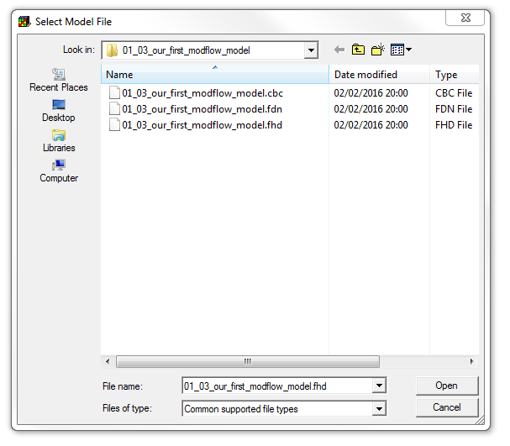
Import model results (1/2)
Select File | Import | Model Results… The Select Model File dialog box should appear.
The file containing the heads should already be selected by default so just click Open.

Slide 26
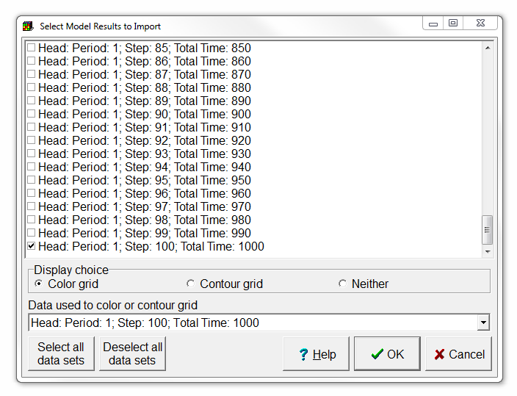
Import model results (2/2)
In the Select Model Results to Import dialog box, the data for the last time step should already be selected, so just click OK.
You can ignore the warning of Missing Geo Reference data, and Close the Errors and Warnings dialog box.

Slide 27
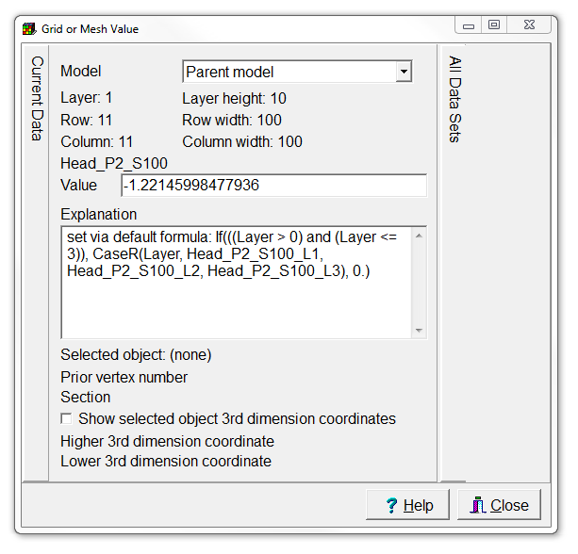
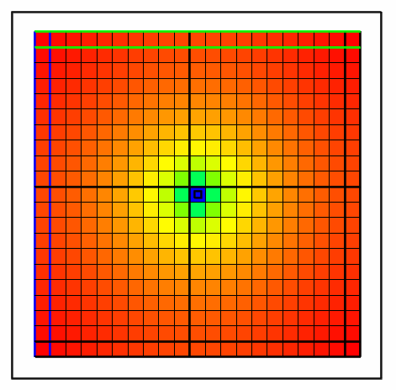
Check model results
Select Data | Show Grid Values. Move the cursor over the model grid and observe the value displayed in the dialog box. This is one way to see what the data value is at a particular location.

Slide 28
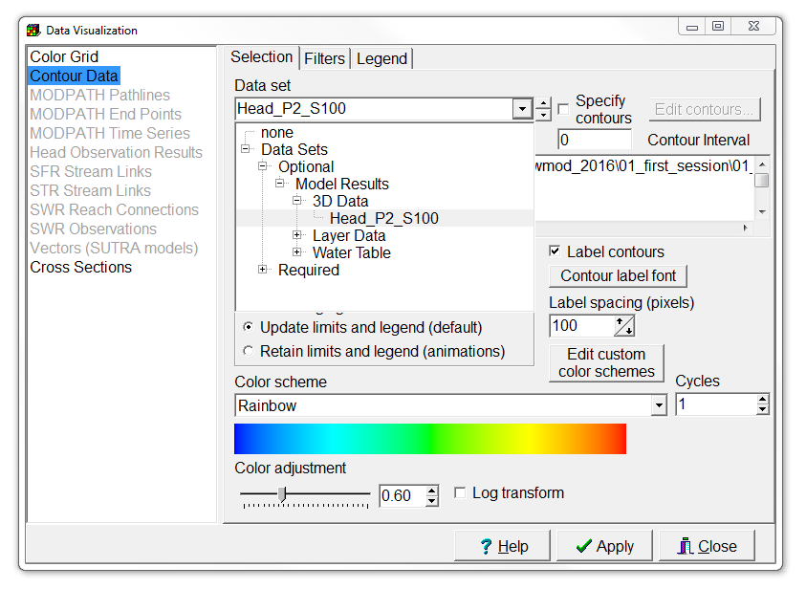
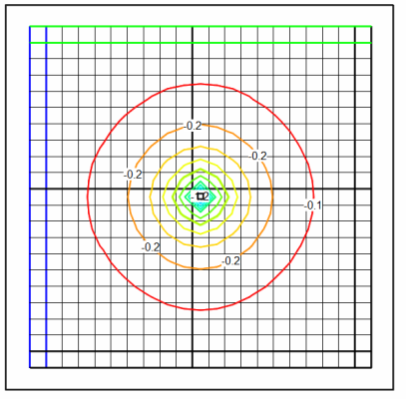
Change visualization type
Select Data | Data Visualization...
Set Color Grid to none, and
Contour Data to Data Sets | Optional | Model Results | 3D Data | Head_P2_S100.
Then click Apply.

Slide 29
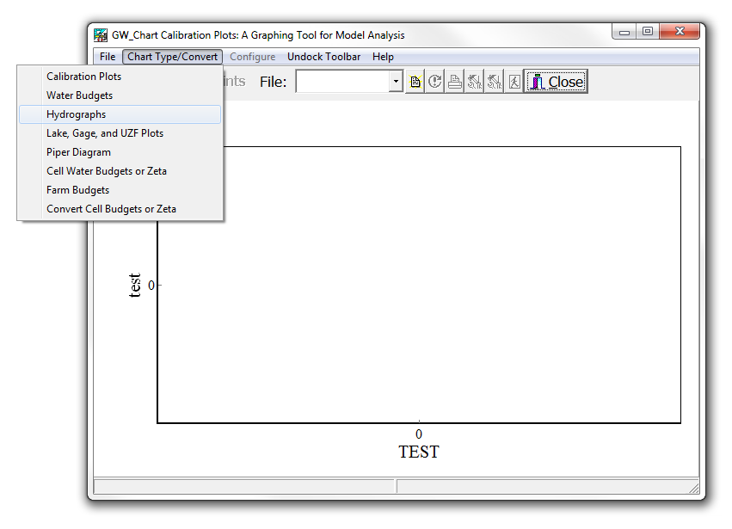
Plot hydrograph (1/2)
Start GW_Chart and select Chart Type/Convert | Hydrographs.

Slide 30
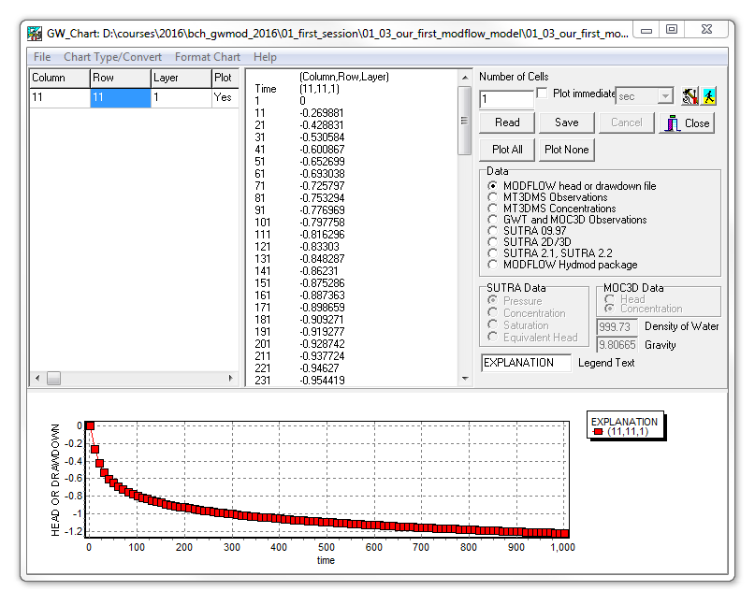
Plot hydrograph (2/2)
Change the column and row to 11.
Then click the Read button, and choose the file with heads for this exercise. GW_Chart will plot the change in head vs time.

Slide 31
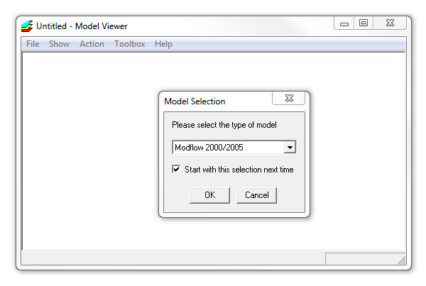
Animate in 3D (1/5)
Start Model Viewer. Select File | New and set the model type to a MODFLOW 2000/2005 model.
Then press OK.

Slide 32
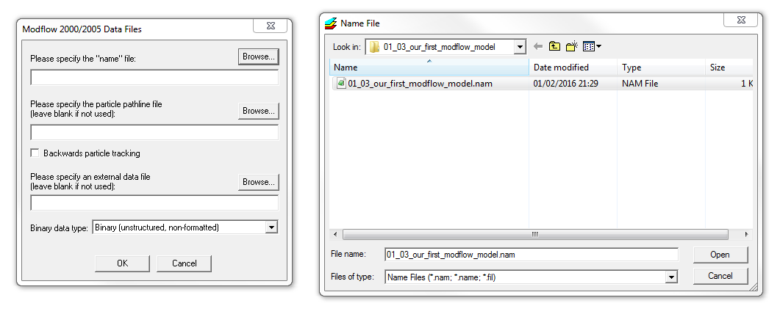
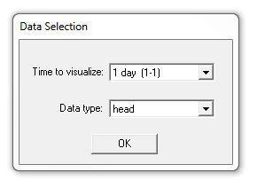
Animate in 3D (2/5)
Select Browse…,
choose the name file from the model and click Open and OK.
Accept the defaults for the data selection, and click OK.

Slide 33
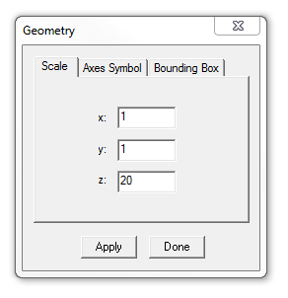
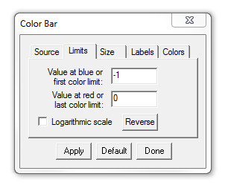
Animate in 3D (3/5)
Select Show | Solid.
Select Toolbox | Geometry, set the scale for z to 20, and click Apply.
Select Toolbox | Color Bar, set the limits to -1 and 0, and click Apply.

Slide 34
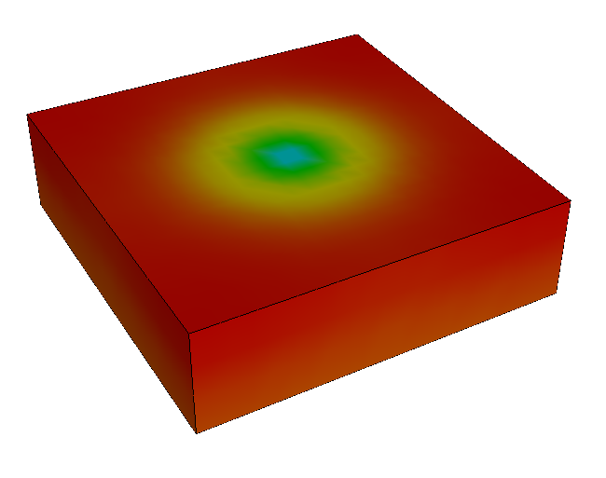
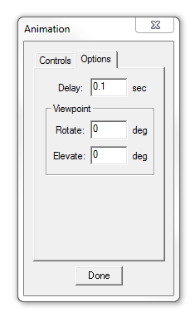
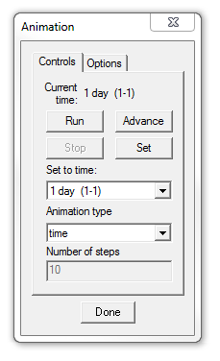
Animate in 3D (4/5)
Then select Toolbox | Animation.
Under the Options tab, set Delay to 0.1, and
and click Run in the Controls tab.
Try dragging with the mouse to rotate the view of the model.

Slide 35
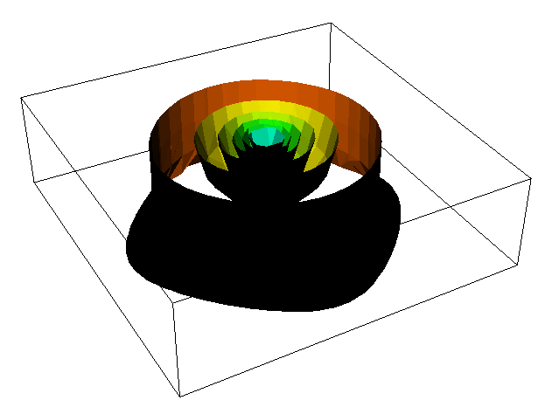
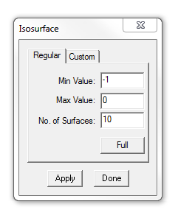
Animate in 3D (5/5)
Select Show | Isosurfaces.
Select Toolbox | Isosurface,
and set the limits again to -1 and 0.
Also change the number of surfaces to 10,
and press Apply.
Now try animating the isosurfaces.

Slide 36
Education evenings 2018
Practical introduction to groundwater modelling
Computer exercises
01 03 Our first MODFLOW model
Questions? Found an error? Please contact B. Rogiers at brogiers@sckcen.be.

