Slide 1
Education evenings 2018
Practical introduction to groundwater modelling
Computer exercises
01 04 Adding features to our model

Slide 2
Purpose
In this exercise, we will
add a river,
a drain,
and constant head boundaries
to our model.
We will also
visualize the fluxes from/to these model features.

Slide 3
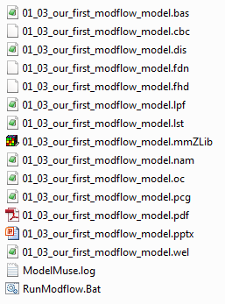

Copy file previous exercise
Copy file “/01-03_our-first-modflow-model/01-03_our-first-modflow-model.mmZLib” to folder “/01-04_adding-features- to-our-model/”
Change the file name to “01-04_adding-features- to-our-model.mmZLib”,
and open the file in ModelMuse.

Slide 4
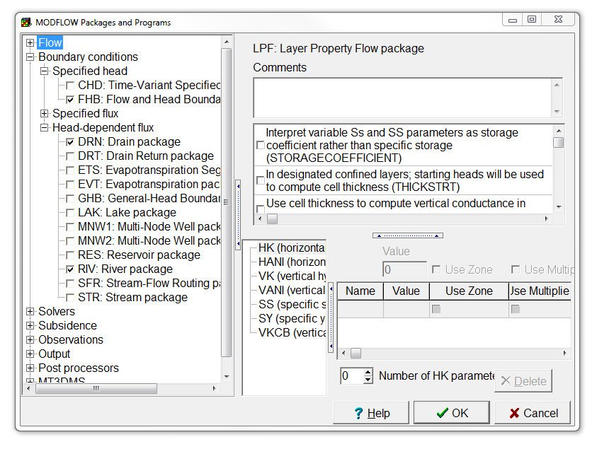
Enable MODFLOW packages
Select Model | MODFLOW Packages and Programs…,
and mark the checkboxes of the Flow and Head Boundary, Drain, and River packages.
Then press OK.

Slide 5
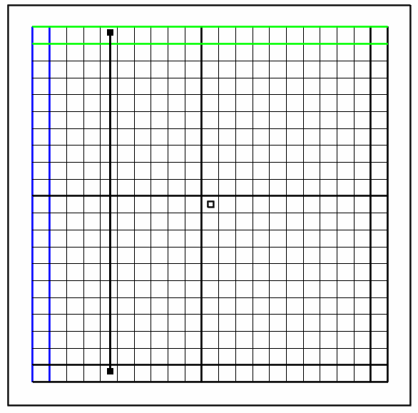
Add a river (1/3)
Select Object | Create | Straight Line or use the corresponding button,
and draw a straight river in the fifth column, going from the first to the last row.
Create straight-line object

Slide 6
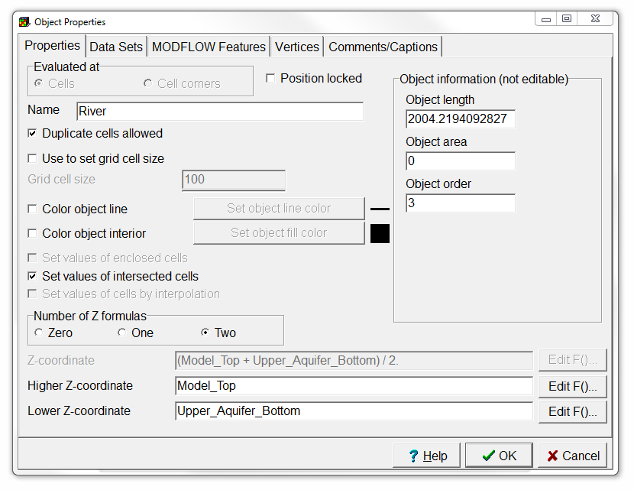
Add a river (2/3)
In the Object Properties dialog box, change the object name to “River”.

Slide 7
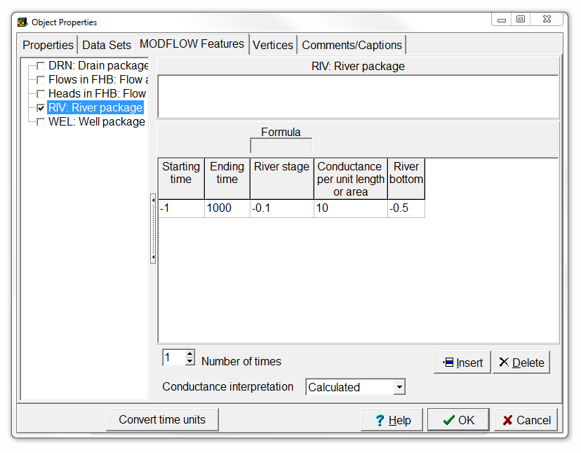
Add a river (3/3)
Switch to the MODFLOW Features tab, and
check the River package.
and fill in the Starting time, Ending time, River stage, Conductance, and River bottom with, respectively, -1, 1000, -0.1, 10, -0.5.
Then press OK.

Slide 8
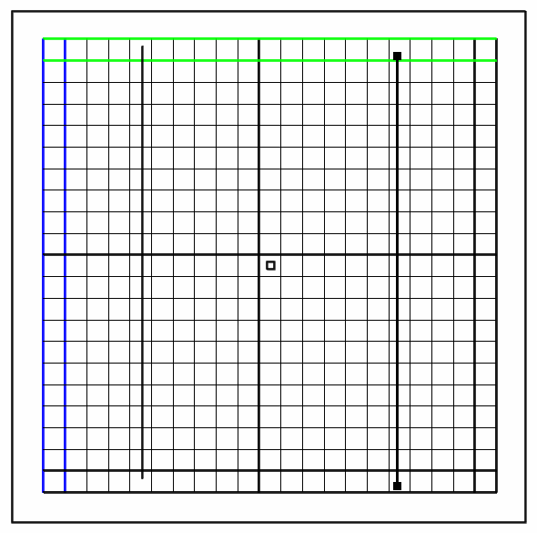
Add a drain (1/3)
Select Object | Create | Straight Line or use the corresponding button,
and draw a straight drain in the 17th column, going from the first to the last row.
Create straight-line object

Slide 9
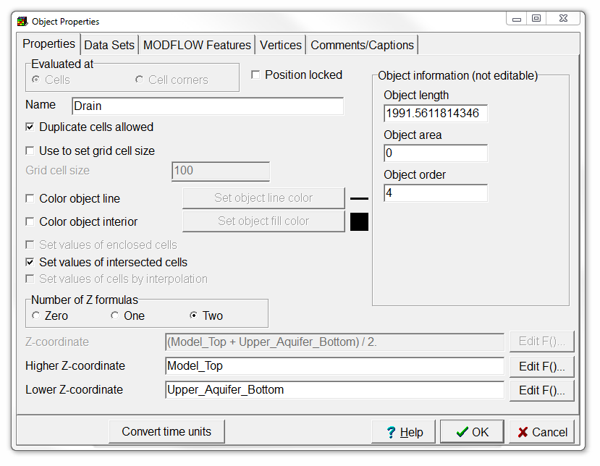
Add a drain (2/3)
In the Object Properties dialog box, change the object name to “Drain”.

Slide 10
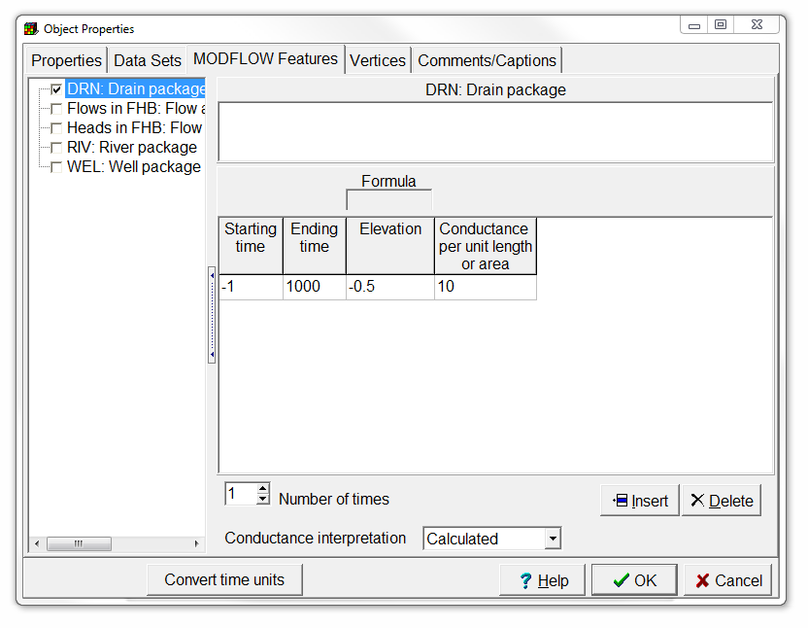
Add a drain (3/3)
Switch to the MODFLOW Features tab, and
check the Drain package.
and fill in the Starting time, Ending time, Elevation and Conductance with, respectively, -1, 1000, -0.5 and 10.
Then press OK.

Slide 11
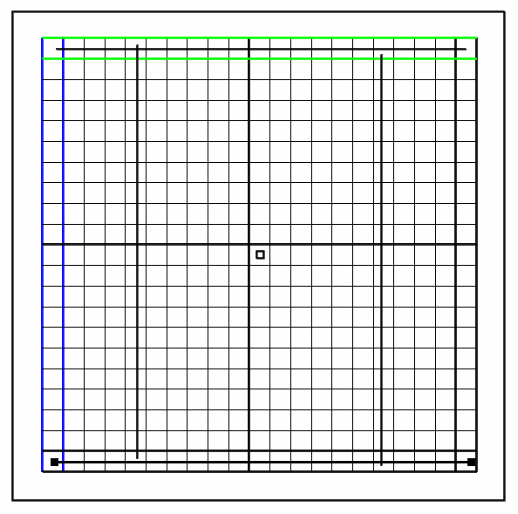
Add constant head boundaries (1/3)
Select Object | Create | Straight Line or use the corresponding button,
and draw a straight line in the first row, going from the first to the last column.
Go through the next 2 slides and then repeat the steps for the last row.
Create straight-line object

Slide 12
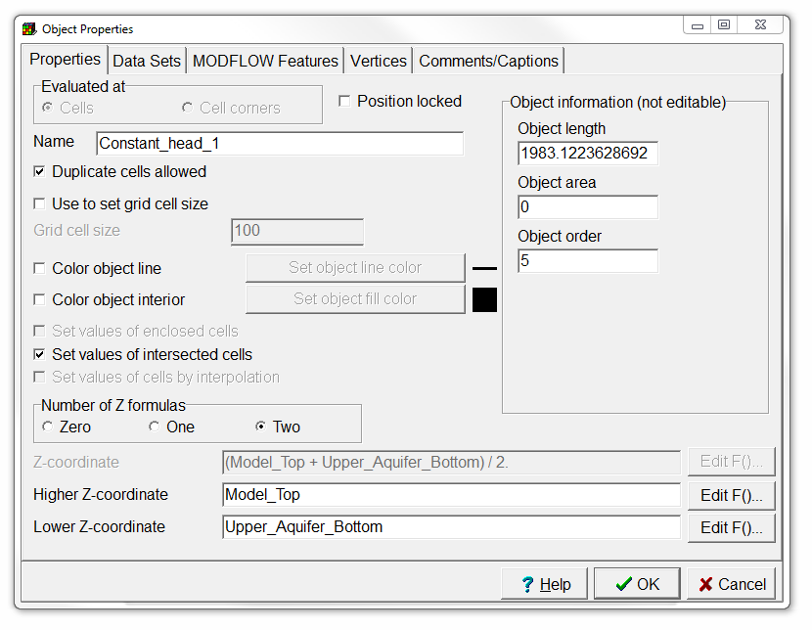
Add constant head boundaries (2/3)
In the Object Properties dialog box, change the object name to “Constant_head_1” or “Constant_head_2”.

Slide 13
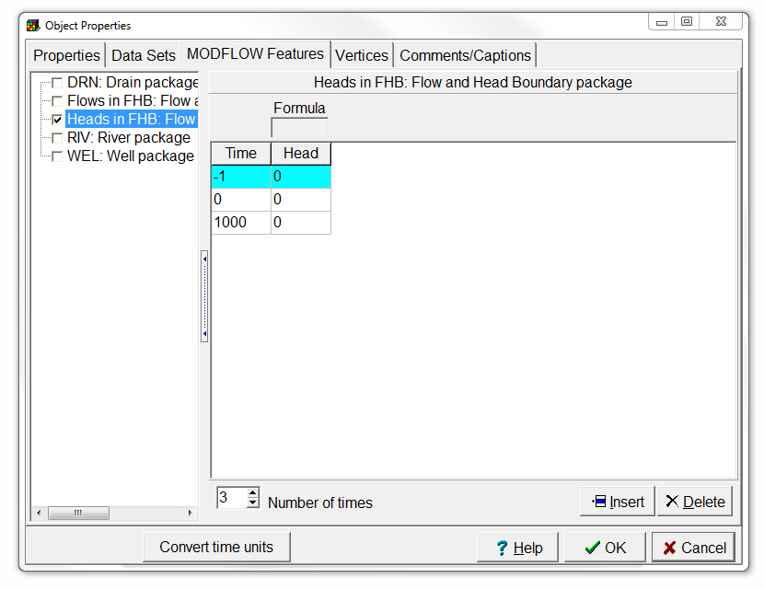
Add constant head boundaries (3/3)
Switch to the MODFLOW Features tab, and
check the Flow and Head Boundary package.
Change Number of times to 3,
and fill in the Time column with -1, 0, 1000, and the Head column with 0, 0, 0.
Then press OK.
Make sure you defined two constant head boundaries!

Slide 14
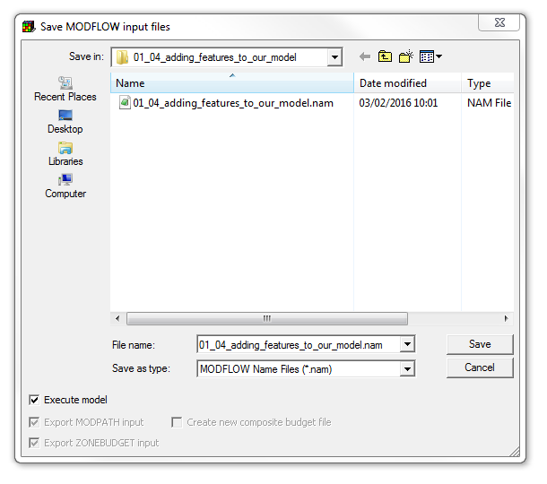
Run model (1/2)
Select File | Export | MODFLOW Input Files,
specify the file name “/01-04_adding-features-to-our-model/ 01-04_adding-features-to-our-model.nam”, and
click Save. ModelMuse will create the MODFLOW input files and start running MODFLOW.

Slide 15
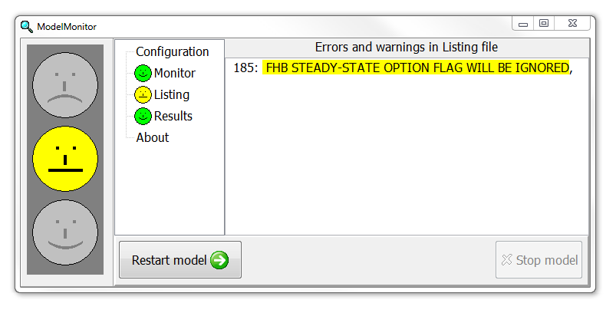
Run model (2/2)
ModelMonitor found a warning in the Listing file, but this is normal when using the Flow and Head Boundary package with transient stress periods.
Close ModelMonitor,
the listing file,
and the command line window.

Slide 16
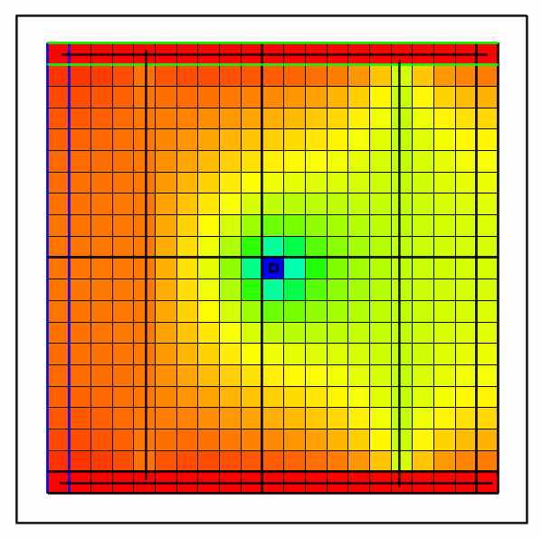
Visualize simulated heads
Color the grid with the simulated heads like we did during the previous exercise.

Slide 17
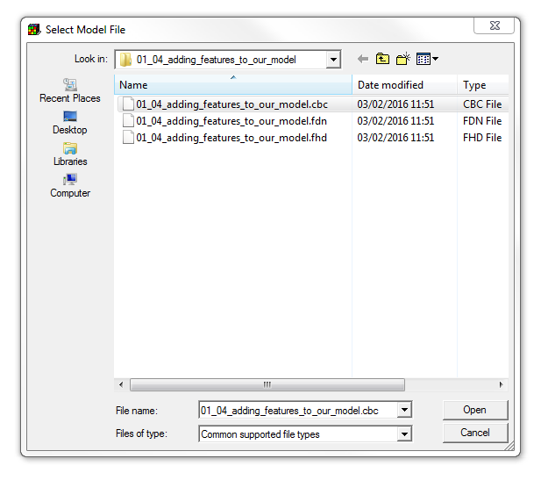
Import flow data (1/2)
Select File | Import | Model Results… or use the corresponding button,
select the binary flow file “01-04_adding-features-to-our-model.cbc”, and
click Open.
Import and display model results

Slide 18
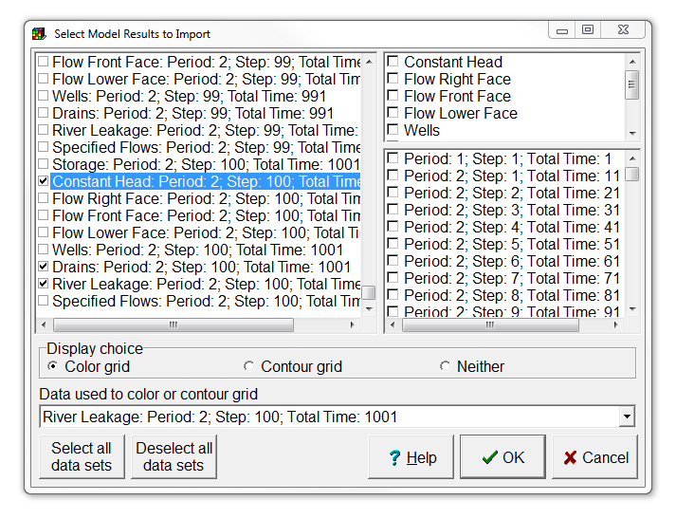
Import flow data (2/2)
In the Select Model Results to Import dialog box, scroll down to the bottom, and
select Constant Head, Drains, and River Leakage for Period: 2; Step: 100.
Also, choose to color the grid with the River Leakage flows.
Then click OK.

Slide 19
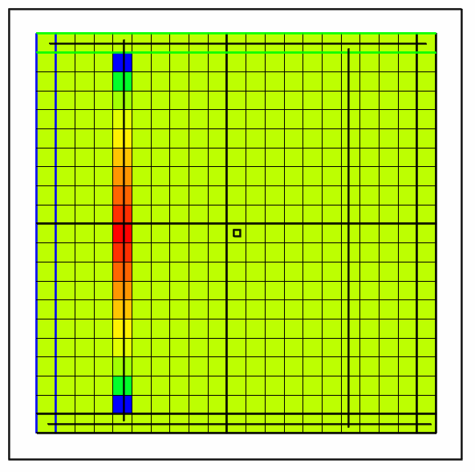
Check fluxes from/to the river
Check the values of the fluxes from/to the river using the status bar, or Data | Show Grid or Mesh Values.
Is the river gaining water from, or losing water to the aquifer?

Slide 20
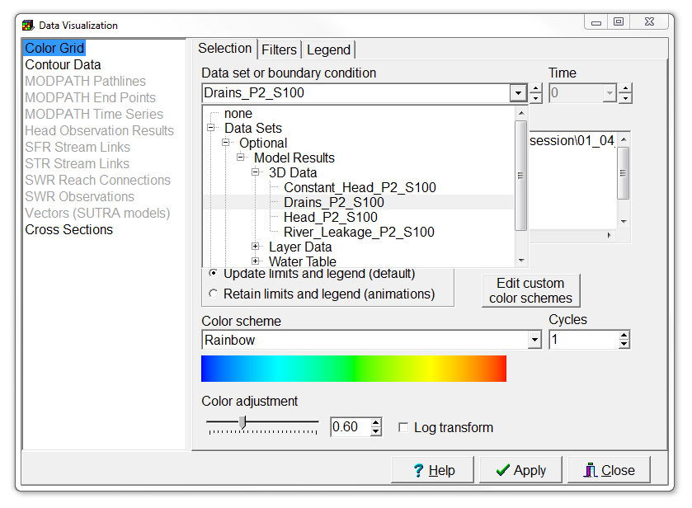
Check fluxes to the drain (1/2)
Now color the grid with the Drain flows, by selecting Data | Data visualization, or using the corresponding button,
changing the data set to Drains_P2_S100,
and pressing Apply.
Data visualization

Slide 21
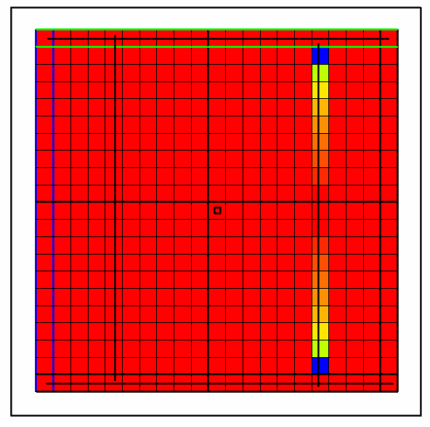
Check fluxes to the drain (2/2)
Check the values of the fluxes to the drain using the status bar, or Data | Show Grid or Mesh Values.
Is the drain active over its entire length?

Slide 22
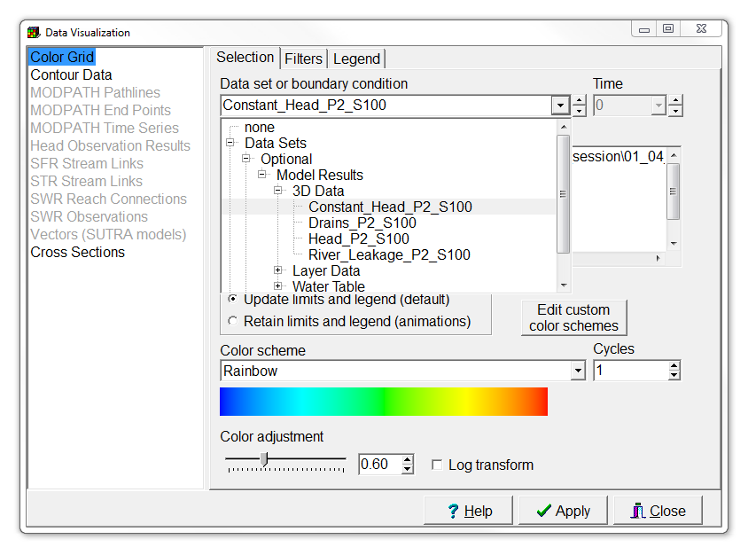
Check fluxes from/to the constant head boundaries (1/2)
Now color the grid with the Constant Head flows, by selecting Data | Data visualization, or using the corresponding button,
changing the data set to Constant_Head_P2_S100,
and pressing Apply.
Data visualization

Slide 23
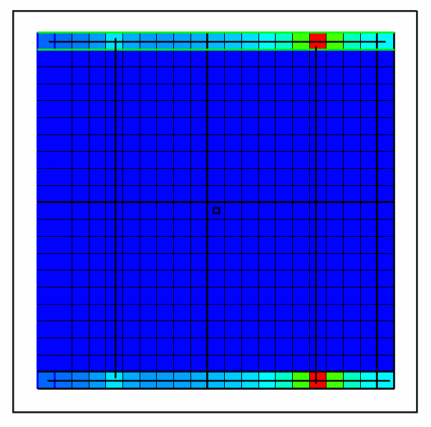
Check fluxes from/to the constant head boundaries (2/2)
Check the values of the fluxes to the Constant Head cells using the status bar, or Data | Show Grid or Mesh Values.
Why are the largest values located at the drain?

Slide 24
Education evenings 2018
Practical introduction to groundwater modelling
Computer exercises
01 04 Adding features to our model
Questions? Found an error? Please contact B. Rogiers at brogiers@sckcen.be.

