Slide 1
Education evenings 2018
Practical introduction to groundwater modelling
Computer exercises
03 01 RMA example model

Slide 2
Purpose
In this exercise, we will reconstruct the Rocky Mountain Arsenal model, which is one of the examples that come with ModelMuse. We will learn to
import a map,
import objects from a shapefile,
generate the grid and
use the CHD package.

Slide 3
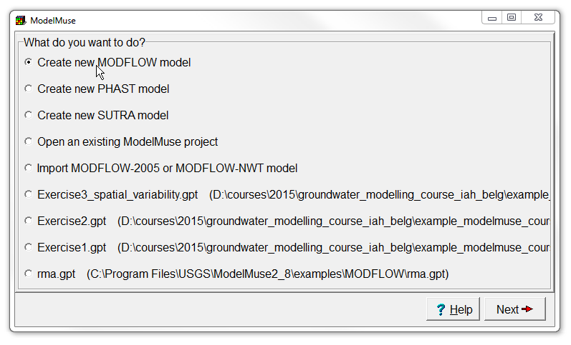
Create new model
Start ModelMuse by double-clicking on its icon.
Choose Create new MODFLOW model and click Next.
Set the Projection to "NA" and click Next.

Slide 4
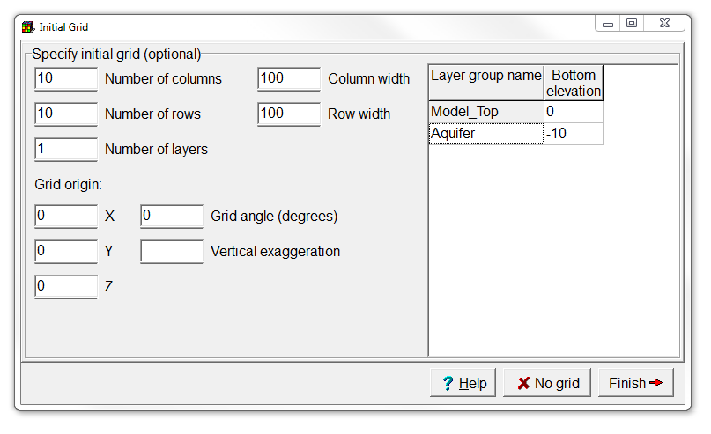
Use a single layer
Change the Number of layers to 1,
set the Layer group name to “Aquifer”,
and click the No grid button.

Slide 5
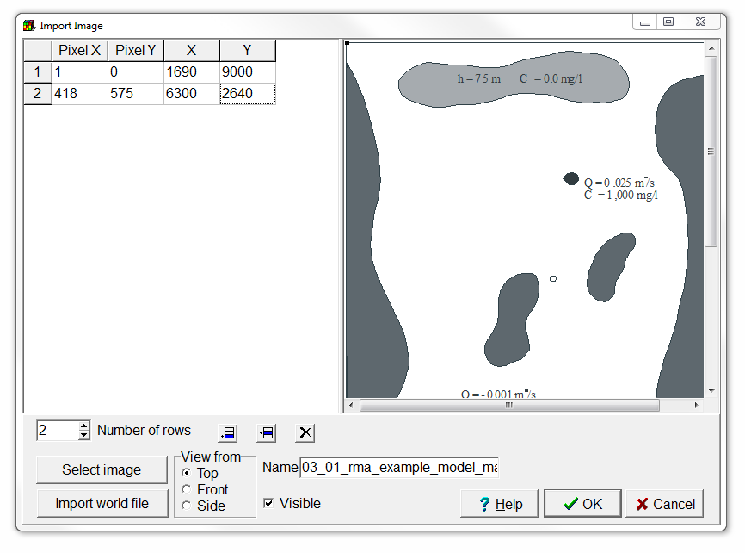
Import image
Select File | Import | Image…,
and use the Select image button to choose “03-01_rma-example-model-map.emf”.
Then increase the Number of rows to 2, and
fill in the table as shown on the right to correctly georeference the image.
Click OK.

Slide 6
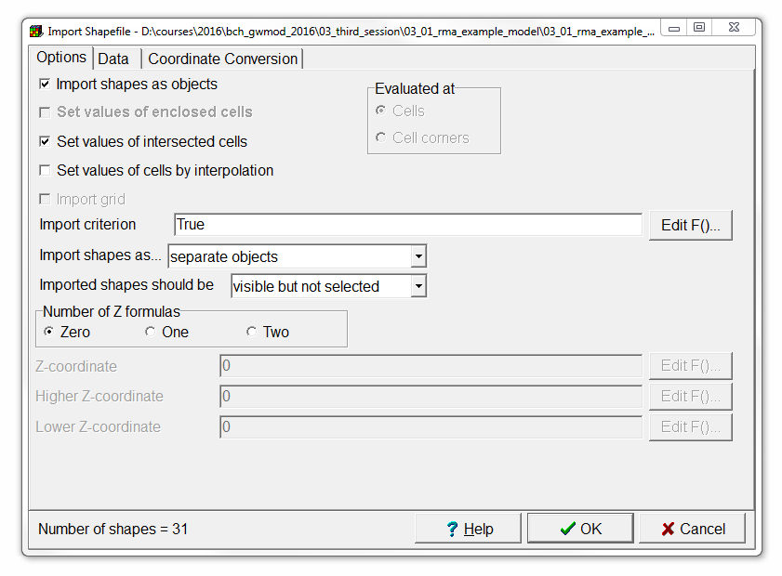
Import objects (1/2)
Select File | Import | Shapefile…,
and choose “03-01_rma-example-model-objects.SHP” in the Open a Shapefile dialog box.
In the Import Shapefile dialog box, check the check box for Set values of intersected cells.
We will only use the geometry of the shapes, so click OK.

Slide 7
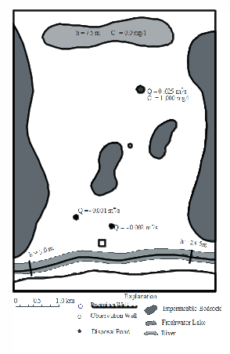
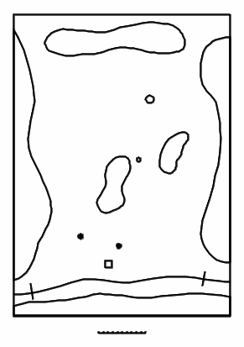
Import objects (2/2)
Take a moment to inspect the different items on the image.
Select Edit | Show or Hide Image, so we can focus on the objects.
Freshwater Lake
Impermeable bedrock
Disposal Pond
Observation well
Pumping wells
River

Slide 8
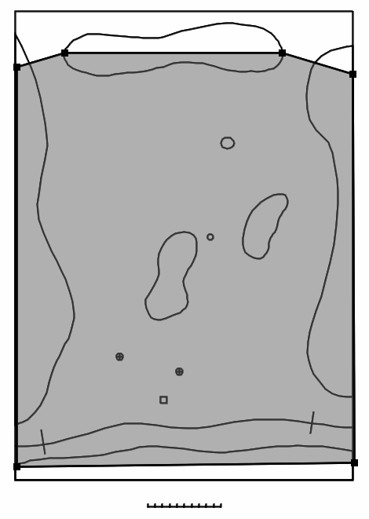
Define model limits (1/2)
Select Object | Create | Polygon, or use the corresponding button,
and draw a polygon as shown on the right.
Double click at the final point, to open the Object Properties dialog box.
Create polygon object

Slide 9
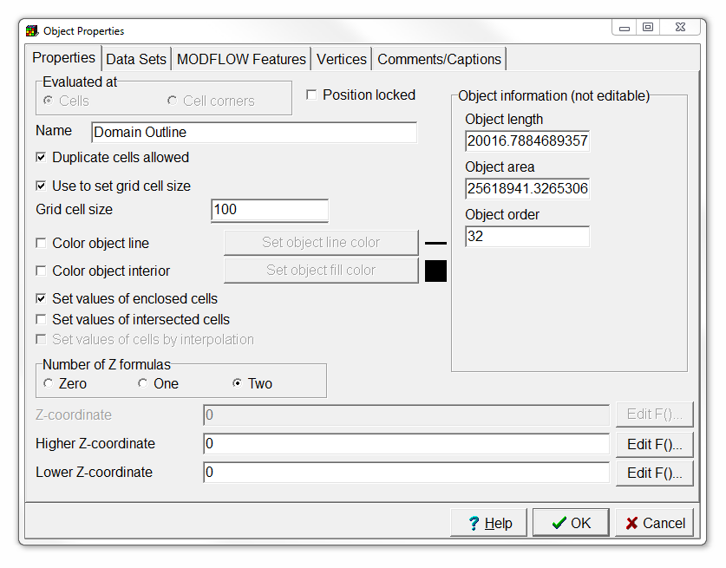
Define model limits (2/2)
Change the object Name to “Domain Outline”,
check the check box for Use to set grid cell size, and
set the Grid cell size to 100.
Then press OK.

Slide 10
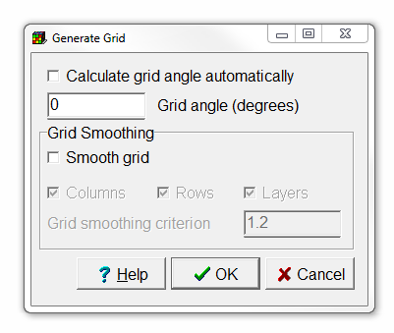
Generate the grid
Select Grid | Generate Grid… or use the corresponding button.
Uncheck the Calculate grid angle automatically check box, and
click OK.
Generate grid

Slide 11
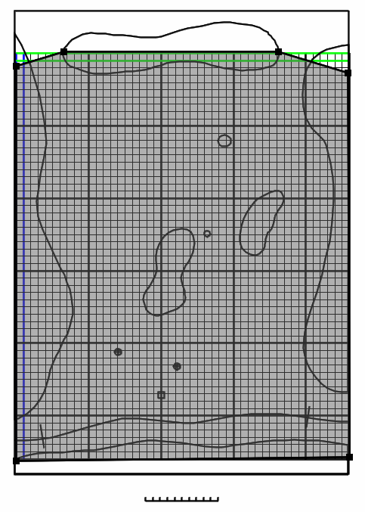
This is what you should get

Slide 12
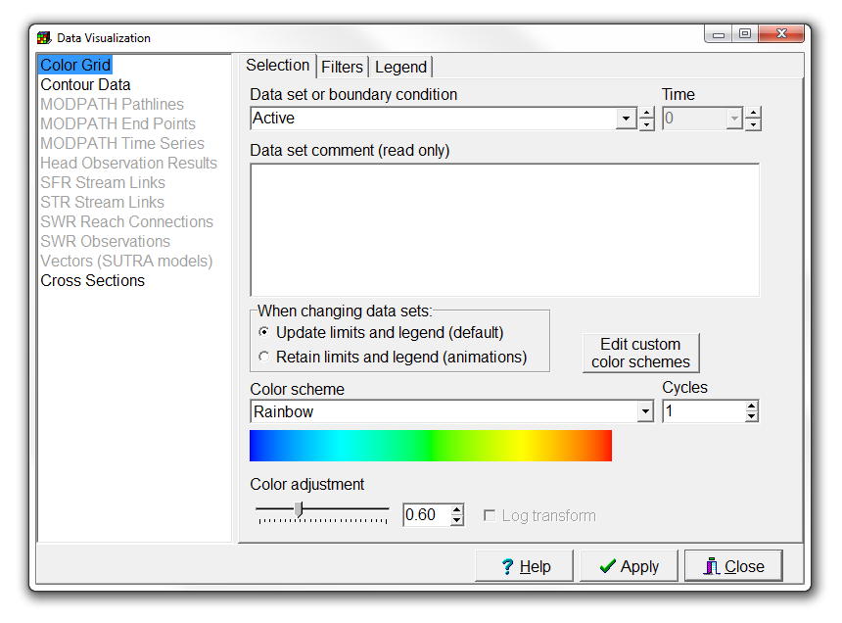
Set active part of the grid (1/6)
First visualize the Active data set by selecting Data | Data Visualization… or using the corresponding button,
expanding Data Sets | Required | Hydrology,
and selecting Active.
Then press Apply.

Slide 13
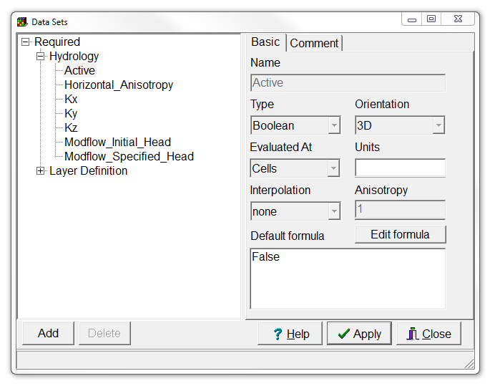
Set active part of the grid (2/6)
Select Data | Edit Data Sets…,
and choose the Active data set.
Change its Default Formula to “False”,
and click Apply.

Slide 14
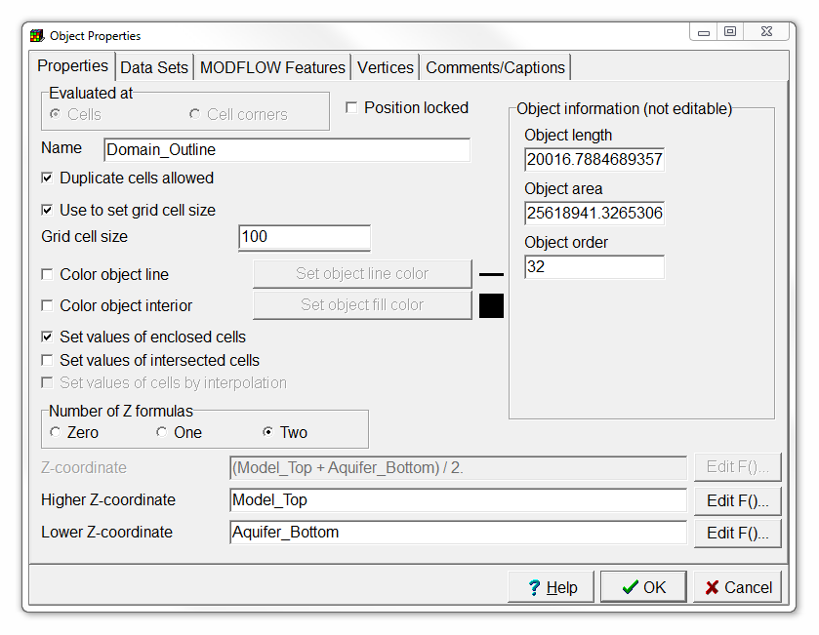
Set active part of the grid (3/6)
Select the object that was used to define the domain outline, and double-click to open the Object Properties dialog box.
Change the Higher Z-coordinate and Lower Z-coordinate to “Model_Top” and “Aquifer_Bottom” respectively.

Slide 15
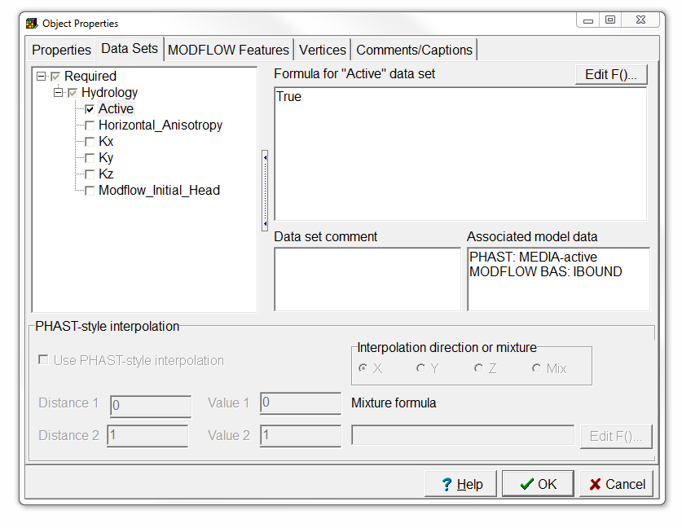
Set active part of the grid (4/6)
Switch to the Data Sets tab,
expand Required | Hydrology,
and select Active.
Change the formula to “True”.
Then press OK.

Slide 16
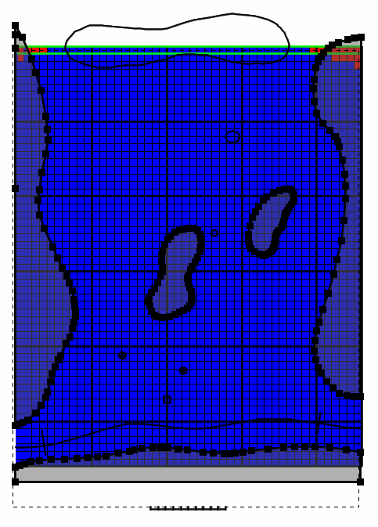
Set active part of the grid (5/6)
Now repeat the procedure in the last two slides for the objects that are selected in the figure on the right, but set the Active data set to “False”.

Slide 17
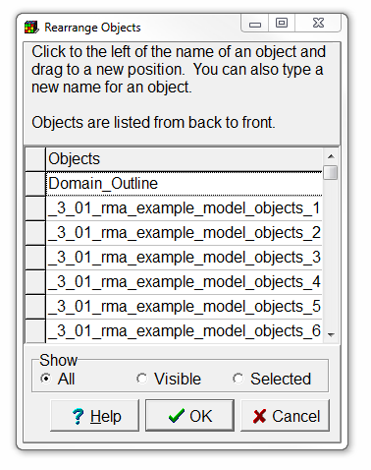
Set active part of the grid (6/6)
Finally, select Object | Edit | Rearrange Objects…, and
move the Domain_Outline object located at the bottom of the list to the top of the list.
Then press OK.

Slide 18
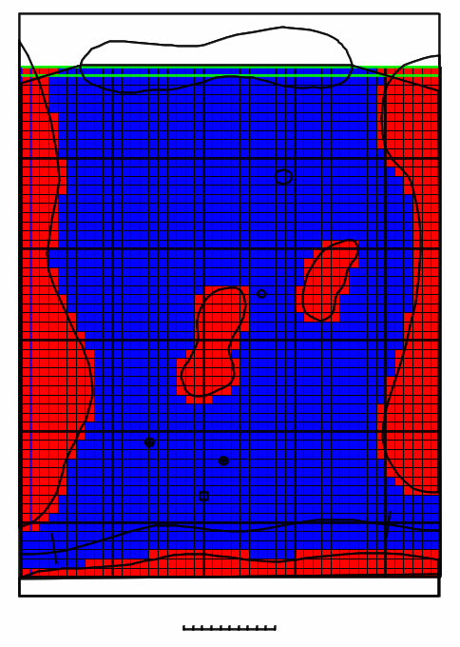
This is what you should get

Slide 19
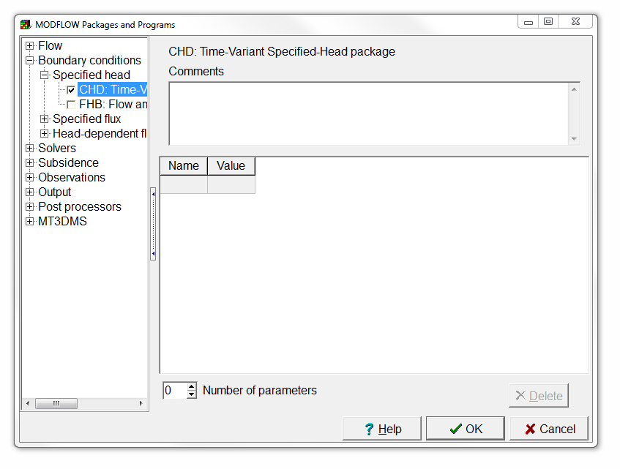
Enable the CHD package
Select Model | MODFLOW Packages and Programs…,
expand Boundary conditions | Specified head,
and select the CHD package.
Then click OK.

Slide 20
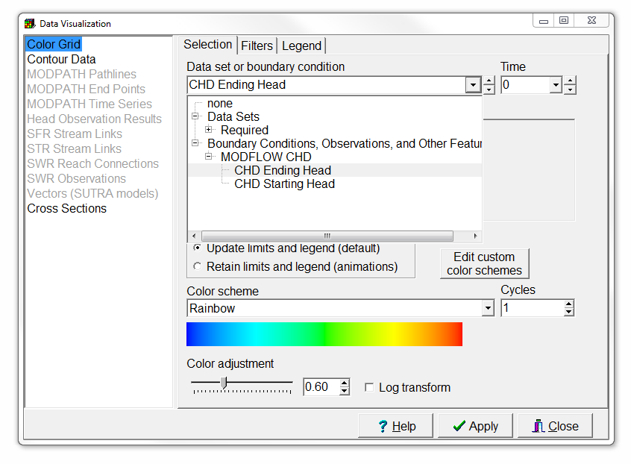
Add specified head boundaries (1/6)
We will model the lake and river as a specified head boundary.
First select Data | Data Visualization… and select the CHD Ending Head.
Then press Apply.
You can ignore the warnings.

Slide 21
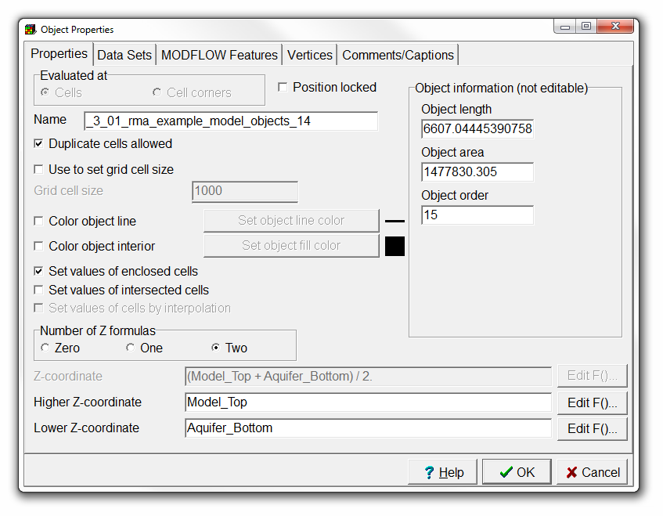
Add specified head boundaries (2/6)
Double-click the object that represents the lake.
In the Object Properties dialog box, check Set values of enclosed cells and uncheck Set values of intersected cells.
Change the Number of Z formulas to Two.

Slide 22
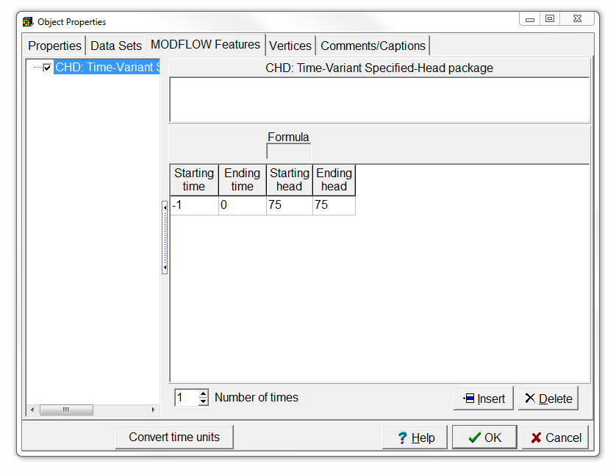
Add specified head boundaries (3/6)
Switch to the MODFLOW Features tab,
select the CHD package,
change the Number of times to 1,
and set Starting time, Ending time, Starting head, and Ending head to -1, 0, 75 and 75.
Then click OK.

Slide 23
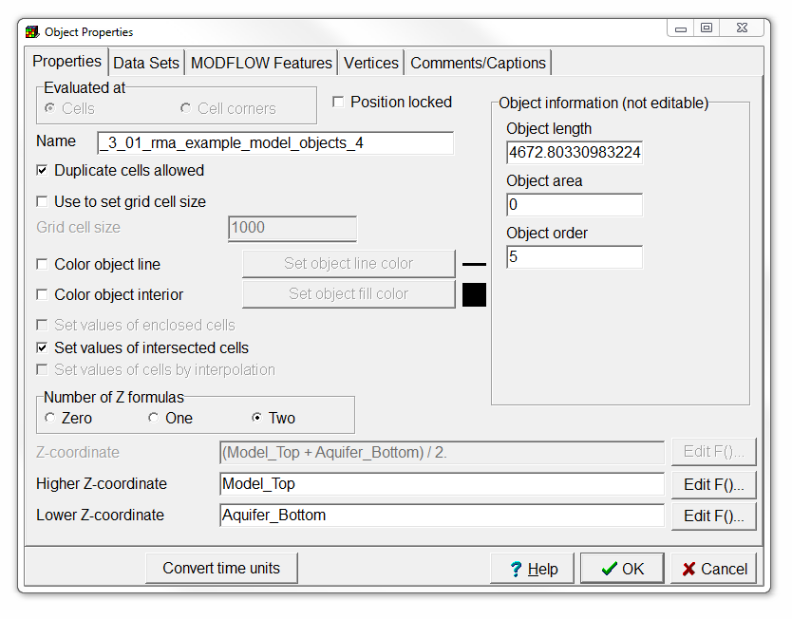
Add specified head boundaries (4/6)
Now double-click on the object that represents the river, to open the Object Properties dialog box.
Change the Number of Z formulas to Two.

Slide 24
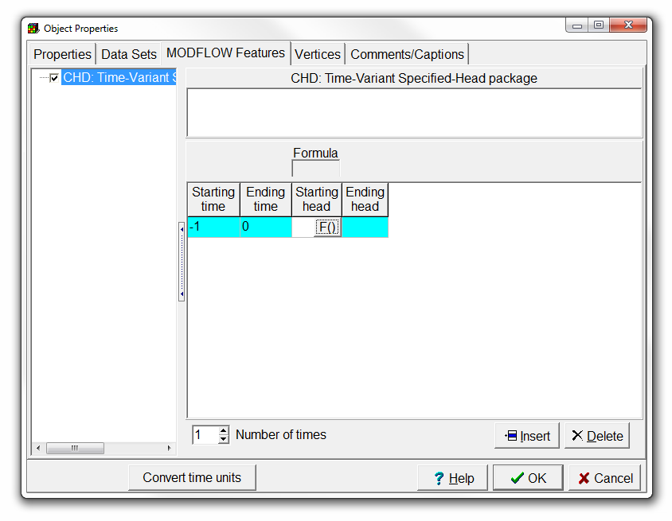
Add specified head boundaries (5/6)
Switch to the MODFLOW features tab,
select the CHD package,
set the Starting time and Ending time to -1 and 0,
and click the button in the Starting head cell to open the Formula Editor.

Slide 25
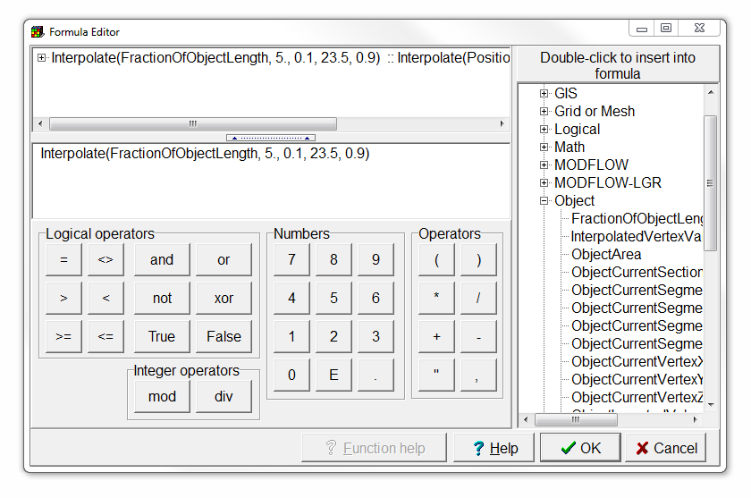
Add specified head boundaries (6/6)
The head in the stream varies from 5 near the cross mark near the left end of the stream to 23.5 near the cross mark at the right end of the stream. The cross marks are at 10% and 90% of the length of the object representing the stream. Enter the formula "Interpolate(FractionOfObjectLength, 5, 0.1, 23.5, 0.9)"
Check the Interpolate and FractionOfObjectLength Function help to see what these functions do, and click OK.
Copy the Starting head formula to the Ending head cell, and press OK.

Slide 26
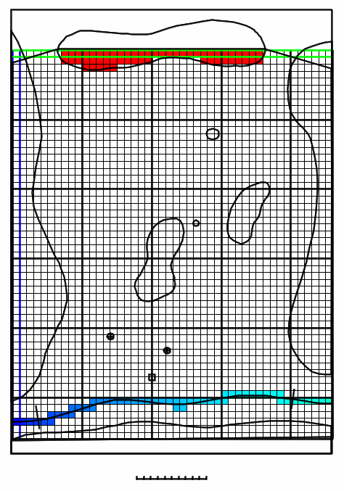
This is what you should get

Slide 27
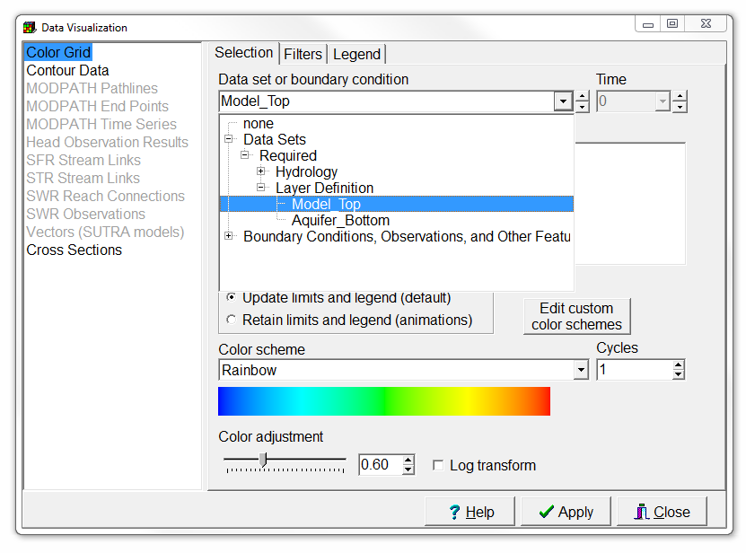
Define aquifer geometry (1/9)
The elevation of the top of the aquifer slopes gradually from approximately 71 at the north end of the model to 1 m above the stream at the south end of the model.
First select Data | Data Visualization… and select the Model_Top.
Then press Apply.

Slide 28
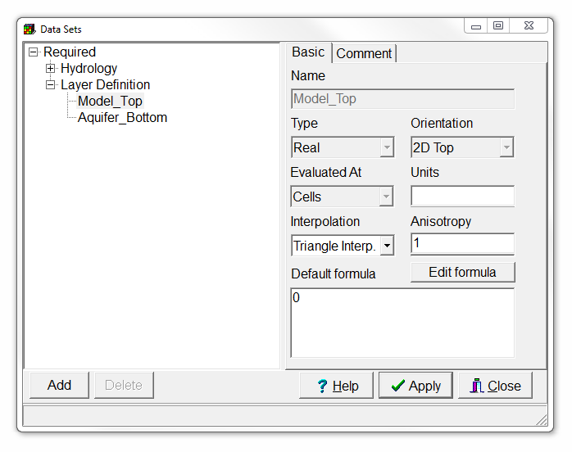
Define aquifer geometry (2/9)
Select Data | Edit Data Sets…,
select Model_Top,
for interpolation, select Triangle Interp., and
press Apply.

Slide 29
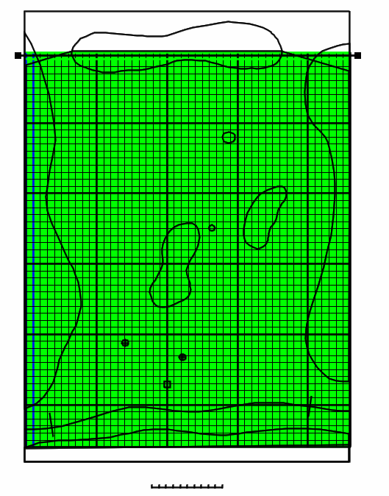
Define aquifer geometry (3/9)
Select Object | Create | Straight Line, or use the corresponding button, and
draw a straight east-west line at the north end of the model.
Create straight-line object

Slide 30
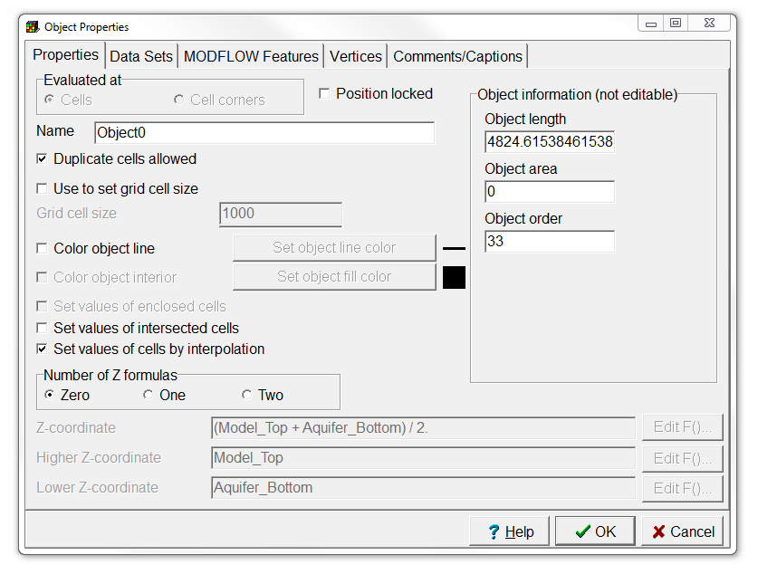
Define aquifer geometry (4/9)
In the Object Properties dialog box, change the Number of Z formulas to Zero,
uncheck Set values of intersected cells, and
check Set values of cells by interpolation.

Slide 31
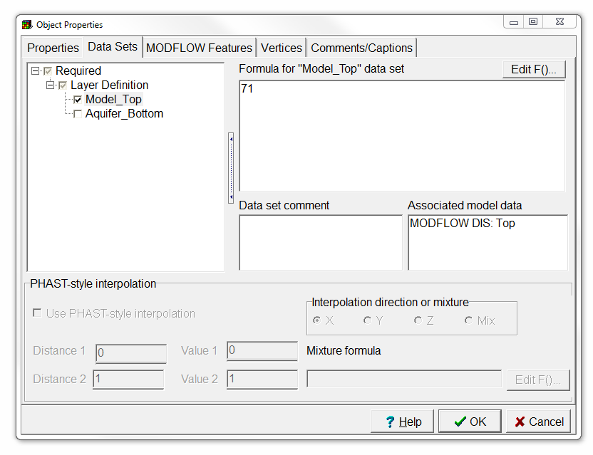
Define aquifer geometry (5/9)
Switch to the Data Sets tab,
select Model_Top, and
change its formula to 71.
Then click OK.
Because there are only two points in this object, nothing will change yet. At least 3 non-collinear points must be present for Triangle Interp. to be used.

Slide 32
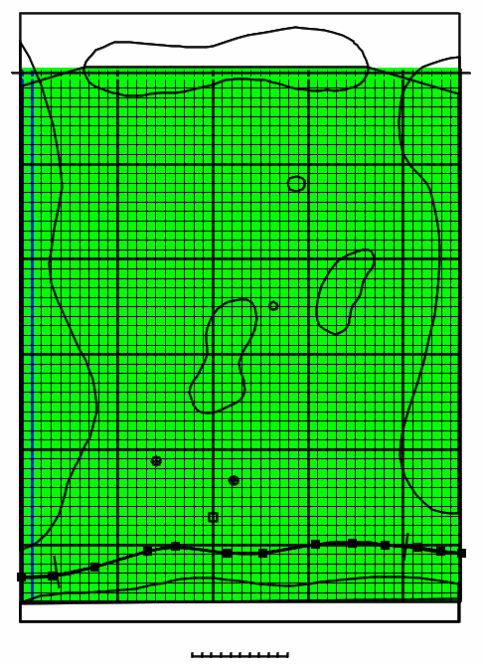
Define aquifer geometry (6/9)
Select Object|Create|Polyline, or use the corresponding button, and
draw a polyline at the location of the stream.
The previous stream object can not be used for this because it must have two Z formulas and this one will need to have zero Z formulas.
Create polyline object

Slide 33
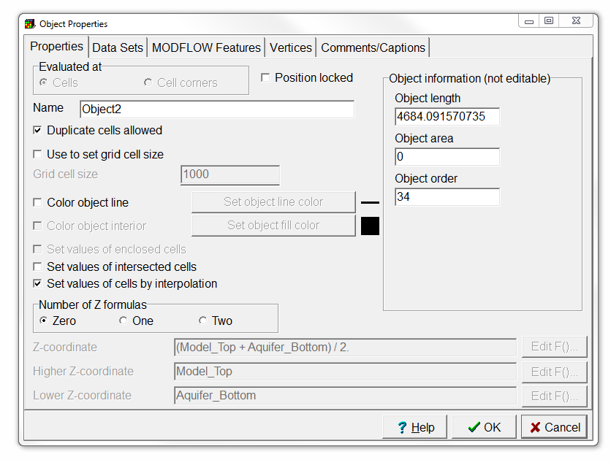
Define aquifer geometry (7/9)
In the Object Properties dialog box, change the Number of Z formulas to Zero,
uncheck Set values of intersected cells, and
check Set values of cells by interpolation.

Slide 34
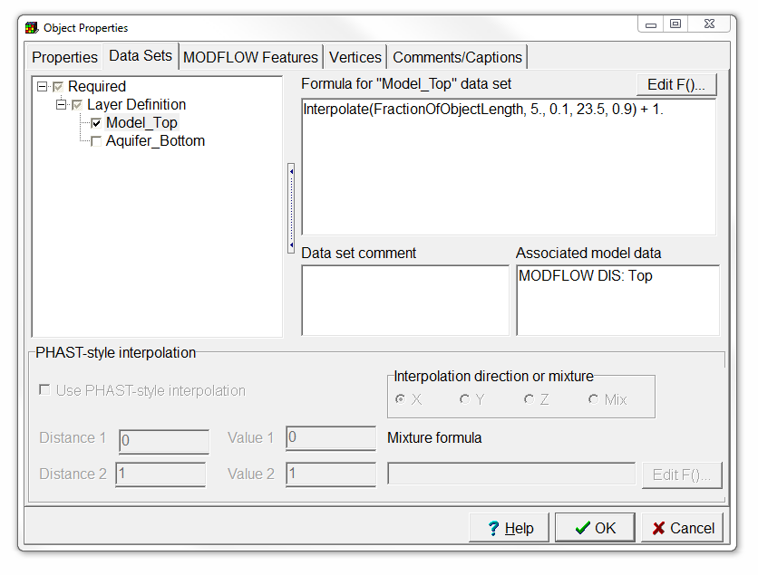
Define aquifer geometry (8/9)
Switch to the Data Sets tab,
select Model_Top, and
change its formula to “Interpolate(FractionOfObjectLength, 5., 0.1, 23.5, 0.9) + 1”.
Then click OK.

Slide 35
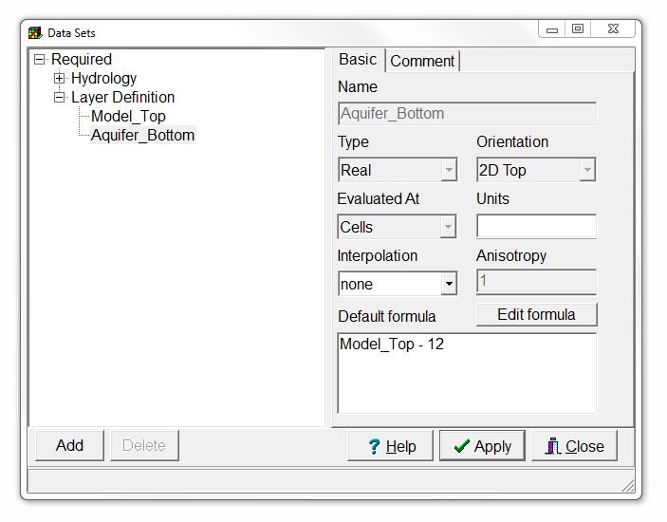
Define aquifer geometry (9/9)
Finally, change the aquifer bottom elevation by selecting Data | Edit Data Sets…,
selecting Aquifer_Bottom, and changing the Default Formula to “Model_Top - 12”.
Then click Apply.

Slide 36
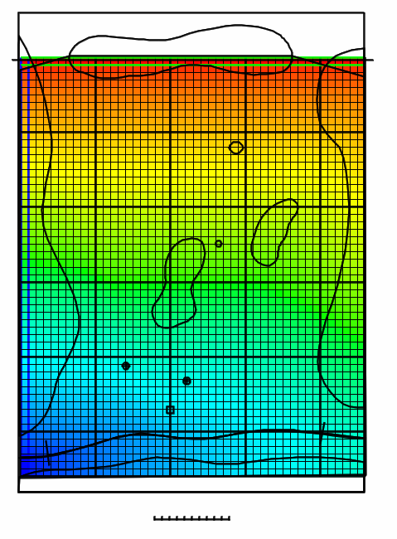
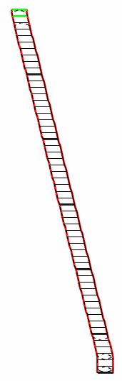

This is what you should get

Slide 37
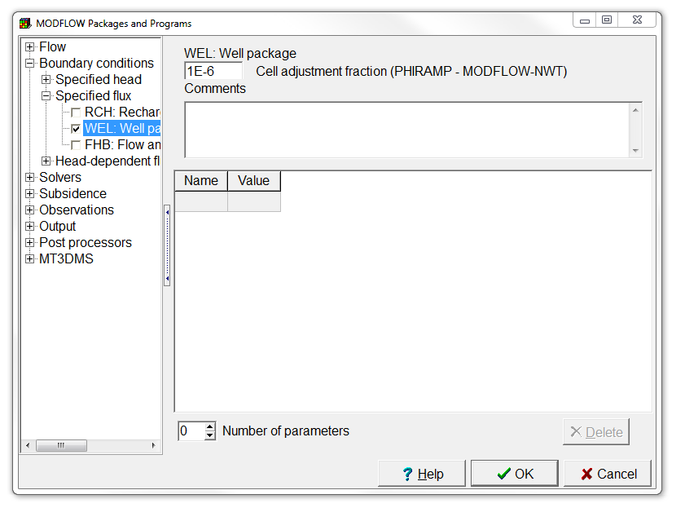
Add wells (1/5)
Select Model | MODFLOW Packages and Programs…,
expand Boundary conditions | Specified flux, and
check the Well Package.
Then click OK.

Slide 38
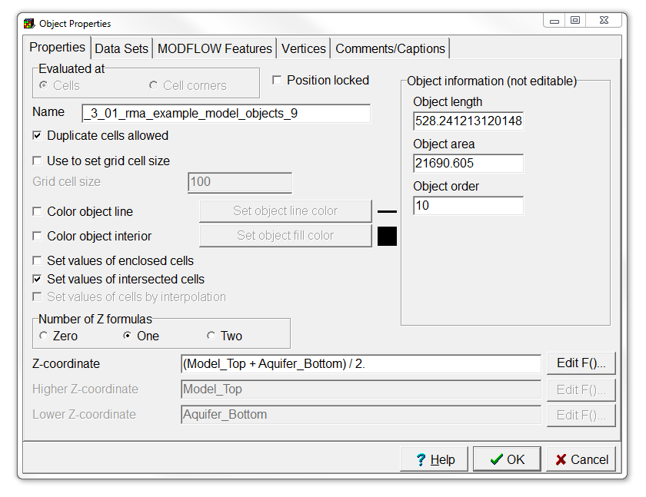
Add wells (2/5)
Double click on the object that represents the disposal pond to open the Object Properties dialog box.
Change the Number of Z formulas to One and make sure the formula is “(Model_Top + Aquifer_Bottom) / 2”.

Slide 39
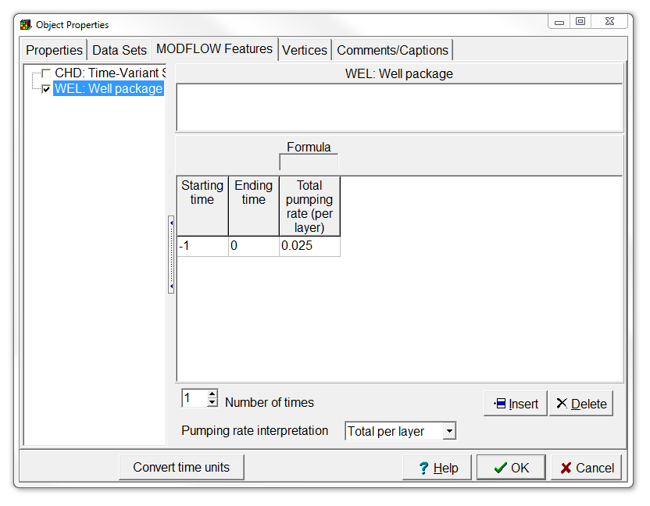
Add wells (3/5)
Switch to the MODFLOW Features tab,
check the WEL package,
change the Number of times to 1,
the Pumping rate interpretation to Total per layer,
and set Starting time, Ending time and Total pumping rate to -1, 0, and 0.025.
Then click OK.

Slide 40
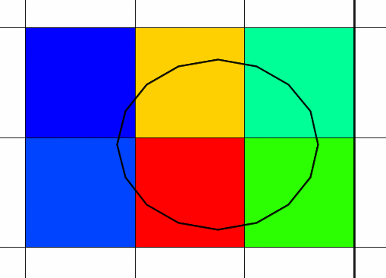
Add wells (4/5)
Now colour the grid with the Well pumping rate,
and check if the total is 0.025.

Slide 41
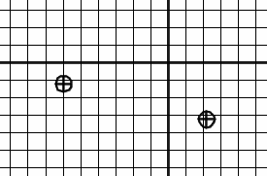
Add wells (5/5)
To add the two pumping wells, create point objects at the center of the well symbols,
check the WEL package,
set the Number of times to 1,
the Pumping rate interpretation to Direct,
the Starting and Ending time to -1 and 0,
and finally the Pumping rate to -0.001 and -0.002 for the western and eastern well respectively.

Slide 42
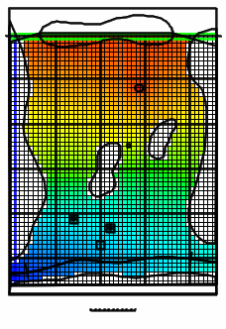
Run the model
Now save the model as “03-01_rma-example-model.mmZLib” in folder “03-01_rma-example-model”,
run MODFLOW, and
import the head results.
You should get something similar to the figure on the right.

Slide 43
Education evenings 2018
Practical introduction to groundwater modelling
Computer exercises
03 01 RMA example model
Questions? Found an error? Please contact B. Rogiers at brogiers@sckcen.be.

