Slide 1
Education evenings 2018
Practical introduction to groundwater modelling
Computer exercises
03 02 Particle tracking

Slide 2
Purpose
In this example, we will use the Rocky Mountain Arsenal model, one of the examples that come with ModelMuse, to set up
forward particle tracking to visualize advective flow paths from a disposal pond, and
backward particle tracking to map an (advective) well capture zone.

Slide 3
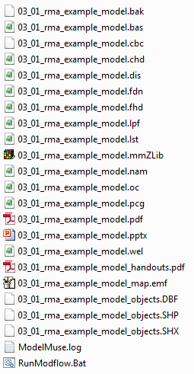

Copy example model
Copy the model from the previous exercise “03-01_rma-example-model.mmZLib” to folder “/03-02_particle-tracking/”,
and rename the copied file to “03-02_particle-tracking.mmZLib”.
Another option is to copy file “03-01_rma-example-model.mmZLib” in folder “/06_solutions/”.
Double click the new file to open ModelMuse.

Slide 4
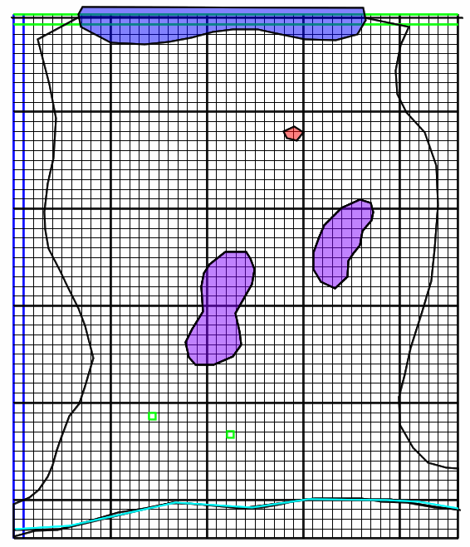
Inspect model features
Disposal pond modelled as an injection well
Take some time to inspect the objects and learn what model features they define, if you did not just create them yourself in the last exercise.
What is the lake head?
How is the river head specified?
How is the impermeable bedrock simulated?
How much does the extraction well pump?
How much does the disposal pump leak?
Lake represented as a specified head boundary
Model boundary
River represented as a specified head boundary
Impermeable bedrock
Extraction wells

Slide 5
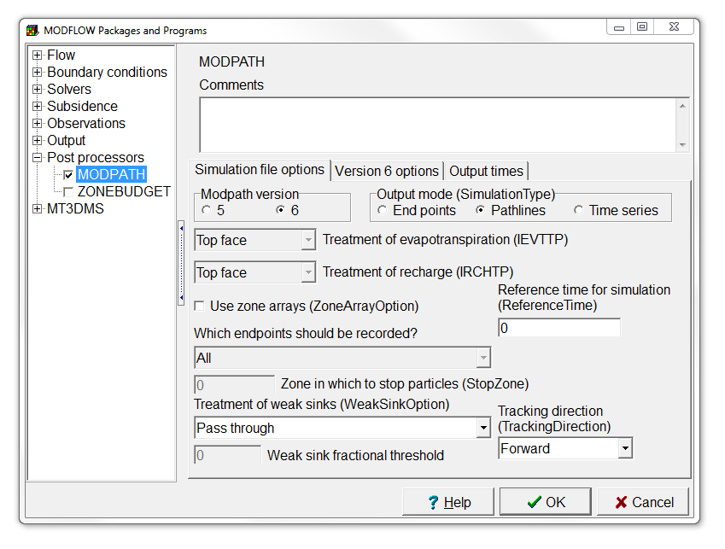
Enable MODPATH
Select Model | MODFLOW Packages and Programs…,
expand Post processors, and
check the check box for MODPATH.
Change the Output mode to Pathlines, and note we will be doing Forward tracking,
and press OK.

Slide 6
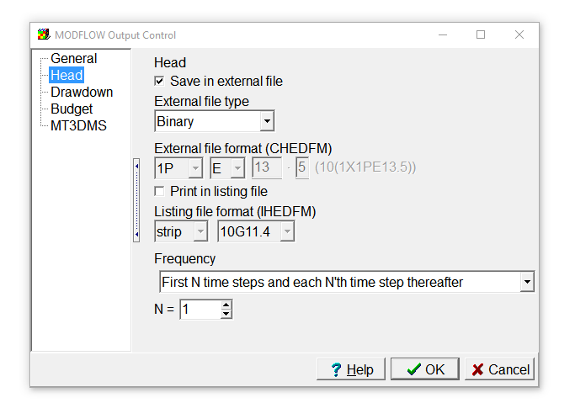
Change head output file type
Note you get a warning concerning the head output file type.
Select Model | MODFLOW Output Control…,
Choose Head, and set the External file type to Binary.
Click OK.

Slide 7
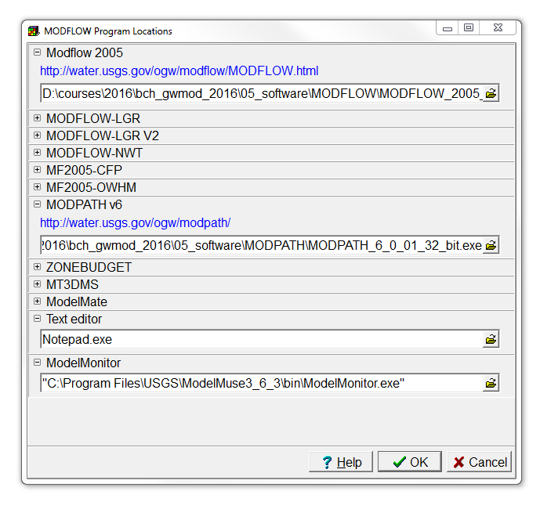
Set the MODPATH program location
Select Model | MODFLOW Program Locations, and
fill in the path to the MODPATH executable for your machine architecture in folder “/05_software/modpath/”.
Then press OK.

Slide 8
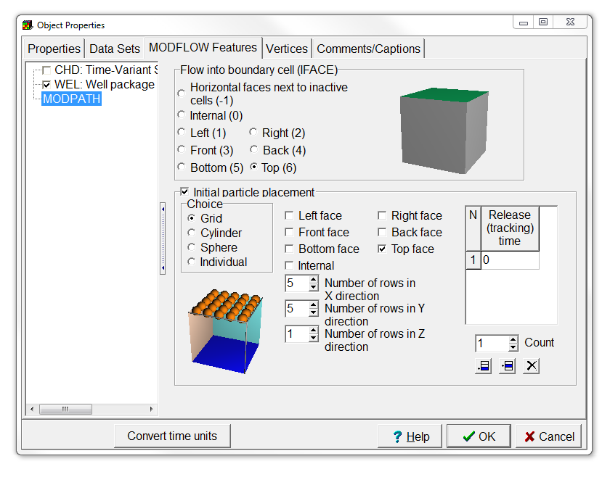
Define initial particle placement
Double click on the disposal pond object,
and in the Object Properties dialog box, select MODFLOW Features, and click on MODPATH.
Set the flow into the cell at the Top face, and
put 5 by 5 particles at the Top face in the Grid.
Then press OK.

Slide 9
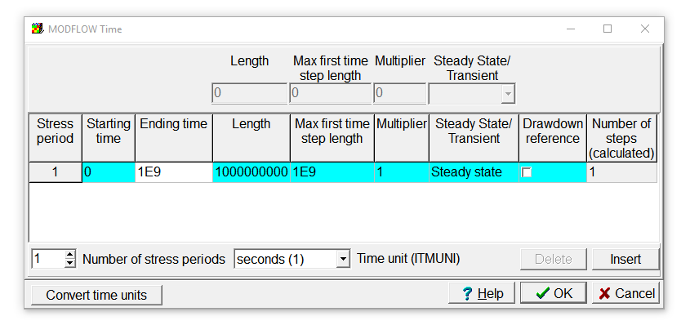
Chance stress period duration
Select Model | MODFLOW Time… and
Set Starting time to 0,
Ending time, Length and Max first time step length to 1E9.
Then press OK.

Slide 10
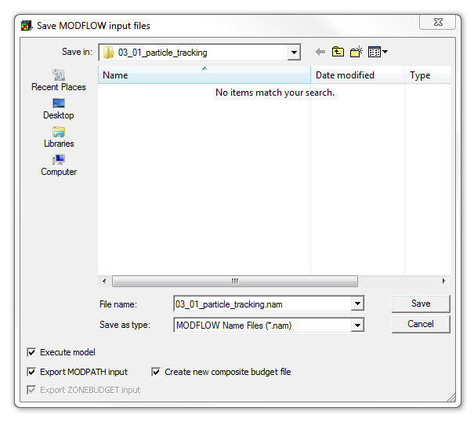
Run model (1/2)
Run MODFLOW by saving the MODFLOW input files.
Note that the Export MODPATH input checkbox is selected as well, and
check the Create new composite budget file checkbox.
Press Save to save and run the model.

Slide 11
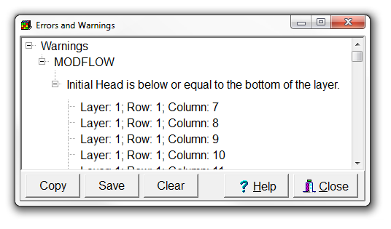
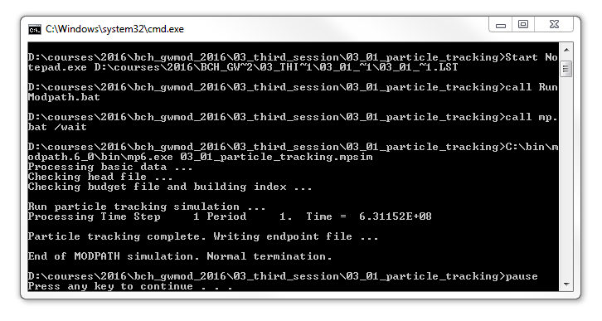
Run model (2/2)
You can neglect the warnings and close the Errors and Warnings window.
Note that when you close ModelMonitor, MODPATH will be launched as well.
Close the command line window after it has finished.

Slide 12
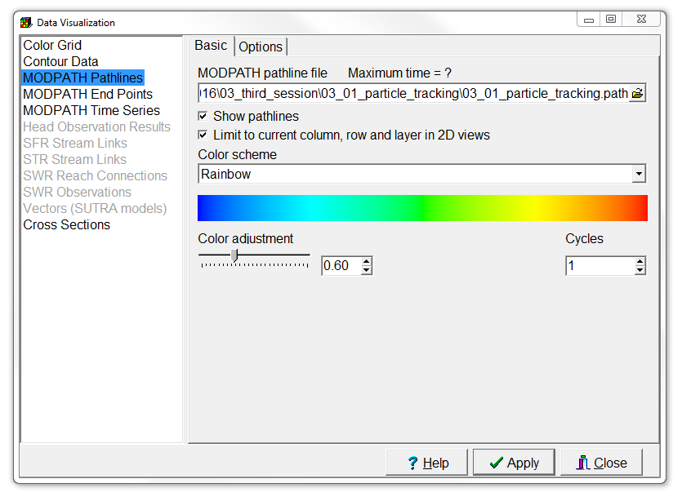
Visualize pathlines (1/2)
Select Data | Data Visualization… or use the corresponding button,
and choose MODPATH Pathlines.
Select the MODPATH pathline file “03-01_particle-tracking.path”.

Slide 13
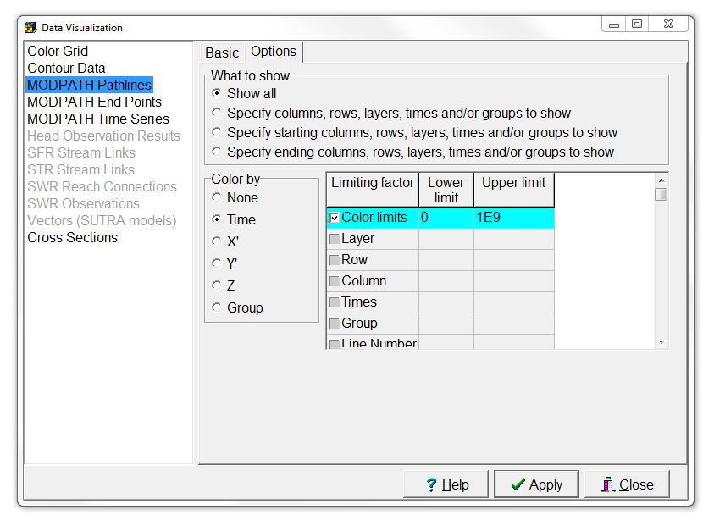
Visualize pathlines (2/2)
Switch to the Options tab, and
set the Color limits to 0 and 1E9.
Then press Apply.

Slide 14
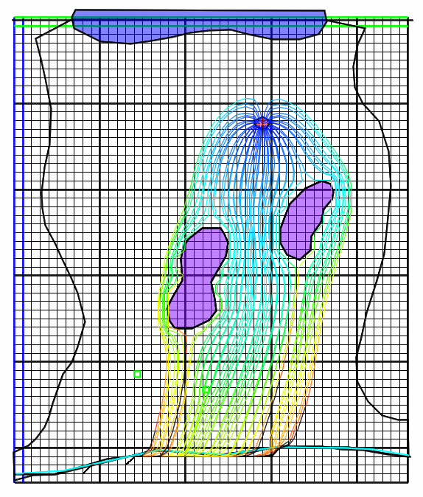
This is what you should get

Slide 15
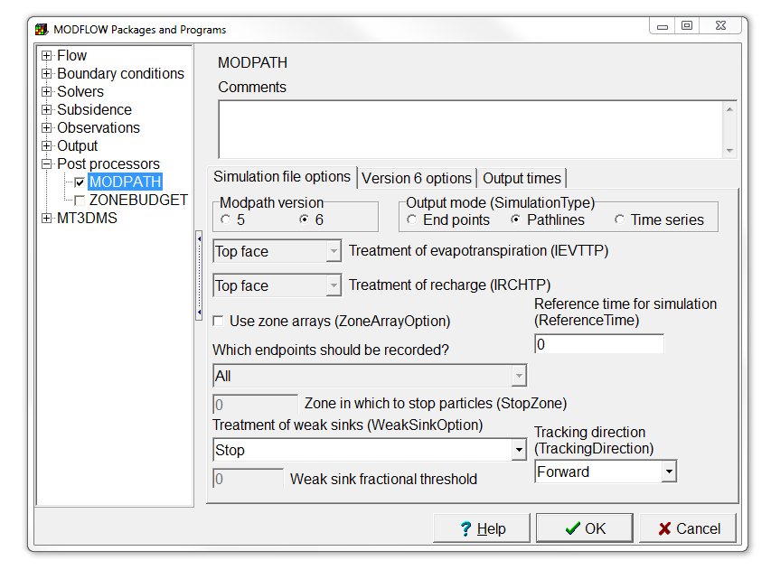
Rerun MODPATH without weak sinks (1/3)
Select Model | MODFLOW Packages and Programs…,
go to MODPATH,
and set the Treatment of weak sinks to Stop.
Then press OK.

Slide 16
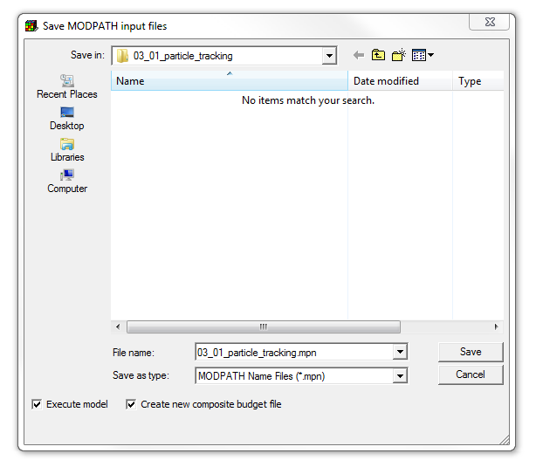
Rerun MODPATH without weak sinks (2/3)
Select File | Export | MODPATH Input Files,
check the Execute model and Create new composite budget file checkboxes, and
press Save.

Slide 17
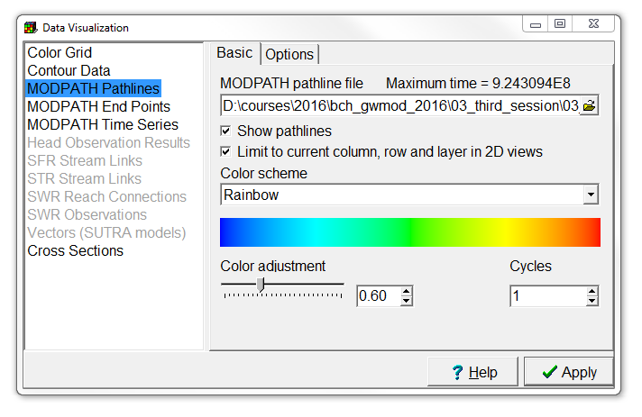
Rerun MODPATH without weak sinks (3/3)
Now update the visualization in the Data Visualization dialog box, by pressing Apply,
and click Yes to import the new file.
Can you see what has changed by stopping the particles at weak sinks?

Slide 18
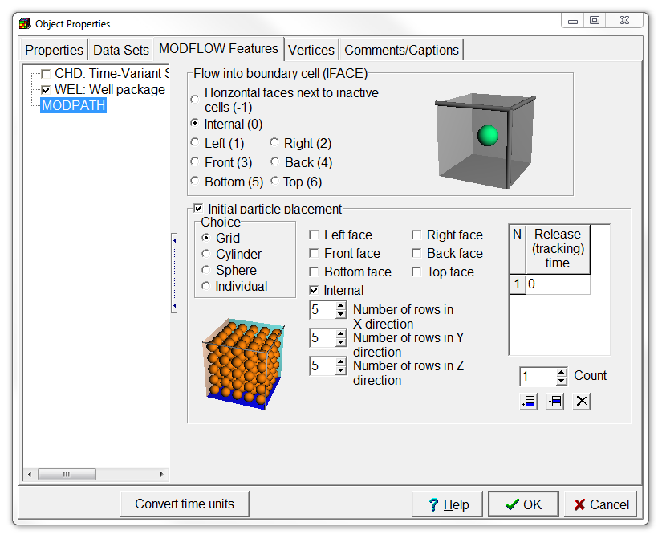
Define particles at well cells
Double click on each of the extraction well objects,
go to the MODFLOW Features tab in the Object Properties dialog box, and
set IFACE to Internal,
the Initial particle placement to Grid and Internal, and
use 5 by 5 by 5 rows.
Then press OK.

Slide 19
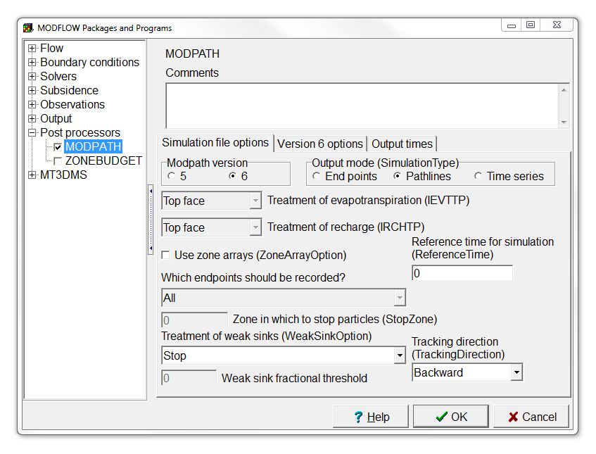
Rerun MODPATH with backward tracking (1/3)
Select Model | MODFLOW Packages and Programs…,
go to MODPATH,
set the Reference time for simulation to 1E9,
and set the Tracking direction to Backward.
Then press OK.
1E9

Slide 20
Rerun MODPATH with backward tracking (2/3)
Select File | Export | MODPATH Input Files,
check the Execute model and Create new composite budget file checkboxes, and
press Save.

Slide 21
Rerun MODPATH with backward tracking (3/3)
Now update the visualization in the Data Visualization dialog box, by pressing Apply,
and click Yes to import the new file.

Slide 22
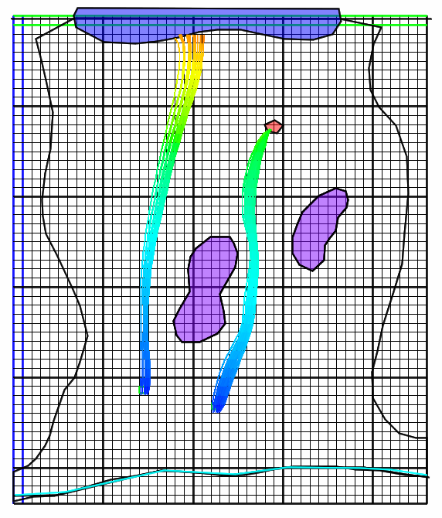
This is what you should get

Slide 23
Education evenings 2018
Practical introduction to groundwater modelling
Computer exercises
03 02 Particle tracking
Questions? Found an error? Please contact B. Rogiers at brogiers@sckcen.be.

