Slide 1
Education evenings 2018
Practical introduction to groundwater modelling
Computer exercises
03 03 Solute transport simulation

Slide 2
Purpose
We will now use the same example model as in the last exercise, but instead of forward particle tracking, we will perform
solute transport simulation accounting for advection, dispersion and diffusion.

Slide 3
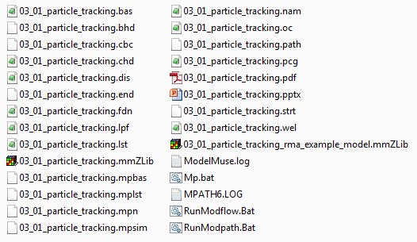

Copy example model
Copy the model “03-02_particle-tracking-rma-example-model.mmZLib” in folder “03-02_particle-tracking”,
to folder “03-03_solute-transport-simulation” and rename the copied file to “03-03_solute-transport-simulation.mmZLib”.
Double click the new file to open ModelMuse.

Slide 4
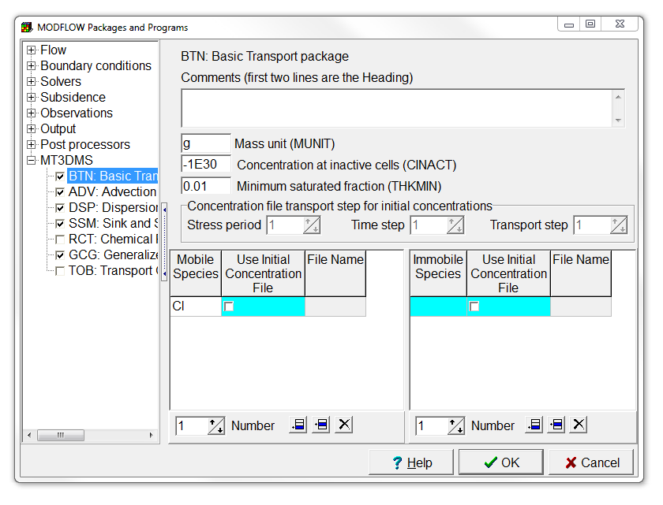
Enable MT3DMS packages
Select Model | MODFLOW Packages and Programs…,
expand MT3DMS or MT3D-USGS, and select the BTN, ADV, DSP, SSM, and GCG packages.
Also fill in the Mobile Species name, e.g. “Cl”.
Then press OK,
and once more OK, in the appearing information dialog box.

Slide 5
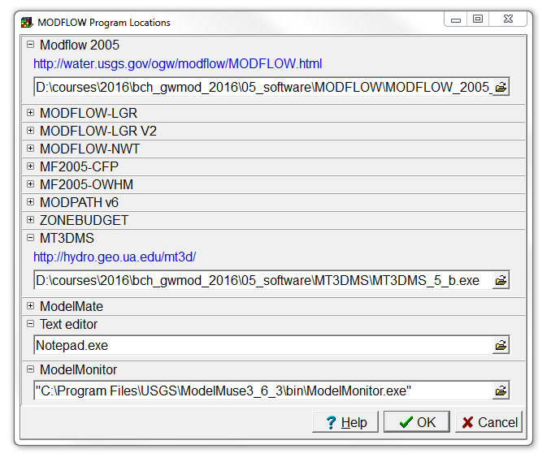
Set the MT3DMS program location
Select Model | MODFLOW Program Locations…, and
fill in the path to the MT3D-USGS executable “mt3d-usgs_64-bit.exe” or “*_32-bit.exe” (depending on your machine architecture) in folder “/05_software/mt3d-usgs/”.
Then press OK.

Slide 6
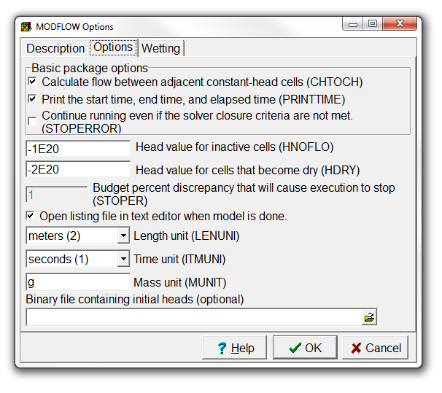
Check mass unit
Select Model | MODFLOW Options…,
go to the Options tab, and
note that by default, the Mass unit is set to grams.
Just leave the settings as they are,
and press OK to close the MODFLOW Options dialog box.

Slide 7
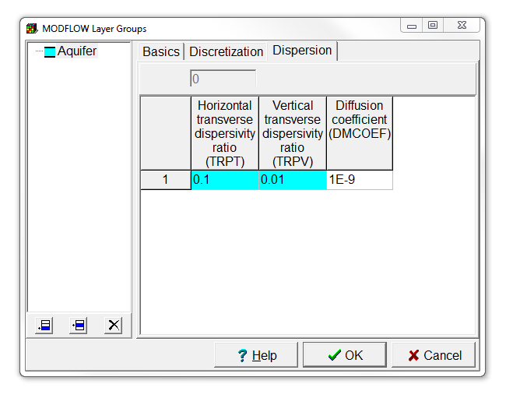
Set dispersion and diffusion parameters
Select Model | MODFLOW Layer Groups…,
and go to the Dispersion tab.
Leave the dispersivities unchanged, but adjust the Diffusion coefficient to 1E-9.
Then click OK.

Slide 8
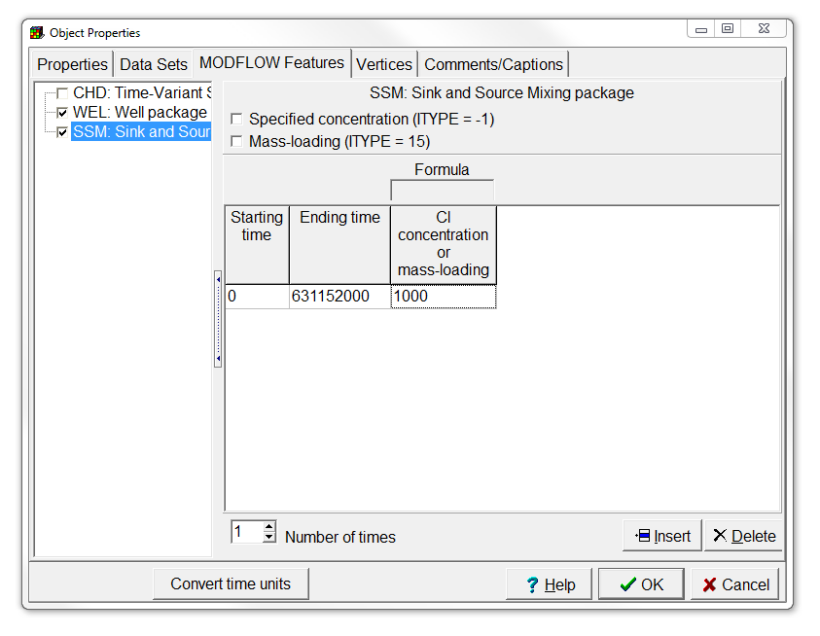
Set the source concentration
Double click the disposal pond object and go to the MODFLOW Features tab in the Object Properties dialog box.
Select the SSM package, and set the Number of times to 1.
Set the Starting time, Ending time, and Cl concentration to respectively 0, 1E9, and 1000.
Then press OK.
1E9

Slide 9
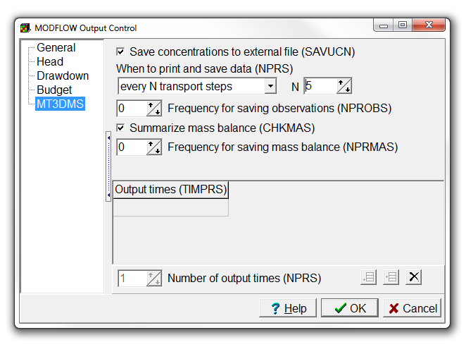
Change output frequency
Select Model | MODFLOW Output Control…,
and choose MT3DMS.
Change When to print and save data to every N transport steps,
and set N equal to 5.
Then click OK.

Slide 10
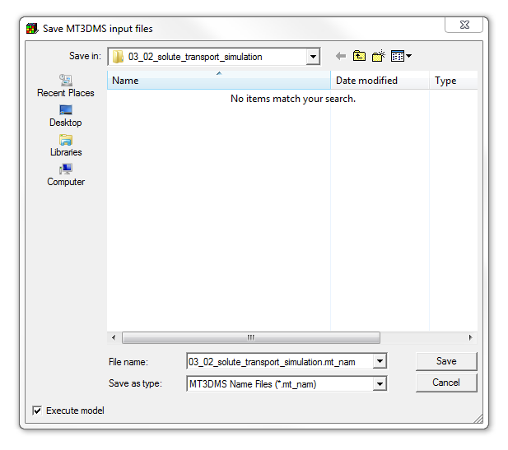
Run MT3DMS
First run MODFLOW again,
then select File | Export | MT3DMS Input Files,
and press Save in the Save MT3DMS input files dialog box.
After MT3DMS has finished, close the text and command line windows.

Slide 11
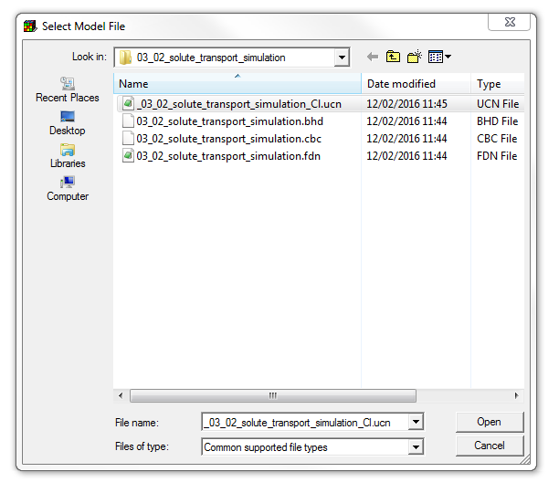
Import MT3DMS results (1/2)
Select File | Import | Model Results,
and choose the “_03_03_solute_transport_simulation_Cl.ucn” file.
Then press Open.

Slide 12
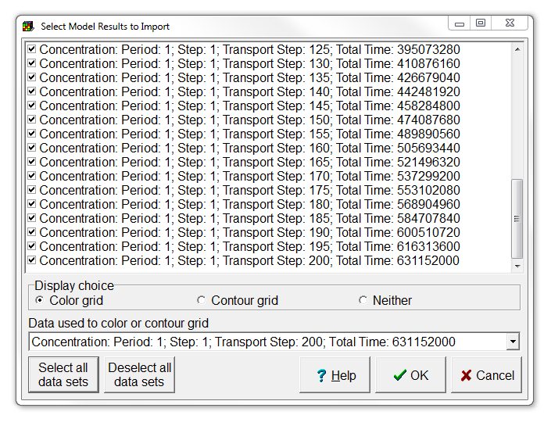
Import MT3DMS results (2/2)
In the Select Model Results to Import dialog box, select all data sets, and
click OK.

Slide 13
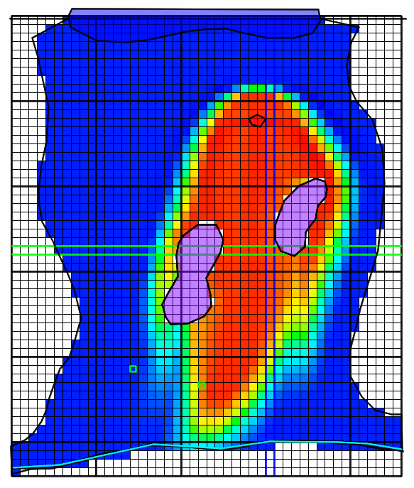
This is what you should get

Slide 14
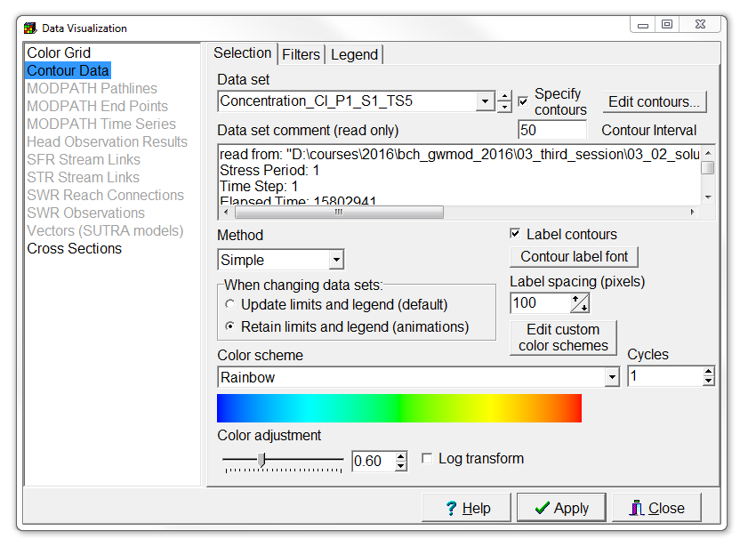
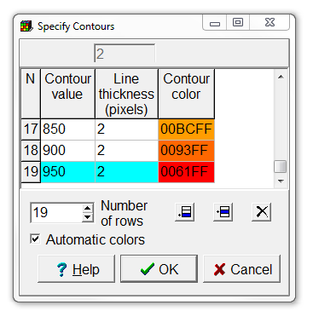
Animate MT3DMS contours (1/3)
Go to the Data Visualization dialog box,
and set the Color Grid Data set to none.
Then go to Contour Data and
select the first concentration Data set.
Set the Contour Interval to 50, and click Apply.
Then check Specify contours, click the Edit contours button and remove the 0 and 1000 contours.
Finally, select Retain limits and legend, and press Apply again.

Slide 15
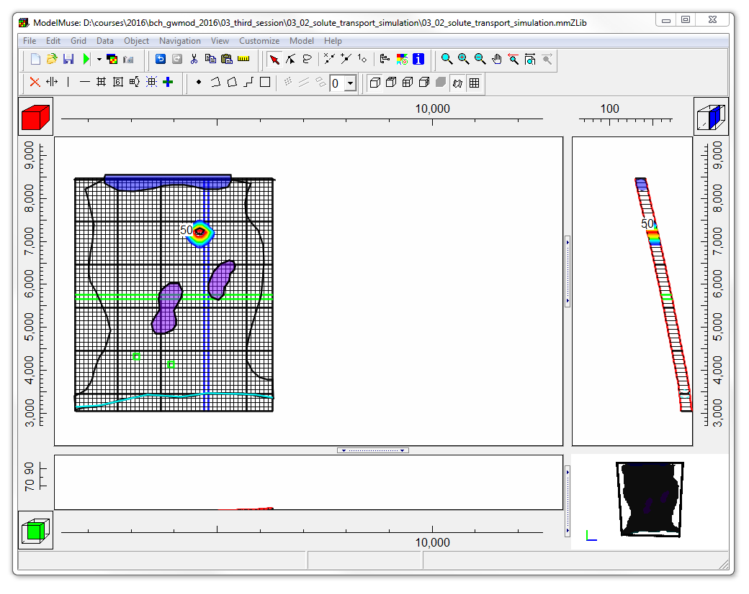
Animate MT3DMS contours (2/3)
Next, move the grid to the left of the Top view pane.
Select File | Export | Image, or use the corresponding button.
Export image

Slide 16
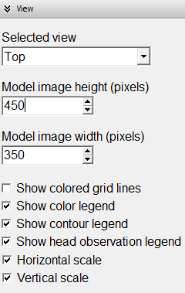
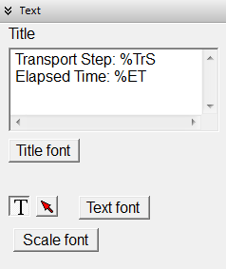
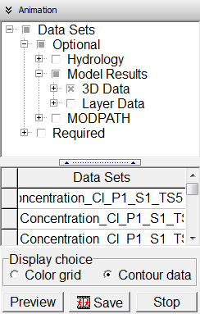
Animate MT3DMS contours (3/3)
In the View pane, adjust the Model image height and Model image width, so the entire grid is visible.
In the Text pane, add “Transport Step: %TrS Elapsed Time: %ET” as title.
In the Animation pane, select Data Sets | Optional | Model Results | 3D Data,
and press Preview.

Slide 17
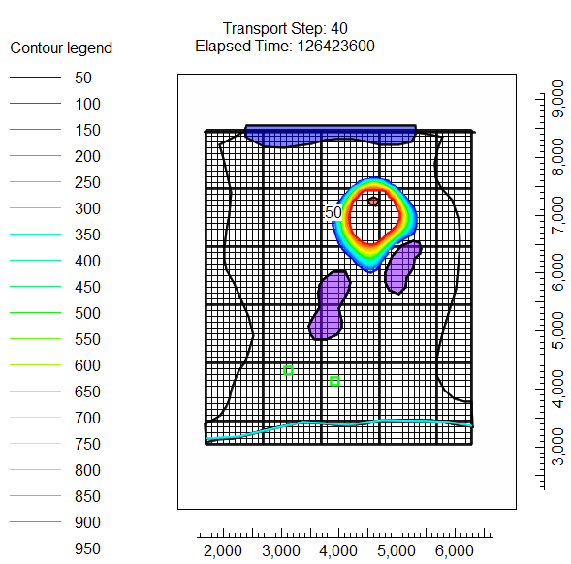
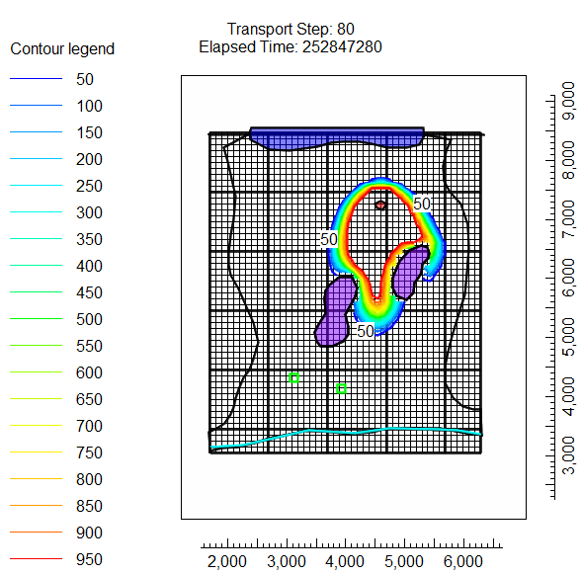
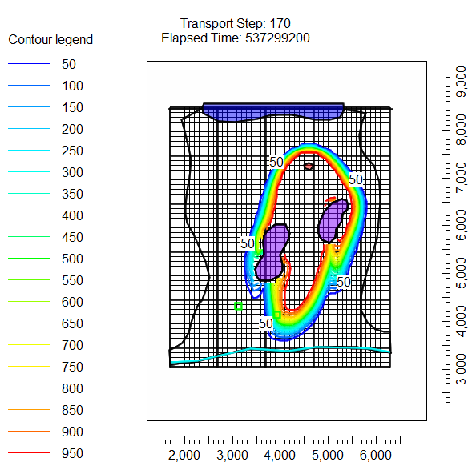
This is what you should get

Slide 18
Education evenings 2018
Practical introduction to groundwater modelling
Computer exercises
03 03 Solute transport simulation
Questions? Found an error? Please contact B. Rogiers at brogiers@sckcen.be.

