Slide 1
Education evenings 2018
Practical introduction to groundwater modelling
Computer exercises
04 01 Grid design

Slide 2
Purpose
In this exercise, we will
modify the default grid manually,
specify the grid design using objects,
change the active part of the grid,
and increase vertical discretization of the default Layer Groups,
in order to get acquainted with some of the ModelMuse grid design possibilities.

Slide 3
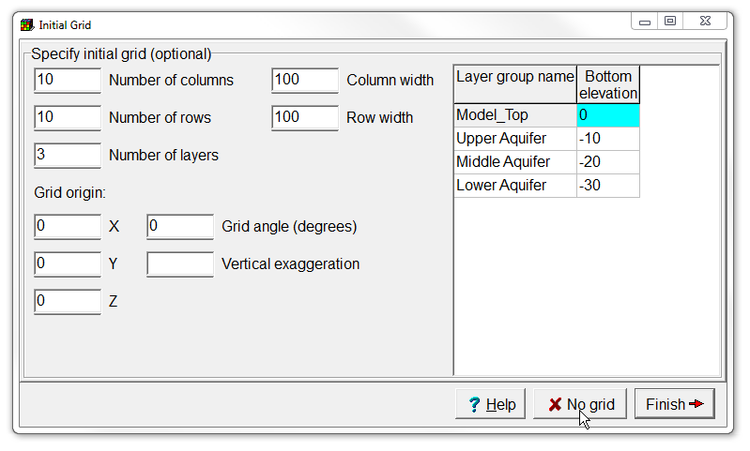
Set initial grid
1. Start ModelMuse, create a new MODFLOW model and set the projection to "NA".
2. We are now at the initial grid window
5. the horizontal cell dimensions
6. and the layer group names and bottom elevations.
3. where we can specify the number of cells in each direction
4. the grid origin, angle and vertical exaggeration
7. Accept the defaults and click Finish.

Slide 4
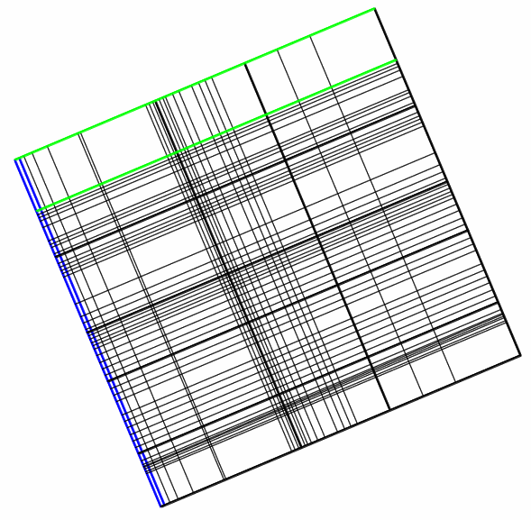
Modify the grid manually
1. The grid toolbar provides different tools to do so.
9. Take a moment to familiarize yourself with the different tools.
8. Drag to rotate grid
2. Delete grid lines
7. Set spacing of selected elements
3. Drag grid lines
4. Add vertical grid line
6. Subdivide grid cells
5. Add horizontal grid line
10. Note you can also use some of the tools in the Top and Side views.

Slide 5
Skip creating a grid
1. Start ModelMuse again, create a new MODFLOW model and set the projection to "NA".
2. We have used the initial grid window before
3. Therefore skip creating a grid at this point by clicking the No grid button

Slide 6
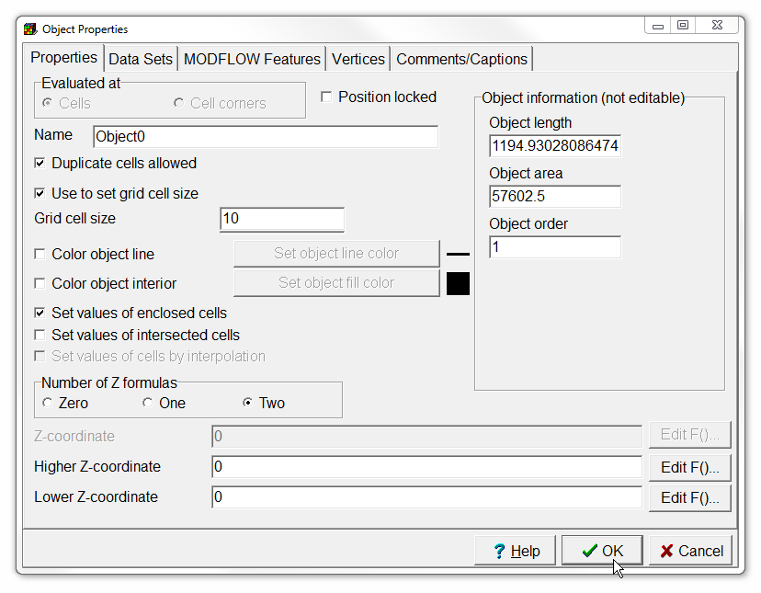
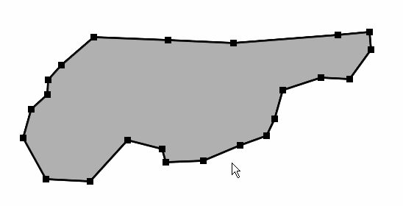
Use object to set grid cell size
4. And set it to 10 (or another reasonable number if your polygon size is not really compatible with it).
1. Select Create polygon object, and
2. Draw a polygon like this.
3. Therefore skip creating a grid at this point by clicking the No grid button
3. In the Object Properties dialog box, check Use to set grid cell size
5. Click OK.

Slide 7
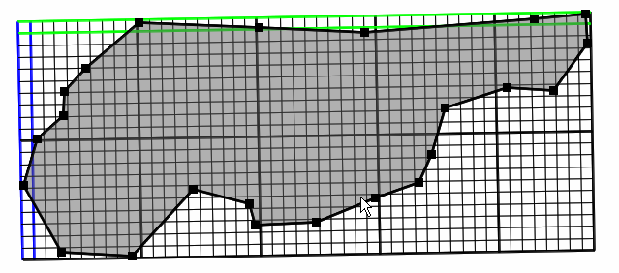
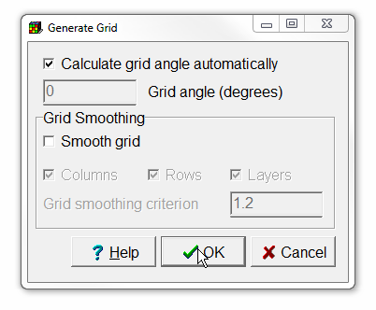
Generate grid
1. Click the Generate grid button
3. This is what you should get.
2. Leave the default options, and press OK.

Slide 8
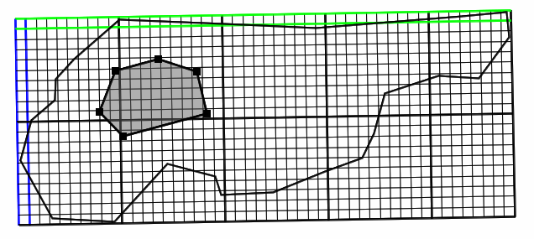
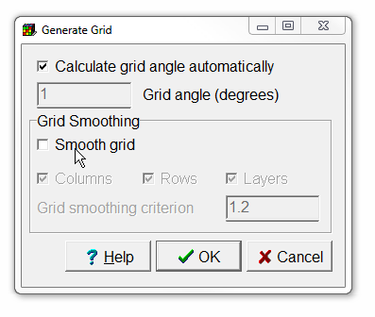
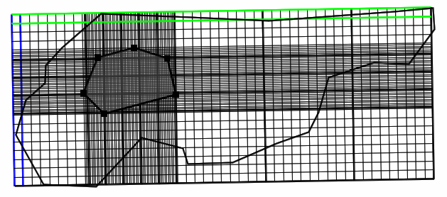
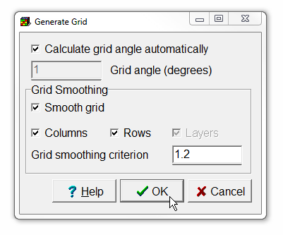
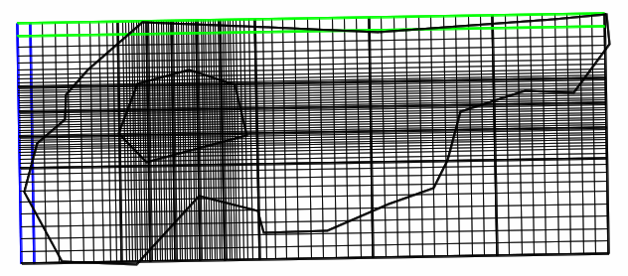
Refine grid with object
1. Add a polygon, and use it to set grid cell size to 2.
2. Generate the grid again without the Smooth grid option.
3. Then press undo and generate the grid with the Smooth grid option to see the difference.

Slide 9
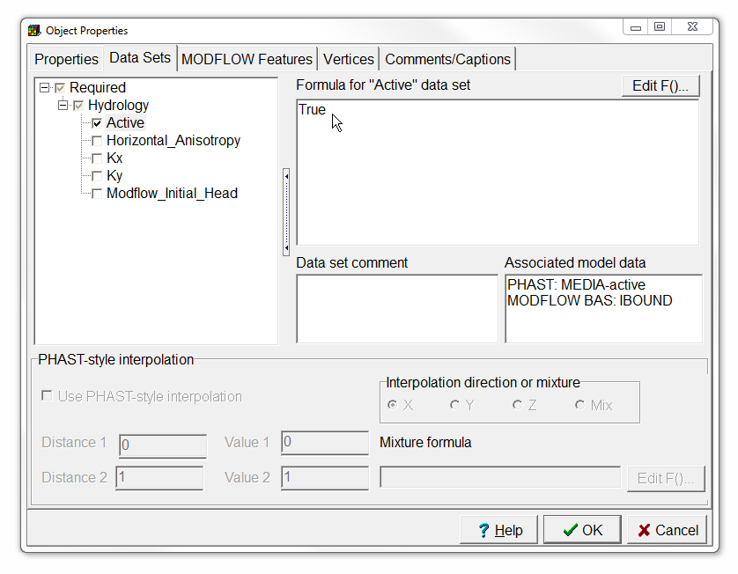
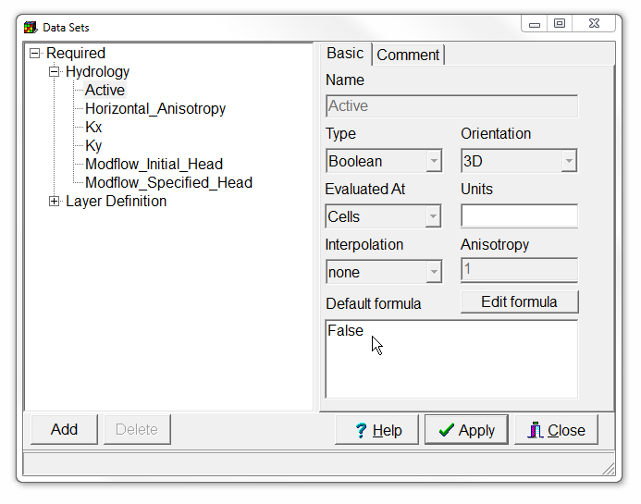
Set active part of grid with object
2. Then modify the data set with the largest polygon. Make sure it has the correct Z coordinates!
1. Set the Active data set default formula to False

Slide 10
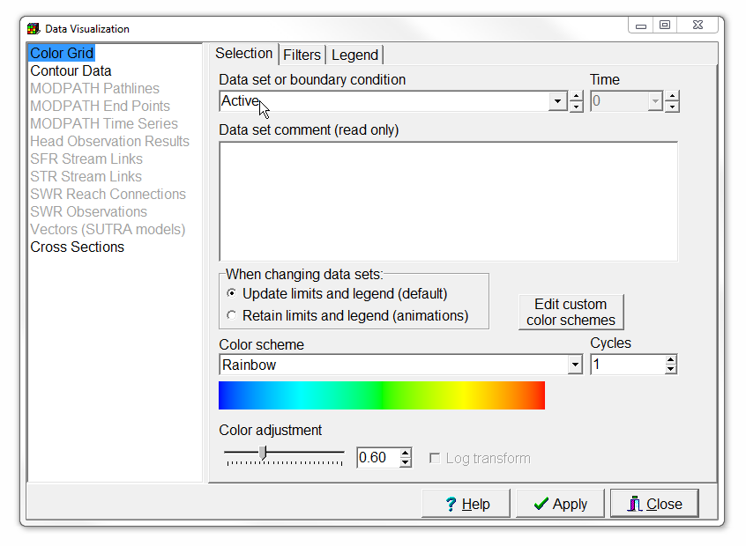
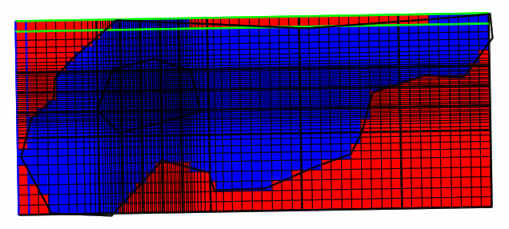
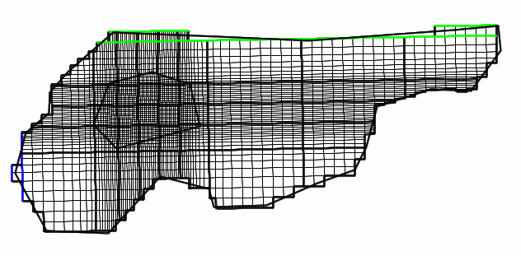

Visualize active part of grid
1. Colour the grid with the active data set, or
2. Select Show or hide 2D gridlines|Show Active

Slide 11
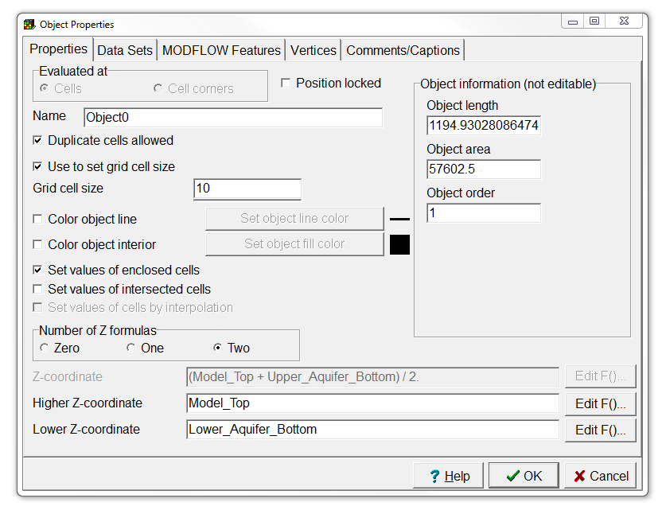
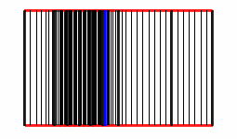
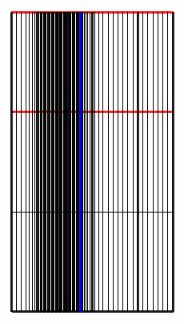
Activate Middle and Lower Aquifers again
1. Check if the second and third layer are active.
2. If not, set the Lower Z-coordinate of the largest polygon to Lower_Aquifer_Bottom to fix this.

Slide 12
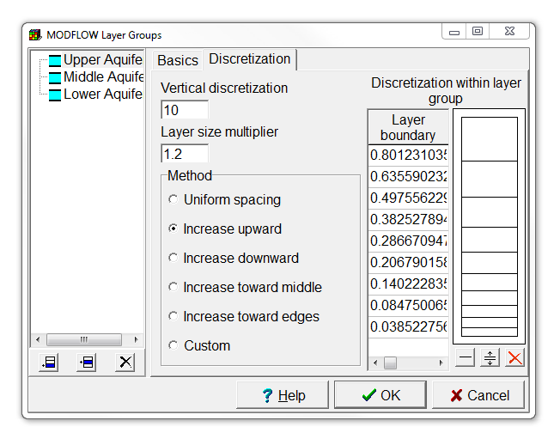
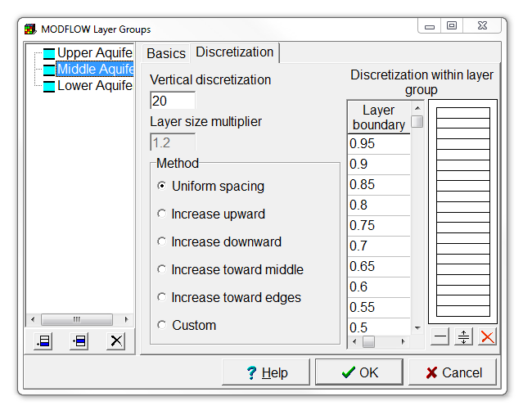
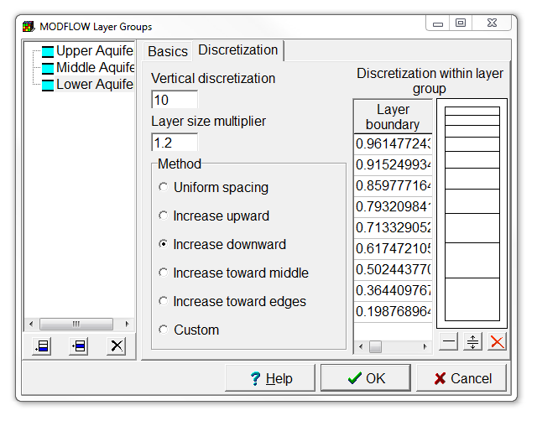
Refine layer discretization
1. Select Model | MODFLOW Layer Groups,
3. And set the Method to Increase upward, Uniform spacing and Increase downward.
2. Change the vertical discretization to 10, 20, and 10 respectively,

Slide 13
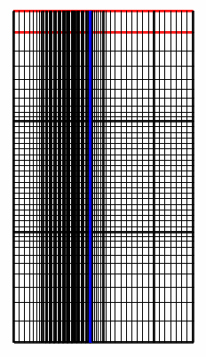
This is what you should get

Slide 14
Education evenings 2018
Practical introduction to groundwater modelling
Computer exercises
04 01 Grid design
Questions? Found an error? Please contact B. Rogiers at brogiers@sckcen.be.

