Slide 1
GET /images?breed=schnauzer&nr=3 HTTP/1.1
Accept: image/gif, image/jpeg
Accept-Encoding: gzip, deflate, br
Cache-Control: no-cache
Host: www.dogbreeds.be
User-Agent: Intel Mac OS X 10_14_4; Chrome/74.0
GET request line with parameters added to the URL
request headers
blank line separating header and body
request body; empty when using GET

Slide 2
POST /nl/login.php HTTP/1.1
Accept: text/html,*/*
Accept-Encoding: gzip, deflate, br
Host: my.service.be Referer: https://www.service.be/index.html
User-Agent: Intel Mac OS X 10_14_4; Chrome/74.0
username=bobby&passw=Azerty123
POST request line
request headers
request body contains login parameters

Slide 3
POST /nl/upload.aspx HTTP/1.1
Accept: text/html,*/*
Host: my.photos.com User-Agent: Intel Mac OS X 10_14_4; Chrome/74.0
-----------------------------735323031399963166993862150 Content-Disposition: form-data; name="file3"; filename="binary" Content-Type: application/octet-stream 5249 4646 5249 4646 c4ea 1a00 5741 5645 666d 7420
1000 0000 0100 0200 44ac 0000 10b1 0200
0400 1000 6461 7461 a0ea 1a00 0000 8000
8000 0001 0001 8101 8101 0102 0102 8102
8102 0103 0103 8003 8003 0004 0004 7f04
7f04 fe04 fe04 7d05 7d05 fb05 fb05 7906
7906 f706 f706 7407 7407 f007 f007 6c08
...
...
POST request line
request headers
request body contains uploaded file

Slide 4
HTTP/1.1 200 OK
content-encoding: gzip
content-type: text/html; charset=UTF-8
date: Fri, 14 Jun 2019 21:24:24 GMT server: nginx <!DOCTYPE html>
<html lang="nl"><head>
<meta http-equiv="Content-Type" content="text/html; charset=UTF-8" />
<title>Dashboard &lsaquo; Act Academie &#8212; WordPress</title>
<script type="text/javascript">
addLoadEvent = function(func) ...
response line
response headers
response body contains response data

Slide 5
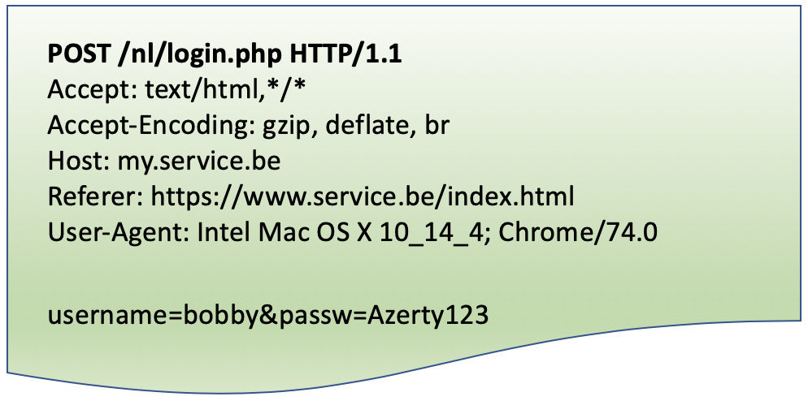
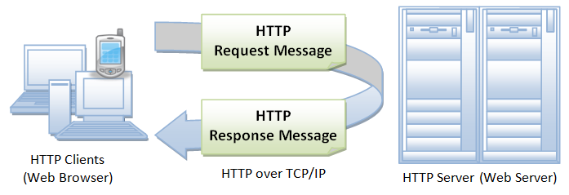

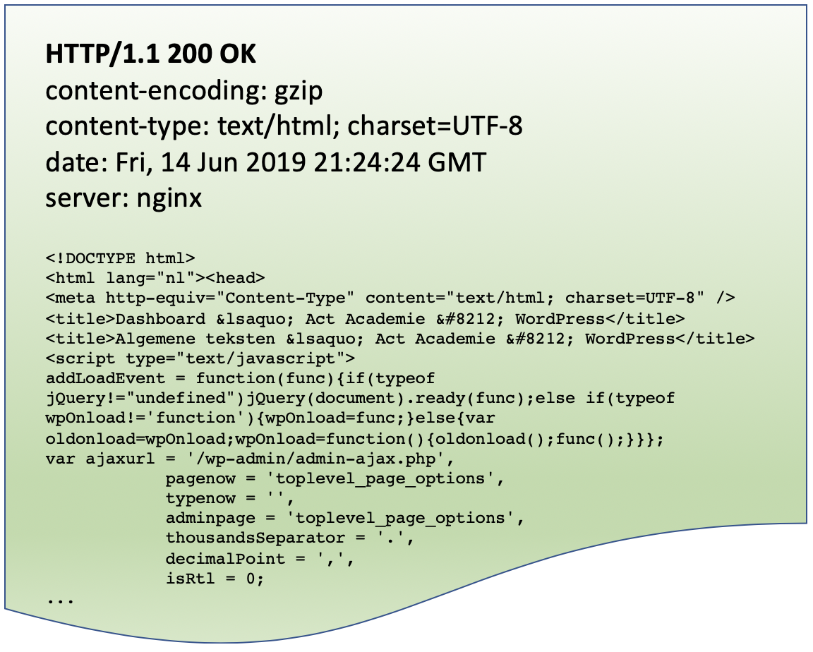
1. request
SERVER
CLIENT
3. response
2. some magic happens here

Slide 6
HTTP/1.1 200 OK
content-encoding: gzip
content-type: text/html; charset=UTF-8
date: Fri, 14 Jun 2019 21:24:24 GMT server: nginx <!DOCTYPE html>
<html lang="nl"><head>
<meta http-equiv="Content-Type" content="text/html; charset=UTF-8" />
<title>Dashboard &lsaquo; Act Academie &#8212; WordPress</title>
<title>Algemene teksten &lsaquo; Act Academie &#8212; WordPress</title>
<script type="text/javascript">
addLoadEvent = function(func){if(typeof jQuery!="undefined")jQuery(document).ready(func);else if(typeof wpOnload!='function'){wpOnload=func;}else{var oldonload=wpOnload;wpOnload=function(){oldonload();func();}}};
var ajaxurl = '/wp-admin/admin-ajax.php',
pagenow = 'toplevel_page_options',
typenow = '',
adminpage = 'toplevel_page_options',
thousandsSeparator = '.',
decimalPoint = ',',
isRtl = 0;
...

Slide 7
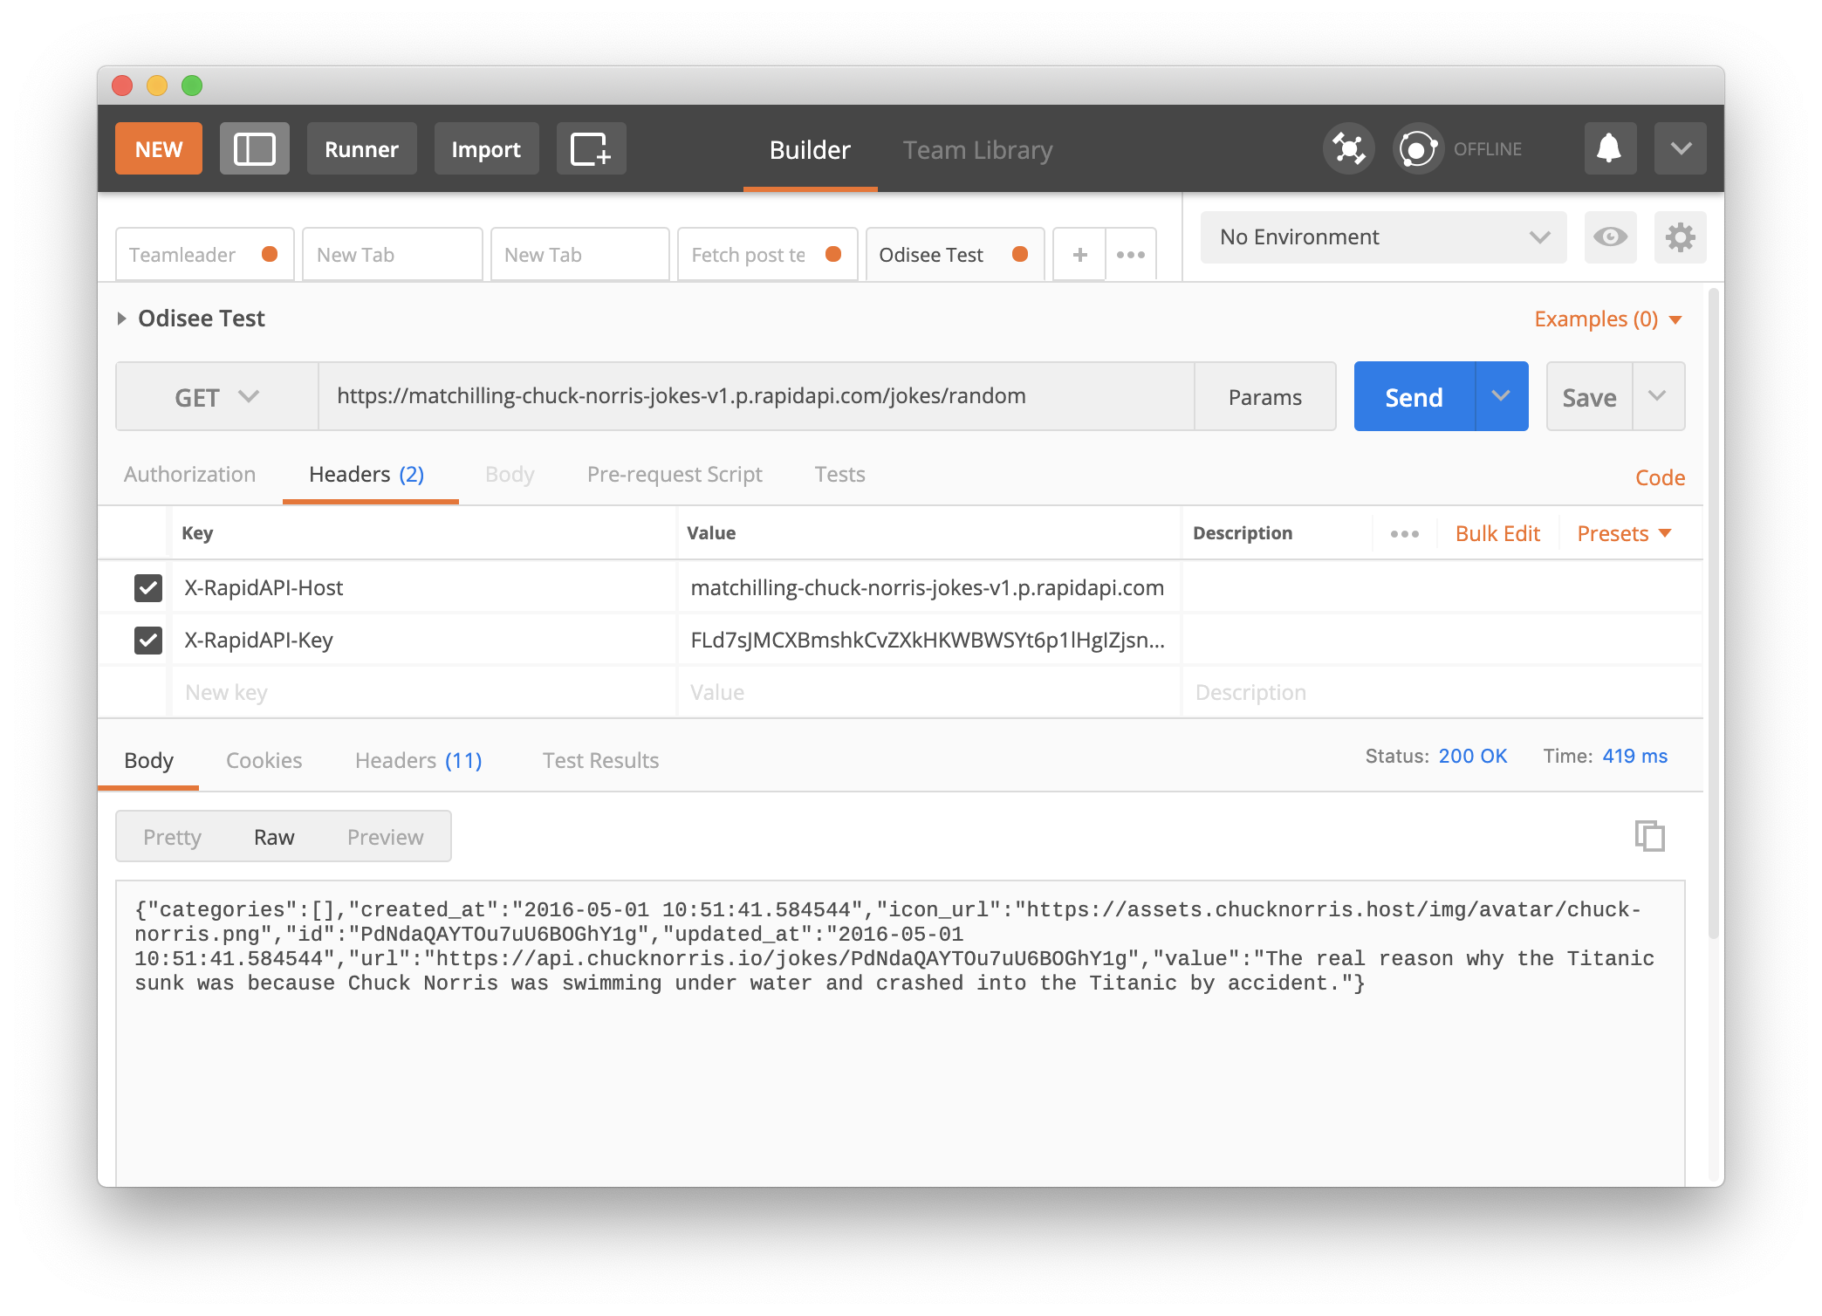
URL
method
send request
custom headers
response

Slide 8
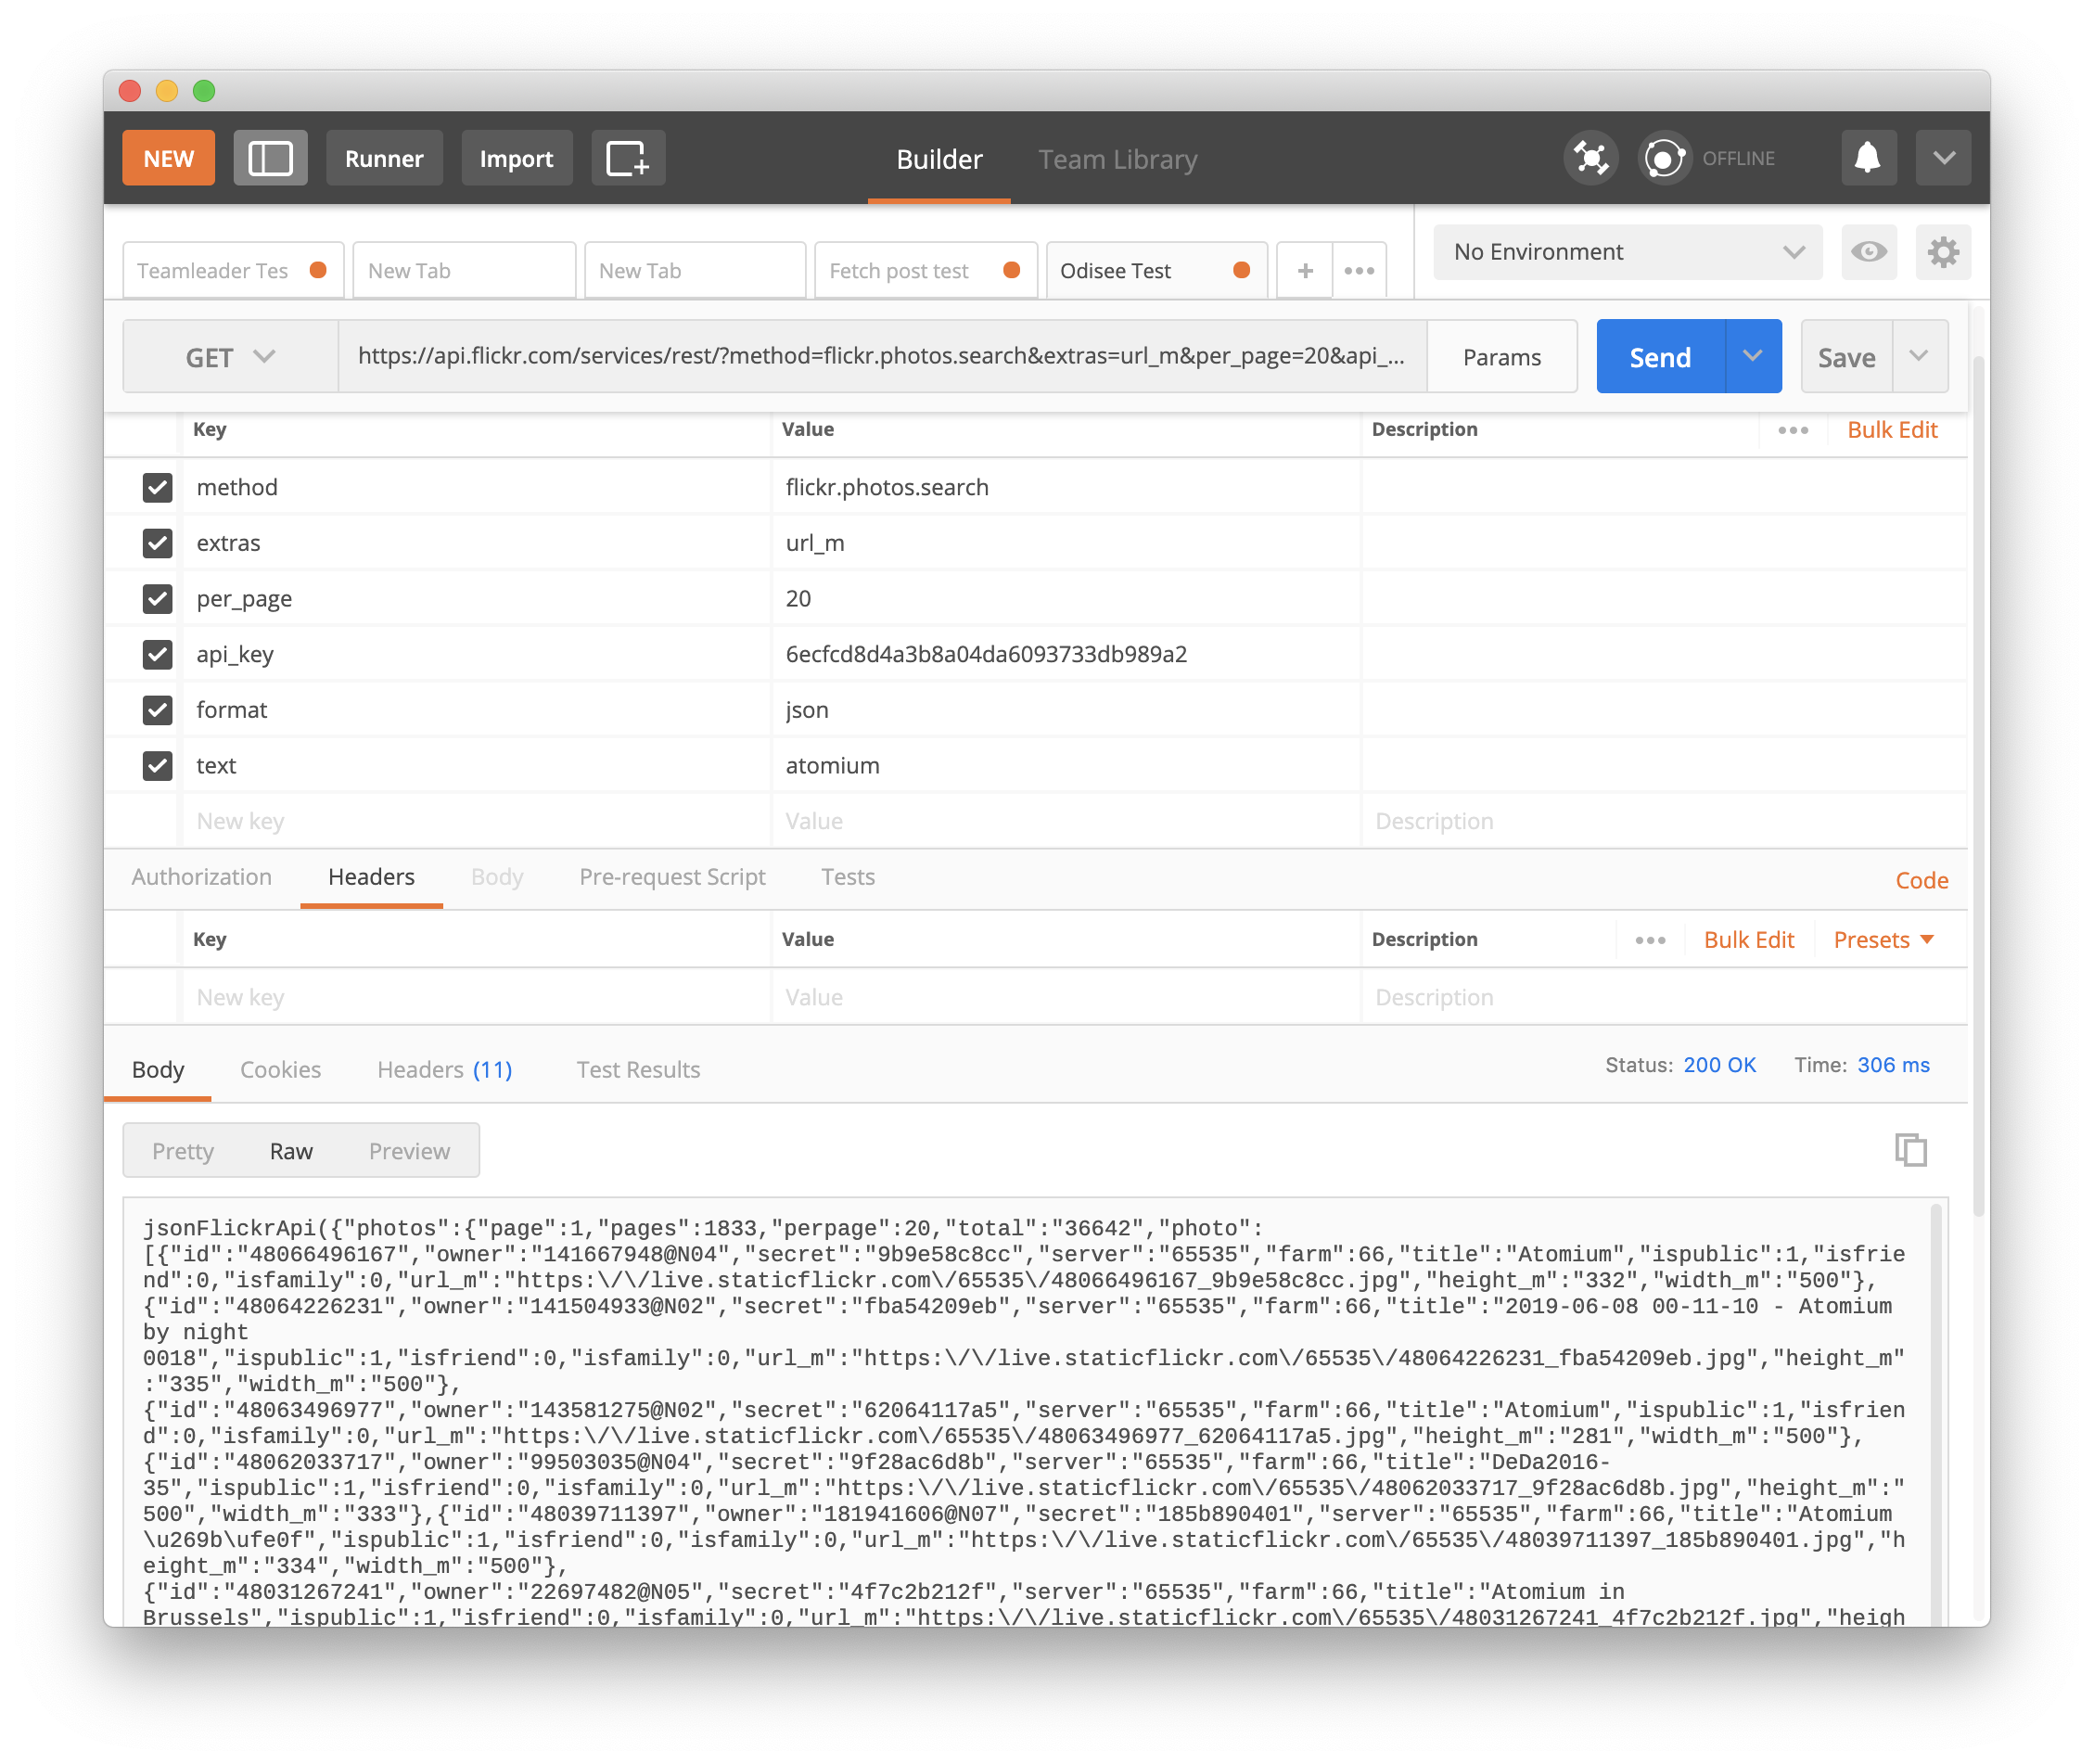
URL
send request
API key
GET parameters
JSON response

Slide 9
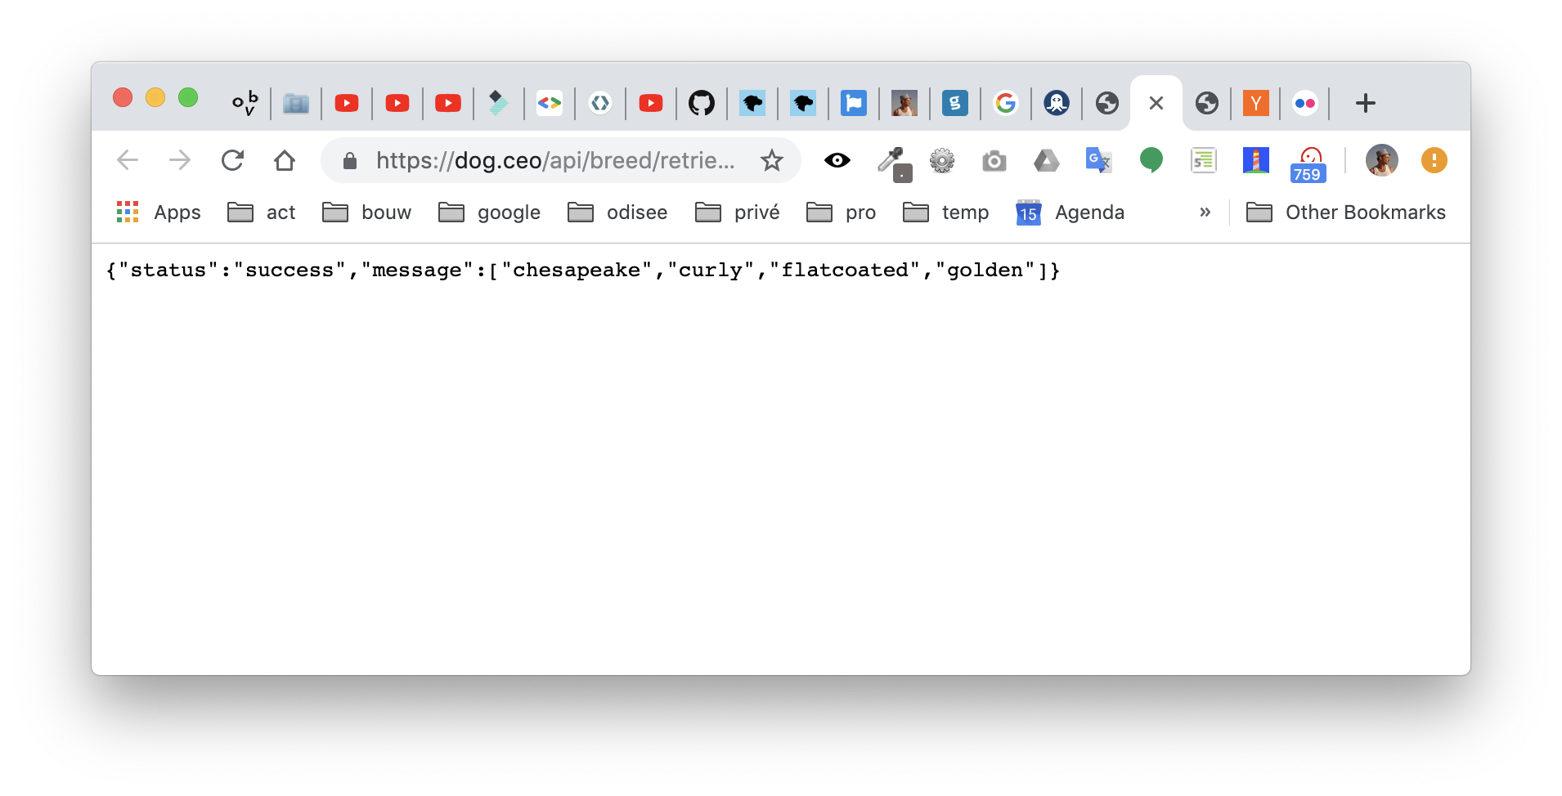
request URL
URL
response text in JSON format

Slide 10
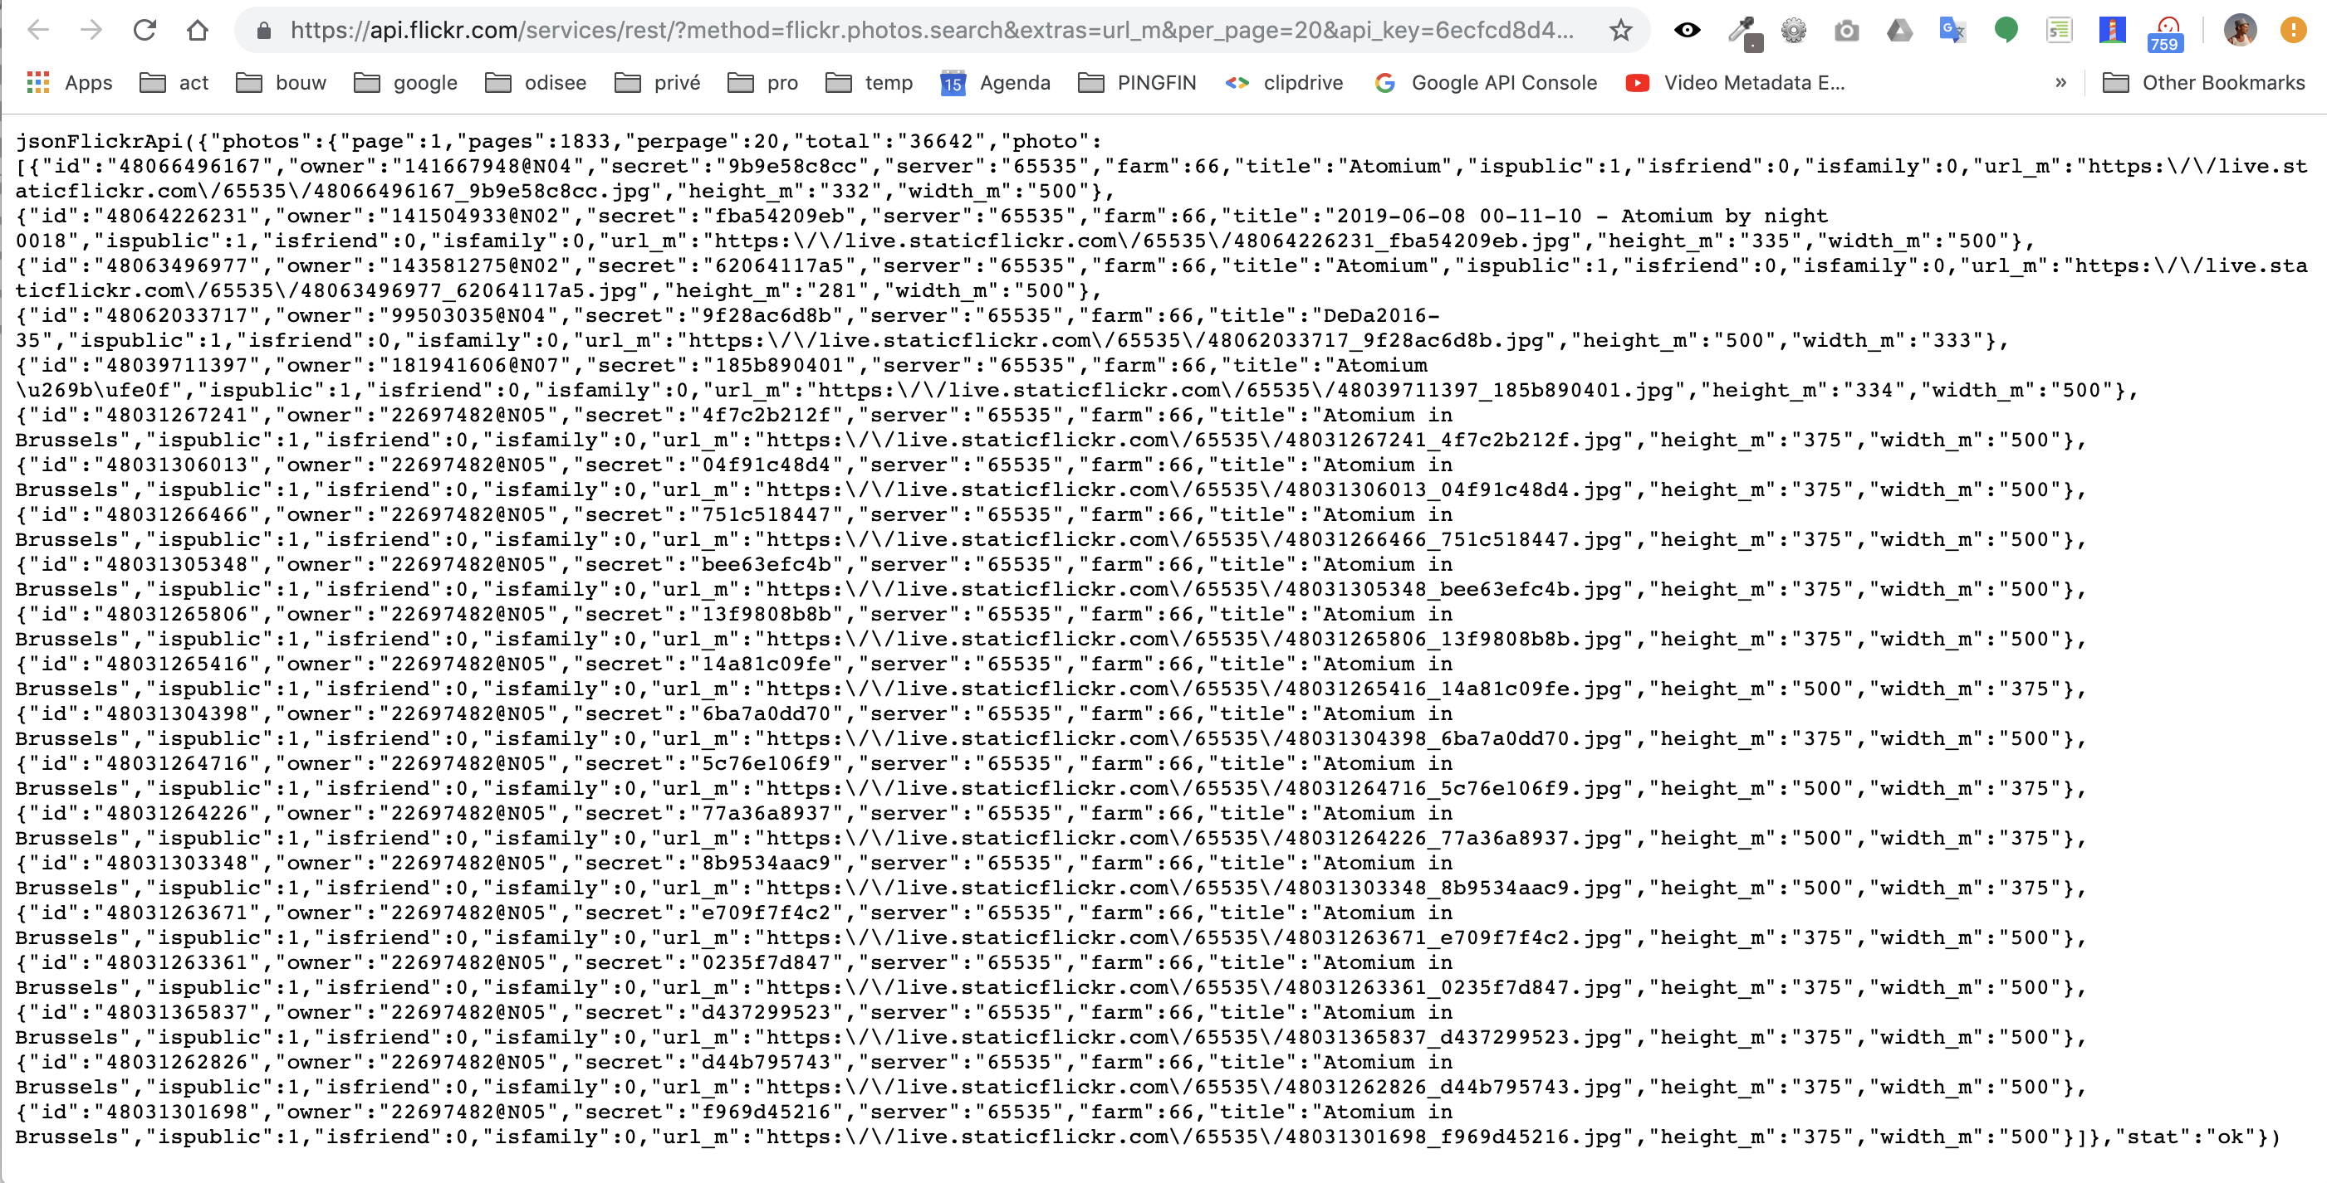
request URL
response text in JSON format

