Slide 1
DOCTOR HERE
ONLINE DOCTOR CONSULTATION
ROGITHKUMAR.B
2019202047
GUIDE: Ms.P.S.APIRAJITHA

Slide 2
INTRODUCTION
To design a system which provides platform for patients to consultant doctor virtually and store their medical records in blockchain.
The application will have three sides, One for Doctors, one for patients and admin to manage both.
Doctors can voluntarily register themselves on our website for their particular profession.

Slide 3
MODULES
PATIENT MODULE:
Patient needs to register and login
Patient need to Search for the doctor
Send request to the doctor to check the availability for consultation
Connect with the doctor virtually
Pay for the consultation
Get the eprescription

Slide 4
MODULES
DOCTOR MODULE:
Doctor need to register and login
Admin will approval the doctor identity
Accept the patient request
After consultation send payment and eprescription to patient
ADMIN MODULE:
Approve doctor identity
Manage patient and doctor details
Manage payment details

Slide 5
Workflow diagram of patient module

Slide 6
Smart contracts to store data in blockchain
Health records:
Smart contracts allow records and information to be stored on a digital ledger. This means if a patient was moving from one hospital to another, they would be able to do so with ease and without having to fill out numerous forms.
Records can then also be viewed by the patient’s preferred physician on the blockchain network.
Hospitals and healthcare companies rely on a number of databases filled with patient information.
However, these can be too restrictive to allow for the sharing of potentially life-saving insights around the globe. Without blockchain and smart contracts, this information may take a long time to reach the recipient and could potentially be hacked.

Slide 7
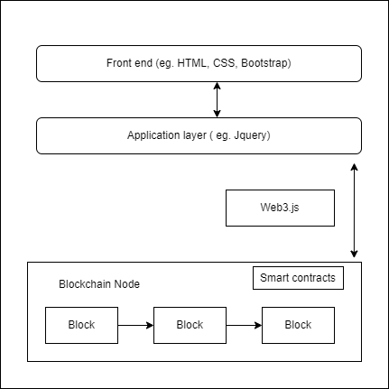
Architecture diagram

Slide 8
Tools and Technologies
Remix IDE
Solidity
Ganache
Web3.js
HTML5
CSS5
Bootstrap and jquery

Slide 9
Thank You

