Slide 1
VIRTUAL DOCTOR
PROJECT GUIDE: STUDENT DETAILS:
MS.P.S.APIRAJITHA ROGITHKUMAR.B
2019202047
BATCH-2

Slide 2
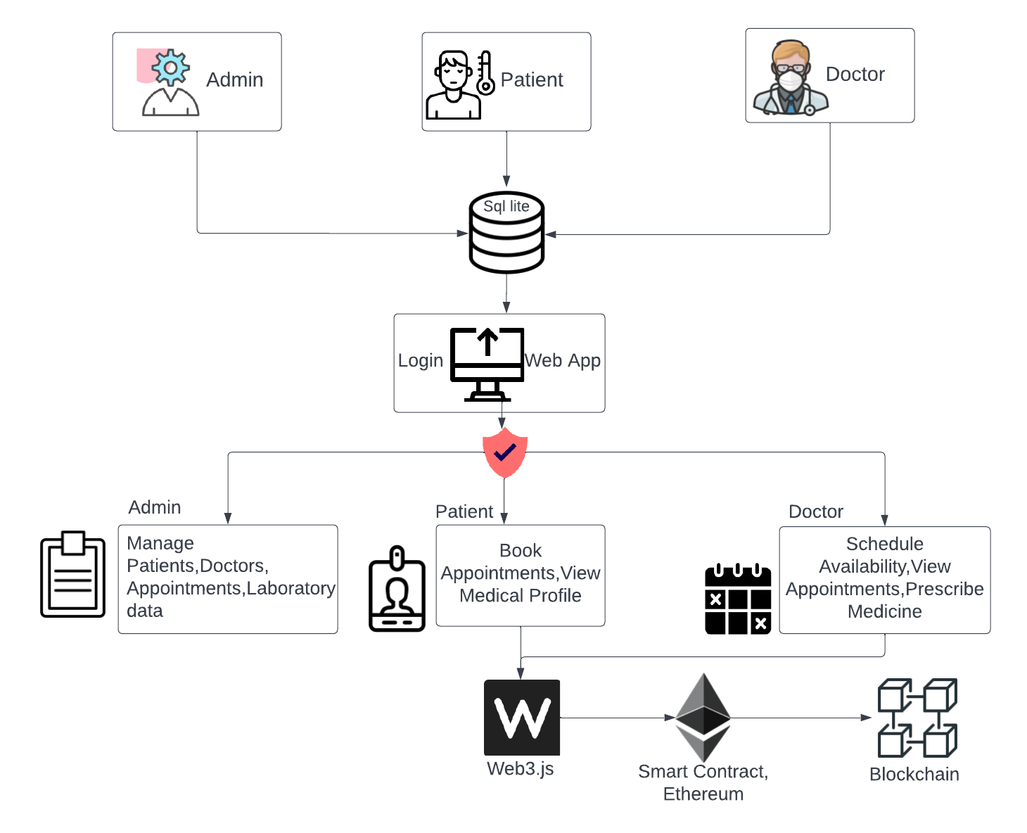
OVERALL ARCHITECTURE

Slide 3
LIST OF MODULES
.
Patients
Doctors
Admin
Appointment bookings
Video chat
Online prescriptions

Slide 4
LIST OF MODULES
ADMIN MODULE:
Approve doctor identity
Manage patient and doctor details
Manage payment details
DOCTOR MODULE:
Doctor need to register and login.
Admin will approval the doctor identity.
Accept the patient request.
sends payment details and prescription to patient

Slide 5
LIST OF MODULES
PATIENT MODULE:
Patient needs to register and login
Search for the doctor
Send request to the doctor to check the availability for consultation
Connect with the doctor virtually
Pay for the consultation
Get the prescription
APPOINTMENT MODULE:
Patient has to select the service
Patient needs to fill the appointment form
Doctor will accept the received appointment
After the doctor appointment approval they can connect virtually

Slide 6
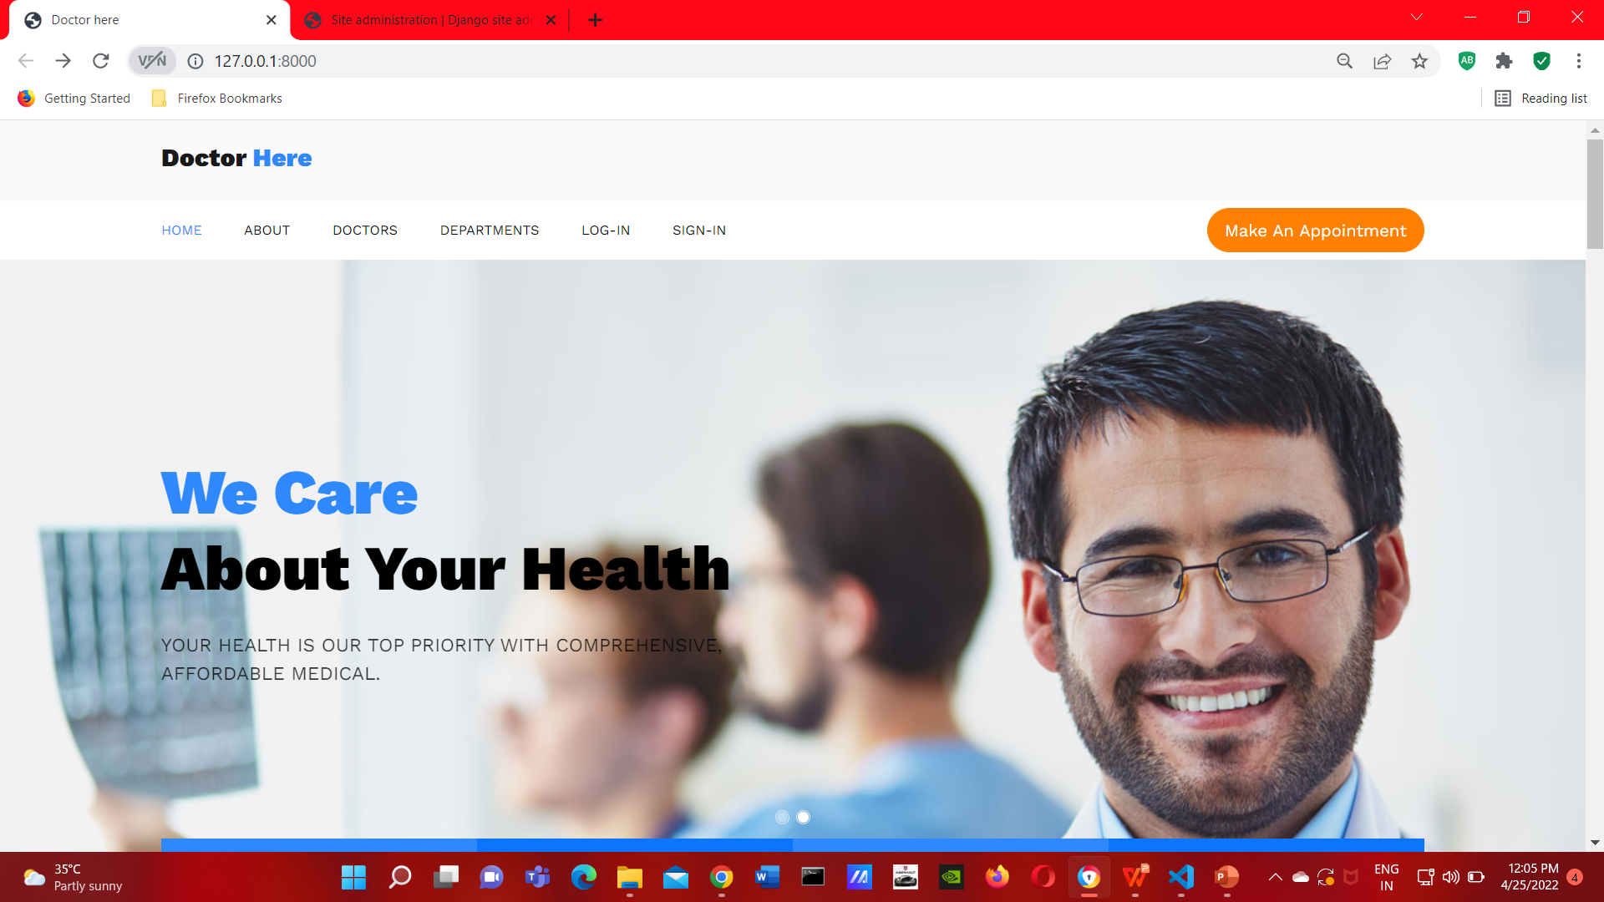
MODULE BASED OUTPUT SCREENSHOTS
HOME SCREEN:

Slide 7
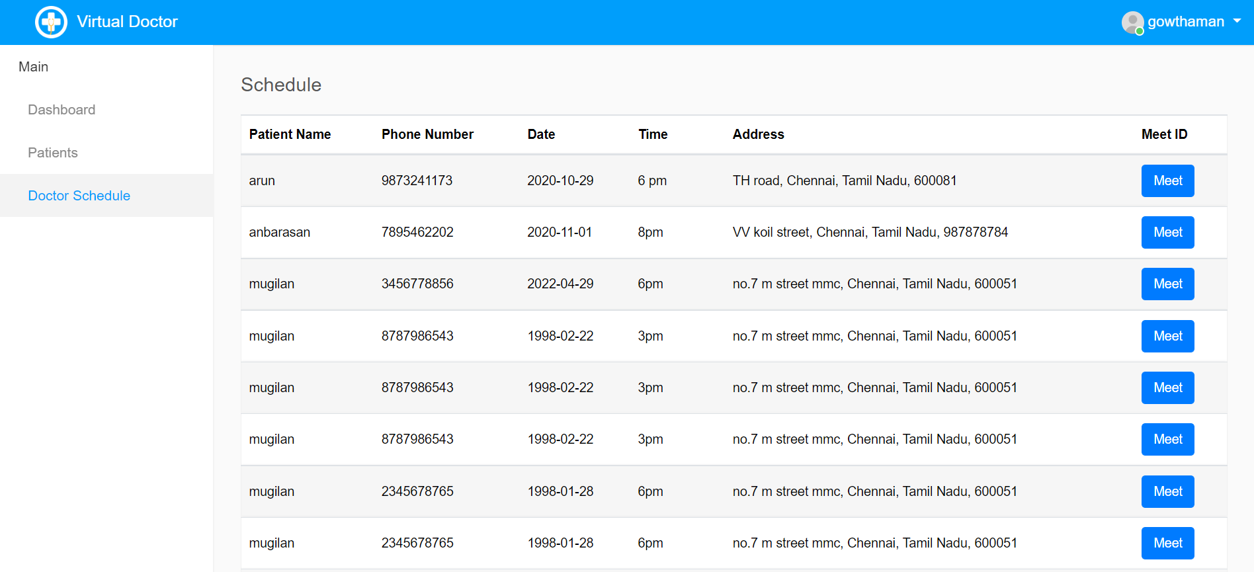
MODULE BASED OUTPUT SCREENSHOTS
DOCTOR SCREEN:

Slide 8

MODULE BASED OUTPUT SCREENSHOTS
PATIENT SCREEN:

Slide 9
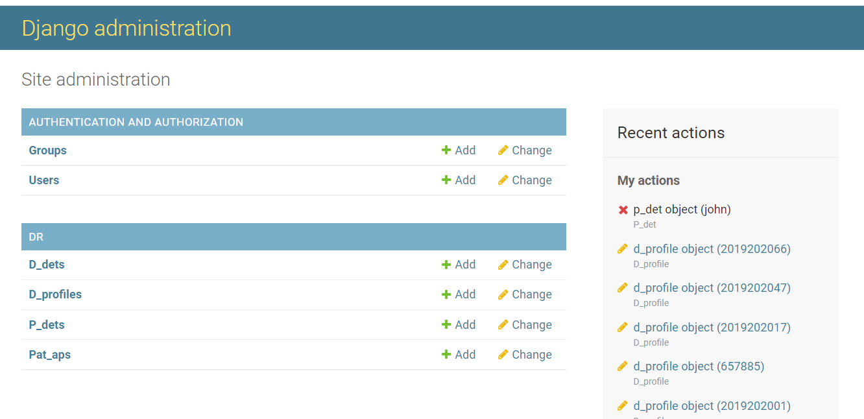
MODULE BASED OUTPUT SCREENSHOTS
ADMIN SCREEN:

Slide 10
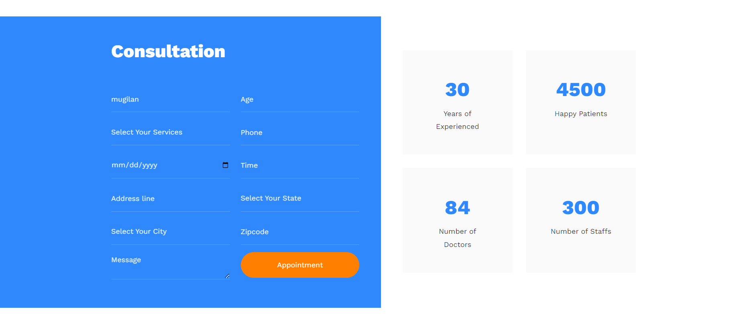
MODULE BASED OUTPUT SCREENSHOTS
APPOINTMENT BOOKING SCREEN:

Slide 11
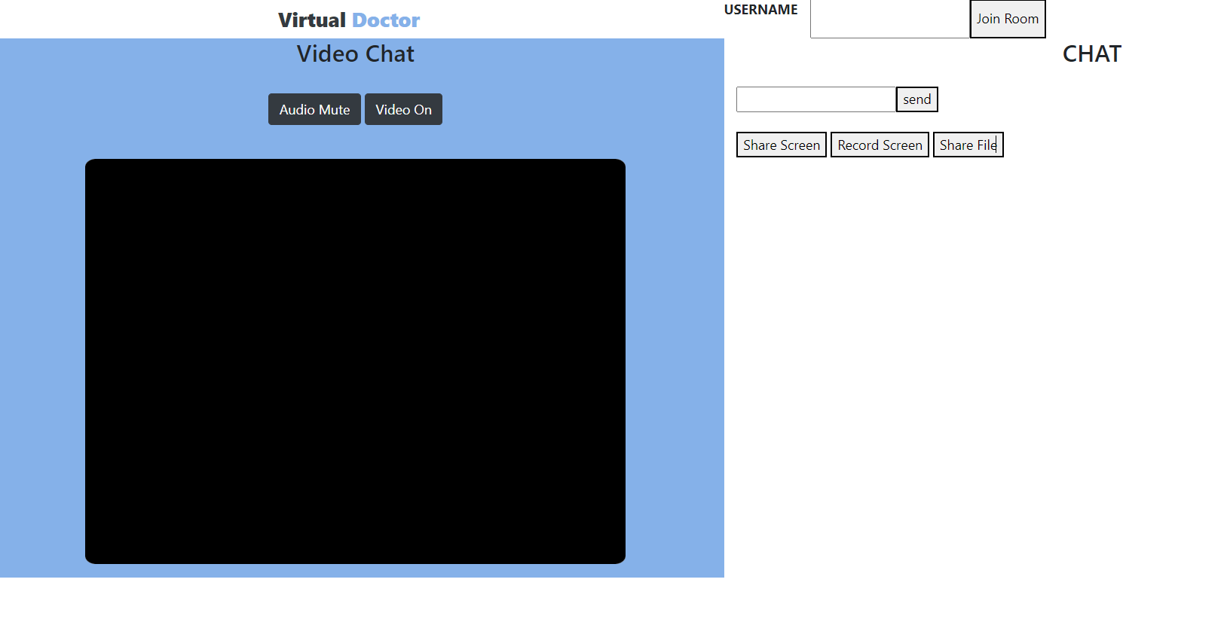
MODULE BASED OUTPUT SCREENSHOTS
VIDEO CHAT SCREEN:

Slide 12
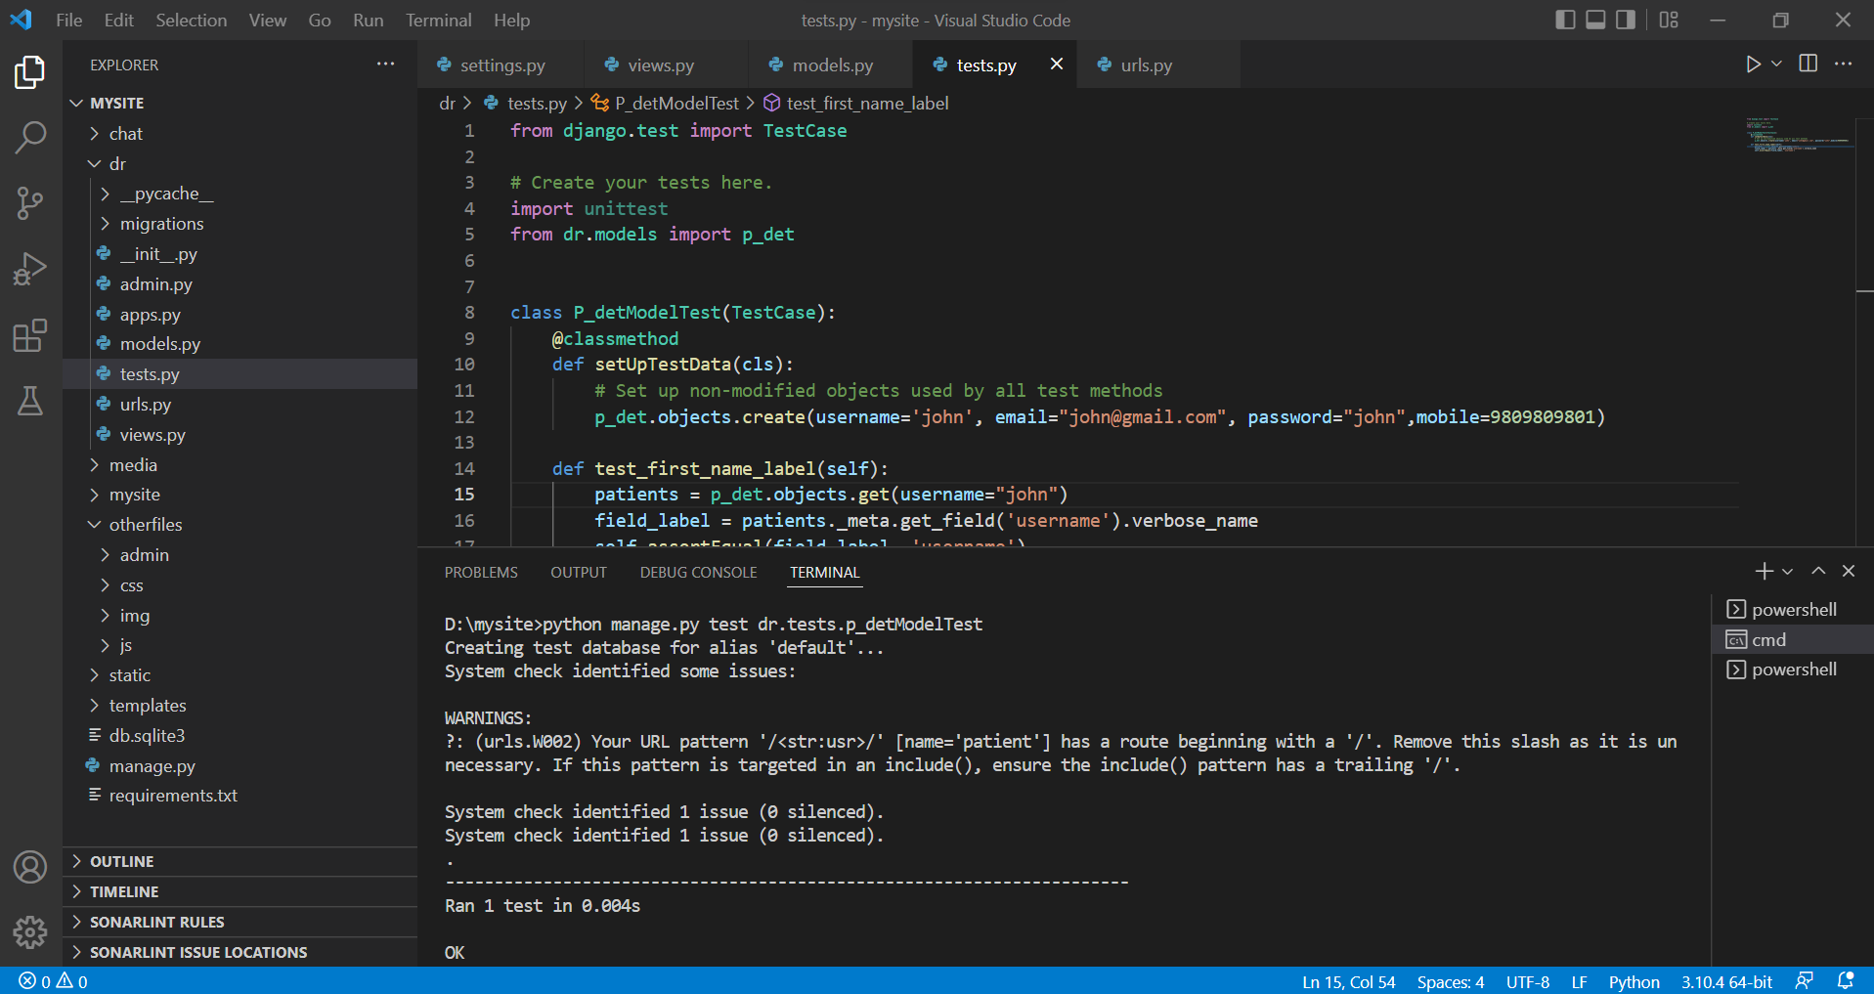
UNIT TESTING TESTING PATIENT MODEL:

Slide 13
REFERENCES
S. S. Devi, J. S. Deepica, K. Dharshini and G. Dhivyashree, "User Interactive Hospital Management System by using Web application," 2021 Second International Conference on Electronics and Sustainable Communication Systems (ICESC), 2021.
Pranjali Anpan, Roshni Udasi, Susneha Jagtap, Shon Thakre and Chalika Kamble, "Hospital Management System", International Research Journal of Engineering and Technology (IRJET), vol. 07, no. 04, 2020.
Dagher, G. G., Mohler, J., Milojkovic, M., & Marella, P. B. (2018). Ancile: Privacy-preserving framework for access control and interoperability of electronic health records using blockchain technology. Sustainable Cities and Society, 39, 283–297.
Kotapati Saimanoj, Grandhi Poojitha, Khushbu Devendra Dixit and Laxmi Jayannavar, Hospital Management System using Web Technology, The Mattingley Publishing Co., Inc., vol. 83, pp. 4493-4496, 2020.

Slide 14
THANK YOU

