Slide 1
F# for C# Developers Why should we care?
Notes:
Intro… Wait until everyone is ready. Warning I am not an expert in Functional Programming I only want to share you my experience because I think this tool is valuable to us.

Slide 2
Why should we care?
Is a tool we already have (No need to install anything to use it)
Performance for free (Time is money!)
Many more (https://fsharpforfunandprofit.com/why-use-fsharp/)
The free performance lunch (Next slide) (http://www.gotw.ca/publications/concurrency-ddj.htm) Quotes in the slides come from this source.
Notes:
Tell the story about how you get to F#. Performance issues in Portal, books you read about parallel on C#, is C# the right tool to parallel programming?
Another story: Task<T> was actually causing bottleneck on Portal.
Another story: People used to make fun of me because I get very excited about new programming tools. Another story: Couple of years ago I did a lunch and learn on Nodejs. Nobody implemented it.

Slide 3
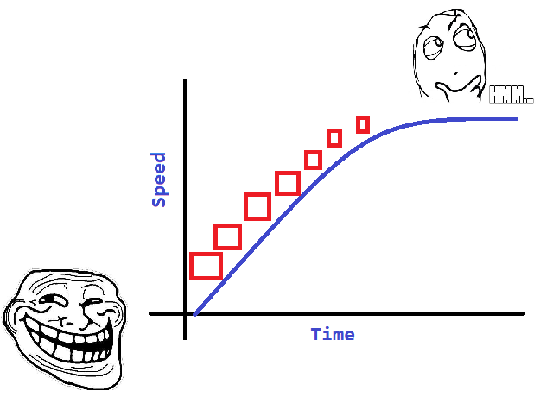

History and Statistics
Seriously: Document bellow explains this. It dates from 2005!
http://www.gotw.ca/publications/concurrency-ddj.htm
Notes:
Some scientist predicted speed performance improvement up to certain point. As processors get faster they consume more energy, and that generates heat and reduces battery life. To avoid that hey made them smaller. When that was not longer posible they made multicore.

Slide 4
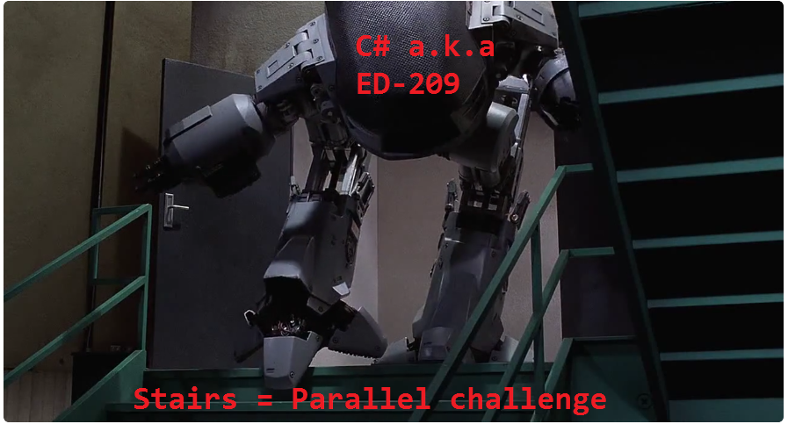
C# Concurrency Demo in Code
“Everybody who learns concurrency thinks they understand it, ends up finding mysterious races they thought weren’t possible, and discovers that they didn’t actually understand it yet after all.”
“there are other pitfalls; for example, concurrent code that is completely safe but isn’t any faster than it was on a single-core machine”
Notes:
What does it mean to have a multicore for a OOP C# developer?

Slide 5
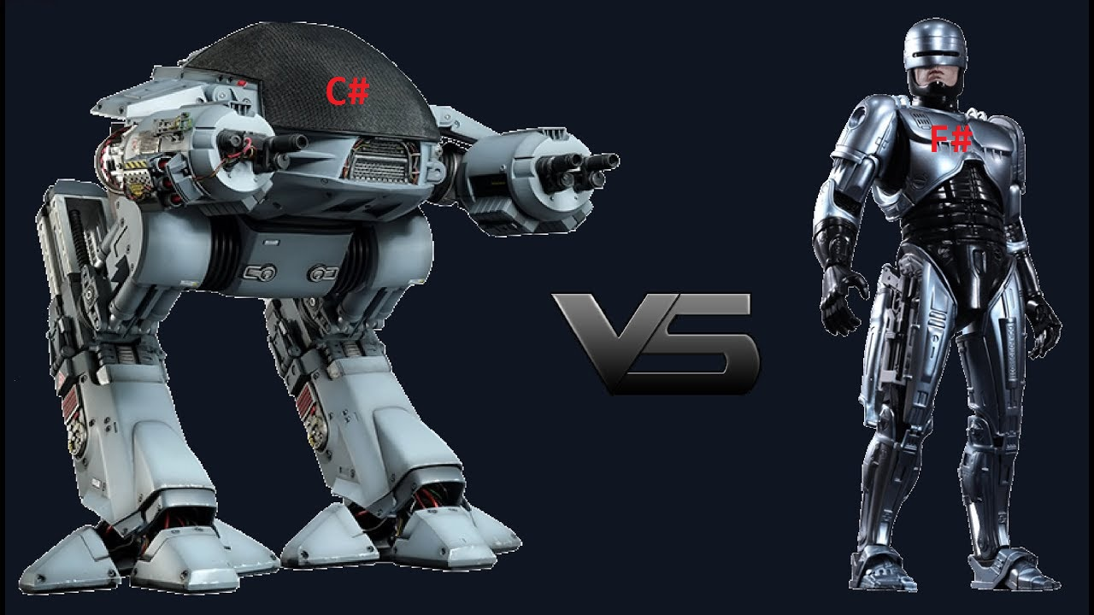
They can be Friends and fight agains difficult requirements together
“Now, not all applications (or, more precisely, important operations of an application) are amenable to parallelization”
Notes:
We can use F# libraries from existing C# code in the VS same solution.

Slide 6
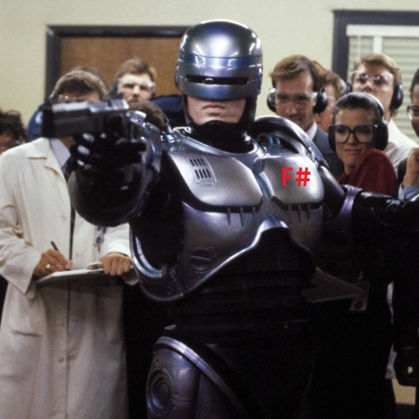
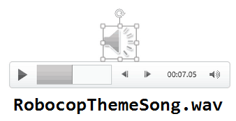
F# Demo
“But the concurrent programming model is learnable and once grokked it isn’t that much harder than OO and hopefully can become just as natural. Just be ready and allow for the investment in training and time, for you and for your team.”
Notes:
What does it mean to have a multicore for a FP F# developer?

Slide 7
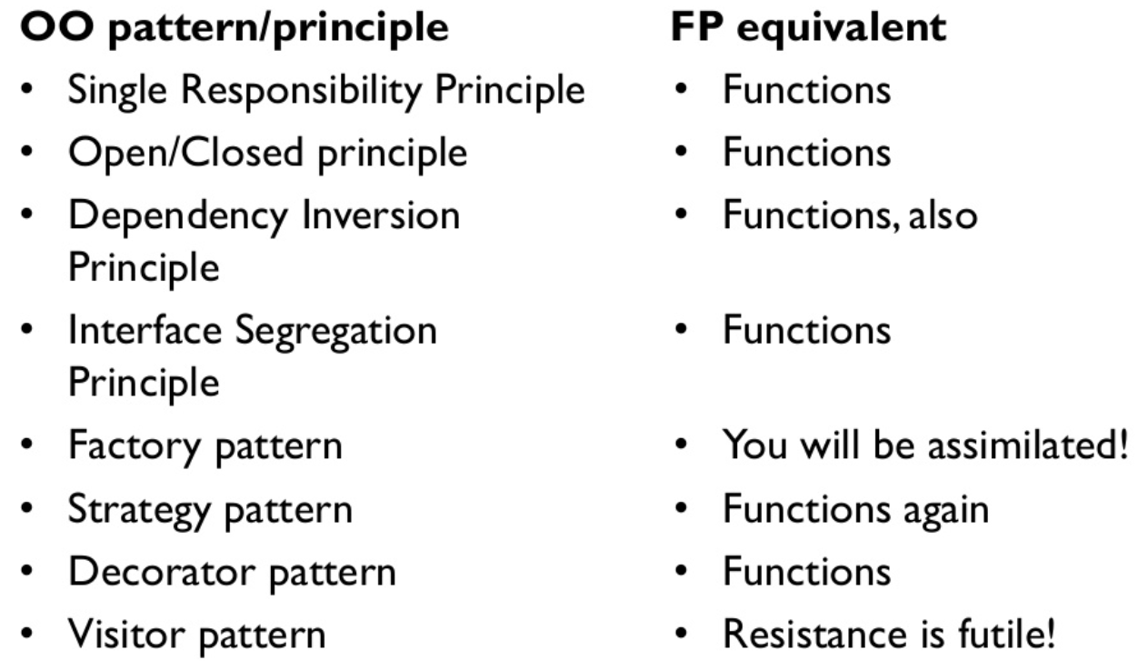
Notes on quality code
Notes:
Knowing the C# language does not make you a good OOP architect. Knowing the F# language does not make you a good FP architect. We can write spagetti code in any language and any paradigm.

Slide 8
Thank you!
Download demo and slides from here:
https://github.com/rogithub/LunchAndLearnFSharp
“Finally, programming languages and systems will increasingly be forced to deal well with concurrency.”
Notes:
Don’t forget to say thank you!
Turn that triumphal music from the Robocop movie off.

