Slide 1
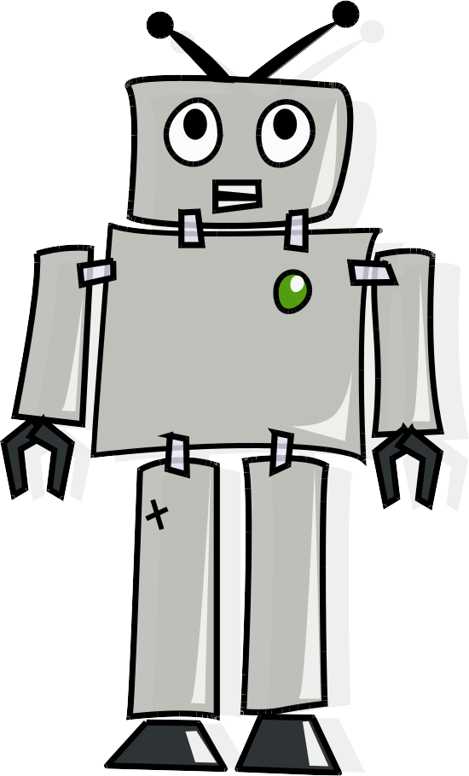
Cool Machine Learning

Slide 2
What is machine learning?
Given data, get a model of the data... so you can predict or make decisions.
Neural Nets, SVM, K-nearest neighbors... and others you can read about in Oreilly's books and other places.
Some of the machine learning algorithms are very black-boxish but SVM is a bit better. We'll learn about this, but first....

Slide 3
What you remember from Statistics
Remember Linear... exponential... power regression to find function of some data (x,y)?
You can do it in LibreOffice Calc, Excel etc.
Match some (x,y) to y=ax+b, ax²+bx+c or others.

Slide 4
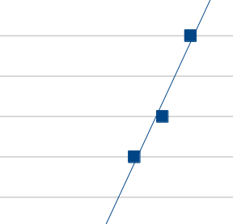
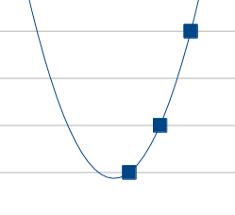
Possible issues – for this and in general
Not enough data?
Overfitting? Maybe it exactly matches, but has no bearing on reality. Maybe this is linear but just a little off, not polynomial?
Best to cut data in half and train, verify on another half of data. (In above, we have both problems)

Slide 5
Now on to SVM
A similar machine learning algorithm lets you quantify two opposing classes and datasets...
The “support vectors” in Support Vector Machine are the nearest points to the dividing-line.
Linear SVM also lets you quantify any vector with positive/negative value distinguishing two types. (and how much so)

Slide 6
SVM
With two dimensions (two variables), this is what it looks like distinguishing two different types from each other – recognize clumping of data into two groups with maximal boundary between them.

Slide 7
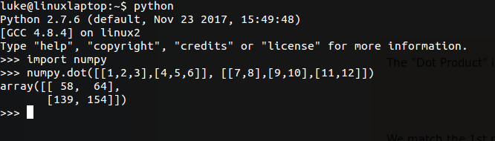
First some math review...
Multiplying matrix with dot product:
For every nth row of first, nth col of second, sum the individual products:
http://www.mathsisfun.com/algebra/matrix-multiplying.html

Slide 8
Other Python Matrix tricks
Turn array “on its side” for multiplying matrix using:
[[x] for x in [1,2,3]]
[[1], [2], [3]]

Slide 9
The Math
Generally you'll see this “hyperplane” described as “MX+B=0” with support vector lines
“MX+B=-1”, “MX+B=1”
(Clear only to matrix robots and mathematicians?)
What this really means is...
?
[3 1] .
X
Y
+ b = 0
→ In english, 3X+Y+b = 0... a line.
X
Y
Z
?
→ In english, 3X+Y+2Z +b = 0... a plane splitting 3d area.
[3 1 2] .
+ b = 0

Slide 10
Simple Example
100% coffee is not so great, and neither is 100% cream. Coffee + sugary cream is very popular as evidenced by Dutch Bros, Human Bean etc. (but tea is better than Coffee, chai some)
A cheesy data set but simple two dimension linear problem... easy code right? Let's try it
+
C
r
e
a
m
-
Coffee

Slide 11
What, no match?
Let's look at documentation and this line:
clf = SVC(kernel='linear'):
“Setting C: C is 1 by default and it’s a reasonable default choice. If you have a lot of noisy observations you should decrease it. It corresponds to regularize more the estimation.”
“Support Vector Machine algorithms are not scale invariant, so it is highly recommended to scale your data. For example, scale each attribute on the input vector X to [0,1] or [-1,+1], or standardize it to have mean 0 and variance 1. Note that the same scaling must be applied to the test vector to obtain meaningful results. See section Preprocessing data for more details on scaling and normalization.”
“In SVC, if data for classification are unbalanced (e.g. many positive and few negative), set class_weight='balanced' and/or try different penalty parameters C.”
C=3 or more, for few, not noisy, very specific points. :)

Slide 12
But wait there's more!
WARNING WILL ROBINSON
VARIABLES FROM THE 4TH
DIMENSION APPROACHING!
The mathematics of this, and, solvers to the bounding line(“hyperplane”) don't care how many inputs you use... handy!

Slide 13
What is a dimension?
Generally you want to consider two or three dimensions, to plot it... but thankfully math generally doesn't care...
What is distance in 2 dimensions, given some movement in x and y? √(x²+y²)
What is that standard euclidean distance in 3 dimensions, given some movement in x, y, and z?

Slide 14
Y
X
Z
√( √(x²+y²)² + z² )
= √( x²+y² + z² ), wow!
In 4 dimensions (which we can't physically pack into real space) the distance would be
√( x²+y² +z² +F² ),
And so on for any number of dimensions... what does that mean?
Dot product, distance, and other formulas (such as the complex methods in SVM solver) can work in many dimensions.

Slide 15
Bogus dimensions add nothing, and get cancelled out.
3x+2y+0z = 0
Z can be anything and solve this, so all points along Z would be part of the plane.
How about more dimensions?
Can we (for example) take many dimensions of the house and see what the political spectrum really is?
Each vote is a dimension of what they value.

Slide 16
The political spectrum function could be calculated as 2.3h9 + .24h7 + .29h17 + .24h6 +.29h13 -.57h2 -.29h4 +.14h12 +0h15 +.24h5 +0h3 +.57h8 +0h1 +0h11 -.5h14 +.5h16 +.5 = Your political spectrum estimation.
But wait... some that don't count in the score have a problem.

Slide 17
There are some “Aye”/no votes not counted (what's the difference??)
The only real 0 is actually a roll call.
Conclusion: You can see which house votes were favored by either party, AND predict Republican/Democrat!
The only one not predicted correctly by this SVM was McHenry, who voted just 3 times.

