Slide 1
Zero Trust Architecture
C768
Matt Lorenzen August 8, 2022

Slide 2
Agenda
Zero Trust Architecture - Why am I here?
What is Zero Trust Architecture
Security beyond the network edge
On-prem and cloud data center security
Increased trust and stability
Increased employee mobility

Slide 3
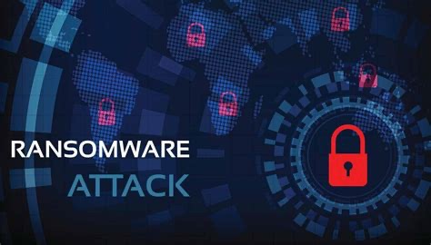
What is Zero Trust Architecture
Zero Trust Architecture is a framework for securing infrastructure and data for today’s modern digital transformation.
Uniquely addresses the modern challenges of today’s business.
Secures remote workers, hybrid cloud environments, and ransomware threats.

Slide 4

Security Beyond the Network Edge
Continuous authentication, authorization, and validation.
Zero Trust removes the concept of “network edge”.
Remove physical and logical boundaries.
Designed to break down the need for
segmentation.
Focus is no longer on the
“network edge”.

Slide 5

On-Prem and Cloud Data Center Security
Gone is “trust but verify. (Rose, S., Borchert, O., Mitchell, S. and Connelly, S., 2020. NIST )
Reduced number of static security polices on next-gen firewalls.
Relies on the concept of “no implicit trust”.
Validation occurs at every step of a
workflow.

Slide 6

Increased Trust and Stability
Significant reduction in credentialed attacks commonly seen with online vendors.
More than 80% of all attacks involve credential use or misuse in the network.(Raina, 2021).
Limited “Blast Radius”.
Increased isolation and
containment.
Real-Time validation.
PCI and SOC 2
compliant.

Slide 7

Increased Employee Mobility
Hybrid workforce due to pandemic.
Significantly reduced threat landscape due to remote workforce.
Forcing employees to “return to
office” is no longer a need based
on security posture.
Increase in employee productivity.
Employ a more robust and mobile
workforce.
Increased talent in hiring pool.

Slide 8
Sources
Rose, S., Borchert, O., Mitchell, S., and Connelly, S., 2020. Zero Trust Architecture. [online] NIST. Available at: <https://www.nist.gov/publications/zero-trust-architecture>.
Rose, S., Borchert, O., Mitchell, S., and Connelly, S., 2020. NIST Special Publication 800-207 - Zero Trust Architecture. [online] https://nvlpubs.nist.gov/. Available at: <https://nvlpubs.nist.gov/nistpubs/SpecialPublications/NIST.SP.800-207.pdf>.
Raina, K., 2021. What is Zero Trust Security? Principles of the Zero Trust Model. [online] crowdstrike.com. Available at: <https://www.crowdstrike.com/cybersecurity-101/zero-trust-security/>.
Dean, E., Fonyi, S., Morrell, C., Lanham, M., & Teague, E. (2021). Toward a Zero Trust Architecture Implementation in a University Environment. The Cyber Defense Review, 6(4), 37–48. https://www.jstor.org/stable/48631305
Davis, J., Simos, M. and Skoniecki, J., 2020. Back to the future: What the Jericho Forum taught us about modern security - Microsoft Security Blog. [online] Microsoft Security Blog. Available at: <https://www.microsoft.com/security/blog/2020/10/28/back-to-the-future-what-the-jericho-forum-taught-us-about-modern-security/>.

