Slide 1
Planning Project Procurements
Collect Project Procurement Inputs
Prepare a Procurement Management Plan
Prepare Procurement Documents

Slide 2
Procurement Management
The management of processes involved in acquiring the necessary products and services from outside the project team.
Create and implement a procurement management plan that:
Specifies the procurements that will be used.
Determines the process for obtaining and evaluating bids.
Mandates standardized procurement documents that must be used.
Describes how multiple providers will be managed.
Includes the management of project contracts and change control processes developed to administer project procurements.

Slide 3
Outsourcing
Moving beyond the organization to secure services and expertise from outside sources on a contract or short-term basis.
Used frequently.
Helps businesses to focus more on their core competencies.
Example: Outsourcing the button production by a New York clothing manufacturer to a company in another location.

Slide 4

Make-or-Buy Analysis
Used to analyze various parameters, such as cost of making versus buying, capacity (based on size) of making, legal eligibility of making, and technical feasibility of making.
Used to determine which is more cost-effective:
Producing in-house
Procuring from an outside vendor
Impacts project time, cost, and quality.
Consider if a product needs to be purchased, leased, or rented, in case of a buy decision.

Slide 5
Factors in Make-or-Buy Decisions
Factor | Description
Impact | Consider the impact on cost, time, or quality.
Ongoing need | If the organization will continue to need a specific skill set—even for future, unrelated projects—it may be a worthwhile investment to train current personnel to perform that service.
Learning curve | While it may make financial sense to develop an in-house solution, there may not be enough time to train personnel and implement the necessary policies and equipment to produce that solution.
Cost-effectiveness | If the required resources are readily available internally, organizations will usually use them. For projects involving technology, skills, materials, or resources that are beyond the organization's capabilities, it may be cost-effective to hire outside help.

Slide 6

The Lease, Rent, or Buy Decisions
Business analysis that determines the most cost-effective way to procure the necessary equipment for a project.
Example: Lease, rent, or buy decisions for acquiring a high-speed copier with collating capabilities.

Slide 7
Market Research
Actively seeking information about potential vendors’ organizations, financial history, and reviews from other customers to assist in making procurement decisions.
Possible sources of market research might include:
Vendor websites
Vendor knowledge bases (when software solutions are involved)
Industry analyst reports
Consumer buying guides
Internal experts

Slide 8

Teaming Agreements
A legal contractual agreement between two or more parties to form a joint venture.
Parties can be internal or external to the organization executing the project.
Significantly impacts the planning processes for the project.
Predefines issues such as the scope of work and competition requirements.

Slide 9
Specifications
Descriptions of the work to be done or the service or product to be provided.
Define the requirements that must be met in exacting detail.
Descriptions can be in the form of words, pictures, or diagrams.
May relate to a product's design, performance, or functionality.
Example: The performance specifications for a toy may include that the lighted elements of the product must have a mean time between failures rating of 1,000 hours.

Slide 10
Guidelines for Collecting Procurement Inputs
Identify the project needs that can be fulfilled by acquiring products, services, or results.
Study the various input documents required for planning procurements.
Consult technical experts to define specifications for the project needs clearly, concisely, and completely.
Perform a make-or-buy analysis to determine whether particular work can be accomplished by the project team or must be procured from outside.
Determine the contract types to be used for procurement.
Document the procurement information collected to use it in the development of the procurement management plan.

Slide 11
Evaluating Procurement Inputs

Slide 12
Procurement Management Plan
Whether or not to procure?
What to procure?
How to procure?
How much to procure?
When to procure?

Slide 13
Source Selection Criteria
The standards used to rate or score proposals, quotes, or bids.
Form part of the procurement solicitation documents.
Objective criteria—Can be demonstrated, specific, and measured.
Subjective criteria—Open to different interpretations.
Criteria can be set in the following ways:
Understanding of need
Overall or lifecycle cost
Technical capability
Management approach
Warranty
Financial capability
Production capacity and interest
Business size and type
Past performance of vendors
References
Intellectual property rights
Proprietary rights

Slide 14
Guidelines for Preparing a Procurement Management Plan
Examine the procurement need and determine which procurement document to use.
Use standard procurement forms or templates, if available.
Develop a strong set of source selection criteria based on the real project needs.
Select from a range of capabilities and experience to get the best fit possible.
Determine how you want the prospective vendors to respond.
Examine the relevant SOW and make any modifications that have been identified during the planning for project contracting.
Verify that the procurement management plan is structured to facilitate consistent, comparable responses from vendors.
Add the list of qualified vendors, bidders’ conferences, vendor payment plan, and change requests to the procurement management plan.
Identify and consider any regulations that may define the required structure of procurement documents for government contracts.

Slide 15
Preparing a Procurement Management Plan

Slide 16
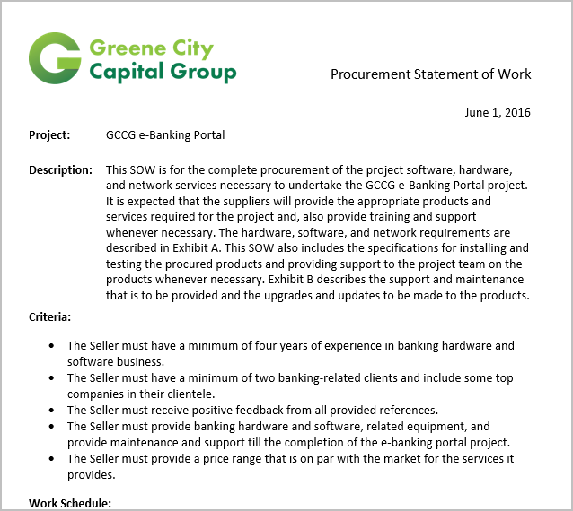
The Procurement SOW
A detailed narrative description of the resources, goods, or services sought from external sources for a project's requirements.
Distributed to potential vendors to evaluate their capability to perform the work or provide the services.
Serves as a basis to develop the procurement documents during the solicitation process.
A project scope baseline is used to create the procurement SOW.

Slide 17
Guidelines for Preparing a Procurement SOW
Review the product description to fully understand the scope of the work being procured.
Consult technical experts to define specifications clearly, concisely, and completely.
Use a mandated procurement SOW format, if it exists, or modify a previous, similar project’s SOW.
Present the information in a logical sequence.
Use consistent terminology and level of detail throughout.
Determine whether any collateral services will be required of the vendor as part of the contract.
Determine the acceptable criteria for the product or service.
Be sure to include the key elements that clearly identify the deliverables and associated specifications.
Have a knowledgeable third party review the procurement SOW to ensure that it is complete, correct, and understandable.
Document your make-or-buy decisions.

Slide 18
Procurement Documents
Documents that are submitted to prospective vendors and service providers to solicit their proposals for the work needed.
Document type used will depend on the type of project and the product or service being procured.
Common documents include:
Request for Information (RFI)
Request for Bid (RFB)
Request for Quote (RFQ)
Request for Proposal (RFP)
Invitation for Bid (IFB)

Slide 19
RFI
Buyer-generated document to solicit information about prospective vendors.
Used to gather relevant information about vendor’s organization and financial history:
Vendor organization’s history
Balance sheets
Business type (family owned, private, publicly listed, etc.)
Owner’s history and background
Bank statements for the past three years

Slide 20
RFB
Buyer-generated document that is used to initiate the formal bidding process.
Used when deliverables are commodities with clear specifications.
Price is the primary determining factor.
Negotiations are anticipated.

Slide 21
RFQ
Buyer-generated document that asks vendors to provide pricing information for project deliverables.
Used when deliverables are commodities with clear specifications.
For comparison purposes only and not a formal bid for work like the RFB.
Negotiations are not expected.

Slide 22
RFP
Buyer-generated document asking vendors for their suggestions and alternative approaches to meet the project goals.
Preparing these documents is time-consuming and potentially costly for the vendor.
Negotiations are expected.
Buyer can make the request but not all vendors will respond.

Slide 23
IFB
Used when deliverables are commodities in large quantities with clear specifications.
Can be used interchangeably with RFQ.
Usually advertised.
Any vendor can submit a bid.
Negotiation is typically not anticipated.

Slide 24
Guidelines for Preparing Procurement Documents
Examine the procurement need and determine which document to use.
Use standard procurement forms or templates.
Develop a strong set of source selection criteria based on project needs.
Allow room to select from a range of capabilities and experience for the best fit possible.
Determine how you want prospective vendors to respond (i.e., what, when, where, and to whom).
Examine the relevant SOW.
Verify the procurement management plan is structured to facilitate consistent, comparable responses.
Identify any regulations that must be followed.
When required, include the following in the procurement management plan: listing of qualified vendors, bidders’ conferences, supplier payment plan, and how change requests will be managed.

Slide 25
Preparing Procurement Documents

Slide 26
How can your organization benefit from more effective procurement planning?
In the future, what do you plan to use to prepare better SOWs and procurement documents?

