Slide 1
Planning for Change and Transition
Develop an Integrated Change Control System
Develop a Transition Plan

Slide 2
Integrated Change Control
The process of identifying, documenting, approving or rejecting, and controlling changes to the project baselines.
Reduces risk to a project by governing the execution of proposed changes that will affect schedule and cost or other objectives.
Allows project managers to record requested changes.
Helps ensure that changes are implemented in a standardized and approved manner.
Helps minimize disruptive effect of changes made and monitor progression.
Documents the change requests in a change request form and sends it to the change management team.
Defines the turnaround time for each change request.

Slide 3

CCB
CCB is a formally chartered group responsible for reviewing, evaluating, approving, delaying, or rejecting changes to the project.
CCB is also responsible for recording and communicating their decisions.

Slide 4
Change Control Systems
A collection of formal, documented procedures for changing official project documents.
Specifies how project deliverables will be controlled, changed, and approved.
Includes forms, tracking methods, processes, and approval levels for authorizing or rejecting requested changes.
Example: Change control system for an internal project that includes:
Standardized change request form that includes changes affecting the original scope, cost, or schedule baselines.
Description of the change being requested.
Relative priority.
Reason behind the change.

Slide 5
Types of Project Changes
Type | Description
Timeline | Changes to any activities that affect the overall schedule.
Funding | Changes to activities that affect the funding allotted to the project.
Risk event | A new risk, or change to an existing risk, that affects any aspect of the project.
Requirements | Changes to the project requirements initiated by a stakeholder.
Quality | Changes to the project scope, schedule, or cost that decrease the quality of deliverables.
Resource | Changes to the project’s human or equipment resources.
Scope | Changes that require the project scope to be modified.

Slide 6
Causes of Project Changes
Dependency | Description
Inaccurate initial estimates | Due to: Lack of experience. Lack of information. Reliance on inaccurate data. Excessive optimism. Technological difficulties. Unreliable resources.
Specification changes | Broadening the project's scope to include new specifications and deliverables.
New regulations | Accommodating new regulations may have an effect on the resource needs, schedule duration, and quality specifications.
Missed requirements | Complete and comprehensive information may not be captured when reviewing documentation and interviewing policy makers and end users. This may lead to slippages at different phases in the project.

Slide 7
Organizational Change Types
Organizational Change | Description
Mergers/acquisitions | The overall size and number of personnel are increased to incorporate another organization. Possibly affecting top-level executives or project sponsor, and trickle down to other levels.
De-mergers/splits | Separating an organization into multiple organizations might affect the top-level executive or sponsor of your project and have trickle-down effects.
Business process change | The organization changes the official process for getting things done. Might affect how funding and resources are approved.
Internal reorganization | When personnel and functional managers are reassigned within an organization, this might affect the project team’s members and processes.
Relocation | When a project team member leaves the organization or is transferred to another department, you might need to find a new project team member.
Outsourcing | When the company decides to procure services from an external resource, this might disrupt the project’s workflow processes or the stakeholders involved.

Slide 8
Project Change Categories
Category | Description
Corrective action | Documented direction on actions that must be carried out to help bring the future project performance requirements back on track and conform with the current project management plan.
Preventive action | Documented direction on actions that must be implemented to diminish the effects of any negative risks.
Defect repair | Formally documented measures that must be undertaken to address the defects in the project components, which are recommended either to be repaired or replaced.

Slide 9
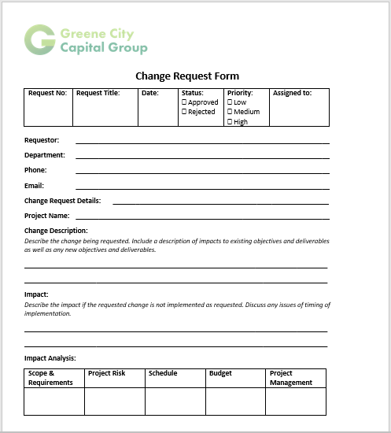
Change Requests
Processed through the change control system for evaluation and approval.
Recommendations for taking corrective or preventive actions.
Can be raised by anyone related to the project using a change request form.

Slide 10
Configuration Management
A tool used to manage changes to a product or service being produced.
Used to:
Control product iterations.
Ensure that specifications are current.
Control steps for reviewing and approving prototypes, testing standards, and drawings or blueprints.
Example: Creating a database to monitor and control change requests to images and animations in advertisements.

Slide 11
Guidelines for Developing an Integrated Change Control System
Use the approved change control system, if it exists.
If no change control system exists, it’s your responsibility to develop one.
Identify what will be considered a change that is significant enough to require management approval.
Identify the responsible parties who are authorized to initiate, approve, execute, manage, and prioritize changes.
Identify how change requests must be approved.

Slide 12
Developing an Integrated Change Control System

Slide 13
Product Transition
Formal handoff of a project's outcome to its recipients (a client or the next phase).
Project’s outcome is transferred to the next level for sustainment.
Training materials, support systems, facilities, and personnel are also delivered during product transition.
Transition process ends when the receiving organization receives the project's end product and incorporates it.
Transitions can be contract-based activities or can occur among functions or projects within an organization.

Slide 14
The Transition Plan
Document that describes how project outputs will be transferred.
Either between organizations or between functional groups.
Created after a detailed discussion with both sponsors and customers.
Might include the complete list of tasks, or just tasks specific to the transition of deliverables.
Indicates when transition events should occur—at a specific lifecycle stage or at the end of the project.

Slide 15
Transition Plan Components
Specify the scope of transition.
Identify the stakeholders who will receive the transferred products.
Ensure that the benefits sustainment plan exists.
Ensure that the products are transferred at the right time.
Create a resource release plan.
Create a financial closure plan.
Ensure that the contract closure requirements are consistent.
Determine the processes to receive deliverable acceptance.
Communicate the requirements for project closure.
List the impacts of project closure.

Slide 16

Transition Dates
Specify the date when the project product, service, or result will be handed off to its recipients.
After the product is handed off, the closure of project finances and contracts will be decided by the managers.

Slide 17
Product Training Events
Demonstrations provided by the company on a product or service during its transition phase.
Undertaken to teach the recipients how to use purchased products or services.
Modes of training include:
Instructor-led training.
Video walkthroughs.
Handbooks.
Service manuals.
Live demonstrations by experienced personnel

Slide 18
Extended Support
Type of assistance provided by the company to its customers.
Often a paid service and offers assistance after the expiration of the warranty period of a particular product or service.
Includes:
Technical support
Customer service
Software or product support
Troubleshooting
Maintenance
Upgrades, installation, or configuration post the warranty period
Provided:
Over phone
Through email
Through technical support personnel
Through a web chat

Slide 19
Guidelines for Developing a Transition Plan
Define the scope of project transition.
Check the project schedule for transition.
Identify the stakeholders involved in transition.
Include the organizational process assets that are available.
Create the benefits sustainment plan.
Include the product training event, if necessary.
Decide on the period of time that support will be provided.
Plan the transition of the project products, results, or services with the stakeholders.

Slide 20
Developing a Transition Plan

Slide 21
How will you manage changes in your organization?
What has been your experience in developing transition plans? What items did you choose to include?

