Slide 1
Executing the Project
Direct the Project Execution
Execute a Quality Assurance Plan
Assemble the Project Team
Develop the Project Team
Manage the Project Team
Distribute Project Information
Manage Stakeholder Relationships and Expectations

Slide 2
Move from Planning to Execution
A review meeting should be conducted when a project transitions from the planning phase to the implementation phase.
Items to be verified during the meeting include:
Have all roles and skills been identified?
Have all project documents been completed, reviewed, and signed off?
Have all issues regarding planning been resolved?
Is the project still feasible?
Are the expectations of the stakeholders aligned with the project plan?

Slide 3






PMIS
Automated or manual system used to gather, analyze, communicate, and store project information.
Collects information on work packages—complete and incomplete.
Compares the results to the planned schedule, cost, quality, and scope.
Microsoft Project is one example of an off-the-shelf PMIS.

Slide 4
Common PMIS Problems
Problem | Description
Reacting to lagging indicators | PMIS reports show problems after the fact, and good project management requires proactive prevention of problems.
Managing symptoms rather than problems | PMIS highlights the exceptions and overruns but it can’t explain the reason for the problem. To truly solve the problem, you need to identify the root cause and fix it.
Over-reliance on PMIS communication | Project managers might be tempted to use PMIS reports in place of communicating directly with the project team and stakeholders.
Invalid data in the PMIS | PMIS reports can make problems look either larger or smaller than they are, as well as not reporting on real problems. Project managers must look beyond the PMIS reports for an accurate picture of project issues.
Too much information | With an overabundance of information, critical issues can get buried or ignored because team members are overloaded with irrelevant or untimely information.

Slide 5
Work Performance Information
Schedule progress with status information.
Deliverables that have been completed and have not been completed.
All schedule activities and their start and finish dates.
The degree to which quality standards are being accomplished.
Expenses authorized and incurred.
Estimates to complete the schedule activities already in progress.
Percent of completed schedule activities that have been started.
Lessons learned that are posted to the lessons learned knowledge base.
Details on resource utilization.
Status for change requests implementation.
Details on corrective and preventive actions and defect repairs.

Slide 6
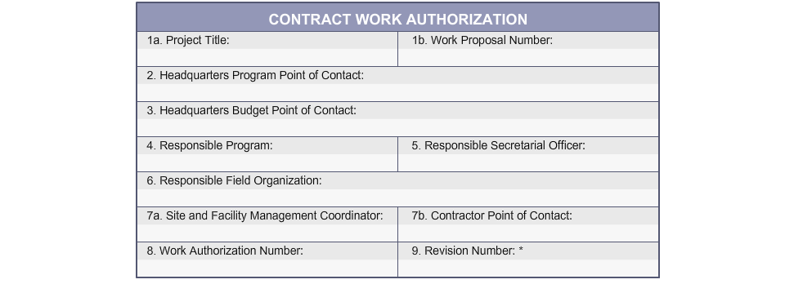
Work Authorization System
A tool that is used to communicate official permission to begin working on an activity or work package.
Ensures that work is done:
At the appropriate time.
By the appropriate individual or group.
Within a specific time.
In the proper sequence.

Slide 7
Guidelines for Directing the Project Execution
Comply with any of the organizational policies and procedures regarding project execution.
Evaluate and select the work authorization system to be used.
Use existing project management infrastructure and available artifacts. Create infrastructure, if necessary.
Work with a systems analyst to create a PMIS that is workable for your project, if necessary.
Determine who will be responsible for its day-to-day operation, whether it will be you or someone else, once the system is in place.
Evaluate the effectiveness of the PMIS for your project.

Slide 8
Directing Project Execution

Slide 9
Quality Audit
An independent evaluation, inspection, or review of a project's quality assurance.
Improves the quality performance of a project.
Can be conducted at scheduled or random intervals.
Example: Quality audits at a manufacturing company.
The auditor reviews:
The quality management plan.
The cost of quality.
The quality process designs.
Ensures that the processes are:
Up-to-date.
Being used correctly.
Still valid.

Slide 10
Quality Audit Topics
Topic | Description
Quality management policy | Evaluated to determine how well management uses quality data and how well others in the organization understand how the data is being used.
Collection and use of information | Evaluated to determine how well the project team is collecting, distributing, and using quality data.
Analytical methods | Evaluated to determine if the best analytical methods are being used consistently and how well their results are being used.
Cost of quality | Evaluated to determine the most effective proportion between prevention, inspection, and costs of repair or rework.
Quality process design | Evaluated to determine how process design, process analysis, and statistical process control should be used to establish and improve the capability of a process.

Slide 11
Process Analysis
Method for identifying organizational and technical improvements to processes.
A variety of techniques are used, including flowcharting and root cause analysis.
Process analysis involves:
Collecting information about the existing process and documenting a process flow diagram.
Determining the entry and exit criteria of each step in the process.
Conducting process analysis interviews with the people to identify the limitations in the process.
Conducting a Failure Mode and Effects Analysis (FMEA) to identify the possible failures in the process.
Assessing the identified limitations and quantifying their impact.
Identifying appropriate operating decisions to improve the process.

Slide 12
Quality Assurance Tools and Techniques
Techniques
Statistical sampling
Inspection
Approved change requests review
Cost-benefit analysis
Cost of Quality (COQ)
Benchmarking
Design of Experiments (DOE)
Tools
Cause-and-effect diagrams
Control charts
Flowcharting
Histogram
Pareto chart
Run chart
Scatter diagram

Slide 13
Guidelines for Executing a Quality Assurance Plan
Ensure that the random and scheduled quality audits are conducted by qualified auditors to evaluate the quality management plan, quality testing procedures, and measurement criteria.
Use one or more of the quality assurance tools and techniques to determine the causes of quality problems in the project's product, service, systems, or processes.
Identify and implement the appropriate actions needed to increase the effectiveness and efficiency of the project team's work results and improve the quality in the product or service.

Slide 14
Executing a Quality Assurance Plan

Slide 15
Project Manager Roles
Role | Description
Leader | Provide clear direction for where the stakeholders need to go and credible strategies for how to get there.
Planner and controller | Facilitate project planning and determine measurement criteria for evaluating the work accomplished.
Communicator | Act as communication central on a project, interfacing with executives, functional managers, customers, vendors, project team members, and other interested parties outside of the project.
Negotiator | Negotiate for resources―time, money, people, and equipment―to complete the project successfully.
Problem-solver | Face problems rather then deny them, determine the root cause of problems, and make decisions about the best method for dealing with the problems.
Organizational change agent | Know how to get things done in the organization, how to avoid political issues that may hamper the project’s progress, and how to influence the organization to bring about change.

Slide 16
Political Capital
Political capital is the reserve of corporate goodwill based on a person’s perceived political position and power in the company.
Its source can be position, reputation, or both.
Can be used to achieve a desired end or result.
Project managers and project sponsors can spend political capital when a project is threatened but do so judiciously.

Slide 17

Team Acquisition
An approach that is used to obtain resources for the project when enough staff is not available within the project team or organization to complete the project.
Organizations hire external resources, if they do not have the required number of appropriate skilled resources on staff.

Slide 18
Project Staff Assignments
The assignment of people who will work on the project:
Full-time
Part-time
As needed
This usually involves:
Creating a team directory
Exchanging memos between team members
Creating project organization charts and schedules

Slide 19

Pre-Assignment
The allocation of project team members to project activities, even before the project has officially kicked-off.

Slide 20

Negotiation
An approach used by individuals or organizations with mutual or opposite interests to come together to reach a final agreement.
Requires knowledge of the economic and strategic worth of the project to effectively bargain for scarce skills resources.

Slide 21
Effective Negotiating Skills
Analyze the situation.
Differentiate the needs and wants of both parties.
Focus on issues and interests rather than on personal positions.
Be realistic when making proposals.
Give concessions and indicate that you are providing something of value.
Ensure a win-win situation for both parties at the end of the deal.
Communicate in an appropriate manner.

Slide 22
Virtual Teams
Teams that are distributed among multiple physical locations.
May be more difficult because:
Bonding and team identity may be hard to develop.
Various forms of communication technologies used.
Difficult to monitor individual performance and progress.
Example: Virtual team for the Apollo 13 mission.
Apollo 13 Spacecraft, 1970.
The virtual team included:
On-board crew members.
Mission control in Houston, Texas.
Telecommunications included voice and television communication.

Slide 23
Guidelines for Assembling the Project Team
Form good relationships with functional managers.
Know when you need specific resources.
Negotiate with functional managers for critical resources.
Ensure that appropriate steps are taken to retain the procured team members.
Look for synergy and diversity among team members.
Look outside to competent suppliers.
Make sure that roles and responsibilities are clearly understood.
Create and distribute an organization chart to all stakeholders.

Slide 24
Assembling the Project Team

Slide 25
Interpersonal Skills
Team building
Motivation
Communication
Influencing
Decision making
Political and cultural awareness
Negotiation
Leadership

Slide 26
Team Development Stages
Forming
Storming
Performing
Adjourning
Team members complete their assigned work and shift to the next project or assigned task.
Team members get to know each other and trust one another.
Team members begin to assert themselves and control emerging issues.
Team begins to work productively, without worrying about personal acceptance or control issues.
Norming
Team is working at optimum productivity and is collaborating easily, communicating freely, and solving its own conflict problems.

Slide 27
Effective Project Teams
Project Manager’s role to build team and foster teamwork.
Work collaboratively.
Communicate effectively.
Develop trust among team members.
Manage conflicts.
Promote collaborative decision making and problem solving.

Slide 28
Symptoms of Teamwork Problems
Frustrated team members.
Unhealthy conflict or excessive competition.
Pointless meetings.
Lack of confidence in the project manager.

Slide 29
Barriers to Team Development
Ambiguous goals or roles.
Conflicting roles.
Poor communication.
Environmental changes.
Poor support from upper management.
Conflicting personal and organizational agenda.

Slide 30

Training
An activity to acquire skills, knowledge, or attitude.
Conducted for teams, small groups, or individuals.
Covers range of topics from management and technical to administrative.
Format can be:
Multi-day, formal workshop
Five-minute, informal on-the-job training
Provided to team members when there is a need.

Slide 31
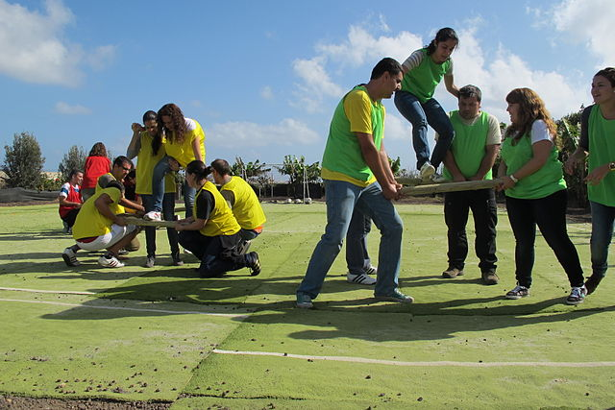
Team-Building Activities
Actions taken to influence diverse individuals from many functional areas, each with their own goals, needs, and perspectives, to work as a cohesive team, for the good of the project.
Also known as “team-building strategies.”
Formal or informal.
Brief or extended.
Facilitated by the project manager or a group facilitator.

Slide 32

Ground Rules
Set clear expectations of the expected code of conduct from team members.
Ensure an increase in the productivity and decrease misunderstandings.
Include all actions that are considered acceptable and unacceptable to the project management context.

Slide 33





Team Logistics
Materials needed for the project and project deliverables.
Physical facilities including space, desks, phones, computers, and network connection.
Communication equipment for team members not in same location.
Software and hardware necessary.
Travel facilities including transportation, lodging, and other arrangements.

Slide 34







Co-location
Positioning team members in the same physical location:
Makes communication easier.
Enhances team performance.
Improves team spirit.
Both small and large projects benefit from co-location.

Slide 35
Reward and Recognition Systems
Rewards
Recognition
Tangible, consumable items
Given as a result of reaching a specific outcome or achievement
Definite start and finish, or fixed time
Usually expected when goal is met
Purpose is to motivate towards a specific outcome; never given without recognition too
Intangible, experiential event
Given as a result of recipient’s behavior rather than outcome
Not restricted to a set time
Usually unexpected by recipient
Purpose is to increase recipient’s feeling of appreciation; can be given without a reward

Slide 36
Team Performance Assessments
Assess and identify the potential of each team member on a continual basis.
Can be formal or informal.
Purpose of assessment:
Improve interaction between team members
Solve issues
Deal with conflicts
Improve skills and competencies of team members
Increase team cohesiveness
Techniques for assessing team performance:
Ask key questions to the team members.
Speak to team members frequently through one-to-one meetings and regular project meetings.
Provide constructive criticism and acclaim to team members, as necessary.
Evaluate individual performance.
Remove under-performing team members, or reassign their work to a new resource.

Slide 37
Guidelines for Developing the Project Team
Recognize the project team’s current stage of development and be proactive in helping the team be as productive as possible.
Conduct periodic project team and one-to-one meetings to evaluate the team’s performance.
Provide appropriate feedback to each project team member.
Develop and implement a formal reward and recognition system.
Consider co-location to enhance the team’s ability to perform together and improve communication.
Provide appropriate training and coaching to help team members gain skills, knowledge, or behavior.

Slide 38
Developing the Project Team

Slide 39

Causes of Conflict
Competition.
Differences in objectives, values, and perceptions.
Disagreements about role requirements, work activities, and individual approaches.
Communication breakdowns.

Slide 40
Conflict Management
Application of one or more strategies to deal with disagreements.
Effective conflict management leads to improved understanding, performance, and productivity.
Ineffective conflict management leads to:
Destructive behavior.
Animosity.
Poor performance.
Reduced productivity.
Use various conflict resolution methods.

Slide 41

Conflict Management Approaches
Confronting or problem solving.
Compromising.
Smoothing or accommodating.
Forcing.
Collaborating.
Withdrawing or avoiding.

Slide 42
Potential Political Barriers
The goals and objectives of each organization are different.
No alignment exists between the different organizations.
Scheduling issues exist as a result of vested interests.
Issues exist regarding the resources required for the project.
User management participation may not exist at the right levels.

Slide 43
Performance Appraisals
Comparing performance to goals.
Reclarifying roles and responsibilities.
Delivering positive and negative feedback.
Discovering unknown or unresolved issues.
Creating and monitoring training plans.
Establishing future goals.

Slide 44
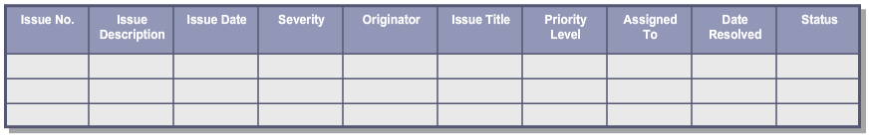
The Issue Log
A document that is used to list, track, and assign items that need to be addressed by the project team.
Records:
Project issues
A unique number to each issue
Issue status
Individuals responsible for resolving certain issues by a specific date
Useful for regular follow-up with the project team and must be updated regularly.
An issue log template that is used to register and manage project issues

Slide 45
Action Items
Any piece of work that needs to be performed by a resource.
Not considered important enough to include in the issue log, and doesn’t qualify as an activity in the project schedule.
Can result from meetings or be related to any project objective.
Can happen throughout the project.
May or may not be formally documented.

Slide 46
Guidelines for Managing the Project Team
Ensure project team members understand their roles and responsibilities.
Communicate the ground rules to each team member.
Establish good communication among team members.
Adjust the communications plan to meet the needs, keep information flowing, and provide feedback.
Ensure project team is informed about key milestones and gate reviews.
Monitor performance of team members on an ongoing basis.
Consider performing a quality audit.
Establish how conflicts will be resolved, including escalation procedures.
Manage conflict within the team using appropriate approaches.
Establish an issue log to track and assign project issues.

Slide 47
Managing the Project Team

Slide 48
Information Distribution Tools
Distribution methods and presentation tools that are used to provide project information to stakeholders.
Include:
Email
Hard-copy documents
Presentations
Video conferencing
Meetings
Phone calls

Slide 49
Guidelines for Distributing Project Information
Create and distribute project information in accordance with the communications management plan.
Use effective communication skills to exchange information.
Use an information retrieval system to provide stakeholders with access to project information.
Select the appropriate information distribution method for distributing project information.
Monitor the communication system for feedback to ensure that messages are getting through as planned.
Analyze effects on project execution and control when unexpected information requests surface.

Slide 50
Distributing Project Information

Slide 51
Project Meetings
For the scheduled meeting, create an agenda and distribute beforehand.
Meeting should be led by someone who is familiar with the topics. Doesn’t have to be the project manager.
Discuss any topics outside of the agenda at the end of the meeting or defer to another meeting.
Start and end the meeting on time.
Prepare meeting minutes and distribute to the appropriate stakeholders and archive for future reference.
For example, a project kick-off meeting might include:
Reinforcing project assignment documents.
Introducing the team members.
Stating the project goals and expectations.
Sharing contact information of the team members.
Establishing timelines and assigning project tasks.
Discussing the potential project issues if any.
Setting the ground rules.

Slide 52
Expectations-Gathering Techniques
Helps maintain and update the values and expectations of stakeholders.
Provides the ability to:
Compare the project's delivery of benefits against the estimated values and expectations.
Analyze and make recommendations for change when value estimates and expectations are not met.
Regularly update deliverables that are modified.
Includes the following common techniques:
Brainstorming
Interviews
Surveys

Slide 53
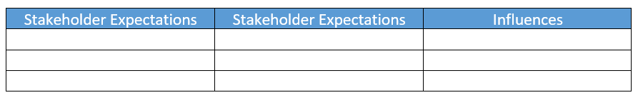
The Stakeholder Expectations Matrix
A document that contains:
Names of project stakeholders.
The stakeholders’ expectations from the project.
The stakeholders’ influence on the project.
May be created through the stakeholder analysis process.
The template for the stakeholder expectations matrix

Slide 54
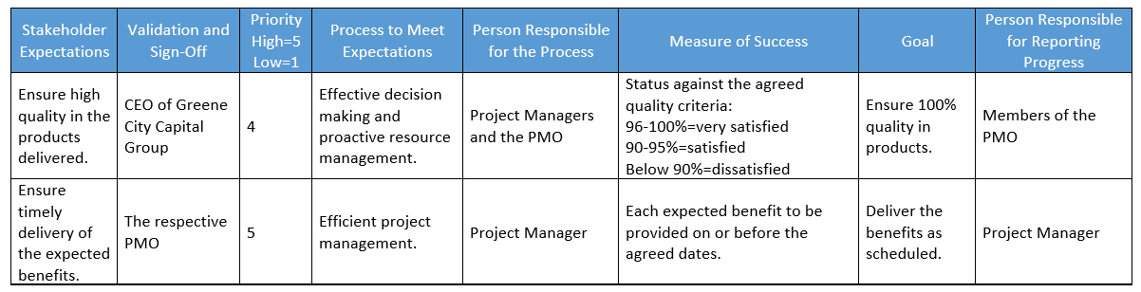
Stakeholder Expectations Matrix Mapping
The process of mapping goals and expectations of senior managers and sponsors within an organization.
Done continuously when new stakeholders are identified as the project planning phase progresses.
An example of the stakeholder expectations matrix mapping document

Slide 55
Expectations Mapping Objectives
Cultivating an understanding of the stakeholder groups.
Identifying and updating stakeholder values and expectations.
Monitoring and controlling project progress.
Defining strategies for resolving conflicts among stakeholder expectations and obtaining consensus.
Communicating how project delivers the benefits.
Identifying and recommending adjustments in the project.
Updating deliverables with changes, current information, and results.

Slide 56
Expectations Mapping Matrix Components
Expectations
Validation and sign-off
Priority
Process to meet expectations
Responsibility for process
Measure of success
Goals
Reporting progress
Schedule frequency
Current rating

Slide 57
Guidelines for Managing Stakeholder Relationships and Expectations
Follow the communications plan and obtain stakeholder feedback.
Conduct meetings with stakeholders.
Be flexible when communicating with the project sponsor or other members of senior management.
Assign, track, and resolve open issues in an issues log.
Process change requests and update the communications plan.
Take corrective action to bring project performance in line with customer expectations.
Document lessons learned.

Slide 58
Managing Stakeholder Relationships and Expectations

Slide 59
What aspects of executing the project plan have you found to be the most challenging? Why?
Which tools and techniques will you use to more effectively execute projects in the future?

