Slide 1
Executing the Procurement Plan
Obtain Responses from Vendors
Select Project Vendors

Slide 2


Qualified Vendors
Vendors who are approved to deliver products, services, or results based on the procurement requirements identified for a project.
List of qualified vendors can be obtained from historical information about different vendors.
If the required resources are new to the organization, some research should be done in collaboration with the Purchasing Department.
Example: A company inviting proposals from vendors for setting up a Wi-Fi network for their new corporate office.

Slide 3
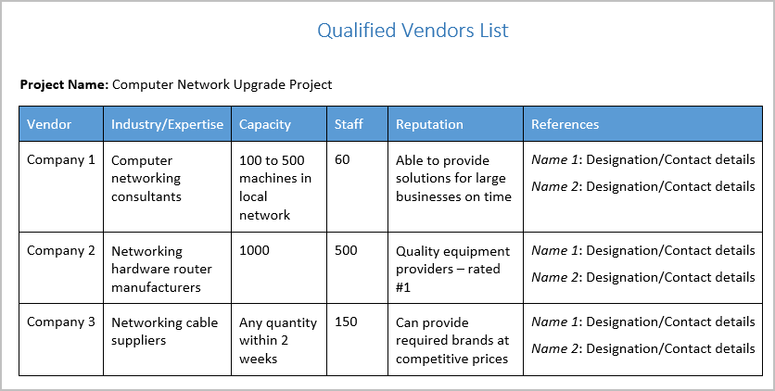
The Qualified Vendors List

Slide 4
Bidder Conferences
Meetings conducted by the buyer prior to submissions of a bid or proposal by the vendors.
The buyer explains the requirements, proposed terms, and conditions and the buyer clarifies the vendors’ queries.
Buyer ensures that all prospective vendors have a clear and common understanding of the technical and contractual requirements of the procurement.
Also known as vendor conferences, pre-bid conferences, pre-proposal conferences, and contractor conferences.
Example: Hosting a Bidder Conference for the Wi-Fi network project.
Advertising for prospective vendors.
Listing the short-listed vendors among the respondents.
Holding a bidder conference.
Clarifying doubts regarding the procurement specifications.
Sending the updated procurement documents along with an RFP to each prospective vendor.

Slide 5
Guidelines for Obtaining Responses from Vendors
Gather and review all procurement documents for accuracy and completeness.
Obtain or develop a qualified vendors list.
Determine how and from whom you will request vendor responses.
Send the request for vendor responses to the identified prospective vendors.
If necessary, hold a bidder conference.
Respond to questions asked during the bidder conference. Be sure to respond in writing to each recipient of the RFP.

Slide 6
Obtaining Responses from Vendors

Slide 7
Vendor Proposals
Responses submitted by potential vendors that are prepared in accordance with the requirements stated in the procurement documents.
Demonstrate an understanding of the procurement need.
Describe the vendor’s ability to provide the service or product.
Describe the proposed methodology of providing the service.
Detail the price for delivering the desired goods or services.

Slide 8


Short-Listing (Screening)
A technique used to reduce the number of proposals received to enable further analysis.
During the process, buyer might use an abbreviated scoring system.
Internal discussions might also remove some proposals from further consideration.

Slide 9
Proposal Evaluation Techniques
Set of methods to evaluate, short-list, and select the vendor.
May suggest subjective or objective criteria or a combination of both.
Evaluation techniques include:
Weighting system
Short-listing (screening)
Independent estimating

Slide 10
Independent Estimates
Organizations prepare their own independent cost estimates or have an external professional estimator to prepare it.
Obtain an independent estimate to verify that the proposed price is reasonable and responsible.
Differences in the cost estimates can indicate that:
The Procurement SOW was ambiguous.
The Procurement SOW was deficient.
Vendors either misunderstood or failed to respond completely to the procurement SOW.

Slide 11
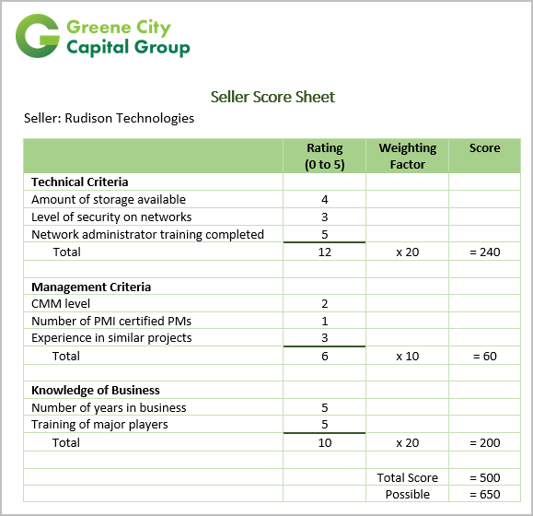
Weighting Systems
The method for quantifying qualitative data to minimize the influence of personal bias on source selection.
Assign numerical weights to evaluation criteria.
The weighted scorecard at Rudison Technologies, as shown here:
Rating ranges from 0 (lowest) to 5 (highest).
The company scores 3, 4, and 5 in the three technical criteria.
Total score for the technical category is 12 out of a possible 15.
Numbers are totaled, then multiplied by weighting factor (20).
Weighted technical score is 240 out of a possible 300.
All weighted scores are totaled to obtain a grand total score.

Slide 12
Procurement Negotiation Stages
Stage |  | Description
1 | Introduction | All parties become acquainted and the overall attitude of the negotiation is established; this tone is largely set by the buyer’s team leader—normally, the person with authority to sign the contract will lead the contract negotiation team.
2 | Probing | Each side attempts to learn more about the other’s real position.
3 | Bargaining | Give-and-take discussions take place to arrive at the best possible agreement for all.
4 | Closure | The tentative agreement is revised and everyone has an opportunity to tweak the results.
5 | Agreement | The team tries to ensure that all parties clearly understand and agree to all terms and conditions of the contract.

Slide 13
Types of Agreements
Memorandum of Understanding
Letter of Intent
Service Level Agreement (SLA)
Contract
Fixed price
Cost reimbursable
Time & Material (T&M)
Procurement Contract
Term Contract
Completion Contract

Slide 14
Memorandum of Understanding
An agreement between two or more parties to form a business partnership.
It is not legally binding, but is more formal than a “gentlemen’s agreement.”
Often used when the parties don’t wish to enter into a formal contract, or when a legally enforceable contract cannot be created.

Slide 15
SLA
A contract between an organization that provides a service, and the user of the service, that is frequently used by information technology companies.
The contract specifies what the customer will receive and the performance standards the provider is obligated to meet.
Performance standards can include:
The percentage of time the service will be available.
Help desk response time.
Performance benchmarks that the level of service will be compared to.
Penalties and exclusions are often included in the SLA.

Slide 16
Contracts
Mutually binding agreements that detail the obligations of both parties in terms of procuring work.
Customized for each agreement.
Contract types:
Fixed price
Cost-reimbursable
Time and Material (T&M) contracts

Slide 17
Contract Components
Description of the project, its deliverables, and scope.
Delivery date or other schedule information.
Identification of authority, where appropriate.
Responsibilities of both parties.
Management of technical and business aspects.
Price and payment terms.
Provisions for termination.
Applicable guarantees and warranties.
Limits of liabilities or damages.
Indemnity or compensation paid for losses incurred.
Insurance requirements.
Nondisclosure, patent indemnification, non-compete, or other applicable legal statements.
Other applicable terms and legal requirements.

Slide 18
Contract Types
Contract Type | Description
Fixed price | It establishes a total price for a product or service. The vendor agrees to perform the work at the negotiated contract value. This value is based on anticipated costs and profit, as well as a premium to cover unforeseen problems. Firm Fixed Price Contract (FFP) Fixed Price Incentive Fee Contract (FPIF) Fixed Price with Economic Price Adjustment Contract (FP-EPA) Purchase Order (PO)
Cost-reimbursable | This contract provides vendors with a refund of the expenses incurred while providing a service, plus a fee representing vendor profit. Cost Plus Fixed Fee Contract (CPFF) Cost Plus Incentive Fee Contract (CPIF) Cost Plus Award Fee Contract (CPAF)
Time and Material (T&M) | This type of contract includes aspects of both fixed-price and cost-reimbursable contracts. The buyer pays the vendor a negotiated hourly rate and full reimbursement for materials used to complete the project.

Slide 19
Procurement Contract
A mutually binding agreement that details the obligations of the buyer and vendor.
Can be a complex document or in the form of a simple purchase order.
Given to selected vendors.
Components in the contract include:
Procurement SOW
Schedule baseline
Period of performance
Performance reporting
Roles and responsibilities
Pricing and payment terms
Acceptance criteria
Warranty and liability limitations
Change request handling
Insurance and performance bonds

Slide 20
Term Contracts vs. Completion Contracts
Term contract
Completion contract
Engages vendor to deliver a set amount of service over a set period of time.
Independent security firms contracted to provide professional services for the duration of the Olympic events.
Stipulates that work will not be considered complete until buyer accepts the product.
Construction companies hired to improve interstate roads and build a new light rail system to handle the increased traffic for the Winter Olympics.
Winter Olympics Example

Slide 21
Selecting Project Vendors

Slide 22
How will you make sure that you are specifying adequate detail when requesting vendor responses?
How do you think assigning numerical weighting factors to the evaluation criteria will help when you are trying to make critical choices about selecting vendors?

