Slide 1
Monitoring and Controlling Project Performance
Monitor and Control Project Work
Manage Project Changes
Report Project Performance

Slide 2
Best Practices of Monitoring and Controlling Project Work
Compare and evaluate project performance with the project plan.
Analyze, track, and monitor risks.
Maintain accurate information.
Maintain the integrity of baselines.
Provide information to support status reporting, progress, and forecasting.
Provide forecasts to update recent cost and schedule information.
Monitor the execution of approved changes.

Slide 3
Technical Performance Measurement
Used to identify the overall technical progress of a project.
Used to compare the actual versus planned parameters related to the overall technical progress of the project.
Planned Accomplishment
Technical Accomplishment

Slide 4
Guidelines for Monitoring and Controlling Project Work
Obtain regular status reports from the project team members.
Use metrics to report project performance to stakeholders.
Conduct effective reviews of the reported project status.
If any new changes are introduced by the project team or other stakeholders, document the change in the change control system and track the change until its closure.
Recognize exceptional performers. Encourage and help lagging performers and provide training or informal mentoring if necessary.
Conduct regular project meetings to understand the issues or problems the team members are facing.

Slide 5
Monitoring and Controlling Project Work

Slide 6
The Change Management Process
Change identification
Change documentation
Analyzing the impact of the change
Course of action
Updating related plans

Slide 7
The Change Management Process Flowchart
Change Request Form
Change initiators
PM logs change request
Send rejection notice
Change request
passes filter?
Rejected
Accepted
Deliverable affected?
No
Yes
PM prepares impact statement for change request
Minor impact PM reviews
Moderate impact PM & stakeholder review
Major impact PM, sponsor, & stakeholder review
Rebalance the project
Execute the change
Build & communicate the change
Yes
Change authorized?
No

Slide 8
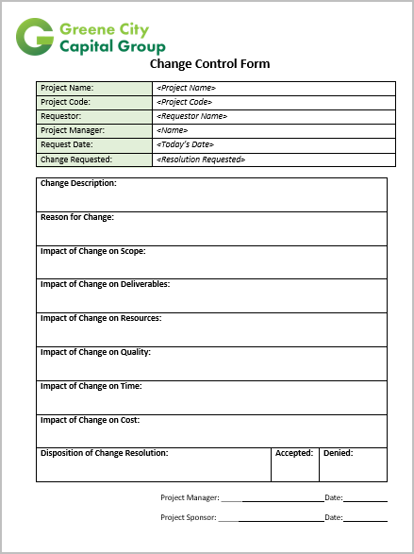
Change Control Form
Used to request a project change.
Generally referred to as change request forms.

Slide 9

Advantages of Effective Change Management
Faster response time.
Maximum traceability of changes.
Increased team awareness of change needs.
Increased engagement of team and stakeholders.
Better team support for change requirements.
Organizational framework for moving forward effectively.

Slide 10
The Impact Analysis Process
Impact identification—identifying the impact of a potential change on:
The triple constraints
Quality
Project complexity
The current and subsequent phases of the project
The list of project milestones and deliverables
Project testing needs
Resources needed for a project
Impact prediction—forecasting the characteristics, magnitude, and duration of the major impacts.
Impact evaluation—evaluating how the expected impact can be mitigated.

Slide 11
Scope Creep
The Project—Creating a PDA for the sales group.
Unapproved and uncontrolled changes
1
2
3
4
Developers begin creating deliverables.
Sales execution requests that the developers add more features without following the change control process.
Developers agree to the changes and begin development because they believe that the changes are good, won’t take long, and will improve the end product.
Developers run into problems when making unauthorized changes. They’ve spent two days on the changes and estimate that it’ll take another four days to incorporate the changes.
Impact—Additional cost, time, and resources were used beyond the scope of the project, and now the developers are behind their schedule.

Slide 12

Formal Acceptance of Project Work
The process of securing approval for completing the remaining project work.
Requires change requests to be documented and analyzed for their impact on other aspects of project work.
Validates that the acceptance criteria will still be satisfied as a consequence of the change.

Slide 13
Guidelines for Managing Project Changes
Make sure that your change control system is cost-effective.
Establish or make use of an existing CCB.
Make sure that the requested change deals with the project deliverable rather than project structure or controls.
Document the effect the changes have on the project baselines.
Obtain approval from the appropriate parties for all change requests.
Use configuration management to document and control changes.
Coordinate changes across knowledge areas as appropriate.
Use performance reports to measure project performance and assess whether plan variances require corrective action.
Identify the necessary corrective action.
Update the project plan.
Document causes of variance.
Have a regression plan to reverse any problematic changes that are out of proportion with the benefits of the change.

Slide 14
Managing Project Changes

Slide 15
Performance Measurement Tools
Tool | Description
Key Performance Indicators (KPIs) | Tools used to indicate if the project is meeting specific goals. Common KPIs relate to how well the project is tracking against the planned schedule and cost baselines, and meeting milestones. Define early in the project Should be quantifiable Measure regularly
Dashboards | Graphical summaries of project measures that provide an “at-a-glance” view of important data. Can be a collection of KPIs Used for decision making
Key Performance Parameters (KPPs) | Key system capabilities that must be met for a system to meet its goals. The threshold value of a KPP is the minimum acceptable value (cost, schedule, technology) for the system.
Balanced scorecard | A tool that integrates project management and portfolio management so that projects are aligned with an organization’s strategy. Identifies financial and non-financial measures and attaches targets to them. When performance deviates from expectations, manager can focus on a specific area.

Slide 16
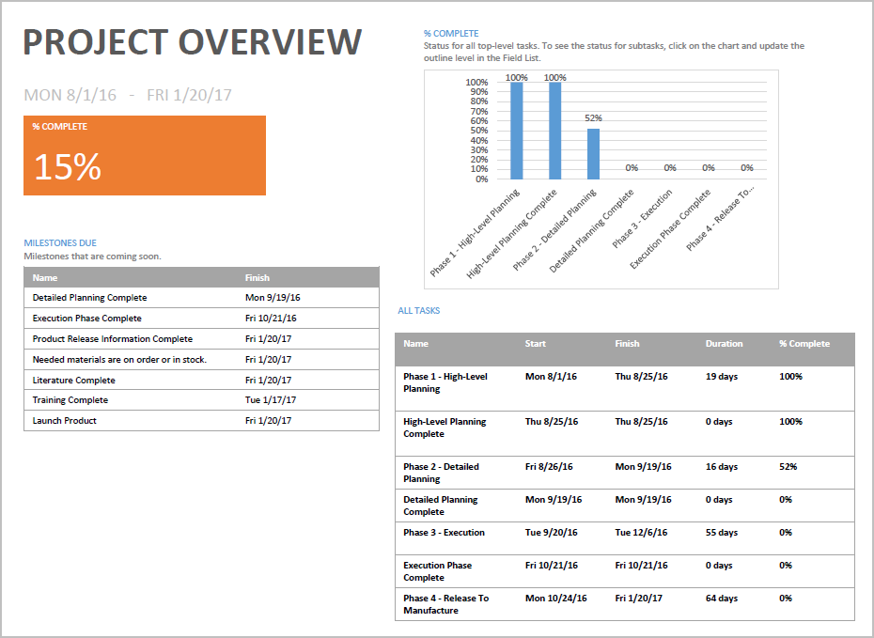
A Dashboard Example

Slide 17

Budget Forecasts
The estimated budget required to complete the remaining project work.
Stakeholders given one of the following:
A calculated Estimate at Completion (EAC) and an Estimate to Complete (ETC)
The reported EAC and ETC values from the organization.

Slide 18
Forecasting Methods
Forecasting Methods Category | Description
Time series methods | Estimation of future outcomes is based on historical data.
Causal or econometric methods | Forecasting the factors that may influence the identified variables, by combining economic theories and statistical information.
Judgmental methods | Forecasting by intuitive methods and probability estimates.

Slide 19
Reporting Systems
Tools that help in collecting, storing, and distributing project information to stakeholders.
Information distributed through various formats, such as presentation and spreadsheet analysis.
Project managers use different software applications to collect information from various sources, consolidate, and then distribute it among stakeholders.
Reporting systems are part of the PMIS.

Slide 20



Report Types
Progress report
Status report
Dashboard report

Slide 21
Performance Reports
A document that reports the progress made in the project activities against the specified baseline.
Performance reports help to:
Monitor the project progress.
Compare achievements with the plan.
Review plans and options against future scenarios.
Detect issues during the early phases of the project.
Initiate corrective action.
Authorize further work.
Common classifications of performance reports
Routine
Exception
Special analysis

Slide 22
Types of Performance Reports
Performance Report | Description
End stage | Submitted by the project manager to the PMO or senior managers to sign off the stage, having met its required success criteria, and approve transition to the next stage.
Highlight | Submitted by the project manager to the PMO or senior managers at regular intervals as the project progresses.
Exception | Submitted by the project manager to the PMO or senior managers when early warnings of any forecast deviations beyond the tolerance levels are identified in the project.
End project | Created and submitted by the project manager to the PMO or the senior manager for the project to be signed off as completed and to consider the necessary follow-up actions.
Post implementation review | Controlled by members external to the project. They are notified whether the expected project benefits have been realized. It is carried out as soon as the benefits and issues are identified and measured after the project's completion.

Slide 23
Performance Report Components
Help in making the actual versus baseline information with forecasted results available in a consolidated manner.
A simple report may contain information on the project scope, time, cost, and quality.
Detailed reports may also contain components such as:
Inferences of the past analysis.
Current risk status.
Work completed.
Work to be completed.
Summary of approved changes.
Variance analysis results; for example, Schedule Variance (SV), Cost Variance (CV), Schedule Performance Index (SPI), and Cost Performance Index (CPI).
Forecasted results; for example, Estimate at Completion (EAC) and Estimate to Complete (ETC).

Slide 24

Benefits of Creating Performance Reports
Analysis of the current status of the schedule and budget
Feedback to team members and work package owners
Communication with upper management and customers
Early identification of variance
Early implementation of corrective actions

Slide 25
Guidelines for Reporting Project Performance
Analyze work results against planned performance.
Hold performance reviews.
Consult your project management plan’s subsidiary plans for guidelines and procedures.
Determine the type of report needed for the information being reported.
Prepare appropriately formatted performance reports.
Balance the cost, time, and logistics of preparing performance reports against the benefits gained.
Measure and monitor performance consistently throughout the project.

Slide 26
Reporting Project Performance

Slide 27
How can you make the change management processes followed in your organization more effective?
In your environment, which elements are the most difficult to control—cost, schedule, or scope?

