Slide 1
Monitoring and Controlling Project Constraints
Control the Project Scope
Control the Project Schedule
Control the Project Costs
Manage Project Quality

Slide 2
Verified Deliverables
Project products or results that are completed and verified for their correctness while performing quality control.
Used as inputs during scope verification of the project to determine if work is complete and satisfies project objectives.

Slide 3

Inspections
An official examination of work results to verify that requirements are met.
Involve:
Comparing the baseline specifications and approved changes to the actual project results.
Determining the likelihood that remaining deliverables will be completed as promised.
Identifying actions needed to ensure that work results will meet specifications, scope, schedule, and budget goals.

Slide 4
Inspection Report Components
Component | Description
Project baseline and status comparison | The comparison of the baseline specifications, schedules, and budgets to the actual project results for the project phase or deliverable.
Overall project status | A discussion of whether the project as a whole is on track, or whether it is likely to deviate in some way from the project plans.
Change recommendations | Based on the inspection result, you may want to recommend changes that will be needed in order to meet specifications, scope, or schedule and budget goals.
Scope and methodology of the inspection | Explains what the audit attempted to prove, how it went about proving it, what measurements were used to determine conformance to requirements, and what assumptions or limitations influenced the way that data was collected.

Slide 5
Variance
The quantifiable deviation from expected results for any product or result, including quality, schedule, and cost.
Example: Late arrival of daily flight from Chicago to New York City. Typically 10- to 20-minute delay due to schedule variances caused by:
Mechanical breakdowns.
Human error.
Weather-related delays.

Slide 6
Variance Analysis
The comparison of the difference between the actual or predicted results and the original scope baseline or expected results.
Determine the cause and degree of variance relative to the scope baseline and decide if any corrective or preventive action is necessary.

Slide 7
Work Performance Measurements
Measuring the variance between the planned and actual technical performance or other scope performance measurements.
Results are documented as a report and then communicated to project stakeholders.
Reports may include:
Features of the product planned versus features of the product being delivered.
Any addition or deletion to the features list.
New changes to the project scope.

Slide 8
Guidelines for Controlling the Project Scope
Develop and implement a scope change control system.
Evaluate change requests by asking questions.
Identify and document corrective actions to bring expected future performance in line with planned performance.
Ensure that formal agreements are reached and new specifications detailed when the project scope is expanded.
Revise cost, schedule, or quality baselines to reflect changes, if necessary.
Use performance measurement techniques to monitor changes.
Document lessons learned during scope change control for future projects.

Slide 9
Controlling the Project Scope

Slide 10

Scheduling Tools
The use of updated schedule data combined with the project management software or other methods to perform schedule network analysis and generate an updated project schedule.
Accelerate the scheduling process by generating start and finish dates of activities based on their inputs, creating network diagrams, and producing resource and activity durations.

Slide 11
EVM
A method for measuring project progress.
Compares actual schedule and cost performance against planned performance.
Important to understand the monetary value of work contribution.
PV
AC
EV
Schedule and Cost Variance

Slide 12

PV
The budgeted portion of the approved cost estimate to be spent during a particular time period to complete the scheduled project work.
400
300
200
100
0
$ (K)
Planned Value (PV)
Earned Value (EV)
Actual Cost (AC)
1
2
3
4
5
6
7
8
9
10
11
12
Time (months)
An illustration of planned value

Slide 13
EV
A composite measurement of actual cost and time performance in relation to scheduled or planned cost and time performance.
EV = % work complete to date x budgeted cost.
400
300
200
100
0
$ (K)
Planned Value (PV)
Earned Value (EV)
Actual Cost (AC)
1
2
3
4
5
6
7
8
9
10
11
12
Time (months)
An illustration of earned value

Slide 14
AC
The total amount of costs incurred while accomplishing work.
400
300
200
100
0
$ (K)
Planned Value (PV)
Earned Value (EV)
Actual Cost (AC)
1
2
3
4
5
6
7
8
9
10
11
12
Time (months)
An illustration of actual cost

Slide 15
EVM Measures for Schedule Control
Schedule Variance (SV = EV - PV)
A positive SV indicates that the project is ahead of schedule.
A zero SV indicates that the project is on schedule.
A negative SV indicates that the project is currently behind schedule.
Schedule Performance Index (SPI = EV / PV)
An SPI number greater than 1.0 indicates that the project is ahead of schedule.
An SPI of 1.0 means the project is on schedule.
An SPI number less than 1.0 indicates that the project is behind schedule.

Slide 16
Schedule Control Chart
Schedule status
Ahead of schedule
Duration units
0
Behind schedule
1
2
3
4
5
6
7
8
Reporting periods

Slide 17
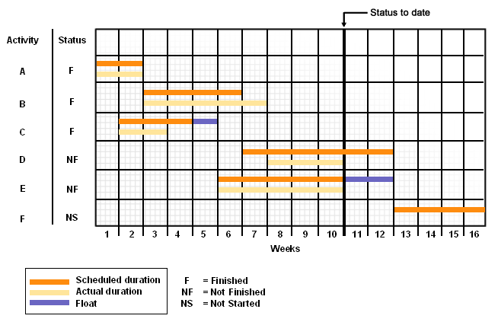
Gantt Chart
A sample Gantt chart for a software development project.

Slide 18
Guidelines for Controlling the Project Schedule
Develop and implement a schedule change control system.
Evaluate change requests by asking questions.
Use performance measurement techniques to compare actual schedule performance to planned performance.
Analyze the results of your performance measurements.
Identify and document corrective action to take.
Revise cost, schedule, or quality baselines to reflect changes.
Use performance measurement techniques to monitor the changes.
Document lessons learned for future projects.

Slide 19
Controlling the Project Schedule

Slide 20
Cost Control
Effective cost control enables you to:
Spot warning signs early
Measure the cost variance
Make the necessary adjustments before cost overruns cause a major problem
Monitor the burn rate to avoid running out of money before the scope has been completed.

Slide 21
EVM Measures for Cost Control
Cost Variance (CV = EV - AC)
A positive CV indicates that the project is performing under budget.
A zero CV indicates that the project is on budget.
A negative CV indicates that the project is performing over budget.
Cost Performance Index (CPI = EV / AC)
A CPI number greater than 1.0 indicates that the project is under budget.
A CPI of 1.0 means the project is on budget.
A CPI number less than 1.0 indicates that the project is over budget.

Slide 22
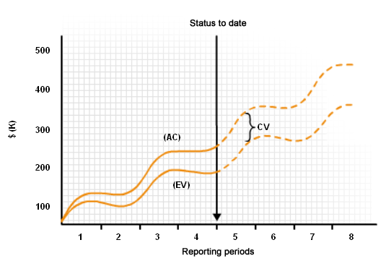
Cost Control Chart

Slide 23
Performance Reporting Techniques
Technique | Description
Variance analysis | Comparing actual project performance to projected performance.
Trend analysis | Inspecting project performance over a period of time to determine if performance is increasing or decreasing.
Earned value performance | Comparing projected performance to actual performance.

Slide 24
EVM Performance Measurement Analysis Techniques
Cost Formula | Description | Calculation
Cost Variance (CV) | The difference between the EV and the AC incurred to complete that work. | CV=EV-AC
Cost Performance Index (CPI) | Cost performance measurement used to determine whether the project is over or under budget. | CPI=EV/AC
Estimate to Complete (ETC) | The total budgeted cost of the project at completion. | ETC=BAC-EV or (BAC-EV)/CPI
Estimate at Completion (EAC) using new estimate | The forecasting technique based on an updated, mid-project estimate. | EAC=AC+ETC
Estimate at Completion (EAC) using remaining budget | The forecasting technique used when the current cost variances are atypical of future variances. | EAC=AC+BAC-EV
Estimate at Completion (EAC) using CPI | The forecasting technique used when current variances are typical of future variances. | EAC=AC+((BAC-EV)/CPI) or EAC=BAC/CPI
Variance at Completion (VAC) | The estimated cost overrun or underrun for completing project work. | VAC=BAC-EAC
To-Complete Performance Index (TCPI) based on BAC | An indicator of the usage of resources for the remainder of the project. | TCPI=(BAC-EV)/(BAC-AC)
To-Complete Performance Index (TCPI) based on EAC | Used when BAC has been deemed unachievable. | TCPI=(BAC-EV)/(EAC-AC)

Slide 25
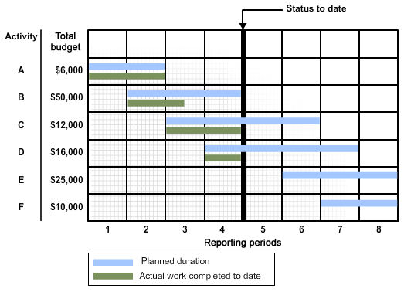
Project Schedule Showing Planned and Actual Work

Slide 26
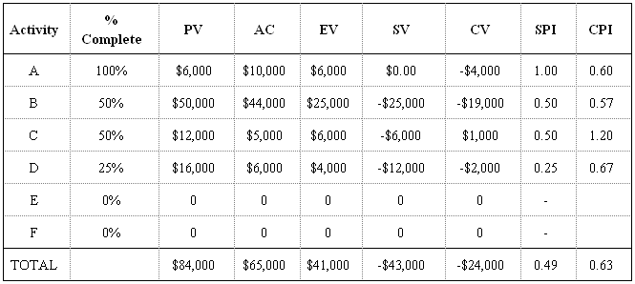
Project Schedule EVM Calculations

Slide 27
Guidelines for Controlling Project Costs
Develop and implement a cost change control system.
Evaluate change requests by asking questions.
Use performance measurement techniques to compare actual cost performance to planned performance.
Analyze the results of your performance measurements.
Identify and document corrective actions to take.
Revise cost, schedule, or quality baselines to reflect changes, if necessary.
Use performance measurement techniques.
Document lessons learned for future projects.

Slide 28
Controlling Project Costs

Slide 29
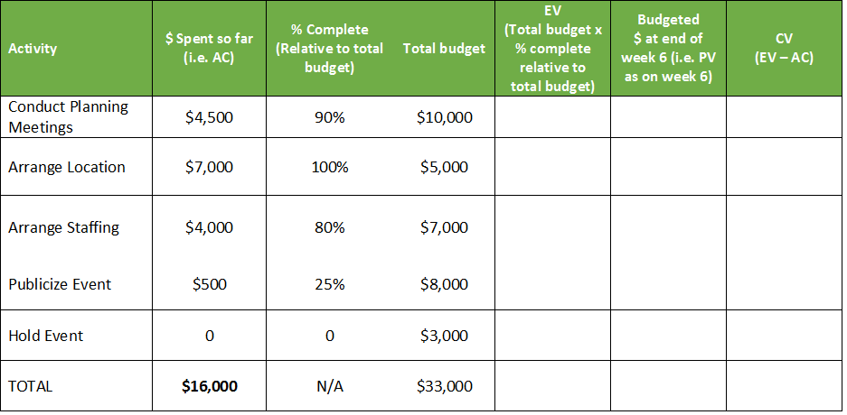

Activity Scenario

Slide 30
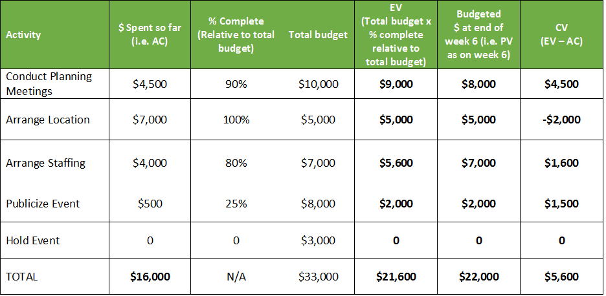
Completed Cost Calculations

Slide 31

Quality Control Measurements
Measurements that are used to assess a product's adherence to the specified standards.
Example: Using a 3D digitizing system to examine the water turbines' adherence to the specified quality: deviation between two blades not to exceed 0.20 degrees.

Slide 32
Causes of Variance
Random causes
Special causes
Always present in work.
Unavoidable.
Random causes: Weather and traffic conditions.
Unusual, sporadic occurrences.
Result of some unexpected circumstance.
Not caused by a flaw in the overall production process.
Special cause: Minor traffic accident.
Example: Variances in the metropolitan bus schedules.

Slide 33
Significance
Weight or importance given to variances to determine whether and what type of corrective action needs to be taken by the project manager.
Determine the significance of the variance by keeping a balance of the three main constraints.
Example: Cost variance in a project.
If variance is $5,000 on a $5 million project, the significance is very low.
If variance is $5,000 on a $50,000 project, the significance is much higher.

Slide 34


Root Cause Analysis
A technique used to determine the true cause of the problem that, when removed, prevents the problem from occurring again.
Example: A customized application for calculating tax miscalculated the sales tax and a root cause analysis was performed to find the root cause.

Slide 35
Tolerances
The measurement values that determine if a product or service is acceptable or unacceptable.
The standards against which data collected will be analyzed.
Example: Tolerance for a product weight.
Tolerance level: 5.8 grams ± 0.2 grams
Unacceptable level:
More than 6 grams
Less than 5.6 grams

Slide 36

Variability Indications
Measurements that exceed the upper and lower control limits are considered to be an indication of instability.
The variability expressed is atypical for the process and may be an indication of a special source of variance.

Slide 37

Standard Deviation and Variability
For normal distribution, almost all values lie within three standard deviations of the mean.
The Six Sigma Process business management strategy states that a process should have no more than 3.4 defects per million. It is used where extremely high-quality results are required.

Slide 38
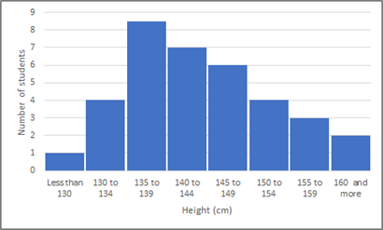
Histograms
Quality control tool that organizes individual measured values in a data set according to the frequency of occurrence.
Use histograms to:
Show the distribution of data.
Evaluate both attribute (pass/fail) and variable (measurement) data.
Determine how variable the process is.
Analyze whether the variation is random.

Slide 39
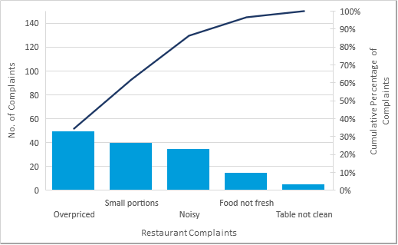
Pareto Charts
Histograms used to rank causes of problems in a hierarchical format.
Variables are ordered by frequency of occurrence.
A Pareto diagram

Slide 40

The 80/20 Rule
General guideline with many applications.
Involved in controlling processes.
Contends that 80 percent of problems or defects are commonly due to 20 percent of causes.
Problems
Causes

Slide 41
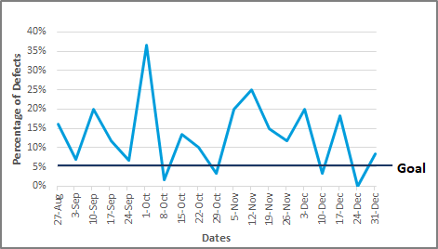
Run Charts
Line graphs showing plotted data points in chronological order.
Show trends in a process or improvement over a period of time.
Used in trend analysis to communicate forecasting information based on the project's current performance.
Used to monitor technical, cost, and schedule performance.

Slide 42
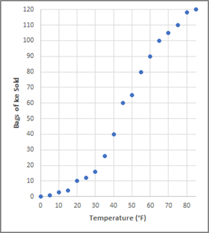
Scatter Charts
Diagrams that display the relationship between two variables.
Plots dependent and independent variables.

Slide 43
Statistical Sampling
A technique used to determine the characteristics of an entire population based on actual measurement of its representative sample.
Produces a process that does not require inspection of every item.
1
2
3
4
2
5
5
6
7
8
8
10
Sample
9
10
11
12
Population showing various characteristics

Slide 44
The Statistical Sampling Process
Involves dividing sampling data into two categories: attribute and variable—each of which is gathered according to sampling plans.
Helps reduce overall quality costs when used during quality control.
Corrective actions
Attribute sampling data
Trend analysis
Variable sampling data
Defects reduced
The statistical sampling process

Slide 45

Attribute Sampling Data
Data from the sample that is counted, such as:
The number of employees participating in profit sharing.
The number of customer complaint calls.
The number of returned items.
Tells you whether or not a standard has been met.
Example: Counting the number of widgets that do not meet the relevant operational definition from a random sample of 500 widgets.
Plan: Fewer than 10 defective widgets.
Actual: 30 defective widgets.
Sample did not pass inspection.

Slide 46

Variable Sampling Data
Data from a sample measured on a continuous scale, such as:
Time
Temperature
Weight
Provide the same level of accuracy as attribute samples with much smaller sample sizes.
Example: An ice cream manufacturing company using variable sampling data to ensure quality control.
Testing random batches to measure:
Flavor
Consistency
Color
Texture
Visual appeal

Slide 47
Guidelines for Managing Project Quality
Conduct inspections to detect quality errors as work is ongoing.
Analyze quality variance to determine the root cause of the problem.
Use Pareto diagrams to focus corrective actions on the problems having the greatest effect on overall quality performance.
Use control charts to analyze and communicate the variability of a process or project activity over time.
Identify ways to eliminate causes of unsatisfactory results to minimize rework.
Initiate process adjustments by implementing corrective or preventative actions.
Continue to monitor, measure, and adjust quality throughout the project life cycle.

Slide 48
Controlling Project Quality

Slide 49
Of the three components, schedule, cost, and scope, which according to you has the most impact on the program outcome?
What performance measurement techniques will you use in the future to measure schedule performance?

