Slide 1
Monitoring and Controlling Project Risks
Monitor and Control Project Risks

Slide 2

Project Status Meetings
Conducted to discuss the current status of the project with the project team members and other stakeholders.
Risk identification and management is one of the agenda items.

Slide 3
Risk Reassessment
Identify new risks
Reassess current risks for their probability and impact
Close outdated risks

Slide 4
The Project Risk Response Audit
Review the risk register
Evaluate the performance in implementing the response plan
Document the results
Recommend risk management improvements

Slide 5
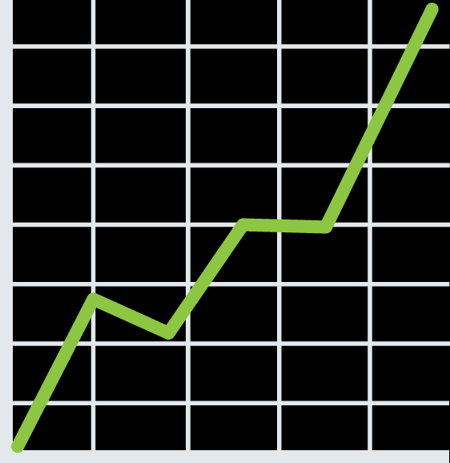
Trend Analysis
The process of examining project results over time to determine if performance is improving or deteriorating.
Involves reviewing the various trends in project performance on a regular basis.
Can be used to predict future performance.

Slide 6
Guidelines for Controlling Project Risks
When an event affects the project objectives, consult the risk response plan to identify risks and triggers.
Monitor the environment for any new risks.
Monitor the effectiveness of the risk response, contingency, and fallback plans.
Deal with unforeseen risks by systematically planning a reasoned response.
Update project documentation as changes are indicated.
Manage the contingency reserve.
Check the project performance.

Slide 7
Controlling Project Risks

Slide 8
How have changes to the business environment affected your project's risk control efforts?
What is your biggest challenge when it comes to monitoring and controlling risks?

