Slide 1
Monitoring and Controlling Procurements
Monitor and Control Vendors and Procurements
Handle Legal Issues

Slide 2
Vendor Management
A management technique that is used to obtain and oversee contracted resources, including:
People
Facilities
Equipment
Materials
Vendor Management involves:
The identification and selection of vendors.
The management of contract terms and conditions.
Example: Levying a 10% delay fee to cover additional costs of schedule delay on a contractor who delays the supply of materials in a construction project.

Slide 3
Procurement Documentation
Created when administering project procurements.
Acknowledged and validated for contract closure.
Contains information about vendor performances on:
Cost
Scope
Quality
Contract change notes
Approved and rejected changes
Payment notifications
Claims

Slide 4

The Procurements Administrator’s Duties
Act as a contract compliance officer.
Interpret contract specifications and ensure that their terms are met.
Monitor vendor performance.
Integrate subcontracted elements.
Manage change requests.
Resolve disputes and manage payments.
Deal with contract breach, early termination, and other issues.

Slide 5
Procurement Performance Reviews
Evaluation of the vendor's work.
Verification that the work performed is in accordance with the scope, schedule, quality, and cost as defined by the contract.
Example: Contract performance review of construction materials in a construction project.

Slide 6
The Contract Change Control System
An offshoot of the overall change control system, but dedicated specifically to control contract changes.
Documentation of the processes for project contract changes, dispute resolution, and approval levels to authorize changes.
Example: A website designing company documenting the changes requested by its client in the contract change control system.

Slide 7
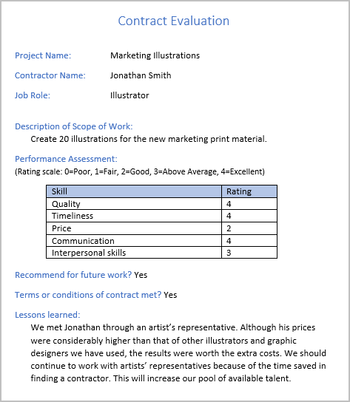
Vendor Inspection and Audit
Buyer verifies compliance in the vendor’s work processes or deliverables.
Goal of the Audit: Establish a record that may be used to shape procurement practices for current and future projects.
Seeks to answer several questions about the procurement process, including:
Were the contract specifications completed as specified and were all terms and conditions met?
Were the quality, timelines, and cost acceptable?
Were the vendor's project management, contract management, financial management, and communications management practices acceptable?
Was the vendor able to accommodate requested changes?
Were the members of the vendor's staff acceptable? Did any individuals merit special recognition?
Was there anyone you will not recommend for future assignments?
Were there areas for improvement?
What were the lessons learned from this contract?

Slide 8

Payment Systems
Systems used to make payments to the vendors that are made contingent on the acceptance of the delivered goods or services and on the receipt of a valid invoice.

Slide 9

Claims Administration
Disputes that arise when buyers and vendors cannot agree on changes.
Handled in accordance with contract terms and are managed throughout the term of the contract.
Claims Administration

Slide 10

The Records Management System
A software application that is used to generate, track, and retrieve documents and for correspondence purposes.
Use to manage the project vendors, procurements, and contract documentation.
Contains the processes, control functions, and automation tools.
A subsystem of the PMIS.

Slide 11
Guidelines for Monitoring and Controlling Procurements
Index and store all contract correspondence for ease of retrieval.
Develop and implement an effective contract change control system.
Evaluate the risk of each contract change request.
Document all contract changes; incorporate them into the project plan.
Develop and implement an effective performance reporting system for the vendor.
Address performance reporting specifications imposed on the vendor.
Set performance milestones to monitor project progress.
Conduct site visits to determine how the vendor’s work is progressing.
Verify that the objectives of the project are being met.
Approve submitted invoices for payment in accordance with the contract and the project's payment system.

Slide 12
Monitoring and Controlling Procurements

Slide 13
Changes to Contract Terms
Change | Description
Administrative changes | These are the nonsubstantive and most common changes to the way the contract is administered.
Contract modification | This is a substantive change to the contract requirements such as a new deadline or a change to the product requirements.
Supplemental agreement | This is an additional agreement related to the contract but negotiated separately.
Constructive changes | These are changes that the buyer may have caused through action or inaction.
Termination of contract | A contract may be terminated due to vendor default or for customer convenience. Defaults are due to nonperformance, such as late deliveries and poor quality, or nonperformance of some or all project requirements.

Slide 14
Legal Concepts
Legal Issue | Description
Warranty | A promise, explicit or implied, that goods or services will meet a pre-determined standard. The standard may cover reliability, fitness for use, and safety.
Waiver | The giving up of a contract right, even inadvertently.
Breach of contract | Failure to meet some or all of the obligations of a contract. It may result in damages paid to the injured party, litigation, or other ramifications.
Non-Disclosure Agreement (NDA) | A legal contract that outlines confidential material, information, or knowledge that two parties wish to share only with each other and protects this information from being shared with other parties.
Cease and Desist (C&D) letter | A letter sent to an individual or a business to stop (cease) allegedly illegal activities and to not undertake them again (desist). Often used as a warning of impending legal action if it is ignored.
Letter of Intent | A document that outlines an agreement between two parties before the agreement is finalized. Sometimes used to highlight fundamental terms of an agreement before potentially expensive legal negotiations are begun, or to indicate that the parties have begun negotiations.

Slide 15
Types of Warranties
Type of Warranty | Description
Express warranty | If the predetermined standard for quality or performance is specified, either in a formal warranty or in the manufacturer's description of the product, it is considered an express warranty.
Implied warranty | If the predetermined standard for quality or performance exists but is not specified, it is considered an implied warranty.
Warranties of merchantability | Implied warranties that require goods to be fit for ordinary usage. Any sale of an item is subject to warranties of merchantability.
Warranties of fitness for purpose | Implied warranties that require goods to be fit for the usage that was intended by the buyer.

Slide 16

Types of Waivers
Inadvertently waiving contract rights includes:
Accepting a product that fails to meet quality or performance standards.
Accepting late deliveries.
Overlooking nonconformance to contractual obligations.
To protect against losses incurred by an inadvertent waiver of contract rights, some contracts are written to specifically exclude the possibility of waiving a specified right.

Slide 17
Types of Breaches of Contract
Type of Breach | Description
Anticipatory | An unavoidable indication that the other party will not be able to produce the performance necessary to fulfill the contract.
Fundamental | A breach so serious that it negates the very foundation of the contract.
Material | A serious breach that prevents the injured party from benefiting from the contract.
Immaterial | The contract is breached in such a way that there is no resulting damage to the injured party; because there are no damages, the injured party is not entitled to receive compensation.

Slide 18
Guidelines for Handling Legal Issues
Have a good understanding of the differences between important legal terms that can, if ignored, have a significant impact on the project—warranty, waiver, and breach of contract.
Be sure to consult with somebody in your company's legal department or seek advice from an outside legal expert so you thoroughly understand any contracts that affect your project.
If your contract isn't written specifically to exclude inadvertent waivers, avoid doing any of the following that would waive your contract rights:
Accept a product that fails to meet standards for quality or performance.
Accept late deliveries.
Overlook an aspect of nonconformance to contractual obligations.

Slide 19
Handling Legal Issues

Slide 20
How will developing and implementing an effective performance reporting system help you administer contracts on future projects?
What are the most common legal issues you’ve encountered when monitoring and controlling vendors?

