Slide 1
Initiating the Project
Identify the Project Selection Process
Prepare a Project SOW
Create a Project Charter
Identify Project Stakeholders

Slide 2
Strategic and Operational Relevance
Strategic
Determines whether the project is aligned with the company's strategic goals.
Decides if the project should be taken up.
To establish strategic relevance:
Check if the desired future state aligns with the organizational strategic objectives.
Check if the project objectives and the strategic priorities are clearly defined and communicated by senior leadership.
Strategic objectives are inherently dynamic and influenced by unpredictable market events.
Operational
Requires the desired future state to be in alignment with the operational priorities set by tactical management.
Requires that the project objectives and operational priorities are clearly defined and communicated by tactical management.
Operational priorities are influenced by both established and emerging strategic priorities.

Slide 3
Reconciliation of Strategic, Tactical, and Operational Goals
Organization’s Strategic Goals
Reconcile project’s business requirement
Organization’s Tactical Goals
Reconcile project’s functional requirement
Organization’s Operational Goals
Reconcile project’s technical requirement

Slide 4
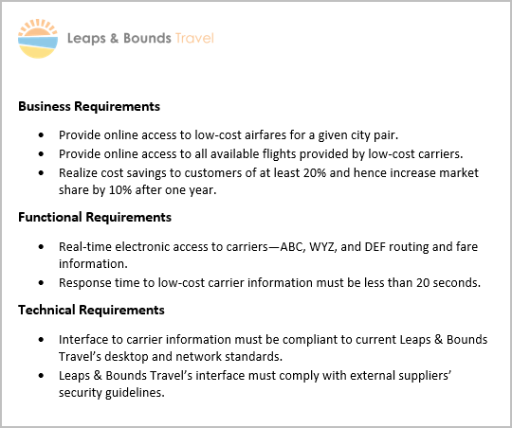
Project Requirements
A sample list of project requirements for a travel reservation company to increase its market share.

Slide 5
Project Selection Criteria
The standards and measurements an organization uses to select and prioritize projects.
Any project selected should be clearly linked to one or more strategic goals.
Selection criteria may be:
Qualitative
Quantitative

Slide 6
Project Selection Methods
Any systematic approach used to analyze the value of a proposed project in order to choose among competing proposals.
These methods should take into account:
The organization’s strategic objectives.
Historical information about past successes and failures.
Example: Opportunity to implement two new projects, but has resources for only one by the end of a fiscal year. Prioritization based on:
Projected cost analysis.
Projected duration analysis.
Projected financial benefits analysis.

Slide 7
Project Selection Decision Models
Decision Model Type | Description
Benefit Measurement Models | Analyze the predicted value of the completed projects in different ways. May present the value in terms of: Forecasted revenue. Return on Investment (ROI). Predicted consumer demand. Internal Rate of Return (IRR).
Mathematical Models | Use different types of mathematical formulas and algorithms to determine the optimal course of action. May consider variables such as: Mathematical models and algorithms. Business constraints. Highest possible profit. Relevant laws and safety regulations.

Slide 8
Capital Budgeting
Helps senior executives make decisions about when and whether to make significant investments in capital expenditures such as:
New equipment
Machinery
Facilities

Slide 9
Scoring and Rating Systems
Use scoring and rating system to find the best available solution or outcome.
Rating System | Description
Decision tree | Selection criteria arranged along the branches of a tree flowchart.
Criteria profiling | Project criteria are scored for comparison.
Weighted factor | Different criteria may be weighted and scored for comparison.
Q-sorting | Groups of people rate the relative priority of a number of projects.
Delphi technique | Experts are located remotely and remain anonymous, yet participate in group decision making. Consensus is achieved through group ranking.

Slide 10
Feasibility Analysis
An evaluation method to determine if the project is feasible in terms of financial, technical, and business aspects.
Provides technical and operational data to management to make a decision about project selection.
Includes:
Problem description
Summary of historical data
Evaluation of available technologies
Evaluation of organization’s technical capabilities
Cost and time estimates
Assumptions and constraints
Recommendations
Statement of project goals and milestones

Slide 11
Cultural Feasibility
Measures the extent an organization's shared values support the project's goals.
Cultural issues that prevent the absorption of the proposed change must be detected.
Can be achieved by looking at the relationship among people, processes, and platforms involved in the implementation of the solution.
Consider these questions to examine cultural feasibility:
What key business processes are involved in the proposed change?
What is the essence or nature of those business processes?
Who within the organization supports those key business processes?
What is the technical proficiency of the staff and can they handle the proposed change?
What is the technical proficiency of the intended audience or customers and can they handle the proposed change?
Does the intended audience believe that the proposed solution can help or benefit them?

Slide 12
Technical Feasibility
A feasibility study to analyze the technical considerations of a proposed project.
An SME should be brought in to assist the quantification of the systems’ impact when you encounter the following situations:
The proposed project has never been attempted before.
The proposed project will interact with any key business process or mission-critical systems.
The project team for the proposed project does not contain personnel sufficiently knowledgeable or certified in key aspects of the technology in question.
The systems’ impact cannot be accurately re-created and tested in a simulation environment.

Slide 13
Cost-Benefit Analysis
A comparison of the estimated costs versus the predicted benefits of the project.
Helps decision makers make informed choices about project selection.
Example: Increased e-commerce capability for a retail organization.
The rough cost estimates are:
Predicted cost = $25K in the next five years.
Predicted increase in sales: 5% of $1 million = $50K.
Predicted net benefit = $25K.

Slide 14
Workflow Analysis
A technique that formally documents the manner in which work gets done and displays that work in a flowchart.
Helpful in breaking down large or complex jobs into discrete tasks and decisions.
Receive check
Drive to bank
Prepare deposit slip
Wait in line
Give deposit to teller
Receive receipt

Slide 15
Use Cases, Prototypes, and Scenarios
Tool | Description
Use case analysis | A method for designing information systems by breaking down requirements into user functions.
Prototype | A simulated version of a new system, essential for clarifying information elements.
Scenarios | A method for developing potential or likely eventualities for different situations.

Slide 16
Reviewing Project Selection

Slide 17
SOW
An internal SOW is supplied by the project's sponsor in response to an organizational need. It is generally referred to as the Project SOW.
An external SOW is usually supplied to a potential client during the procurement process.
An external project (or Procurement) SOW could be included with a request for a proposal or as part of a contract.

Slide 18
Project SOW
Describes the products, services, or results that the project will deliver.
Contains or references the following:
Business need
Market demand
Technological advance
Legal requirement
Government regulation
Environmental consideration
High-level scope definition
Characteristics of the product, service, or result
Any known high-level project risks
Strategic plan
Organization’s strategic vision, goals, and objectives
High-level mission statement

Slide 19
Guidelines for Preparing a Project SOW
Provide the description and scope of the project.
Benefit to the organization.
Business need that is driving the project.
Identify the major deliverables and any anticipated milestone events.
Identify resource requirements.
Human resource needs
Other resources, such as hardware, software, funding, etc.
Identify risks or other concerns that might affect the project.
Define the criteria used to indicate when the project is complete.
Use the mandated project SOW format, if one exists, or modify an existing SOW from a previous, similar project.

Slide 20
Preparing a Project SOW

Slide 21
Business Case
Document that justifies the investments made for a project.
Describes how an investment aligns with the organization's policy.
Outlines the technical, investment, and regulatory factors influencing the project.
Provides a framework to link an investment proposal to the achievement of an organizational objective.
Example: The business case for adding a geothermal energy project to GCCG’s portfolio includes:
Details of the proposed investments, including the timeline.
Expected returns from the project with the proposed timeline.
Expected ROIs.
Reference to the payback period in the context of organizational strategies and project objectives.

Slide 22
Business Case Components
Component | Description
Business need | Substantiates the business reason for conducting the project.
Project contribution | Determines the project's contribution toward the organization's objectives.
Stakeholders | Lists the project stakeholders, their expectations, and contribution toward the project.
Constraints | Compiles the limitations of the project.
Strategic risks | Lists the risks that the project may face and the possible risk management measures.
Benefits evaluation | Analyzes and outlines the key benefits to be obtained.
Project roles | Lists the members of the project team and their respective job roles in the project.
Benefits realization plan | Provides an outline of the benefits realization plan.
Contingency plan | Outlines the alternate solutions for unplanned accidents.

Slide 23
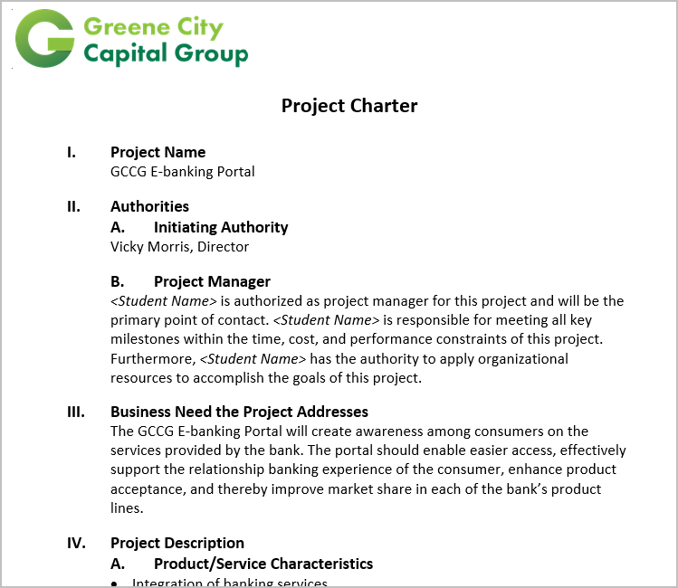
Project Charter
Document that formally launches and authorizes a new project, or authorizes an existing project to continue with its next phase.

Slide 24
Project Charter Components
Project purpose
Problem statement
Project authorization
Scope definition
Project objectives
Project description
Project deliverables
Project milestones and cost estimates
General project approach
Constraints and assumptions
Risks
Project stakeholders
Related documents
Project organizational structure
Issuing authority

Slide 25
Guidelines for Creating a Project Charter
Gather the prerequisites required to create a project charter.
Use a corporate template, if there is one.
Involve an expert, if necessary.
Include project and authority ID information.
Include a clear, concise description of the business need, opportunity, or threat.
Include summary descriptions of the project product or services.
Include a description of the project’s relationships to need.
Consider any known constraints and assumptions.
Ensure that the people with the required knowledge and authority sign the project charter.
Distribute the charter to stakeholders.

Slide 26
Creating a Project Charter

Slide 27
Stakeholder Analysis
1. Identify potential project stakeholders
2. Classify stakeholders based on impact or support
3. Plan for stakeholder reaction and response

Slide 28
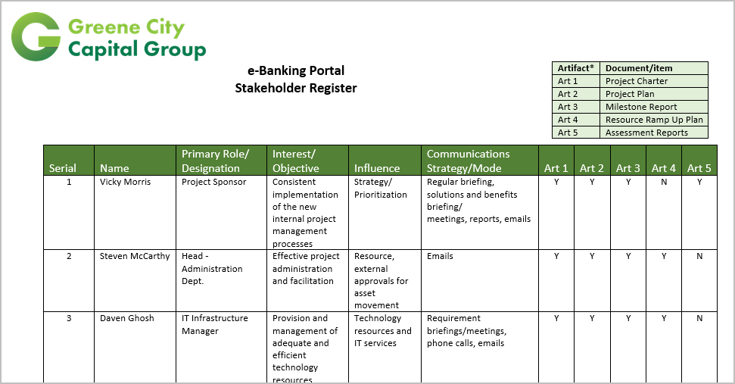
Stakeholder Register
Document that identifies stakeholders of a project with information that includes their identification, assessment, and stakeholder classification.

Slide 29
Stakeholder Management Strategies
A management strategy that is created to ensure maximum support and minimize the negative impacts of stakeholders throughout the project life cycle.
A stakeholder management strategy document can include:
Stakeholder identification.
Stakeholder map.
Stakeholder analysis influence and importance matrix.
Stakeholder list.
Stakeholder communication.
Communication efficiency.

Slide 30
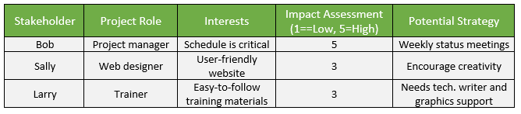
Stakeholder Analysis Matrix
Document that lists the project stakeholders and describes their interests and the ways in which they influence the project.

Slide 31
Guidelines for Identifying Project Stakeholders
Create a list of internal and external parties who may be impacted by the project.
Gather the relevant documents to identify the stakeholder needs (i.e., the project charter and procurement documents).
Identify groups or individuals with specialized training or knowledge.
Interview the identified stakeholders.
Identify the key stakeholders of the project.
Classify the potential impact or support of each stakeholder.
Assess how stakeholders will react or respond in various situations (i.e., bad news) during the project life cycle.
Document stakeholder information in the stakeholder register.
Devise a stakeholder management strategy to increase support and minimize negative impact.

Slide 32
Identifying Project Stakeholders

Slide 33
How is the project initiation phase (process group) important while managing a project in your organization?
How do you think creating the Project SOWs in your organization helps you manage your projects?

