Slide 1
Planning the Project
Identify Project Management Plan Components
Determine Stakeholder Needs
Create a Scope Statement

Slide 2
Project Management Plan
Document that details how the project will be executed to achieve its objective, including:
Description of project management processes to be used and level of implementation.
Description of the tools and techniques used to complete the processes.
Extensive description of the tasks to be completed.
Plans for monitoring and controlling change during the project.
Configuration management plan details.
Performance measurement baselines.
Stakeholder communication techniques to be used.
Definition of the project life cycle.
A plan for identifying, documenting, and addressing issues.

Slide 3
Subsidiary Plans
Subsidiary Plan | Description
Scope management plan | Provides guidance on the project scope.
Requirements management plan | Specifies the planning for requirements of the project.
Schedule management plan | Describes the plan to control the project schedule.
Cost management plan | Describes the plan to control project costs.
Quality management plan | Describes the implementation of the organization's quality policy throughout the project.
Process improvement plan | Analyzes processes to identify activities that enhance their value.
Human resource plan | Provides guidance on effective human resource management.
Communications management plan | Documents the approach to communicate efficiently and effectively with the stakeholders.
Risk management plan | Describes how risk management is structured and performed on the project.
Procurement management plan | Describes how the procurement processes will be managed.

Slide 4
Scope Management Plan
Describe how a project team will define, verify, manage, and control the project scope.
Can be formal or informal.
Example: The scope management plan for the geothermal energy program describes:
How frequently and extensively the scope is expected to change.
How the project team will identify, discuss, and classify changes to the scope.
Who will approve the changes.

Slide 5
Requirements Management Plan
A document that describes how the project requirements throughout the project life cycle will be:
Analyzed.
Documented.
Managed.
Phase-to-phase relationships between various phases strongly influence how requirements are managed.
Components of the plan include:
Methods to plan, track, and report requirement activities.
Configuration management related activities.
Process for requirements prioritization.
Traceability matrix for requirements.

Slide 6
Schedule Management Plan
Provides an approach to develop, maintain, and manage the project schedule. A typical plan includes:
The purpose of the plan.
Approved schedule development tools and techniques.
The number, types, and purposes of the project schedules to be developed and maintained.
How changes to the schedule baseline will be managed.
Who is responsible for developing and maintaining project schedules.
How and when schedule performance will be reported.

Slide 7
Cost Management Plan
Outlines the guidelines for planning, estimating, budgeting, and controlling project costs.
Describes how risk budgets, contingencies, and management reserves will be communicated and accessed.
Provides the planning and structure necessary to control project costs.
Example: Cost management plan for a construction project that contains:
The estimates, methods, and procedures required for calculating direct and indirect costs of the project.
The process for calculating contingency costs.

Slide 8
Quality Management Plan
Describes a team’s approach to implementing the quality policy.
Outlines how quality control and quality assurance will be performed.
Example: Clothing manufacturer’s labor cost reduction. Quality management plan includes:
How will quality control and assurance be performed?
Who will be responsible for quality control?
How, when, and to what degree will they conduct inspections?
How will the team respond to quality issues?

Slide 9
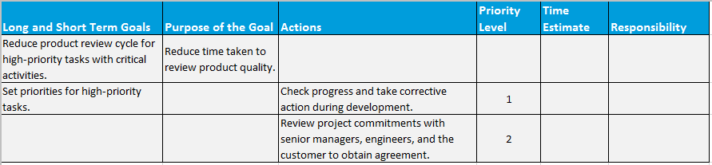
Process Improvement Plan
Describes the steps to analyze and determine areas of improvements in the creation of the project deliverables.
Areas of process improvements include:
Process boundaries.
Process configuration.
Process metrics.
Targets for improved performance.
A sample Process Improvement Plan

Slide 10
Human Resource Plan
Provides guidance on how human resources are managed for a project.
Includes components necessary for developing the cost estimates such as:
Project staffing attributes.
Personnel rates.
Rewards and recognitions.
Includes the staffing management plan.
Example: The human resource plan for the Sales Force Automation project contains:
Required qualifications of the work force.
Employment contract.
Availability status, duration, and cost.
Resource training needs.

Slide 11
Communications Management Plan
Describes the project team’s approach to communicating information about the project. The document includes:
What information must be communicated.
To whom, by whom, and when.
In what manner.
How the information is collected, archived, and accessed.
Example: Communications management plan for a company’s annual meeting. The plan includes:
Regularly scheduled status meetings.
Distribution of the meeting minutes.
An email distribution list.
All stakeholders and resources included on communication.

Slide 12
Risk Management Plan
Describes the team’s approach to identifying risks.
Identifies methodology, approaches, and tools.
Documents roles and responsibilities.
Identifies budgeting and scheduling.
Identifies risk categories.
Example: Entrepreneurs seeking funding from venture capitalists for building an amusement park.
Risk management plan will include:
Losses due to employee theft as business risk.
Liabilities for park ride injuries as insurable risk.

Slide 13
Procurement Management Plan
Outlines the guidelines for procuring work from outside sources.
Specifies the types of contracts that will be used.
Describes the process for obtaining and evaluating bids.
Mandates the standardized procurement documents that must be used.
Describes how multiple providers will be managed.
States how procurement activities will be coordinated with other project management activities.
May be formal or informal; brief or detailed.
Example: An advertising agency procuring contracts from external sources for some work that is beyond its core capabilities.

Slide 14
Identifying Elements of Project Management Plans

Slide 15
Project Objectives
Specific in scope
Quantifiable
Realistic and attainable
Consistent with organization

Slide 16
Customer Requirements
Document the customers' needs and expectations to meet project objectives.
Need to be elicited, analyzed, and recorded in sufficient detail to enable measurement during project execution.
Form the basis for planning the cost, schedule, and quality for the project.
Example: Analyzing the customer requirements for an e-commerce capability on a firm’s existing website.

Slide 17

Stakeholder Requirements Collection Methods
Interviewing
Focus groups
Facilitated workshops
Group creativity techniques
Group decision-making techniques
Questionnaires and surveys
Observations
Prototypes

Slide 18
Interview Techniques
A technique that uses one-to-one interaction to understand the project requirements from individual stakeholders.
Helps to identify the stakeholder's individual requirements, goals, or expectations relating to the project.
Aids in identifying and defining the features and functions of the desired project deliverables.

Slide 19

Focus Groups
Are trained moderator-guided interactive discussions.
Include stakeholders and SMEs.
Are a form of qualitative research.
Example: A focus group of system administrators was formed to discuss their thoughts and preferences on issues relevant to developing an online documentation system.

Slide 20
Facilitated Workshops
Are group sessions that:
Bring together key multidisciplinary or cross functional stakeholders.
Define the project or product requirements for the project.
Example: Conducting facilitated workshops for the GCCG's Warehouse Management Software project.
Stakeholders include:
Staff of the Process Development and Implementation department.
Key project managers.
Administration personnel.
Key PMO staff.
Chief of the Business Transformation team.
Discussions highlight the stakeholder differences.
Enables reconciliation of the stakeholder differences.

Slide 21
Group Creativity Techniques
Identifying Requirements
The Delphi technique
Nominal group technique
Brainstorming
Idea or mind mapping
Affinity diagram

Slide 22
Group Decision-Making Techniques
Unanimity
Majority
Plurality
Dictatorship

Slide 23
Other Requirement Collection Techniques
Questionnaires and Surveys
Observations
Prototypes

Slide 24
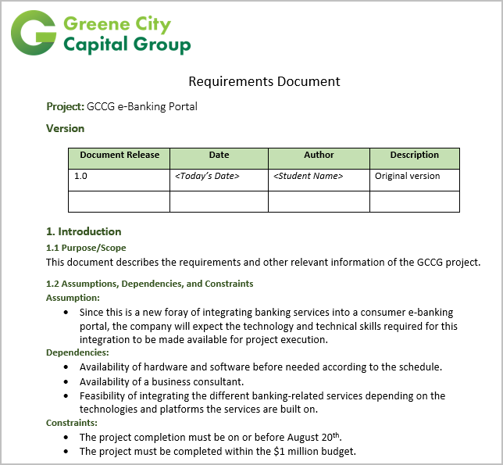
Requirements Documentation
Describes how individual requirements meet the business requirements of the project.
Requirements must be:
Unambiguous
Traceable
Complete
Consistent
Acceptable to key stakeholders

Slide 25
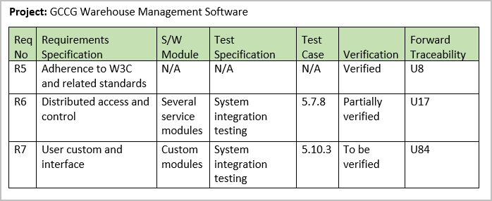
The RTM
A tabular document that links the project or product requirements to their origin and traces them throughout the project life cycle.
Links each requirement to the:
Business and project objectives
WBS
Product design and development
Test scenarios

Slide 26
Guidelines for Determining Stakeholder Needs
Study the project charter to identify the high-level project requirements and product descriptions.
Examine the stakeholder register to identify stakeholders who can provide information.
Use various methods to collect the requirements.
If possible, provide a working model or prototype of the expected product.
Create the requirements documentation for the project.
Review and validate the requirements management plan along with the key stakeholders.

Slide 27
Determining Stakeholder Needs

Slide 28
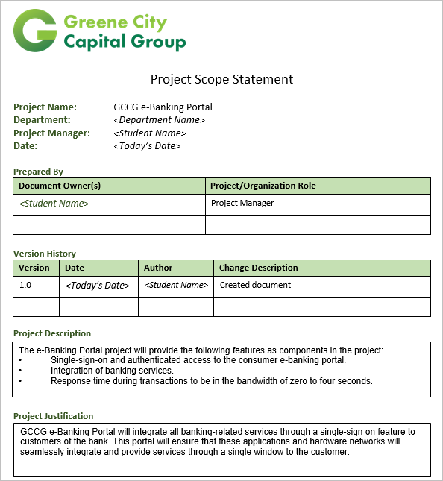
The Project Scope Statement
Defines the project and what it does and does not need to accomplish.
Created at an early stage in the project.
Reflects the stakeholders’ common understanding of major activities to be performed.
Typically includes:
Project objectives, deliverables, and requirements.
Project constraints and assumptions.
Product acceptance criteria.

Slide 29
Project Scope Statement Components
Component | Description
Project objectives | The measurable success criteria for the project.
Product description | The characteristics of the product, service, or result of the project undertaken.
Project requirements | The conditions or capabilities the deliverables of the project must meet.
Project deliverables | Any tangible, measurable result or outcome required to complete a project or portion of a project.
Project boundaries | The parameters of what is and what is not included within a project.
Product acceptance criteria | The process and criteria for accepting finished products or services resulting from a project.
Project constraints | Factors that limit the way that the project can be approached.
Project assumptions | Statements that must be taken to be true in order for the planning to begin.

Slide 30
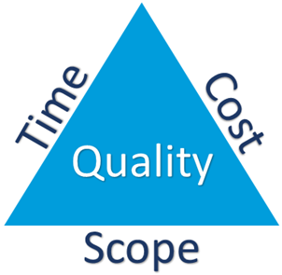
Constraints
Limitations that concern scope, time, and cost.
Factors are interrelated and exist in a state of equilibrium.
All three factors should be balanced to accommodate any project changes without compromising on the quality of the product or service.

Slide 31
Product Analysis
An evaluation of the project's end product and what it will take to create the product.
Translates project objectives into tangible deliverables and requirements.

Slide 32
Product Analysis Techniques
Each technique is an evaluation of the project's end product and what it will take to create this product.
Technique | Description
Functional analysis | Analyzing all the things that a product does, including primary and related functions, to identify unnecessary functions that may drive up cost on a product.
Value engineering and value analysis | Identifying and developing the cost versus benefits ratio for each function of a product.
Quality function deployment | Identifying what the customer's needs are and translating those needs into technical requirements.
Systems engineering | Analyzing products holistically and integrating factors, such as users, usage environment, and related hardware or software, with which the product must function.

Slide 33
Alternatives Identification Techniques
Methods for generating as many alternative solutions and plans as possible during project planning.
Technique | Description
Lateral thinking | A creative approach to problem solving in which the team attempts to think about a problem in new ways and generate a fresh solution.
Brainstorming | A general creativity technique for generating possible alternatives. The goal is to generate as many ideas as possible from as many team members as possible.
Delphi technique | A group technique that extracts and summarizes anonymous group input to choose among various alternatives.

Slide 34
Guidelines for Creating a Scope Statement
Refine the project objectives, deliverables, and product scope description from the preliminary scope statement.
Reexamine the project requirements.
Review the project boundaries.
Update the project constraints, risks, and assumptions.
Create schedule milestones.
Include revised cost estimate.
Identify and document known risks.
Map the internal organization with the project.
Document product specifications and approval requirements.
Finalize acceptance procedure.

Slide 35
Creating a Scope Statement

Slide 36
Which factors are important to your organization while defining the project scope?
In your experience, what are the most critical inputs for developing a project scope statement?

