Slide 1
Preparing to Develop the Project Schedule
Develop a WBS
Create an Activity List
Identify the Relationships Between Activities
Identify Resources
Estimate Time

Slide 2
The WBS
Project
Stage 1
Stage 2
Stage 3
Deliverable
Deliverable 2.1
Deliverable 2.2
Deliverable 2.2.1
Deliverable 2.2.2
Subproject 2.2.1.1
Subproject 2.2.1.2
Work package 2.2.1.2.1
Work package 2.2.1.2.2
Work package 2.2.2.1
Work package 2.2.2.2
Work package 4.1
Work package 4.2
Work package 4.3
Work package 4.4
Maps to project scope statement
Subdivides project work into smaller deliverables

Slide 3
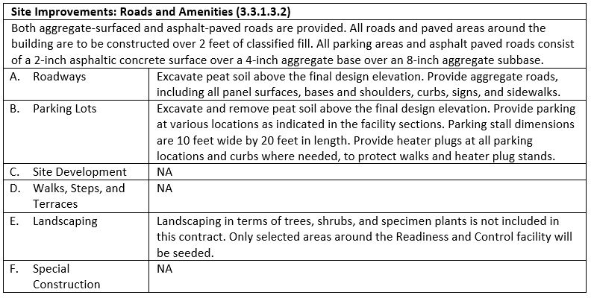
The WBS Dictionary

Slide 4




Decomposition
A technique for creating the WBS by subdividing project work to the work package level.
Level of decomposition varies for different projects.
Stopped when:
The components of the work packages are sufficient to complete the work.
The project work can be assigned to an individual person or group, cost estimated, scheduled, and monitored.
Project
Deliverables
Decomposition
Work packages
Decomposition
Activities

Slide 5
Code of Accounts
Any system for numbering the elements in a WBS.
Allows project managers to track WBS components.
Helpful in performance, reporting, and cost.
Example: School district’s uniform code of accounts.
Record, track, and document.
Revenues and expenditures.
Consistent in every school.
32 / 101 / 417
Function / Category / Program
(Consultant fees)
(Special education)
(Professional expenditures)

Slide 6

The Scope Baseline
Describes the need, justification, requirements, and boundaries for the project.
Components include:
The detailed project scope statement.
The WBS.
The WBS dictionary.
Project Scope Statement
WBS
WBS Dictionary

Slide 7
Guidelines for Developing a WBS
Gather the reference materials and other inputs.
Determine how you are going to organize the work of the project.
Identify the major deliverables or subprojects for the project.
Analyze each element to determine whether it is sufficiently decomposed.
Break down each WBS element into sub-deliverables until you reach the work package level.
Validate your WBS using a bottom-up approach starting at the work package level.
Use the code of accounts to assign a unique numeric cost code for each element.

Slide 8
Developing a WBS

Slide 9
Duration
The amount of time that a particular task or work package will take to complete.
The metrics used to express duration are in units of time such as days, weeks, months, or years.
Fixed duration is used to describe a task or work package that requires a set amount of time to complete.
Elapsed time the actual calendar time required for an activity from start to finish.
The hardware will take 3 days to install.
Amount of time
Task or work package
The code will take 2 days to write.

Slide 10
Effort
The measure of labor that must be applied to the completion of a particular task or work package.
The metrics used to express effort are expressed in number of resources times the duration of the work; for example, “person-hours,” “person-days,” and “person-months.”
Effort-driven is used to describe a task where the effort (or work) remains fixed regardless of the number of resources used to complete the work.
3 hours of engineering
Duration
Labor
5 days of writing code

Slide 11
Work Packages
Project: Annual Report
Subproject 1: Audit
Subproject 2: IRS filings
Deliverable 3.1: Graphic design
Deliverable 1.1: Finance report
Deliverable 1.2: CPA review
Deliverable 1.3: Auditor’s report
Deliverable 2.1: W-2 and W-3 wage filings
Deliverable 2.3: Form 944 annual filing
Deliverable 3.2: Copy edit
Deliverable 3.3: Printing
Deliverable 2.2: Form 941 quarterly filing
Subproject 3: Production
Work Package 3.1.1: Cover design
Work Package 3.1.2: Interior layout
Work Package 3.1.3: Board of Director’s photos

Slide 12
The 8/80 Rule
More than 8 hours of effort
Less than 80 hours of effort
Work Package

Slide 13
Activities
Elements of project work that require an action to produce a deliverable.
Have expected duration.
Consume budget and human resources.
Named in verb-noun format.
Example: Activities in a company project.
Revise user manual.
Make a sales presentation.
Reserve conference room
Verb (Action)
Noun (Deliverable)
Revise user manual
Expected duration determined by (whatever)

Slide 14
Activity Lists
A definitive list of activities that must be completed to produce the desired project deliverables.
Example: Creating an activity list for conducting a training program, including:
Determine training budget
Schedule training date
Set training requirements
Identify trainers
Confirm attendees
Reserve conference room
Set up audio-visual materials
Acquire training software
Train attendees
Collect feedback

Slide 15
Activity Attributes
Contain additional information about activities in an activity list.
Similar to the WBS Dictionary, but for activities.
Describe the activities by listing the different components associated with the activities.
Used to develop project schedule.

Slide 16

Milestones
5
A milestone is a control point event in a project with zero duration that triggers a reporting requirement or requires sponsor or customer approval before proceeding with the project
4
3
2
1

Slide 17
Milestone Lists
Activity | Required | Duration (in Days) | Resources
Site preparation completion | Yes | 0 | Site preparation crew
Foundation completion | Yes | 0 | Mason
Basement completion | Yes | 0 | Mason
Crawl space completion | Yes | 0 | Mason
Flooring completion | No | 0 | Framing crew
Roof framing completion | No | 0 | Framing crew
Porch completion | No | 0 | Framing crew
Windows and doors completion | No | 0 | Framing crew
Plumbing completion | Yes | 0 | Plumbing crew
Electrical and insulation completion | Yes | 0 | Electricians
Dry walling completion | Yes | 0 | Dry wall installers
Furnishing completion | Yes | 0 | Carpenters

Slide 18
Entry/Exit Criteria
Milestone 1
Milestone 2
Subproject 1
Subproject 3
Subproject 4
Subproject 2
Entry criteria
Exit criteria

Slide 19
Creating an Activity List

Slide 20
Activity Dependencies
A logical relationship that exists between two project activities.
Relationship indicates whether the start of an activity is contingent on an event or input from outside the activity.
Activity dependencies shape the sequence among project activities.
Example: Designing room layouts.
Architect needs to assess the functionality of his room design.
Assessment cannot start until the builders finish framing the walls, windows, and roof.
After structure is in place, then architect can reassess design plans to determine if modifications are necessary.

Slide 21
Activity Dependency Types
Mandatory
Discretionary
External
Inherent to the work itself.
Defined by the project and the team.
Contingent on inputs from outside the project.
Internal
Contingent on inputs from within the organization.

Slide 22
Precedence Relationships
The logical relationship between two activities that describes the sequence in which the activities should be carried out.
Each activity has start and finish dates.
Precedence relationships are always assigned to activities based on the dependencies of each activity:
Predecessor activity drives the relationship, and most often, occurs first.
Successor activity is driven by the relationship.

Slide 23
Precedence Relationship Types
Finish to Start (FS)
Predecessor activity must finish before successor activity can start.
Example: Building foundation must finish before framing can start.
Finish to Finish (FF)
Predecessor activity must finish before successor activity can finish.
Example: Construction must finish before inspection can finish.
Start to Start (SS)
Predecessor activity must start before successor activity can start.
Example: Building design must start before electrical layout can start.
Start to Finish (SF)
Predecessor activity must start before successor activity can finish.
Example: Electrical inspections must start before the drywall can finish.

Slide 24
Lag
A
10 days
No Lag
B
4 days
14 days
A
10 days
Lag = 4 days
B
4 days
18 days

Slide 25
Lead
A
8 days
B
6 days
No Lead
14 days
A
8 days
Lead = 4 days
B
6 days
10 days

Slide 26
Project Schedule Network Diagram
Graphical representation of the sequence of project activities and the dependencies among them.
Read from left to right or top to bottom.
Typically accompanied by summary information.
May include the entire project or specific parts of it.
Characteristics:
Detailed or high-level
Generated manually or with software
Constructed using a variety of methods

Slide 27
The PDM
Always read from left to right.
Show duration only in the nodes.
Create manually or with software.
Report a group of related activities as an aggregate activity.
Can use all precedence relationship types.
A
B
Start
C
E
D
Finish
F
G
H
I
J

Slide 28
Summary Activities
Group of related activities shown as a single aggregate activity.
Hammock activity.
Might contain internal sequence of activities.
A
B
Start
C
E
D
Finish
F
G
H
I
J
Hammock

Slide 29
Conditional Diagramming with GERT Diagrams
Design logo
GERT Network Diagram with Conditional Branch
Dig trench
Sponsor approval?
No
Loops
Yes
No
Install sump system
Demo for focus groups
Trench dry?
Pump trench
Yes
Focus group OK?
No
Lay pipe
Conditional branch
Yes
Produce final artwork
GERT Network Diagram with Loops

Slide 30
Identifying the Relationships Between Activities

Slide 31

Completed Network Diagram
1.1.1
1.1.2
1.1.3
1.1.4
1.2.4
1.2.3
1.2.2
1.2.1
TRN001.1
TRN001.2
TRN001.3
1.3.1
1.3.2
1.3.3
1.3.4
TRN001.4
TRN001.5
1.4.1
1.4.2
1.4.3
1.4.4
1.5.4
1.5.3
1.5.2
1.5.1

Slide 32
Project Resources
Any useful materials or people needed for project completion.
Resources can include labor, materials, facilities, equipment, consultants, services, supplies, and utilities.
Three major resource categories: work, materials, and cost.
Resource Type | Description
Shared resources | Used for multiple projects and must be managed as such.
Dedicated resources | Committed for project’s use.
Benched resources | Retained during downtime because of their specialized skills but are not performing “billable” tasks.
Low-quality resources | Do not possess specialized skills or qualities.

Slide 33
Resource Availability Constraints
When the best resource is… | Potential solutions
Unavailable within the organization (shortage) | Hire someone with needed skills. Use a temporary employee from an agency. Subcontract the work to another company. Team with another company to share a portion of the scope.
Assigned to an activity (overallocation) | Delay some of the work until the resource can handle within their schedule. Assign some of the work to another resource. Change the scope. Permit overallocation and compensate the resource with overtime pay.
Assigned to multiple projects | Competition for resource time will create an imbalance—either shortages or overallocations.

Slide 34
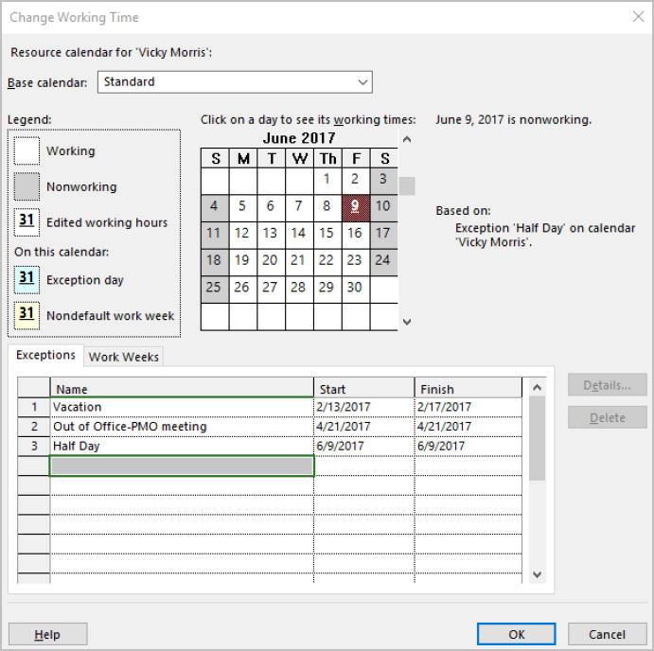
Resource Calendar
A calendar that lists the time during which the resources can participate in the project tasks.
Helps prevent resource scheduling conflicts.
A resource calendar in MS Project

Slide 35
Alternatives Analysis
The process of examining the different methods of accomplishing activities and determining a preferred method.
Can involve:
Selecting among different skills, tools, and equipment.
Determining whether the project work can be accomplished by the project team or must be procured from outside the organization.

Slide 36

Published Estimating Data
Information found in commercial publications about production rates, resource cost, and labor requirements.

Slide 37






Project Management Software
A software application that generates and organizes resource information, such as cost estimates, work breakdown structures, and project schedules.
Helps optimize resource utilizations.
Examples include:
Microsoft Project 2016
Oracle Primavera
LiquidPlanner
Smartsheet
Atlassian JIRA

Slide 38



Activity Resource Requirements
Descriptions of resources and the quantities of resources necessary to complete project activities.
Progressively elaborated when developing the human resource plan.

Slide 39

The Resource Breakdown Structure
A hierarchy of identified resources, organized by category and type.
Helps organize and report project schedule information along with the resource utilization data.
Project Resources

Slide 40
Guidelines for Identifying Resources
Determine the resources necessary to complete each activity in the work packages.
Determine the quantity of resources necessary to complete each activity.
Refer to the resource calendars to identify the availability of each resource.
Generate possible alternatives for unavailable resources.
Analyze the scope statement to ensure that you identified all the resources.
Consider organizational policies that could affect resource acquisition and usage.
Identify and use expert judgment resources.
Analyze the resources currently available.
Use project management software to plan, organize, and manage project schedules and resources.

Slide 41
Identifying Project Resources

Slide 42
Reserve Analysis
The process of identifying and adding extra time that will serve as contingency or management reserves to the duration estimates.
Contingency reserves serve as buffers in recognition of scheduled risks or setbacks.
Management reserves are buffers added to the project for unforeseen changes to project scope and cost.
Example: A cellphone manufacturing company contracting a vendor to integrate a new telecommunication technology with its system. The project manager:
Schedules to complete the project within one month.
Anticipates delay due to unavoidable circumstances and specifies one more month as contingency reserve.
Senior managers added two weeks as management reserves to accommodate the risks due to unknown-unknowns.

Slide 43
The Analogous Estimating Technique
An estimation technique in which managers use experience, historical information, and expert judgment.
Determines the total project cost or time estimate.
Apportions the total across the major categories of work.
Used when:
Only limited amount of detailed information is available.
Similar project is available for comparison.
Estimators have appropriate experience.

Slide 44
The Parametric Estimating Technique
A technique that is used to predict duration or cost by using historical data in a mathematical model.
The most common parametric model uses simple multiplication.
Example: Parametric estimating for a web-design project.
Similar sites with 5 pages required 15 hours of development time.
Using parametric estimating, a site with 10 pages will require 30 hours of development time.

Slide 45
The Three-Point Estimating Technique
A method of activity duration estimating in which three types of estimates are incorporated into a singular duration estimate scenario: optimistic, most likely, and pessimistic.
Optimistic: best-case estimate of the time required to complete the specified work.
Most likely: time required to complete the work under normal conditions.
Pessimistic: worst-case estimate of the time required to complete the work.
Duration = [Optimistic + (4 * Most Likely) + Pessimistic] / 6
Example: Using three-point estimating for a marketing campaign project, the project manager had these historical estimates:
Optimistic time was one month.
Most likely time was three months.
Pessimistic time was 11 months.
He then estimated the project duration to be four months: [1+(4*3)+11]/6

Slide 46
The Bottom-Up Estimating Technique
Estimates the duration or cost for each work package.
Estimates are then rolled up or aggregated.
Used when:
More detail is available about the work packages.
More accurate estimates are needed.
There is time to invest in making the estimates.
Example: A caterer using the bottom-up estimating technique based on a detailed WBS for a large corporate event.

Slide 47
Guidelines for Estimating Time
Gather all the prerequisites.
Involve the work package owners or others who are familiar with the work of the activity.
Consult historical information.
Determine which technique you want to use to estimate the activity duration.
Determine how you want to quantify the work that needs to be done: in terms of the estimated hours of labor that will be needed, the number of units to be produced, and the number of customers to be served.
Consider resource requirements and capabilities.
Determine the appropriate estimation method to use.
Modify the constraints and assumptions from the other planning processes.
Verify the accuracy of your estimates.
Consider the need for reserve time.
Include a range of variance for each estimate.
Update all project documents that require changes.

Slide 48
Estimating Time

Slide 49
How do you think creating an activity list for projects will help ensure that your project activities are tied to the project scope?
Reflect on the advantages of creating a project schedule network diagram. How do you think this will help you organize your project more effectively?

