Slide 1
Developing the Project Schedule
Develop a Project Schedule
Identify the Critical Path
Optimize the Project Schedule
Create a Schedule Baseline

Slide 2
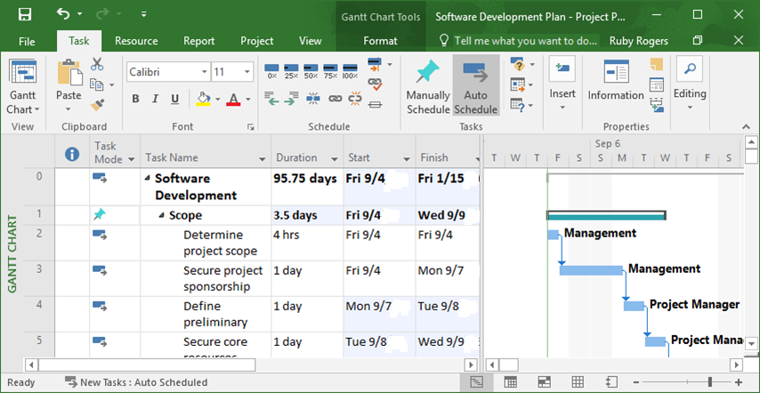
Project Schedules
The project team's plan for starting and finishing activities on specific dates and in a certain sequence.
Specifies planned dates for meeting project milestones.
Coordinates activities to form a master plan in order to complete the project objectives on time.
Tracks schedule performance and keeps upper management and project stakeholders informed about the project's status.

Slide 3
The Critical Path
Activity 2
4 weeks
Activity 4
3 weeks
Start
Activity 1
6 weeks
Activity 6
1 week
Finish
Activity 3
5 weeks
Activity 5
4 weeks
1[6w] + 2[4w] + 4[3w] + 6[1w] = 14 weeks
1[6w] + 3[5w] + 5[4w] + 6[1w] = 16 weeks Critical Path

Slide 4
Float
Activity 2
4 weeks
Activity 4
3 weeks
2 weeks
float
Start
Activity 1
6 weeks
Activity 6
1 week
Finish
Activity 3
5 weeks
Activity 5
4 weeks

Slide 5
Standard Schedule Diagramming Notation
ES = Early Start is the earliest time an activity can start.
EF = Early Finish is the earliest time an activity can finish.
LS = Late Start is the latest time an activity can start.
LF = Late Finish is the latest time an activity can finish.
DU = Duration is the number of work periods required for the completion of an activity.
ES
EF
LS
DU
LF

Slide 6
Total Float
The total amount of time an activity can be delayed without delaying the project finish date.
EF
29
EF
37
EF
50
Activity C
ES
25
Activity D
ES
29
Activity E
4.2.3
4.2.4
ES
37
4.2.5
LS
36
DU
4
LF
40
LS
40
DU
8
LF
48
LS
48
DU
13
LF
61
TF = 11
TF = 11
TF = 11
EF
10
EF
25
EF
66
Activity A
ES
0
Activity B
ES
10
Activity H
4.2.1
4.2.2
ES
61
4.2.8
LS
0
DU
10
LF
10
LS
10
DU
15
LF
25
LS
61
DU
5
LF
66
TF = 0
TF = 0
TF = 0
EF
41
EF
61
Activity F
ES
25
Activity G
4.2.6
ES
49
4.2.7
FS 8
LS
25
DU
16
LF
41
LS
49
DU
12
LF
61
TF = 0
TF = 0

Slide 7
Free Float
The amount of time an activity can be delayed without delaying the ES of any activity that immediately follows it.
EF
29
EF
37
EF
50
Activity C
ES
25
Activity D
ES
29
Activity E
4.2.3
4.2.4
ES
37
4.2.5
LS
36
DU
4
LF
40
LS
40
DU
8
LF
48
LS
48
DU
13
LF
61
TF = 11
FF = 0
TF = 11
FF = 0
TF = 11
FF = 11
EF
10
EF
25
EF
66
Activity A
ES
0
Activity B
ES
10
Activity H
4.2.1
4.2.2
ES
61
4.2.8
Activity H’s ES (61) – Activity E’s EF (50) = 11
Free Float for Activity E = 11
LS
0
DU
10
LF
10
LS
10
DU
15
LF
25
LS
61
DU
5
LF
66
TF = 0
FF = 0
TF = 0
FF = 0
TF = 0
FF = 0
EF
41
EF
61
Activity F
ES
25
Activity G
4.2.6
ES
49
4.2.7
FS 8
LS
25
DU
16
LF
41
LS
49
DU
12
LF
61
TF = 0
FF = 0
TF = 0
FF = 0

Slide 8
Schedule Network Analysis
Technique that is used to calculate the theoretical early and late start and finish dates for all project activities.
Four methods:
Critical Path Method (CPM)
Critical chain method
What-if scenario
Resource leveling
Example: A marketing campaign schedule.
Involves:
Using software to create request for proposals.
Launching campaign.
Estimating slack.
Adjusting activities.

Slide 9
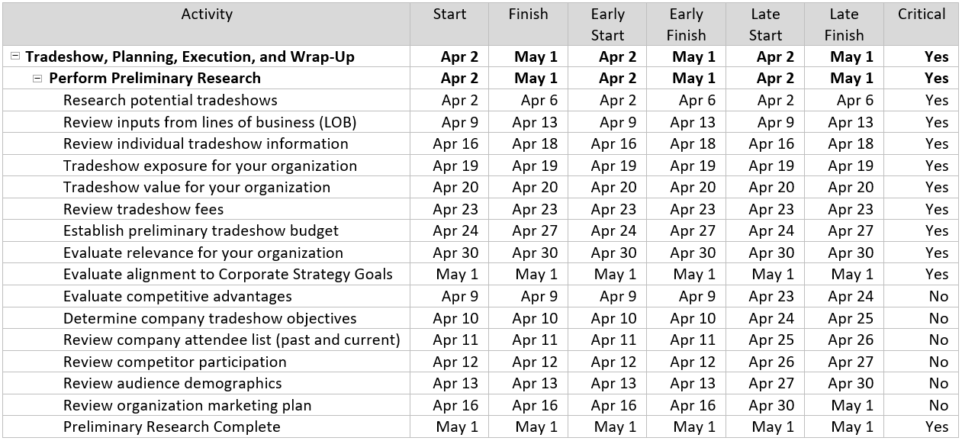
The CPM
A schedule network analysis method.
Calculates one early and late start and finish date for each activity.

Slide 10
The Critical Chain Method
Consider resource limitations.
Adjust the schedule accordingly.
Plan and manage reserves.
Mitigate possible cost and schedule risks.
Established by analyzing the critical path alongside available resources.
Task 1.1 Duration 4 days Mar 4-7 Samantha
Task 1.2 Duration 2 days Mar 8-9 James
Task 3.1 Duration 7 days Mar 10-16 Carol
Task 2.1 Duration 3 days Mar 10-12 Michael
Task 2.2 Duration 4 days Mar 13-16 Carol
Carol is over allocated

Slide 11
What-If Scenario Analysis
Used to consider different situations that may occur and influence the schedule.
Computes different schedules based on potential delays.
Simulated outcomes can be used in risk response plans.
Helps select the optimum plan.
Example: What-if scenarios for planned move of headquarters.
What if the contractor finishes late?
What if key decision makers are elsewhere during planning?
What if a union strike affects construction workers?

Slide 12
Resource Leveling
Used to analyze the schedule model.
Helps readjust the work as appropriate so that people are not overly allocated.
Automated Leveling utilizes the project management software capability to level resources. Often, it pushes out the project’s completion date or reallocates resources to inappropriate times due to the constraints.
Resource Smoothing is a technique that reschedules activities in a project to ensure that appropriate resources are allocated to each activity.
Example: Allocating the most expensive hourly workers in a construction project appropriately and consistently.

Slide 13
Schedule Formats
Gantt Chart
Milestone Chart
Project Schedule Network Diagram with Dates

Slide 14
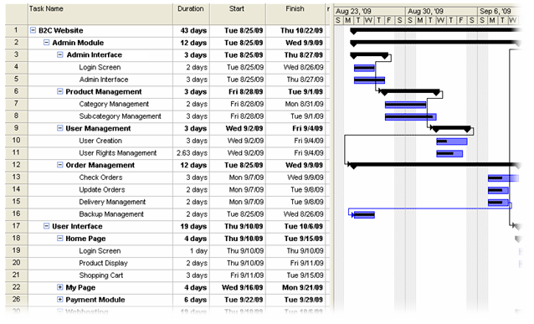
Gantt Chart
Shows start and end dates, duration, and order.
Shows precedence relationships.
Shows percentage completion and actual progress.
Used to present project status to the project team and management.

Slide 15
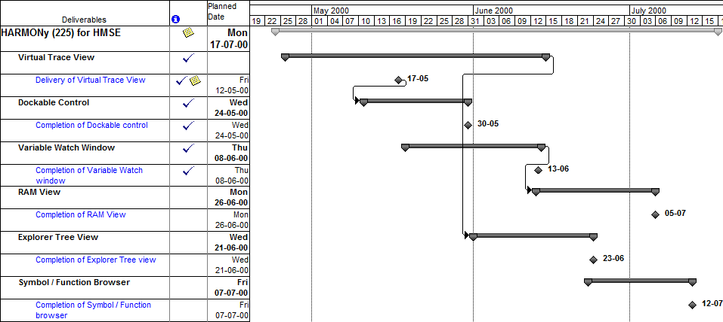
Milestone Chart
Provides the summary level view of a project’s milestones.
Uses icons or symbols.
Useful for upper management, who are not interested in fine details.

Slide 16
Project Schedule Network Diagram with Dates
Assigns start and finish dates to activities.
Communicates the project status in terms of activity precedence relationships.
7 Mar
13 Mar
13 Mar
25 Mar
25 Mar
13 Apr
EF
29
EF
37
EF
50
Activity C
ES
25
Activity D
ES
29
Activity E
4.2.3
4.2.4
ES
37
4.2.5
LS
36
DU
4
LF
40
LS
40
DU
8
LF
48
LS
48
DU
13
LF
61
TF = 11
TF = 11
TF = 11
3 Feb
14 Feb
14 Feb
7 Mar
28 Apr
6 May
EF
10
EF
25
EF
66
Activity A
ES
0
Activity B
ES
10
Activity H
4.2.1
4.2.2
ES
61
4.2.8
LS
0
DU
10
LF
10
LS
10
DU
15
LF
25
LS
61
DU
5
LF
66
TF = 0
TF = 0
7 Mar
31 Mar
10 Apr
28 Apr
TF = 0
EF
41
EF
61
Activity F
ES
25
Activity G
4.2.6
ES
49
4.2.7
FS 8
LS
25
DU
16
LF
41
LS
49
DU
12
LF
61
TF = 0
TF = 0

Slide 17
Developing a Project Schedule

Slide 18
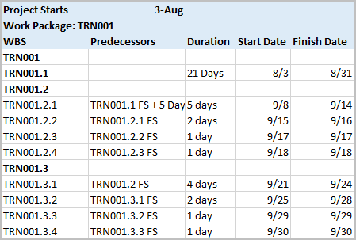

Completed Project Schedule

Slide 19
Critical Activities
The activities on the critical path.
Have ES = LS and EF = LF.
EF
29
EF
37
EF
50
Activity C
ES
25
Activity D
ES
29
Activity E
4.2.3
4.2.4
ES
37
4.2.5
LS
36
DU
4
LF
40
LS
40
DU
8
LF
48
LS
48
DU
13
LF
61
TF = 11
FF = 0
TF = 11
FF = 0
TF = 11
FF = 11
EF
10
EF
25
EF
66
Activity A
ES
0
Activity B
ES
10
Activity H
4.2.1
4.2.2
ES
61
4.2.8
Critical activities:
A, B, F, G and H
LS
0
DU
10
LF
10
LS
10
DU
15
LF
25
LS
61
DU
5
LF
66
TF = 0
FF = 0
TF = 0
FF = 0
TF = 0
FF = 0
EF
41
EF
61
Activity F
ES
25
Activity G
4.2.6
ES
49
4.2.7
FS 8
LS
25
DU
16
LF
41
LS
49
DU
12
LF
61
TF = 0
FF = 0
TF = 0
FF = 0

Slide 20
Identifying the Critical Path

Slide 21
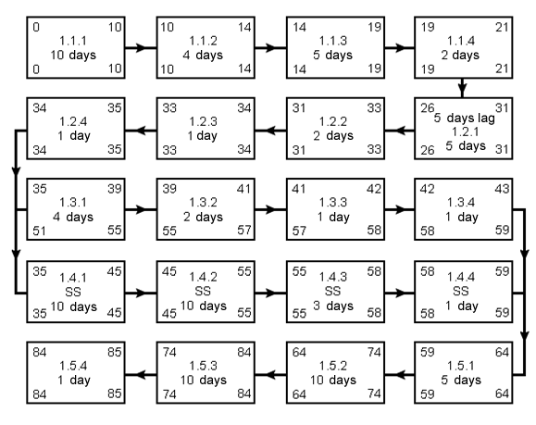
Completed Critical Path

Slide 22
Schedule Compression
The shortening of the project schedule without affecting the project scope.
Two methods:
Fast-tracking
Crashing
Example: Schedule compression using fast-tracking for building and installing cabinets.
Involves a carpenter and subcontractor.
The subcontractor installs cabinets while the carpenter builds them.
Changes precedence.

Slide 23
Fast Tracking
The process of compressing the project duration.
Involves performing sequential activities concurrently.
Example: Fast-tracking activities for launching a new product.
Product and user manual developed concurrently.
Project duration shortened.

Slide 24
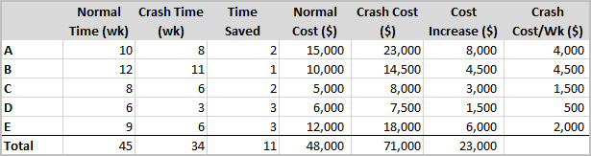

Crashing
Analyzes cost and schedule trade-offs to determine how to obtain the greatest amount of schedule compression for the least incremental cost.
Involves allocating more resources to activities on the critical path.
$$Crash costs per week=\frac{(Crash cost −Normal cost) }{(Normal Time −Crash Time)}$$
Crash costs of a website project

Slide 25
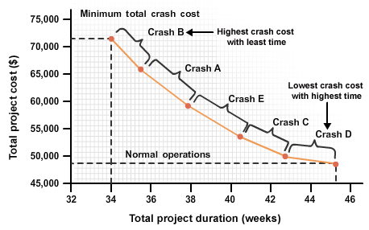
Crash Cost Plotting Methods
Techniques for analyzing the crash costs by creating a graph or visual representation.
Activities plotted from right to left, starting with the lowest crash cost per week.
Crash costs plotted on a graph

Slide 26

Delaying
A project scheduling process where activities are postponed to accommodate the availability of resources.
May be caused by internal or external resources.

Slide 27
Guidelines for Optimizing the Project Schedule
Consider your resource leveling options.
Consider fast tracking the project.
Analyze activities on the critical path to determine if crashing the schedule will produce a viable option.
Identify if any resources are overly allocated. Prioritize the project tasks assigned to resources to avoid over allocation.
Analyze each activity on the critical path to determine whether reducing the scope is a viable option for reducing duration.
Recalculate the critical path after compressing the schedule.
Review any schedule changes with key stakeholders.
Revise the schedule and distribute to the team.

Slide 28
Crashing a Project Schedule

Slide 29
Activity Scenario
B
(6)
C
(6)
D
(6)
A
(13)
G
(5)
E
(10)
F
(20)

Slide 30
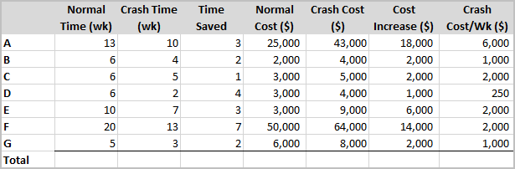
Calculated Crash Costs Per Week

Slide 31
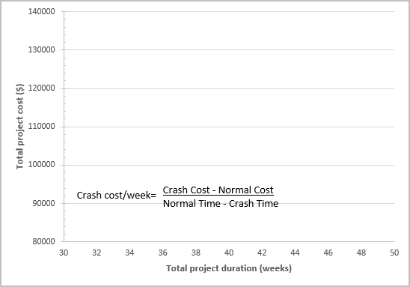
Completed Crash Plot
Crash all activities
Crash A
Crash C
Crash F
Crash B
Crash G

Slide 32
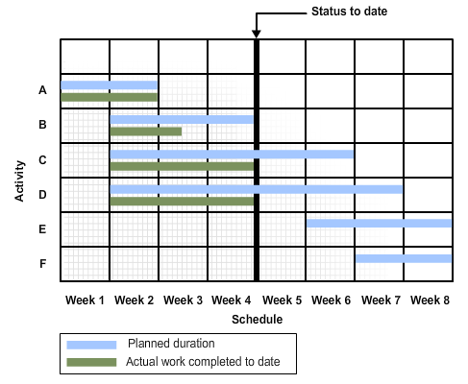
Schedule Baseline
The management-approved version of the project schedule.
Drawn from schedule network analysis.
Provides the basis for measuring and reporting schedule performance.
A chart showing a schedule baseline

Slide 33
Guidelines for Establishing a Schedule Baseline
Gather your preliminary project schedule, which includes the project's start and finish dates.
Distribute the proposed schedule baseline to the appropriate stakeholders and project management team for approval.
Incorporate any changes to the schedule baseline as required by the management team.
Update your cost baseline as needed.
Use a formal change process approved by management for changes to the schedule baseline after it has been approved.
Save the original schedule baseline.

Slide 34
Creating a Schedule Baseline

Slide 35
In your experience, which schedule format do you find to be the most beneficial and why?
When developing a project schedule, which element or component of the schedule do you find to be the most crucial?

