Slide 1
Planning Project Costs
Estimate Project Costs
Estimate the Cost Baseline
Reconcile Funding and Costs

Slide 2
Common Cost Estimate Types
Type or Level of Accuracy | Description or Accuracy Rating
Rough Order of Magnitude (ROM) estimate | Developed without basis of detailed data and often based on very high-level historical data, expert judgment, or a costing model. Accuracy: -25 percent to +75 percent.
Range of estimate | Often used as an alternative to ROM where the accuracy of the estimate is not well known. Accuracy: ±35 percent.
Approximate estimate | Based on more information than ROM estimates, but still lacks the detail required for high accuracy. Accuracy: ±15 percent.
Budgetary estimate | Often used for appropriation purposes. Accuracy: -10 percent to +25 percent.
Definitive (or control or detailed) estimate | Developed by estimating the cost for each work package in the WBS. Accuracy: -5 percent to +10 percent.
Phased (or rolling wave or moving window) estimate | Allows the use of ROM or approximate estimates for some later parts of the work. Accuracy: ±5 percent to ±15 percent.

Slide 3



Project Management Estimating Software
Any software application that assists in cost estimating while managing projects.
Helps simplify the usage of cost estimating techniques and facilitates effective cost estimate alternatives.

Slide 4
Vendor Bid Analysis
A cost estimation technique based on the bids obtained from vendors.
Proposed costing from the vendors is considered while developing estimates for the project.
Costing can be sought from the vendors through their proposals, bids, or quotations.
Costing can be indicative figures with less accuracy or very accurate detailed figures as well.
Example: The company decided to outsource one of its projects and the project manager sends an invitation to vendors to obtain the best bids that will include all the project deliverables and supports the final total project cost.

Slide 5
Activity Cost Estimates
Provide estimates of costs necessary to finish project work.
Includes:
Costs on direct labor
Materials
Equipment
Facilities
Services
Information technology
Contingency reserves
Indirect costs
Cost estimates for each activity are added together to create an overall cost estimate for the work package.

Slide 6
Basis of Estimates
Supporting and additional information needed to justify the cost estimates. Details include:
The project scope.
Justification for the estimate.
Assumptions.
Constraints.
The confidence level on the estimate.
The expected range of estimate.

Slide 7
Advantages and Disadvantages of Estimating Techniques
Technique | Advantages | Disadvantages
Analogous estimating | Ensures that no work is inadvertently omitted from work estimates. | Can be difficult for less-experienced team members to apportion cost estimates.
Bottom-up estimating | Is accurate and gives lower-level managers more responsibility. | Might be time consuming and can be used only after the WBS has been well-defined.
Parametric estimating | Not time consuming. | Might be inaccurate, depending on the integrity of the historical information used.

Slide 8
Guidelines for Estimating Project Costs
Involve the work package owners.
Gather any relevant input information.
Determine which estimating technique to use.
Look for alternative costing options.
Determine the units of measure that will be used.
Consider possible risks that may impact cost.
Ensure that all cost estimates are assigned to the appropriate account, according to the chart of accounts.
Ensure that your cost estimates include the estimated costs of all resources, the level of estimate, the list of assumptions made when developing the estimates, and how long the estimate is valid.

Slide 9
Estimating Project Costs

Slide 10
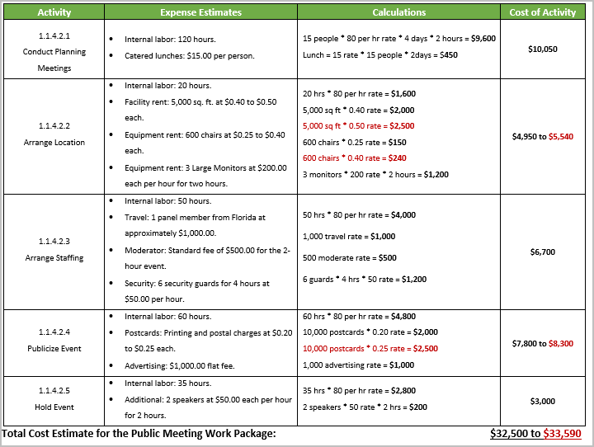

Completed Cost Estimates

Slide 11
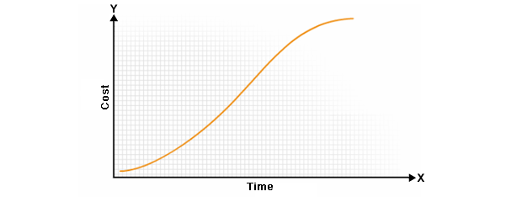
Cost Baselines
A time-phased budget that monitors and measures cost performance throughout the project life cycle.
Developed by adding the estimated costs of project components by period.
A generic cost baseline shown as an S-curve

Slide 12
Cost Aggregation
A technique used to calculate the cost of a whole component by finding the aggregate of the cost of the constituent parts of the whole component.
Activity costs are combined into work package costs, which are then aggregated up the WBS until a single project cost is produced.
Aggregate the cost of all project components to determine the total cost of the project.

Slide 13

Contingency Allowances
Contingency allowances are additional funds that allow for unanticipated events.
Contingency reserves are added at the activity level by the project manager to account for risks that might affect an activity.
Management reserves are added at the project level by the sponsor to account for unknown-unknowns.
Release contingency funds only through a closely controlled and well-documented process.
Example: Contingency allowances for the jazz festival, hosted by the city of Montreal, may include funds to cover an unexpected problem, such as a cancellation by a headlining act.
Contingency Reserve
Management Reserve

Slide 14
Cost Assignment Methods
Cost Assignment Method | Description
50/50 percent rule | 50 percent credit is given when the activity begins and the remaining 50 percent credit is given when the work is completed.
Percentage completed rule | Completion percentages are estimated and assessed at specified reporting intervals. This is perhaps the most commonly used rule, and it is generally the most accurate method.
Weighted milestones | The total work package value is divided up and assigned to milestone intervals within the work package. The value is earned when the milestone is achieved.

Slide 15
Project Funding Requirements
Obtained from the cost baseline and occur in increments.
Incremental amounts are not continuous but are done periodically based on the project's funding requirements.
Total amount of funds includes the cost baseline plus the management contingency reserve.
Define how much funds are required and when they are required.
Optimize the funds inflow to the project.

Slide 16
Historical Relationships
Involve relationships that are used in parametric or analogous estimates to develop simple or complex mathematical models to calculate project costs.
Historical information used must be accurate and parameters quantifiable.

Slide 17
Guidelines for Estimating the Cost Baseline
Gather the inputs you will need to establish the baseline, such as the WBS, the project schedule, the cost estimates, and the risk management plan.
Use the project schedule to determine when activities will be taking place.
Use one of the methods for assigning costs to allocate funds for each activity or work package for the time period in which it will be taking place.
Consider adding a contingency reserve to accommodate the risk of incurring extra expenses.
Avoid adding contingency reserves for small one-time miniscule amounts.
Total the costs for each time period.
Plot the costs for each period on a chart to create an S-curve of the baseline.
Publish and distribute the cost baseline to the appropriate project stakeholders.

Slide 18
Estimating the Cost Baseline

Slide 19
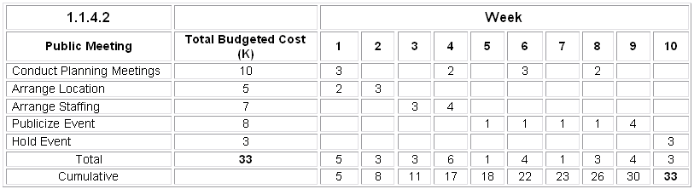
Completed Costs Per Week

Slide 20
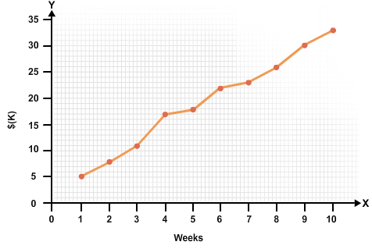
Completed S-Curve Graph

Slide 21
Funding Limit Reconciliation
A method of adjusting spending, scheduling, and allocating resources to bring expenditures in alignment with budgetary constraints.
Most budgets assume steady incoming and outgoing flows.
Large, sporadic expenditures are usually incompatible with organizational operations.
Funding limits help regulate the outgoing capital flow to protect against overspending.
Example: A customer wants to spread project costs over two quarters.
$250,000 during Q1
$350,000 during Q2
The project manager will need to make adjustments to the project so these values are not exceeded.

Slide 22
Guidelines for Reconciling Funding and Costs
Gather the materials you will need.
Map the project budget, scope statement, and schedule to the funding available.
Involve the project sponsor.
Partner formally with the company's financial decision makers.
Reconcile funding with costs on an iterative basis.
Apprise the sponsor (and the external customer, if there is one) of any additional costs that are incurred.
Monitor spending.
Monitor the schedule.
Monitor the risks.

Slide 23
Reconciling Funding and Costs

Slide 24
How do you think the ability to effectively estimate costs will improve your performance on the job?
How do you think incorporating good funding reconciliation practices will help in completing a project within the allocated budget?

