Slide 1
Planning Human Resources and Quality Management
Create a Human Resource Plan
Create a Quality Management Plan

Slide 2
Project Interfaces
Interface | Description
Organizational | Reporting relationships among different organizational units. Internal or external to the parent organization. Include interfaces among the project team, upper management, functional managers supporting the team, and customers.
Technical | Reporting relationships among technical disciplines on the project. Occur during a phase or during the transition between phases. Reflect informal or formal relationships with project team and outside of the team.
Interpersonal | Reporting relationships among individuals working on the project. Formal and informal. Internal and external.
Logistical | Relationships between project team members who are distributed across different buildings, countries, and time zones.
Political | Relationships inside an organization among people who have different interests in the organization and its projects. Can be affected by: Interpersonal dynamics. Individual aspirations. Individual’s need to satisfy disclosed or undisclosed interests.

Slide 3
The RAM
 | Project Manager | Engineering Manager | Quality Assurance Manager | Purchasing Manager | Manufacturing Manager
Create Blueprints | S | A | P |  | p
Manufacture Circuit Board | S | A | P |  | P
Test Circuit Board | S | P | A |  | P
Order Components | S | P | P | A | P
Assemble | S |  | P |  | A
S = Sign-off A = Accountable P = Participant

Slide 4
The RACI Chart
Responsible—active participant role
Accountable—the “buck stops here” role
Consulted—advisory role
Informed—aware but not active role
 | Project Manager | Engineering Manager | Quality Assurance Management | Purchasing Manager | Manufacturing Manager
Create Blueprints | A | R | C | I | C
Manufacture Circuit Board | I | C | C | I | A
Test Circuit Board | I | R | A | I | R
Order Components | C | C | I | A | I
Assemble | I | R | C | I | A
R = Responsible A = Accountable C = Consulted I = Informed

Slide 5
Ownership
Refers to a condition where everyone in the project claims to understand the roles and responsibilities assigned to them.
Can be achieved by clearly defining roles and responsibilities.
Makes people accountable for the tasks they are expected to do.
Example: A team member volunteering to take up another member’s project work in his or her absence.

Slide 6
Networking
A technique that is used during human resource planning.
Helps to build rapport with the functional managers and stakeholders, internal and external, to know their readiness, willingness, and bandwidth to provide resources.
Involves understanding the political and interpersonal factors in an organization that influence staffing management.
Enhances the professional project management practices of a project manager at different phases of a project.
Example: A project manager of the business process re-engineering project decided to meet with the functional department heads to earmark some resources. This was made possible by the rapport that was built over a period of time.

Slide 7
Staffing Management Plans
Forecasts what types of staff will work on a project, when they will be needed, how they will be recruited, and when they will be released from the project.
Example: Writing a company’s 100th anniversary book.
The staffing management plan includes:
External resources.
Internal resources with specialized knowledge.
Who will be needed.
When they will be needed.
What they will contribute.
How long they will participate.
Project Management Plan
HR Plan
Staffing Management Plan

Slide 8
Staffing Management Plan Components
Component | Description
Staff acquisition | Defines internal or external sourcing, expertise costs, physical location, and amount of assistance provided by other departments.
Resource calendars | Identify the working days and times that each resource is available.
Staff release plan | Identifies when team members’ expertise is needed and when they can be released from the project.
Training needs | Identifies additional training or certification needed by team members to benefit the project.
Recognition and rewards | Define how incentives for meeting milestones and other deliverables will be used to positively affect the project.
Compliance | Identify any government regulations or other standards that must be adhered to in regard to staffing.
Safety | Define specific safety precautions that must be taken and document safety-related policies and procedures for team members to follow.

Slide 9
Guidelines for Creating a Human Resource Plan
Review the staffing requirements for the project.
Identify any constraints that might limit your organizational planning options.
Address the organizational structure and how it might affect the project team.
Document the roles, responsibilities, and reporting relationships of the project personnel.
Create an organization chart to document the relationships in the project team.
Analyze the formal and informal project interfaces that exist among organizational units, technical disciplines, and individuals for their potential impact on the plan.
Create a RAM to document the roles and responsibilities for key project stakeholders.
Create the staffing management plan to define staff acquisition, resource calendars, the release plan, training needs, recognition, compliance, and safety issues.
Distribute the human resource plan to the team members and other key project stakeholders.

Slide 10
Creating a Human Resource Plan

Slide 11
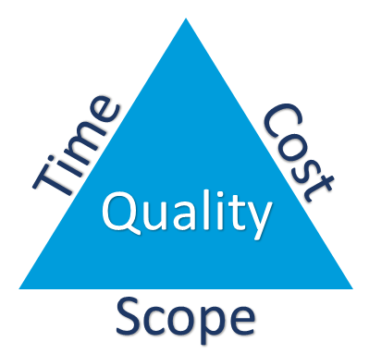
Quality
Totality of features and characteristics of a product or services that influence and support its ability to satisfy the stated or implied needs.
In business, quality should be:
Feasible
Modifiable
Measurable

Slide 12
The Quality Process
Quality management includes three stages: quality planning, quality assurance, and quality control.
Planning
Quality planning
Quality control
Quality assurance
Controlling
Executing

Slide 13
Variables Affecting Quality
Cost associated with a particular problem.
Time loss associated with a particular problem.
Degree of hazard associated with a particular problem, such as health or safety.
Pressure to get a product to market.
Poor design.
Unclear directions.
Issues with vendors.
Burned out team members.

Slide 14
TQM
An approach to improving business results through emphasis on customer satisfaction, employee development, and processes rather than on functions.
Theorist | Approach
W. Edwards Deming | The Deming cycle focuses on continuous process improvement in which quality must be continuously improved to meet customer needs.
Joseph M. Juran | The Juran trilogy breaks quality management into quality planning, control, and improvement.
Philip B. Crosby | This method emphasizes four absolutes: conformance to requirements, quality is achieved by prevention, standard of zero defects, and quality is measured by determining the cost of quality.
Genichi Taguchi | The Taguchi method emphasizes that quality should be designed into the product so that factors that cause variation can be identified and controlled.
William (Bill) Smith, Jr. | Six Sigma emphasizes responding to customer needs and improving processes by systematically removing defects.

Slide 15
Standards and Regulations
Standards
Voluntary guidelines or characteristics that have been approved by a recognized body of experts such as the International Organization for Standards (ISO).
Regulations
Compliance-mandatory characteristics for specific products, services, or processes.
Example: 2007 U.S. recall of toys with lead-based paint.
New rules and regulations.
Stricter federal regulations with criminal penalties.
U.S. toy retailers forced suppliers to meet tougher standards.

Slide 16
The ISO 9000 Series
A quality system standard that is applicable to any product, service, or process in the world.
Developed by ISO, a consortium of approximately 100 of the world’s industrial nations.
Does not guarantee that an organization will produce quality products or services.
Simply confirms that appropriate systems are in place.

Slide 17
Cost of Quality
The total cost of effort needed to achieve an acceptable level of quality in the project’s product or service.
Type of Cost | Description
Prevention costs | Upfront costs of programs or processes needed to meet customer requirements or design in quality.
Appraisal costs | Costs associated with evaluating whether the programs or processes meet requirements.
Internal failure costs | Costs associated with making the product or service acceptable to the customer after it fails internal testing and before it is delivered to the customer.
External failure costs | Costs due to rejection of the product or service by the customer.

Slide 18
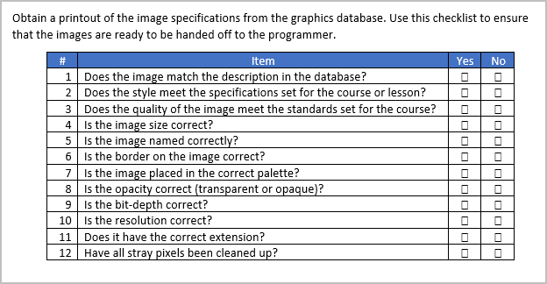
Checklists
A job aid that prompts employees to perform activities according to a consistent quality standard.
Items are stated as either imperatives or questions.
Checklists can be simple or complex depending on employees expertise and the situation.

Slide 19
Flowcharts
A diagram that shows the relationships of various elements in a system or process.
Two flowcharting techniques include:
Process or system flowchart
Cause-and-effect diagram
Help identify potential quality problems and possible effects of the problems.

Slide 20
Process Flowchart
A
Pressurization test
X-ray the weld to detect micro-fractures
B
Fractures detected?
Yes
Grind out the old weld
No
Prepare the weld surface
Connect pressure unit to open end of pipe
Apply the new weld
Pressurize unit
A
Check weld for leaks for 15 minutes
B
Yes
Leaks detected?
No
Test complete

Slide 21
Cause-and-Effect Diagram
Machine
Method
Materials
Non-standard software
Incompatible file formats
Poor specs
Poor training
Mac or PC
No style guide
Late storyboards
Rejected Images
Inexperienced
Low morale
Wrong space
Overworked
Noise
Measurement
Personnel
Environment

Slide 22
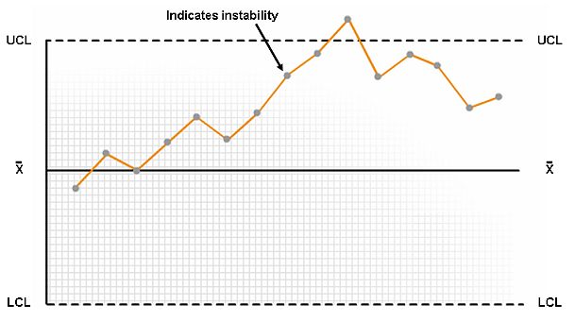
Control Chart (Variability Above UCL)
A graph used to analyze and communicate the variability of a process or project activity over time.
Shows the potential capability of the process.
Upper Control Limit (UCL) is usually three standard deviations above the mean.
= mean

Slide 23
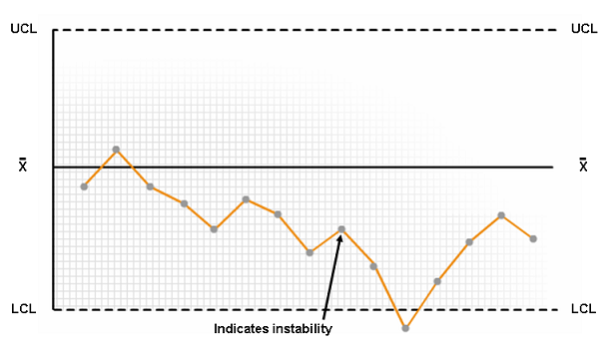
Control Chart (Variability Below LCL)
LCL Control Limit (LCL) is usually three standard deviations below the mean.
= mean

Slide 24
Benchmarking
Addresses the evaluation of a group’s business or project practices in comparison to those of other groups.
Used to identify best practices in order to meet or exceed them.
Example: Benchmarking the espresso-based beverages based on the performance of Seattle-based Starbucks Corp.

Slide 25
DOE
A technique to systematically identify varying levels of independent variables.
Example: The production of a new style of jar in a cannery. This involves:
Determining the optimum torque needed to tighten and loosen the lid.
Testing torque with spindle speed and conveyor speed.
Determining adjustments to these settings.

Slide 26
Quality Metrics
An actual value that describes the measurements for the quality control process.
Determines:
Which elements of the project are going to be measured.
How they will be measured.
How they are factored into the project.
Examples of quality metrics include:
Timely performance
Budget control
Defect density
Reliability
Rate of failure
Test coverage

Slide 27
Process Improvement Planning
The process of analyzing and identifying areas of improvement in project processes.
Enumerating an action plan based on the project goals and identified issues.
Involves:
Describing operational theories and project roles and responsibilities.
Identifying long- and short-term goals.
Describing process improvement objectives and activities.
Identifying risks and resource requirements.
Determining process improvement activities.
Creating a process improvement plan.
Receiving approval from stakeholders and senior managers.
Executing the process improvement plan.

Slide 28
Guidelines for Creating a Quality Management Plan
Collect the documents required to create a quality management plan.
Review the organization’s quality policy and determine how your project team will implement the policy.
Review the product description to identify customer/stakeholder quality requirements.
Identify the variables affecting the quality of the deliverable.
Determine the cost of quality trade-offs.
Review the quality management plan and verify that it:
Describes the project management team’s approach to implementing the quality policy.
Describes the resources required to implement quality management.
Includes quality management roles and responsibilities for the project.
Provides the required detail and formality according to the project’s quality needs.
Includes how customer satisfaction will be measured and managed.

Slide 29
Creating a Quality Management Plan

Slide 30
Which components will you include while creating a staffing management plan in your organization?
What is the purpose of a quality management plan in your organization?

