Slide 1
Planning for Risk
Create a Risk Management Plan
Identify Project Risks and Triggers
Perform Qualitative Risk Analysis
Perform Quantitative Risk Analysis
Develop a Risk Response Plan

Slide 2
Risk
An uncertain event with positive or negative impact.
Primary components include:
A measure of probability that the risk event will occur.
The impact of the risk occurring on a project.
Example: The threat of rain is a risk when planning an outdoor festival that could seriously affect attendance and revenue.

Slide 3
Negative Risks
Risks that have a negative impact on the project.
Also referred to as threats.
Example: Because a competitor introduced a new and improved product, the demand for the existing product may decrease; therefore, the revenue will be impacted.

Slide 4
Positive Risks
Risks that when taken, produce a positive project outcome.
Also referred to as opportunities.
Example: The increase in market demand and revenue for a product due to effective marketing strategies and need for the product.

Slide 5
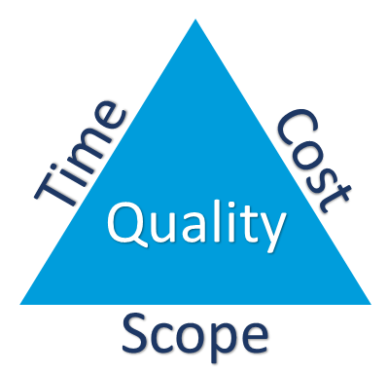
Effect-Based Risk Classification
Analyzing the major risks that are inherent to a project, and their effect upon:
Time
Cost
Quality
Scope
Example: In a complex project such as a large-scale corporate production where many departments, teams, and external resources are involved, failure to produce work on time and on budget will affect the project.

Slide 6
Source-Based Risk Classification
A method of analyzing risk in terms of its origins.
Sources may be:
Internal to the project.
External to the project.
Technical.
Nontechnical.
Industry-specific.
Generic.
Example: An advertising campaign requires internal and external sources and the risks can be classified based on their origin.

Slide 7
Business Risk vs. Insurable Risk
Business risk
Inherent in business.
All projects have potential for loss or profit.
Example: Purchasing inventory without guaranteed sales.
Insurable risk
Only the potential for loss.
No potential for profit.
Insurance may be purchased to offset losses.
Example: Loss of inventory due to fire.

Slide 8
Business Risk Types
Business Risk | Description
Competitive | Increased competition in the marketplace and a rival company developing a superior product.
Legislative | New laws or changes in regulations governing your products, goods, or services, requiring your company to spend more to maintain compliance.
Monetary | Increased prices for raw materials, increased taxes, increased operating costs, and losses due to nonpayment by customers.
Operational | Fraud, theft, employee injury, workplace accidents, and damage to equipment.

Slide 9
Insurable Risk Types
Insurable Risk | Description
Direct property | Property damage due to weather, fire, and so on.
Indirect property | Additional expenditures needed to recover from property loss.
Liability | Needing to make good after causing damage to another.
Personnel-related | Liability for damage to employees.

Slide 10
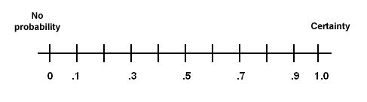
Probability Scales
Graph that illustrates the value assigned for the likelihood of risk occurring.
Relative probability values can be linear, nonlinear, or ordinal.
Probability score ranges from 0.0 (no probability) to 1.0 (certainty).

Slide 11
Basics of Probability
Principle of Probability | Description
Sum of probabilities | The sum of the probabilities of all possible events must equal 1 (100%).
Probability of single event | The probability of any single event must be greater than or equal to 0 and less than or equal to 1.
Mean | The sum of the events divided by the number of occurrences.
Median | The number that separates the higher half of a probability distribution from the lower half.
Standard deviation | This is the measure of the spread of the data, or the statistical dispersion of the values in your data set.

Slide 12
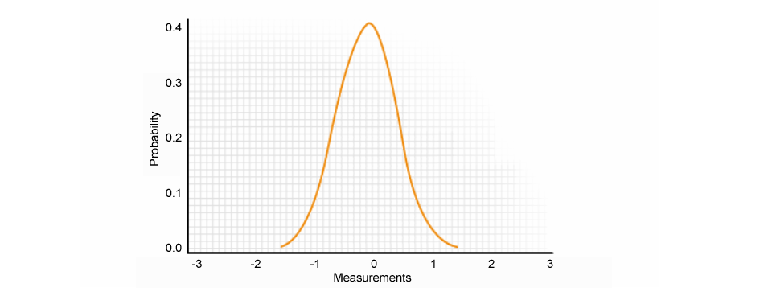
Probability Distribution
The scattering of values assigned to likelihood in a sample population.
Visually depicted in the form of a Probability Density Function (PDF).

Slide 13
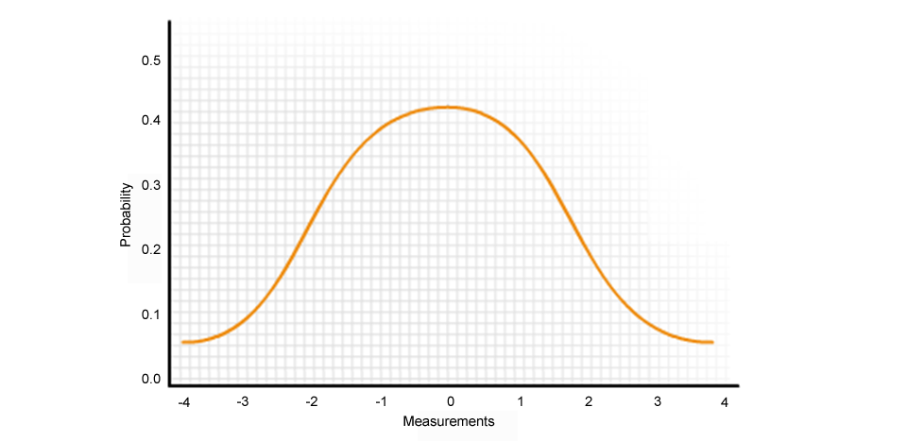
The Normal Distribution PDF
Results when there is a symmetrical range or variation in the probabilities of each outcome.

Slide 14
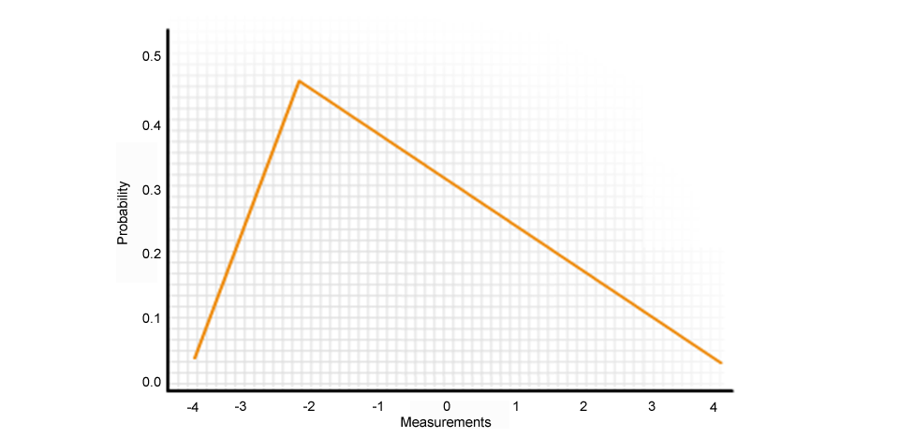
The Triangular Distribution PDF
Results when there is an asymmetrical distribution of probabilities.

Slide 15
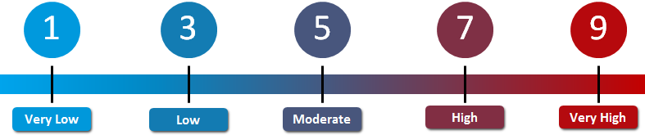
Impact Scale
If this risk occurs, the impact on the project’s objectives is…
Minor and not noticeable outside of the project.
Minor but noticeable to the customer or sponsor.
Significant and would create customer or sponsor dissatisfaction with the project.
Significant and would create major customer or sponsor dissatisfaction with the project.
Catastrophic. The project would be cancelled.

Slide 16
Levels of Uncertainty
Known
Items that you know could affect you and you can roughly predict the nature and extent of the effect.
Known-unknown
Items that you know could affect you, but you are unable to predict the nature and extent of the effect.
Items that are beyond your ability to foresee, predict, or prepare for.
Unknown-unknown

Slide 17
The Project Risk Management Process
Identify Risks
Analyze Risks
Plan Response to Risk
Qualitative
Plan for Risk
Risk Breakdown Structure
Risk Management Plan
Negative Risk Strategy
Positive Risk Strategy
Contingent Response Strategy
Risk Register
Quantitative

Slide 18
Risk Management Plan
Document that describes the team’s approach to identifying risks.
Identifies methodology, approaches, and tools.
Documents roles and responsibilities.
Identifies budgeting and scheduling.
Identifies risk categories.
Example: Entrepreneurs seeking funding from venture capitalists for building an amusement park. The risk management plan will include:
Losses due to employee theft as operational risk.
Liabilities for park ride injuries as insurable risks.

Slide 19
Risk Management Plan Components
Component | Descriptions
Methodology | The tools, approaches, and data sources used to perform risk management on the project.
Roles and responsibilities | The lead, support, and risk management team membership for each type of action in the risk management plan.
Definitions of risk probability and impact | Scales of risk probabilities and impact for use in qualitative risk analysis using terms such as “very unlikely” with their associated numerical values.
Probability and impact matrix | Predefined matrix with risk priority areas earmarked with product of impact value on the X-axis and probability value on the Y-axis.
Revised stakeholder tolerances | Updated stakeholder tolerances based on risk management.
Budgeting | The established budget for project risk management should be included.
Timing | How often the risk management activities will be performed throughout the project life cycle.
Risk categories | Documentation, such as RBS or categories from previous projects, will help identify and organize risks.
Reporting formats | How outputs of this process will be documented, analyzed, and communicated.
Tracking | Documents how risk activities will be recorded and audited.

Slide 20
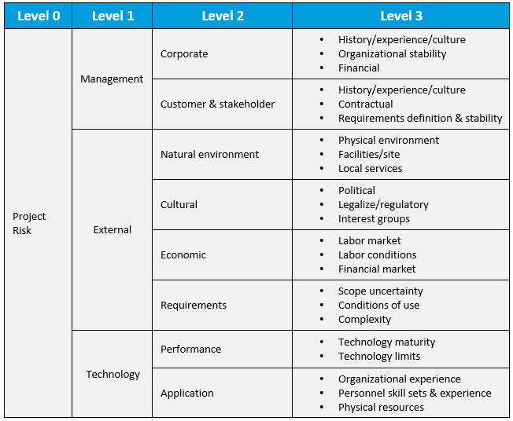
RBS

Slide 21
Risk Analysis
Evaluation of probability and impact of occurrence of risk in a project.
Either qualitative or quantitative risk analysis is performed.
Example: A manufacturing company may conduct risk analysis before launching new product lines.

Slide 22
Risk Tolerance
Level of risk acceptable to a project manager or key stakeholder when the investment is compared to the potential payoff.
Example: Stakeholders are different and may perceive risk differently.
Some prefer conservative, low-risk projects while others may prefer high-risk ventures.

Slide 23
Risk Tolerance Levels
Risk Averter
Not likely to take risk considered to be high risk.
Risk Neutral
Tolerance to risk is proportional to the amount of money at stake.
Risk Seeker
Accepts an uncertain outcome and might be willing to take high risk regardless of consequences.

Slide 24
Guidelines for Creating a Risk Management Plan
Collect the cost, schedule, and communications management plans to know how budget, schedule, and contingencies and management reserves will be communicated and accessed.
Determine how you will organize your project’s risk management team.
Conduct risk planning meetings to develop the risk management plan.
Establish a budget for risk management.
Consult your organization’s risk management policy for compliance.
Use a risk management plan template, if available.
Describe the approaches, tools, and data sources that may be used to perform risk management activities for the project.
Determine the schedule for performing risk management activities.
Determine how your team will document risk response efforts.
Determine how lessons learned will be documented.
Include organizational and stakeholders risk thresholds.

Slide 25
Creating a Risk Management Plan

Slide 26
Triggers
Triggers are early warning signs or indications that risk is about to occur.
External factors include proposed changes in legislation.
Internal factors include proposed:
Changes in staffing.
Changes in governance.
Changes in funding.
Example: For a documentary program production, an impending television writers’ strike will be a trigger and involves positive and negative risks.

Slide 27
Information-Gathering Techniques
Technique | Description
Brainstorming | Used to identify overall project risks or may focus on the risks within a particular project segment or work package.
Delphi technique | Used to generate a consensus among project risk experts who anonymously submit their risk list to a facilitator.
Root cause analysis | Used to identify problems, discover the root cause, and develop corrective actions.
Interviewing | Used to get information from people with wide experience across many projects.

Slide 28
Documentation Reviews
The structured reviews of project plans and related documents that are conducted to improve the quality of the documents.
Help determine if there are any discrepancies between the documents and the stated project requirements, which may be indicators of project risks.
Example: Reviewing and updating an activity list with changes made during the monitoring/controlling phases of a project.

Slide 29
Checklist Analysis
Determine the process or system of interest.
Define the areas of interest.
Classify the process or system.
Create relevant checklists.
Subdivide the elements of the activity or system if necessary.
Respond to the questions related to the checklists.
Use the results for making validations, recommendations, or improvements.

Slide 30
Assumptions Analysis
Assumptions are statements that must be taken to be true in order to begin project planning.
Assumptions analysis is the process of validating the assumptions made during project planning.
Involves:
Documenting the assumptions made during project planning.
Determining the risks that may be caused due to inaccuracy, instability, or incompleteness of the project assumptions.
Can be carried out at any phase of the project life cycle.

Slide 31
Diagramming Techniques
Techniques used to identify project risks, including:
Cause-and-effect diagrams
Flowcharts

Slide 32
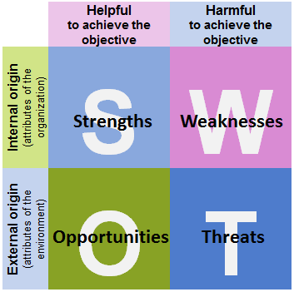
SWOT Analysis
Examine the project from the perspective of strengths, weaknesses, opportunities, and threats.
Identify the objective of the project and the external and internal factors that may positively or negatively impact the project.
Use to make decisions and develop strategies that help an organization achieve its business objectives.

Slide 33
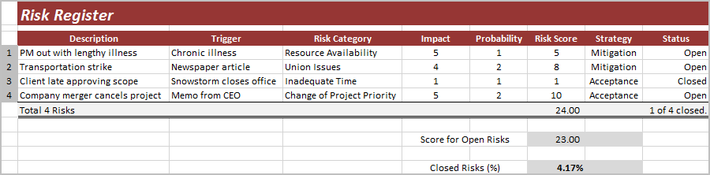
Risk Registers
Identifies and categorizes risks, potential risk responses, and their triggers or warning signs.
Must be updated as risks categories change.
Risk responses should be included in the risk response planning.

Slide 34
Risk Categories
Risk Category | Examples
Technical, quality, or performance risks | Technical changes. Changes to industry standards during the project. Reliance on unproven or complex technology. Unrealistic performance goals.
Project management risks | Inadequate time and resource allocation. Ineffective project plan development. Poor cost estimates.
Organizational risks | Resource conflicts with other projects. Inadequate project funding. Inconsistent management support.
External risks | Union issues. Change of management in customer’s organization. Regional security issues.

Slide 35
Guidelines for Identifying Project Risks and Triggers
Perform structured review of documents and planning processes.
Use a consistent method to identify project risks and triggers.
Apply the methods consistently.
Think outside of the box.
Collect information to perform an assumptions analysis.
Consult relevant historical information for lessons learned.
Group identified risks into categories.
Determine triggers for each identified risk.
Initiate the risk register.

Slide 36
Identifying Project Risks and Triggers

Slide 37
Qualitative Risk Analysis
A technique to determine the probability of occurrence and the impact of each identified risk.
Determine the risk exposure of the project by multiplying the probability and impact.
Example: An event management company planning a jazz concert in a particular coastal city where there is a threat of bad weather. You need to determine what bad weather means before you can determine the probability of it occurring.

Slide 38
Risk Matrix Criteria
Level | Criteria
5 | Will break the project.
4 | Significant additional resources in time and cost will be required to complete the project.
3 | The project will be delayed, but can still be completed with moderate additional resources.
2 | The project can be completed with minor additional resources in time or cost.
1 | Minor inconvenience.

Slide 39
Risk Data Quality Assessment
Evaluation of the reliability of data concerning a risk.
Examining data includes:
Amount of data available.
Quality of data available.
Source of information.
Legitimacy of data.
Dependability of data.
Example: Risk assessment performed for a restaurant chain’s new site development.

Slide 40
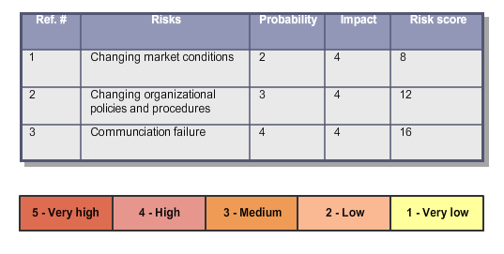
Risk Probability and Impact Assessment
A risk assessment technique that is used to evaluate the likelihood of occurrence and potential impact of the identified project risks.
Methods used include:
Meetings
Interviews
Expert judgment
Historical information

Slide 41
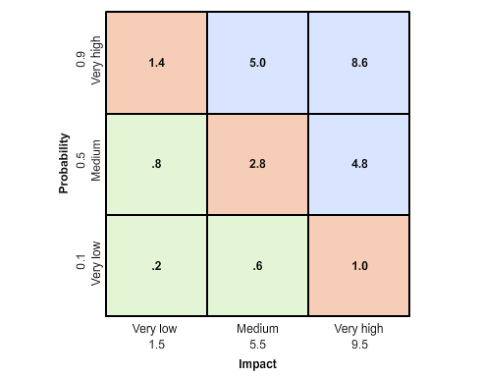
Probability and Impact Risk Rating Matrix
A graph showing the assignment of risk rating to risks or conditions

Slide 42
Risk Urgency Assessment
The task of evaluating project risks and prioritizing them based on their urgency.
Includes specific information on timing for responding to each risk.
Example: Risk urgency assessment in a construction project.
Inadequate scaffolding support will require immediate attention while other risks, such as unavailability of resources, will be less urgent.

Slide 43
Risk Register Analysis
Technique | Description
Relative ranking or priority list of project risks | The overall risk ranking for a project can be determined by adding the individual risk factor scores and dividing by the number of risks.
Risks grouped by categories | Placing risks in categories may reveal areas of risk concentration.
Causes of risk or project areas requiring particular attention | Identifying specific frequently occurring causes in risk occurrence enables better risk response planning.
Lists of risks requiring response in the near term | Some risks may require action in the near term. These can be grouped separately from the risks that will be addressed at a later date.
List of risks for additional analysis and response | Risks that may require additional analysis and management typically include risks classified as high or moderate.
Watchlist of low-priority risks | Risks that are not urgent and do not require near-term action can be documented on a watchlist for monitoring.
Trends in qualitative risk analysis results | As qualitative risk analysis is repeated, a trend may result that can make risk response or further analysis more urgent or less.

Slide 44
The Ongoing Risk Assessment Process
An iterative process of identifying, analyzing, and documenting risks.
Project managers outside the project shadow and provide oversight for the project.
Identifying risks
Analyzing risks
Documenting risks

Slide 45
Guidelines for Performing Qualitative Risk Analysis
Examine the list of identified risks.
Analyze the data to assign a data precision ranking score.
Determine the organization's risk threshold for this project.
Analyze the assumptions identified as potential risks.
Analyze the probability and impact of each identified risk.
Determine the risk factor scores of each risk using a probability/impact risk rating matrix.
Prioritize the risks according to the risk management plan.
Identify risks that require additional analysis.
Determine the overall risk ranking for the project.
Document all changes to the risk register.

Slide 46
Performing Qualitative Risk Analysis

Slide 47
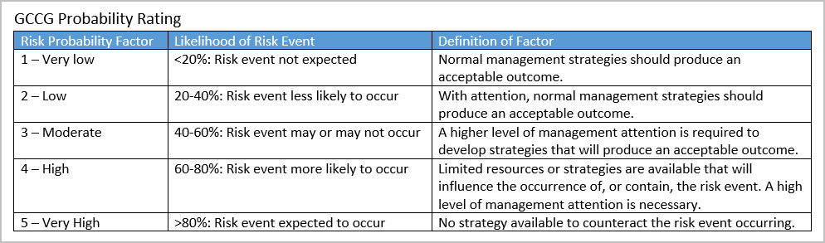
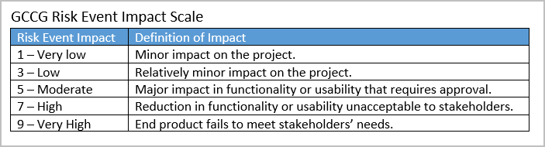

Activity Scenario

Slide 48
Quantitative Risk Analysis
A technique used to assess the risk to overall project objectives and determine the confidence levels of achieving the project objectives.
Identify time and cost contingencies.
Enhance the prioritization and scoring of risks.
Example: A Supply-Chain Management Software project team identifies process data for a statistical analysis using a Monte Carlo simulation to determine if the project will be completed on time and within budget.

Slide 49
Quantitative Risk Analysis Update Components
Component | Description
Probabilistic analysis of the project | Once risks are qualitatively and quantitatively analyzed, the project team should be able to forecast the possible completion dates and costs and provide a level of confidence for each.
Probability of achieving the cost and time objectives | Using quantitative risk analysis, the project team can estimate the likelihood of achieving the project objectives under the current plan and with the current knowledge of the project risks.
Prioritized list of quantified risks | Identified risks are prioritized according to the threat they pose or the opportunity they present to the project. This prioritized list includes a measure of the impact of each identified risk.
Trends in quantitative risk analysis results | Repeating the quantitative risk analysis allows the project's risk management team to analyze the trends and make adjustments as necessary.

Slide 50
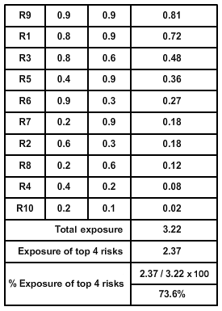
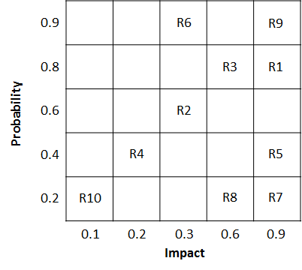
Project Risk Ranking
Overall risk ranking for final deliverable.
Sum of risk factor scores for individual risks divided by number of risks.
Example: A risk management team calculating the percent exposure of the top four risks.

Slide 51
Quantitative Analysis Methods
Sensitivity analysis
Decision tree analysis
Simulation
EMV analysis

Slide 52
Sensitivity Analysis
Places a value on the effect of changing a single variable within a project by analyzing that effect on the project plan.
Provides a comparison of each variable’s impact on project performance.
Advantages:
Simple method for analyzing the impact of potential risk.
Results are easy for stakeholders to understand.
Limitations:
Not good for assessing combinations of risk and their affect on a project.
Doesn’t provide the probability of the occurrence of a risk event.

Slide 53
Decision Tree Analysis
Factors both probability and impact for each variable, indicating the decision providing the greatest expected value when all uncertain implications and subsequent decisions are quantified.

Slide 54
Simulation
Uses computer models and estimates of risk.
Translates uncertainties into potential impact.
Involves calculating multiple project durations using varying sets of assumptions.
Example: The project team for the multimedia campaign decides which printing contractor to use and chooses between two vendors.

Slide 55
Monte Carlo Analysis
A technique used to make predictions about optimistic, most likely, and pessimistic estimates.
Simulates various outcomes.
Calculates a range of possible results.
Effective with large inputs of numbers.
Well suited for complex project management problems.
Example: Monte Carlo analysis for a project that has three tasks with inexperienced resources.

Slide 56
EMV Analysis
EMV represents Expected Monetary Value
Method of calculating the average outcome when the future is uncertain.
Opportunities have positive values.
Threats have negative values
EMV = monetary value of a possible outcome X probability

Slide 57
Guidelines for Performing Quantitative Risk Analysis
Break out the original estimate into manageable chunks.
Determine the variable you wish to investigate.
Calculate the impact of changing the range of results on the overall project estimate for each value in the range.
Consult historical information.
Use the appropriate interviewing technique and obtain probability distributions.
Depict the distributions in a PDF.
Perform a sensitivity analysis.
Use the decision tree analysis technique.
Conduct a project simulation.
Prioritize the quantified risks.
Document changes to the risk register.

Slide 58
Performing Quantitative Risk Analysis

Slide 59
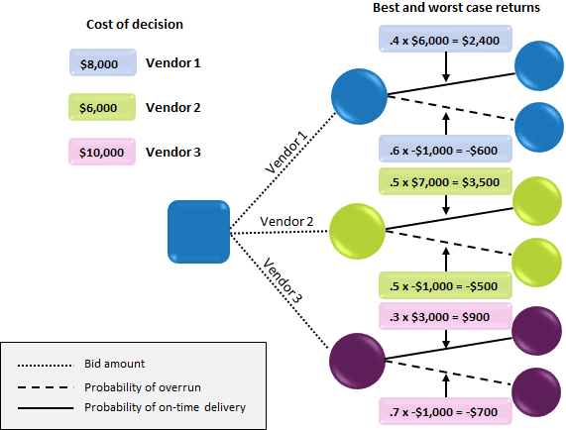
Activity Scenario

Slide 60
Negative Risk Strategies
Strategy | Description
Risk avoidance | Involves changing the project plan to prevent a potentially detrimental risk condition or event from happening.
Risk transference | Shifts the impact of a risk event and ownership of the risk response to a third party.
Risk mitigation | Attempts to reduce the probability or impact of a potential risk event to an acceptable level.
Risk acceptance | Involves accepting that a risk exists. The acceptance may be passive or active.

Slide 61
Positive Risk Strategies
Strategy | Description
Risk exploitation | Often used when a project team wants to make sure that a positive risk is fully realized.
Risk sharing | Entails partnering up with another party in an effort to give your team the best chance of seizing the opportunity.
Risk enhancement | Attempts to increase the probability that an opportunity will occur.
Risk acceptance | Involves accepting the risk and actively responding to it as it comes, but not through pursuit.

Slide 62

Contingent Response Strategies
A risk response strategy developed in advance, before things go wrong.
Used if and when identified risks become reality.
Might include a fallback plan.
Also called a contingency plan.
Example: A rain date for an outdoor event.

Slide 63
Contingency Reserves
A predetermined amount set aside.
Additional time
Money
Resources
Used in case known risks become reality.
Example: Soliciting more volunteers than required as a contingency reserve for a trade show.

Slide 64
Risk-Related Contract Decisions
Risk response approaches agreed upon by both parties when procuring materials from a third party.
Made when:
Planning risk responses for the project.
Sharing or transferring part or all of the risk (opportunity or threat, respectively).
Enhancing or mitigating part or all of the opportunity or threat, respectively, faced by an organization.

Slide 65
Guidelines for Developing a Risk Response Plan
Examine each identified risk to determine its causes.
Brainstorm possible response strategies for each risk.
Choose the response strategy that is most likely to be effective.
Develop specific actions for implementing the chosen strategy.
Identify backup strategies for risks with high risk factor scores.
Determine the amount of contingency reserves necessary.
Consult the risk management plan for the description of the content and format of the risk response plan.
Incorporate the risk response plan into the overall project plan.
Examine trends in analysis results.

Slide 66
Developing a Risk Response Plan

Slide 67
How could your organization benefit from comprehensive risk planning?
Which tools and techniques will you use to effectively perform qualitative risk analysis for future projects you manage?

