Slide 1
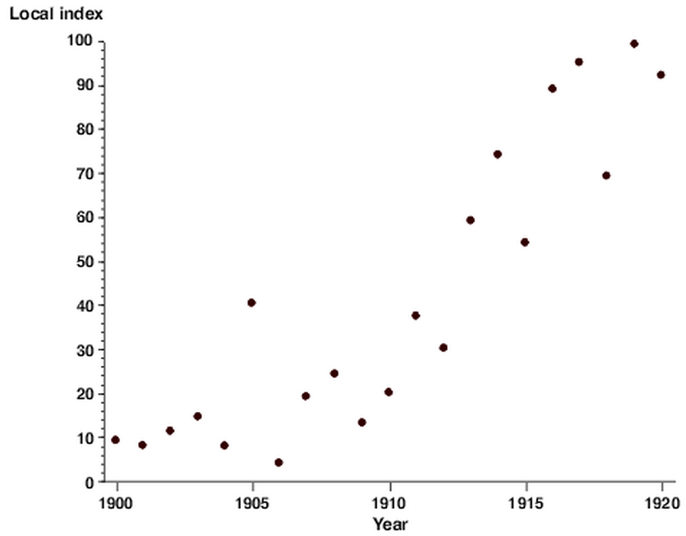
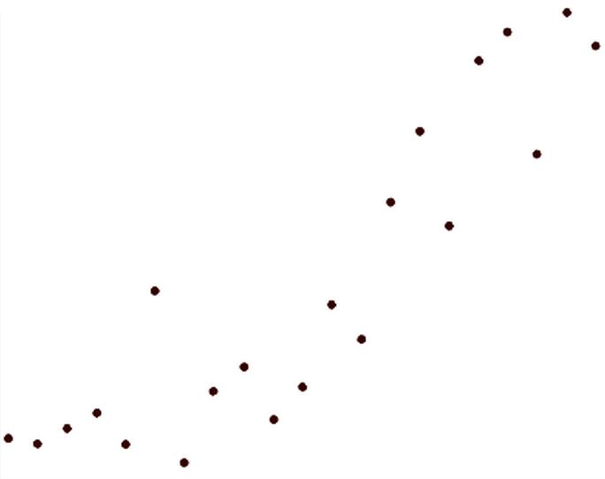
random_scatterplot.png
random_scatterplot_trimmed.jpg

Slide 2
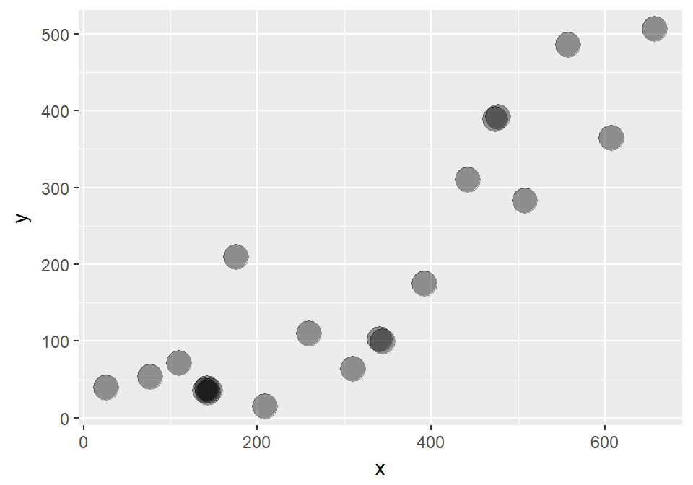

Only single cluster
where there should be 2
Two clusters
where there should only be one

Slide 3
