Slide 1
CSC 270 – Survey of Programming Languages
C Lecture 1 : Getting Started: in C
Modified from Dr. Robert Siegfried’s Presentation

Slide 2
Objective
Intro to C
Tools we will use
Program file structure
Variables
Read from screen and print to screen
Decisions (If)

Slide 3
C Orientation
Created in 1972 to write operating systems (Unix in particular)
  By Dennis Ritchie
  Bell Labs
Evolved from B
Can be portable to other hardware (with careful design – use Plauger’s The Standard C Library book)
Built for performance and memory management – operating systems, embedded systems, real-time systems, communication systems

Slide 4
C Standardization
1989 ANSI and ISO -> Standard C
1999 C99
2011 C11
Don’t get thrown when you lookup information on websites and find conflicts based upon standards

Slide 5
Later Languages
1979 C++ by Bjarn Stroustrup also at Bell
  Object orientation
1991 Java by Sun
  Partial compile to java bytecode: virtual machine code
  Write once, run anywhere
  Memory manager – garbage collection
  Many JVMs written in C / C++

Slide 6
A First Program
makes input
and output available
to us
#include <stdio.h>
int main(void)
{
printf("This is my first C program.\n");
return(0);
}
header
open and close braces mark
the beginning and end
statements

Slide 7
A First Program – What Does It Do?
  printf("This is my first C program.\n");
  return(0);
Prints the message
This is my first C program.
Ends the program
Ends the line

Slide 8
Java Reminder
Program | C | Java
hello, world | #include<stdio.h> | public class HelloWorld {
 | int main(void) { | public static void main(String[] args) {
 | printf("Hello\n"); | System.out.println("Hello");
 | return 0; | }
 | } | }

Slide 9
C Program Phases
Editor - code by programmer
Compiling using gcc:
  Preprocess – expand the programmer’s code
  Compiler – create machine code for each file
  Linker – links with libraries and all compiled objects to make executable
Running the executable:
  Loader – puts the program in memory to run it
  CPU – runs the program instructions

Slide 10
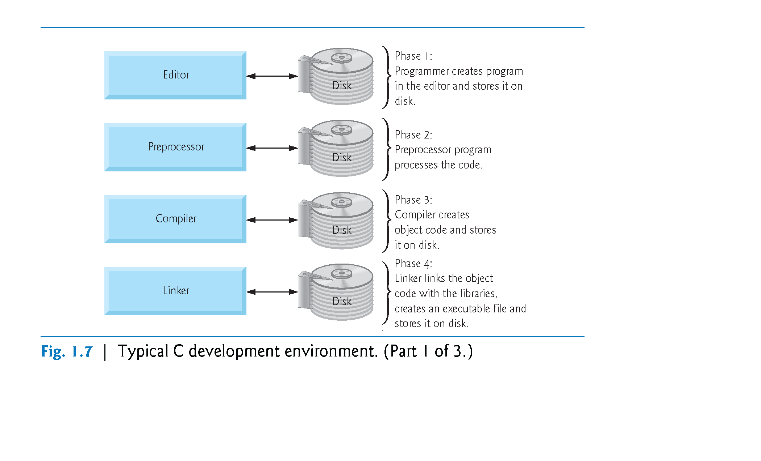
Copyright © Pearson, Inc. 2013. All Rights Reserved.

Slide 11
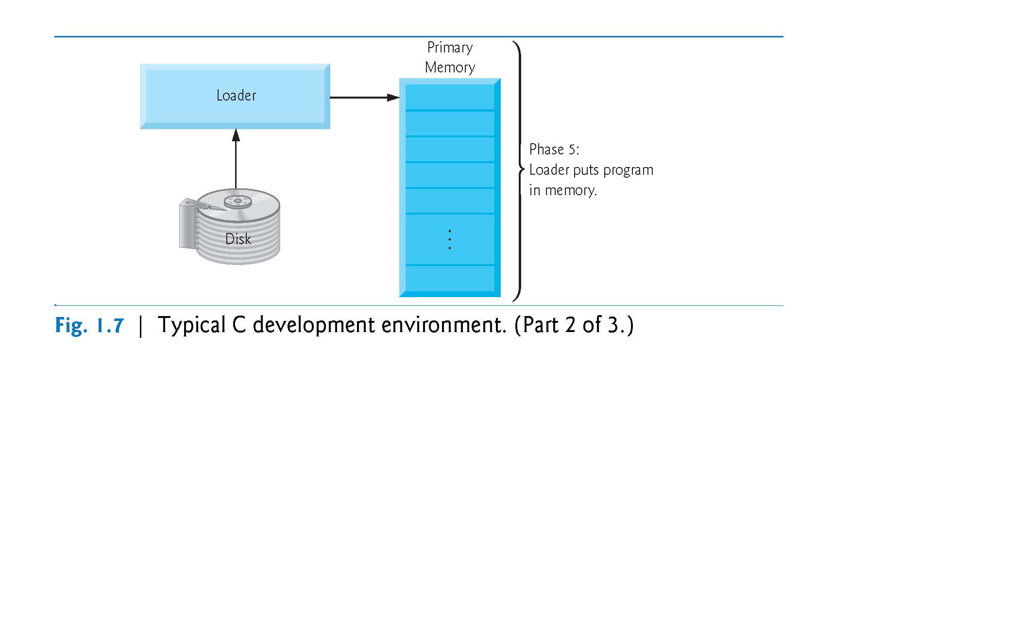
Copyright © Pearson, Inc. 2013. All Rights Reserved.

Slide 12
Run First Program
Write in notepad++
Transfer with Filezilla
Connect to panther as terminal (putty) using SSH (Secure Shell)
More filename to see the file
gcc filename -o filename without c -g (ex: gcc hello.c -o hello -g )
./hello

Slide 13
Using variables
#include <stdio.h>
int main(void)
{
int sum, value1, value2, value3;
float average;
value1 = 2;
value2 = 4;
value3 = 6;
sum = 2 + 4 + 6;
average = sum / 3;
printf("The average of %d , %d, %d is %f\n", value1, value2, value3, average);
return(0);
}
Print a float value from the
rest of the parameter list

Slide 14
Variables and Identifiers
Variables have names – we call these names identifiers.
An identifier must begin with a letter or an underscore _
C is case sensitive upper case (capital) or lower case letters are considered different characters. Average, average and AVERAGE are three different identifiers.
Numbers can also appear after the first character.
However, C only considers the first 31 (external identifiers) or first 63 (internal identifiers) significant.
Identifiers cannot be reserved words (special words like int, main, etc.)

Slide 15
User Input
Let’s rewrite the average program so it can find the average any 3 numbers we try:
We now need to:
  Find our three values
  Add the values
  Divide the sum by 3
  Print the result

Slide 16
Average3.c
#include <stdio.h>
int main(void)
{
int value1, value2, value3;
float sum, average;
printf("What is the first value? ");
scanf("%d", &value1);
printf("What is the second value? ");
scanf("%d", &value2);
Read
The address of variable value1
Indicates that we are
reading an integer

Slide 17
printf("What is the third value? ");
scanf("%d", &value3);
sum = value1 + value2 + value3;
average = sum / 3;
printf("The average of %d , %d, %d is %f\n", value1, value2, value3, average); return(0);
}
scanf needs the &
before the identifier

Slide 18
Scanf Conversion Characters
https://wpollock.com/CPlus/PrintfRef.htm#scanfConv
Doubles on our machine are read with a lf. (A double is a long float.)

Slide 19
Formatting %d and %f
The specifiers %d and %f allow a programmer to specify how many spaces a number will occupy and how many decimal places will be used.
%nd will use at least n spaces to display the integer value in decimal (base 10) format.
%w.nf will use at least w spaces to display the value and will have exactly n decimal places.
Example:
  printf("The average of %2d , %2d, %2d is %5.2f\n", value1, value2, value3, average);

Slide 20
Changing the width
Number
Formatting
Print as:
182
%2d
182
182
%3d
182
182
%5d
``182
182
%7d
`’’`182
-182
%4d
-182
-182
%5d
`-182
-182
%7d
```-182

Slide 21
Changing the width (continued)
Number
Formatting
Print as:
23
%1d
23
23
%2d
23
23
%6d
….23
23
%8d
……23
11023
%4d
11023
11023
%6d
.11023
-11023
%6d
-11023
-11023
%10d
….-11023
Notes:
46

Slide 22
Changing The Precision
Number | Formatting | Prints as:
2.718281828 | %8.5f | `2.71828
2.718281828 | %8.3f | ```2.718
2.718281828 | %8.2f | ````2.72
2.718281828 | %8.0f | ````````3
2.718281828 | %13.11f | 2.71828182800
2.718281828 | %13.12f | 2.718281828000

Slide 23
Average – add comments
#include <stdio.h>
/*
* This program calculates average pay
*/
int main(void)
{
int value1, value2, value3;
float sum, average;
string
// now get the first value
;
comments

Slide 24
Character Data
All of our programs so far have used variables to store numbers, not words.
We can store one or more characters by writing:
  char x, s[10];
  x can hold one and only one character
  s can hold up to nine characters (reserving 1 for ending null)
For now, we use character data for input and output only.

Slide 25
A program that uses a character variable
#include <stdio.h>
/* A very polite program that greets you by name */
int main(void)
{
char name[25];
/* Ask the user his/her name */
printf("What is your name ? ");
scanf("%s", name);
/* Greet the user */
printf("Glad to meet you, %s\n.", name);
return(0);
}

Slide 26
Features so far
Include
Variable types: int, float, char
Read using scanf
  requires & for address of variable being read
Print using printf
Format strings: %f (float), %d (int), %u (unsigned int), %c (char), %s (character array)
Comments /*.. */ or //

Slide 27
if and if-else and if-else if - else
If (boolean_expression 1)
{ /statements }
else if ( boolean_expression 2)
{ /* statements */ }
else if ( boolean_expression 3)
{ /* statements */ }
else
{ /* statements */ }

Slide 28
IsItNeg.c – illustrate if
#include <stdio.h>
// Tell a user if a number is negative
int main(void)
{ float number;
/* Ask the user for a number */
printf("Please enter a number ? ");
scanf("%f", &number);
// Print whether the number is negative or not
if (number < 0){
printf("%f is a negative number\n", number); }
else {
printf("%f is NOT a negative number\n", number); }
return(0); }

Slide 29
Relational operators
Operator | Meaning | Example
== | equals | x == y
!= | is not equal to | 1 != 0
> | greater than | x+1 > y
< | less than | x-1 < 2*x
>= | greater than or equal to | x+1 >= 0
<= | less than or equal to | -x +7 <= 10

Slide 30
Integer Division
Our compound interest program prints the values for every year where every ten or twenty years would be good enough.
What we really want to print the results only if the year is ends in a 5. (The remainder from division by 10 is 5).

Slide 31
Integer Division Results
8 / 3 = 2 | 8 % 3 = 2
2 / 3 = 0 | 2 % 3 = 2
49 / 3 = 16 | 49 % 3 = 1
49 / 7 = 7 | 49 % 7 = 0
‑8 / 3 = ‑2 | ‑8 % 3 = ‑2
‑2 / 3 = 0 | ‑2 % 3 = ‑2
‑2 / ‑3 = 0 | ‑2 % ‑3 = ‑2
2 / ‑3 = 0 | 2 %‑3 = 2
‑49 / 3 = ‑16 | ‑49 % 3 = ‑1

Slide 32
Choosing Data Types
Sizes implementation dependent in limits.h
  int -2147483648 to 2147483647
  short -32768 to 32767
  long -9223372036854775808 to 9223372036854775807
  Float 1.17x10⁻³⁸ to 3.4 * 10³⁸
Keyword unsigned starts at 0 but goes higher

Slide 33
Declaring Constants
There are two ways of defining constants in C: using #define and const.
#define is a compiler preprocessor which replaces each occurrence of the constant's name with its value:
The general form of the constant declaration is:
#define ConstantName ConstantValue
Let's take a look at a few examples:
#define withholding_rate 0.8
#define prompt 'y'
#define answer "yes"
#define maxpeople 15
#define inchperft 12
#define speed_limit 55

Slide 34
Declaring Constants
The general form of the constant declaration is:
const datatype ConstantName = ConstantValue,
AnotherConstantName =
AnotherConstantValue;
Let's take a look at a few examples of constants:
const float withholding_rate = 0.8;
const char prompt = ‘y‘,
answer[] = “yes”;
const int maxpeople = 15,
inchperft = 12;
speed_limit = 55;

Slide 35
Java Comparison Thus Far
Feature | C | Java
type of language | function oriented / imperative | object oriented
file naming conventions | stack.c, stack.h | Stack.java - file name matches name of class
basic programming unit | function | class / Abstract Data Type
portability of source code | possible with discipline | yes
portability of compiled code | no, recompile for each architecture | yes, bytecode is "write once, run anywhere"
compilation | gcc hello.c creates machine language code | javac Hello.java creates Java virtual machine language bytecode
buffer overflow | segmentation fault, core dump, unpredicatable program | checked run-time error exception
boolean type | use int: 0 for false, nonzero for true OR include <stdbool.h> and use bool | boolean is its own type - stores value true or false
character type | char is usually 8 bit ASCII | char is 16 bit UNICODE
strings | '\0'-terminated character array | built-in immutable String data type
accessing a library | #include <stdio.h> | import java.io.File;
Credit: http://introcs.cs.princeton.edu/java/faq/c2java.html

Slide 36
More Java Comparison
Feature | C | Java
printing to standard output | printf("sum = %d", x); | System.out.println("sum = " + x);
formatted printing | printf("avg = %3.2f", avg); | System.out.printf("avg = %3.2f", avg)
reading from stdin | scanf("%d", &x); | int x = StdIn.readInt();
declaring constants | const and #define | final
for loops | for (i = 0; i < N; i++) | for (int i = 0; i < N; i++)
variable auto-initialization | not guaranteed | instance variables (and array elements) initialized to 0, null, or false, compile-time error to access uninitialized variables
casting | anything goes | checked exception at run-time or compile-time
demotions | automatic, but might lose precision | must explicitly cast, e.g., to convert from long to int
variable declaration | at beginning of a block | before you use it
variable naming conventions | sum_of_squares | sumOfSquares
Credit: http://introcs.cs.princeton.edu/java/faq/c2java.html

Slide 37
Summary
Tools we will use
  Notepad++
  Filezilla
  Panther (gcc)
  Putty
Program file structure
  #include <> or “ “
  Main function

Slide 38
Summary Cont.
Variables
  int, float, char
  unsigned keyword
  String defined as char array : char name[26]
  For bool, include stdbool.h
  Constant:
    #define name value
    const type name = ?
  Get address of variable with &
  Cast with (type) var

Slide 39
Summary Cont.
Read from screen and print to screen
  Scanf (control string, variable addresses)
  Printf(string, variables to insert)
  Format strings %2f, %d, %s, %u
  #include <stdio.h>
Decisions
  If / else if / else

Slide 40
Exercise
https://prof.beuth-hochschule.de/fileadmin/user/scheffler/Lehre/Think-C_v1.08.pdf
Exercise 2.1

