Slide 1
Part 2.1: Problem solving - Searching
Part 2.1 General introduction to searching
Part 2.2 Uninformed (Blind)/ Informed (Heuristic) search
Part 2.3 Game playing search

Slide 2
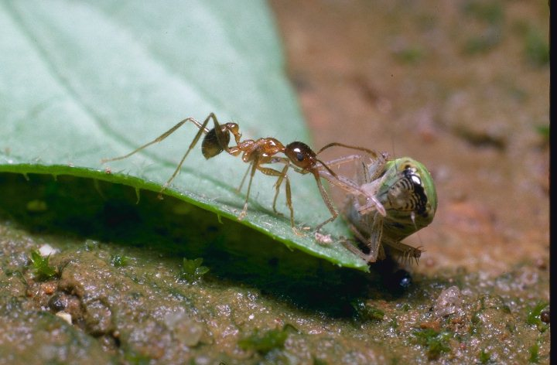
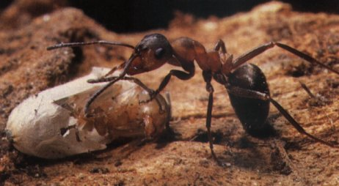
Workers are always Searching
Brief info on Ants, http://www.winnipeg-bugline.com/ants.html,
http://www.boston.com/globe/magazine/2002/0623/frontiers.htm

Slide 3
Problem solving techniques in A.I
Broad Approaches
  using search techniques
    e.g. in Games
  modeling
    using Knowledge Base Systems (KBS)
    using Machine Learning techniques e.g. Artificial Neural Networks, Decision Trees, Case-base reasoning, Genetic algorithms, ..

Slide 4
Searching as a problem solving technique
Searching is the process of looking for the solution of a problem through a set of possibilities (state space).
Search conditions include:
  Current state -where one is;
  Goal state – the solution reached; check whether it has been reached;
  Cost of obtaining the solution.
The solution is a path from the current state to the goal state.

Slide 5
Searching as a problem solving technique
Process of Searching
Searching proceeds as follows:
  Check the current state;
  Execute allowable actions to move to the next state;
  Check if the new state is the solution state; if it is not, then the new state becomes the current state and the process is repeated until a solution is found or the state space is exhausted.

Slide 6
Search problem
The search problem consists of finding a solution plan, which is a path from the current state to the goal state.
Representing search problems
  A search problem is represented using a directed graph. The states are represented as nodes while the allowed steps or actions are represented as arcs.
A search problem is defined by specifying:
  State space;
  Start node;
  Goal condition, and a test to check whether the goal condition is met;
  Rules giving how to change states.
  Path cost

Slide 7
Example: Romania
On holiday in Romania; currently in Arad.
Flight leaves tomorrow from Bucharest
Formulate goal:
  be in Bucharest
Formulate problem:
  states: various cities
  actions: drive between cities
Find solution:
  sequence of cities, e.g., Arad, Sibiu, Fagaras, Bucharest

Slide 8

Example: Romania

Slide 9
Problem types
Deterministic, fully observable → single-state problem
  Agent knows exactly which state it will be in; solution is a sequence
Non-observable → sensorless problem (conformant problem)
  Agent may have no idea where it is; solution is a sequence
Nondeterministic and/or partially observable → contingency problem
  percepts provide new information about current state
  often interleave} search, execution
Unknown state space → exploration problem

Slide 10

Example: vacuum world
Single-state, start in #5. Solution?

Slide 11
Example: vacuum world
Single-state, start in #5.
Solution? [Right, Suck]
Sensorless, start in
{1,2,3,4,5,6,7,8} e.g.,
Right goes to {2,4,6,8}
Solution?

Slide 12
Example: vacuum world
Sensorless, start in
{1,2,3,4,5,6,7,8} e.g.,
Right goes to {2,4,6,8}
Solution?
[Right,Suck,Left,Suck]
Contingency
  Nondeterministic: Suck may
  dirty a clean carpet
  Partially observable: location, dirt at current location.
  Percept: [L, Clean], i.e., start in #5 or #7
  Solution?

Slide 13
Example: vacuum world
Sensorless, start in
{1,2,3,4,5,6,7,8} e.g.,
Right goes to {2,4,6,8}
Solution?
[Right,Suck,Left,Suck]
Contingency
  Nondeterministic: Suck may
  dirty a clean carpet
  Partially observable: location, dirt at current location.
  Percept: [L, Clean], i.e., start in #5 or #7
  Solution? [Right, if dirt then Suck]

Slide 14
Single-state problem formulation
A problem is defined by four items:
initial state e.g., "at Arad"
actions or successor function S(x) = set of action–state pairs
  e.g., S(Arad) = {<Arad → Zerind, Zerind>, … }
goal test, can be
  explicit, e.g., x = "at Bucharest"
  implicit, e.g., Checkmate(x)
path cost (additive)
  e.g., sum of distances, number of actions executed, etc.
  c(x,a,y) is the step cost, assumed to be ≥ 0
A solution is a sequence of actions leading from the initial state to a goal state

Slide 15
Selecting a state space
Real world is absurdly complex
  → state space must be abstracted for problem solving
(Abstract) state = set of real states
(Abstract) action = complex combination of real actions
  e.g., "Arad → Zerind" represents a complex set of possible routes, detours, rest stops, etc.
For guaranteed realizability, any real state "in Arad“ must get to some real state "in Zerind"
(Abstract) solution =
  set of real paths that are solutions in the real world
Each abstract action should be "easier" than the original problem

Slide 16
Problem Definition - Example, 8 puzzle
5
4
1
1
1
2
2
4
3
3
7
6
1
8
8
4
2
5
5
4
6
8
7
3
2
7
7
3
6
8
6
5
Initial State
Goal State

Slide 17
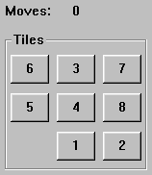
Problem Definition - Example, 8 puzzle
States
  A description of each of the eight tiles in each location that it can occupy. It is also useful to include the blank
Operators/Action
  The blank moves left, right, up or down
Goal Test
  The current state matches a certain state (e.g. one of the ones shown on previous slide)
Path Cost
  Each move of the blank costs 1

Slide 18
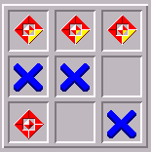
Problem Definition - Example, tic-tac-toe
x
o
o
o
x
x
x
x
x
x
x
x
o
x
x
x
o
x
x
x
o
o
o
x
x
x
o
………..
o
x
x
x
x
x
x
x
x
x
x
o
o
o
o

Slide 19
Tree/Path example:
4
4
3
A
B
C
S
5
5
G
4
D
E
F
3
2
4
Implicit network of towns
Two possible tasks:
  1. FIND a (the) path. = computational cost
  2. TRAVERSE the path. = travel cost
2. relates to finding optimal paths

Slide 20
The associated loop-free tree of partial paths
4
4
3
A
B
C
S
5
5
G
4
3
D
2
E
4
F
3
S
4
4
A
D
2
5
5
B
D
A
E
4
5
2
4
5
4
C
2
E
4
5
E
B
B
F
4
4
5
4
4
3
D
F
B
F
C
E
A
C
G
3
4
3
4
G
C
G
F
3
G

Slide 21
Paths:
We are not interested in optimal paths here, so we can drop the costs.
Denotes:
SA
S
A
Denotes:SDA
D
B
D
A
E
C
E
E
B
B
F
D
F
B
F
C
E
A
C
G
G
C
G
F
Denotes:
SDEBA
G
Nodes do not denote themselves, but denote the partial path from the root to themselves!!

Slide 22
Terminology:
S
A
D
B
D
A
E
C
E
E
B
B
F
D
F
B
F
C
E
A
C
G
G
C
G
F
G
Node, link (or edge), branch, arc
Parent, child, ancestor, descendant
Root node, goal node
Expand / Open node / Closed node / Branching factor

Slide 23
Using a Tree – The Obvious Solution?
But
  It can be wasteful on space
  It can be difficult to implement, particularly if there are varying number of children (as in tic-tac-toe)
  It is not always obvious which node to expand next. We may have to search the tree looking for the best leaf node (sometimes called the fringe or frontier nodes). This can obviously be computationally expensive

Slide 24
How good is a solution?
Does our search method actually find a solution?
Is it a good solution?
  Path Cost
  Search Cost (Time and Memory)
Does it find the optimal solution?
  But what is optimal?

Slide 25
Evaluating a search
Completeness
  Is the strategy guaranteed to find a solution?
Time Complexity
  How long does it take to find a solution?
Space Complexity
  How much memory does it take to perform the search?
Optimality
  Does the strategy find the optimal solution where there are several solutions?

Slide 26
Search Trees
Some issues:
  Search trees grow very quickly
  The size of the search tree is governed by the branching factor
  Even this simple game tic-tac-toe has a complete search tree of 984,410 potential nodes
  The search tree for chess has a branching factor of about 35

