Slide 1
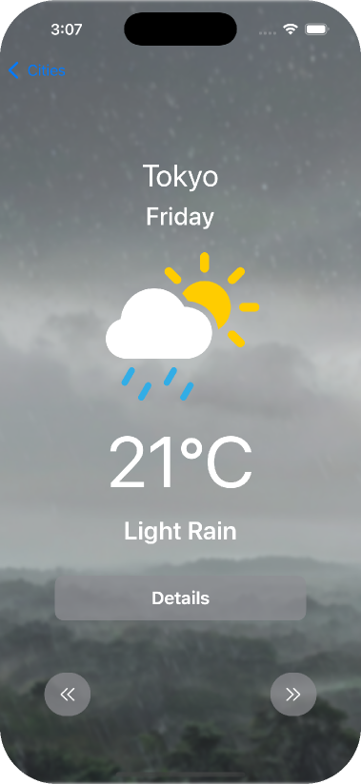
MYWeatherAPP_V3

Slide 2
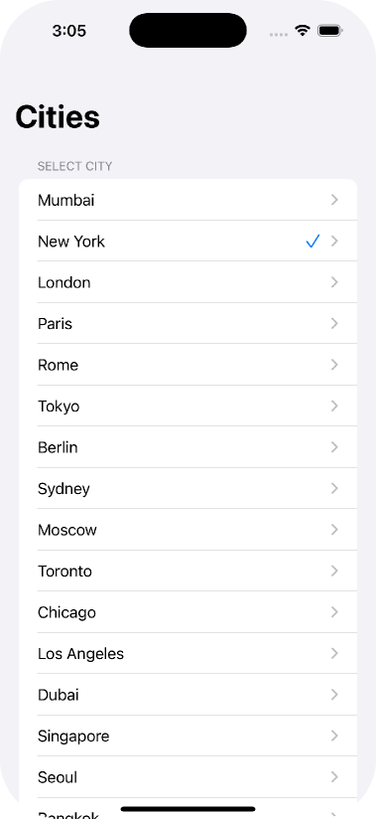

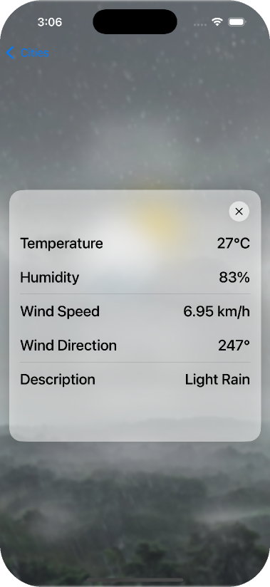

CitySelectView
MainWeatherView
DetailedWeatherView

Slide 3


On first launch, SelectCityView appears, prompting the user to pick a city. This triggers an API call to fetch weather data and then shows the MainWeatherView
CitySelectView
MainWeatherView

Slide 4

On MainWeatherView, the city name, day of the week, an SF Symbol emoji, temperature, and weather description are shown. Below, three buttons: – Details shows the DetailWeatherView card – Two arrow buttons switch to the previous or next day's weather.
MainWeatherView
DetailedWeatherView

