Slide 1
Text to image

Slide 2


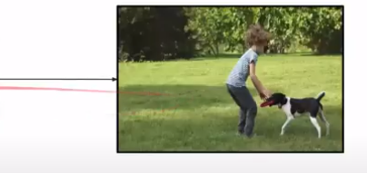
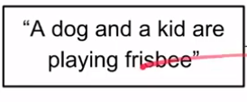

Problem Text to image

Slide 3
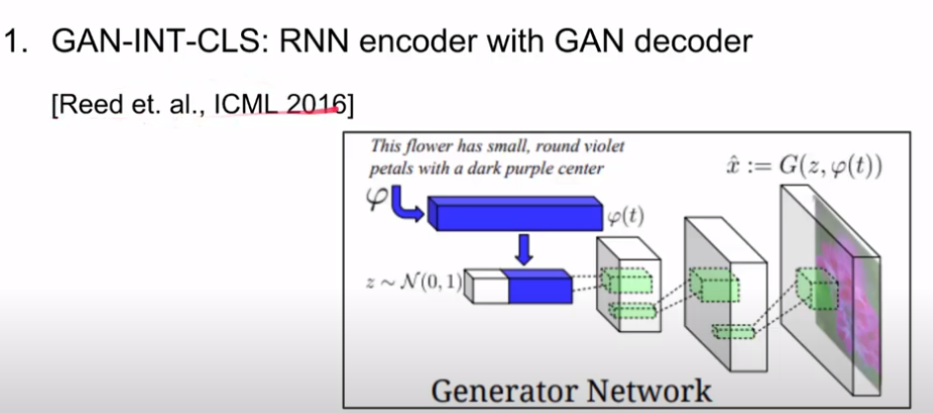
Related work

Slide 4
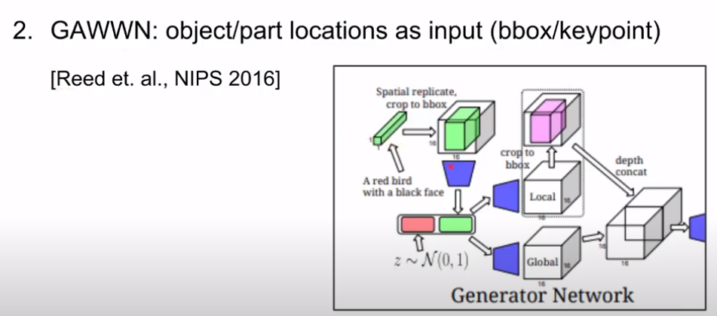
Related work

Slide 5
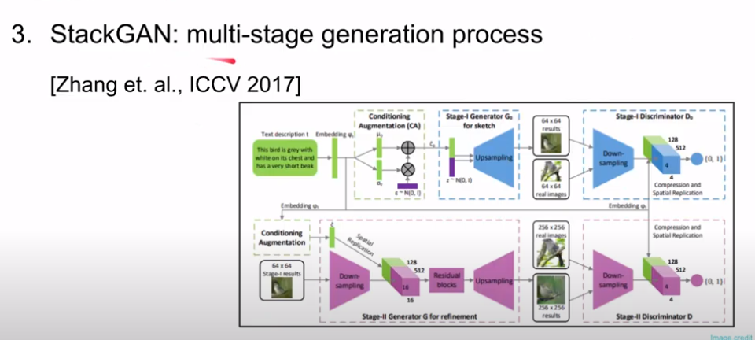
Related work

Slide 6
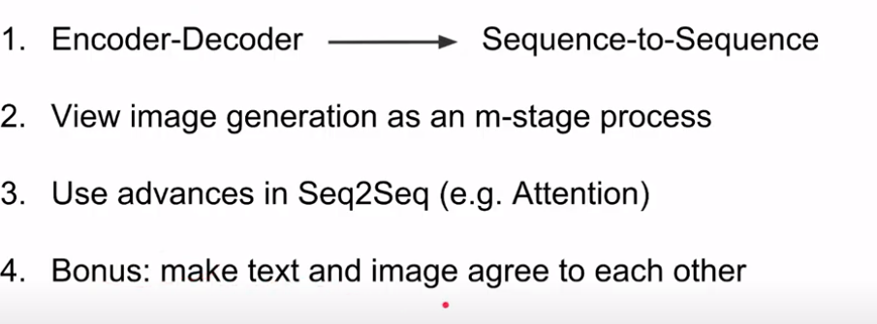
Architecture

Slide 7
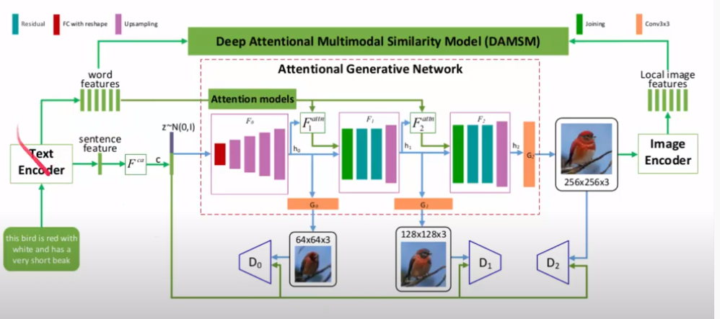
Architecture

Slide 8
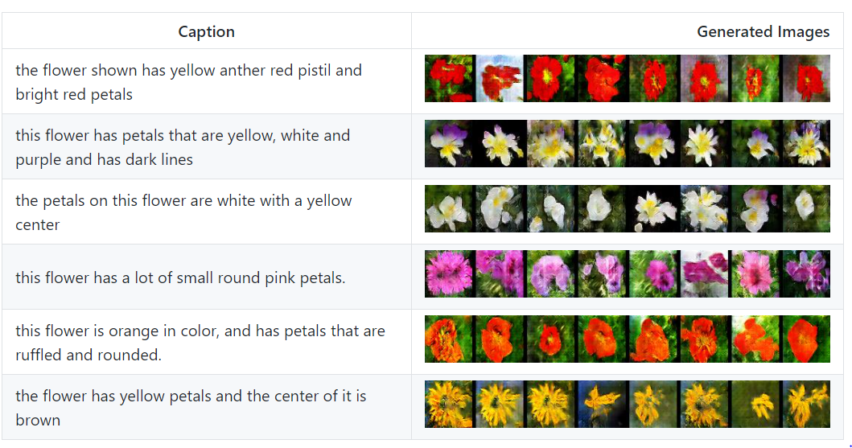
Output

Slide 9
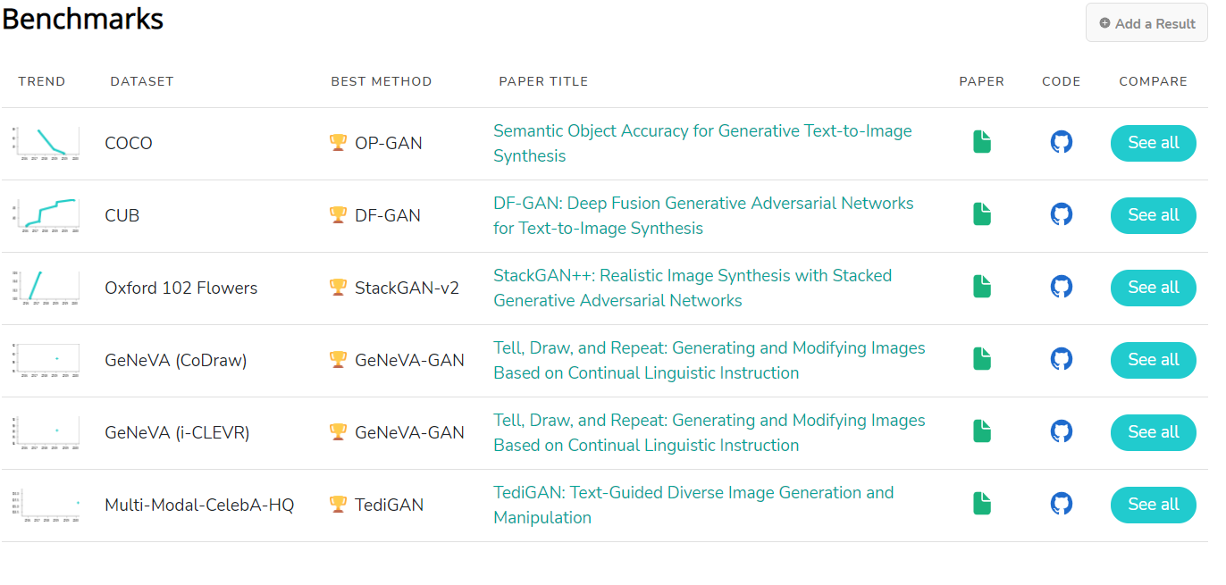

Slide 10
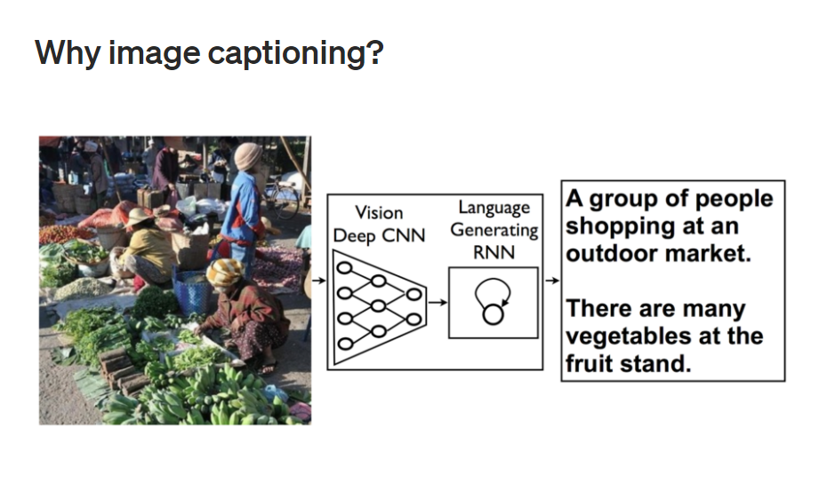

Slide 11

How

Slide 12
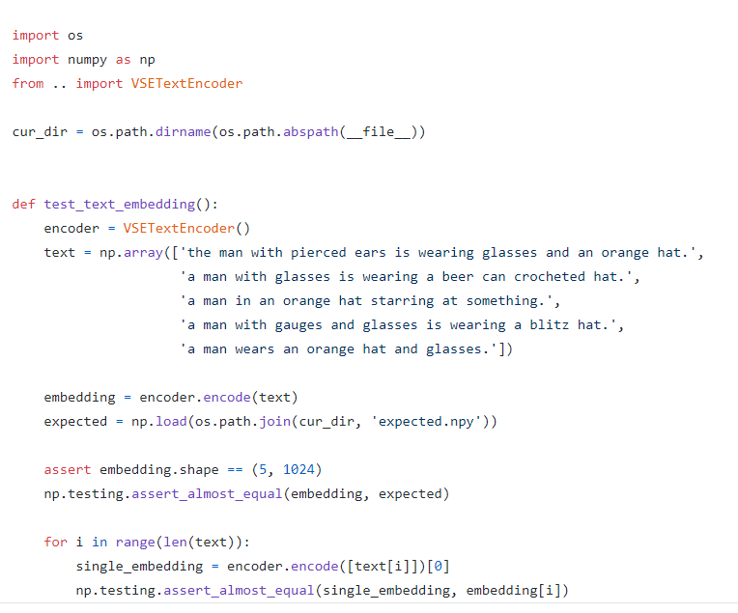
VStextEncoder

Slide 13
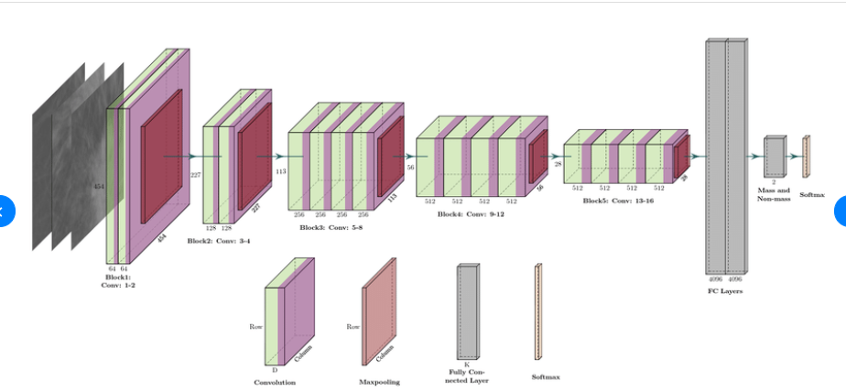
VGG 19

Slide 14
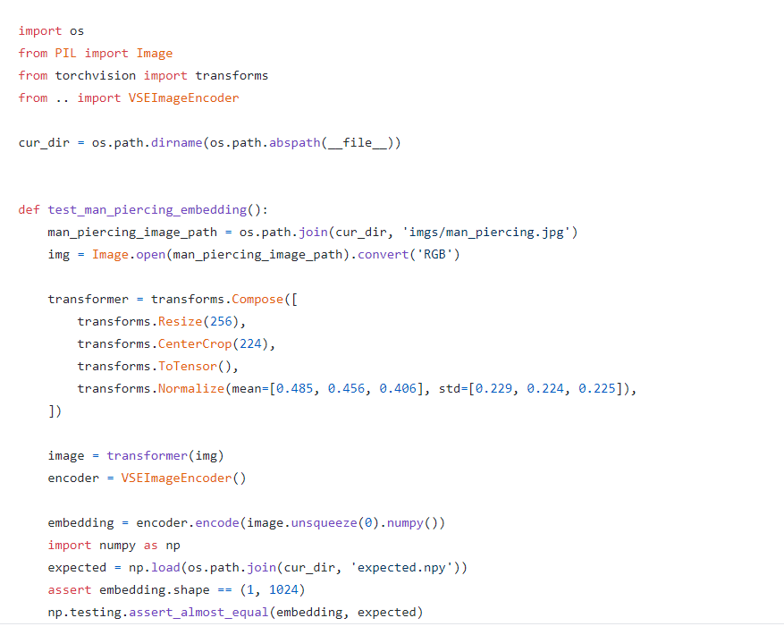
VSE Image Encoder

Slide 15
Reference link
https://github.com/paarthneekhara/text-to-image
https://github.com/zsdonghao/text-to-image

