Slide 1
Parallel & Distributed Computing — Final Project
Triangle-inequality K-means
Gap 1: OpenMP scheduling
Gap 2: Dimensionality
Mohammad Rohaan (22I-2327) · Ali Bin Salman (22I-0894)
Base paper: Kwedlo & Czochanski, IEEE Access 2019

Slide 2
Deliverables & artifacts (repo root)
Written report: PDC_Kmeans_Final_Report.docx → export PDF (build_final_report_docx.py).
This deck: PDC_Kmeans_Presentation.pptx (build_presentation.py).
Figures under experiments/figures/ — regenerate with plot_pdc_figures.py after logs change.

Slide 3
Problem & motivation
K-means: alternate assignment (nearest centroid) and update (means).
Lloyd’s assignment is O(N·K·M) per iteration — dominant cost at large N, K.
Triangle-inequality methods (e.g. Elkan) skip many distance evaluations.
Base paper: hybrid MPI/OpenMP implementations on a cluster; scheduling matters.

Slide 4
Base paper
Kwedlo & Czochanski — hybrid MPI/OpenMP for Lloyd + Elkan, Annulus, Drake, Yinyang.
Data-parallel assignment; all-reduce for centroid updates.
Compared static vs guided OpenMP on large-scale hardware.
Our work: same codebase, workstation / WSL, two focused gaps.

Slide 5
Project scope — two gaps
1) Gap 1: Static-oriented build vs guided build (DYNAMIC=y) for Elkan.
01
Vary OMP_NUM_THREADS on one medium dataset (e.g. N=200k, M=128, K=256).
2) Gap 2: Vary feature dimension M on synthetic .bin data (N=100k, K=256, T=8).
02
Track Avg distance calculations ratio and naive vs Elkan runtime.
Out of scope: multi-node MPI, GPU, modifying authors’ core C++.

Slide 6
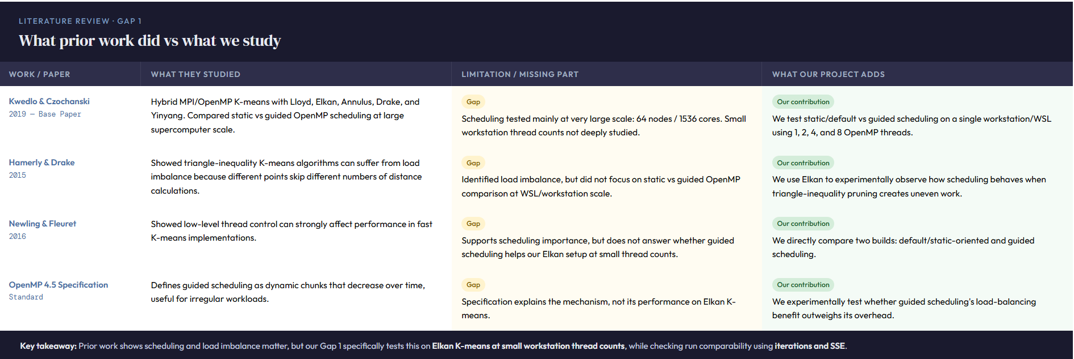
Gap 1

Slide 7
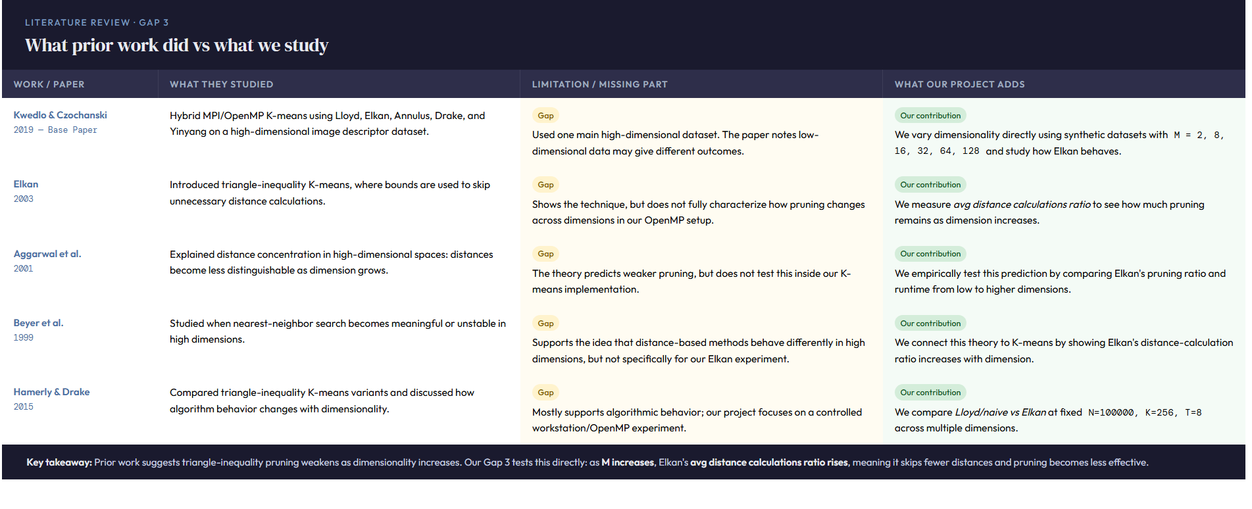
Gap 2

Slide 8
Methodology
Upstream: hybrid-triangle-kmeans (Bitbucket), fixed commit.
No edits to Clust/*.cpp — two binaries from Makefile flags only:
• make kmeans OPT=y OPENMP=y → kmeans_static_gap1
• make kmeans OPT=y OPENMP=y DYNAMIC=y → kmeans_guided_gap1
Metrics from program output: k-means execution time, iterations, SSE, ratio.
Pairing script: parse_gap1_log.py flags OK vs DIFF_PATH (iter/SSE mismatch).

Slide 9
Experimental setup
Environment: WSL Ubuntu, g++, OpenMP (-fopenmp).
K-means: Forgy init, -r 42, -R 1e-4, -a naive or -a elkan.
Gap 1 log: gap1_medium_runs.txt → gap1_parsed_summary.txt
Gap 3 log: gap3_runs.txt (run_gap3_matrix.sh)
Figures: plot_pdc_figures.py → experiments/figures/

Slide 10

Live demo (what we can show)
1) Show dataset binary format (optional: ls -lh experiments/data_gap3/).
2) One short run: kmeans_static_gap1 <file.bin> -a elkan -c 256 -r 42 -R 1e-4
3) Point to k-means execution time + Avg distance calculations ratio in stdout.
4) Optional: same command with kmeans_guided_gap1 for contrast.

Slide 11
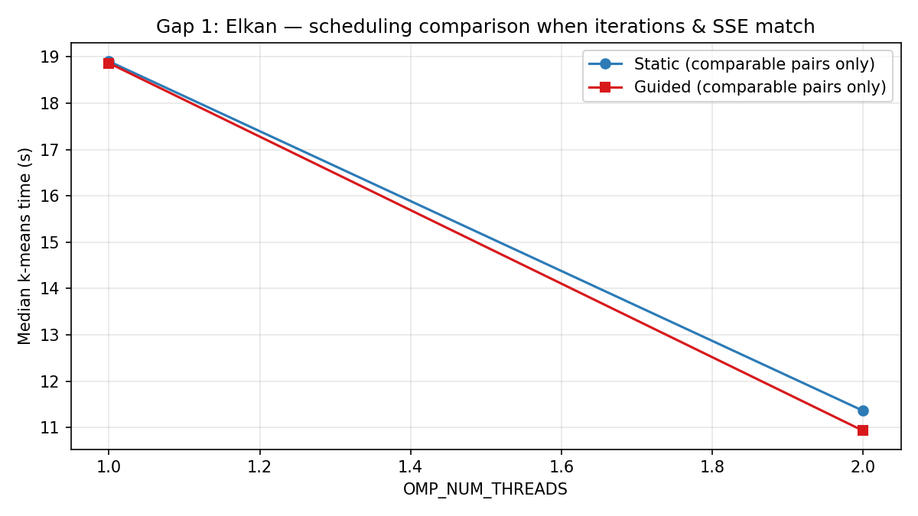
Gap 1 — Comparable pairs (median time)

Slide 12
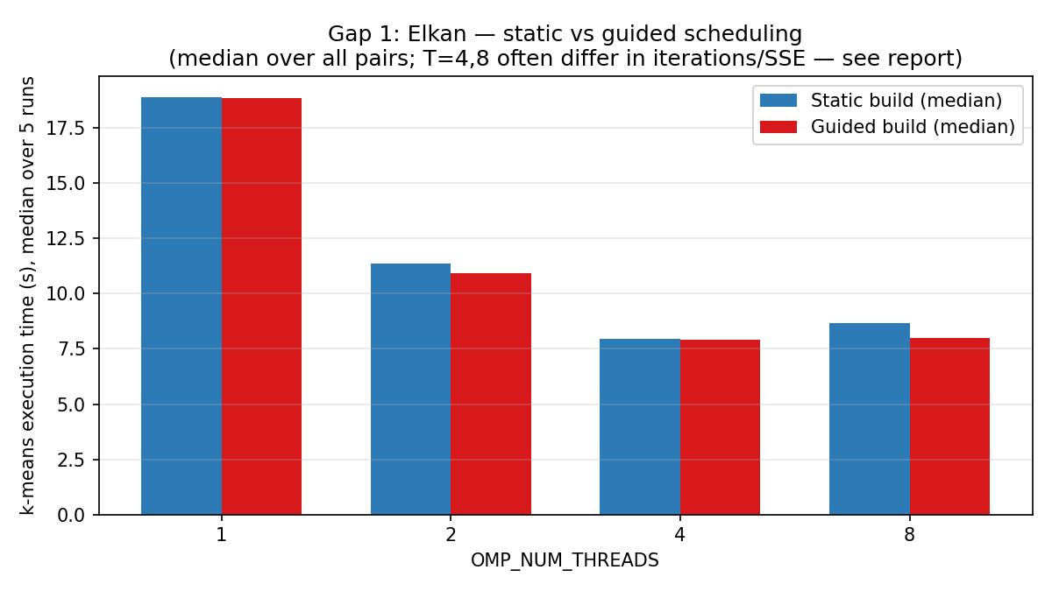
Gap 1 — All runs median (includes non-comparable T=4,8)

Slide 13
Gap 1 — Interpretation
T = 1,2: pairs usually OK — guided can be slightly faster (load balance).
T = 4,8: often DIFF_PATH — different iterations/SSE between builds.
Cause: parallel float reductions + schedule change trajectory (not a bug).
Fair comparison only when iterations and SSE align.

Slide 14
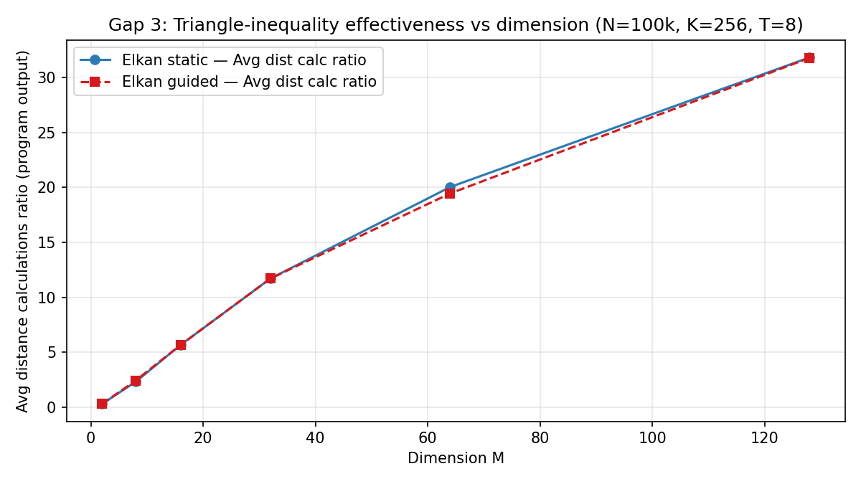
Gap 2 — Pruning vs dimension M

Slide 15
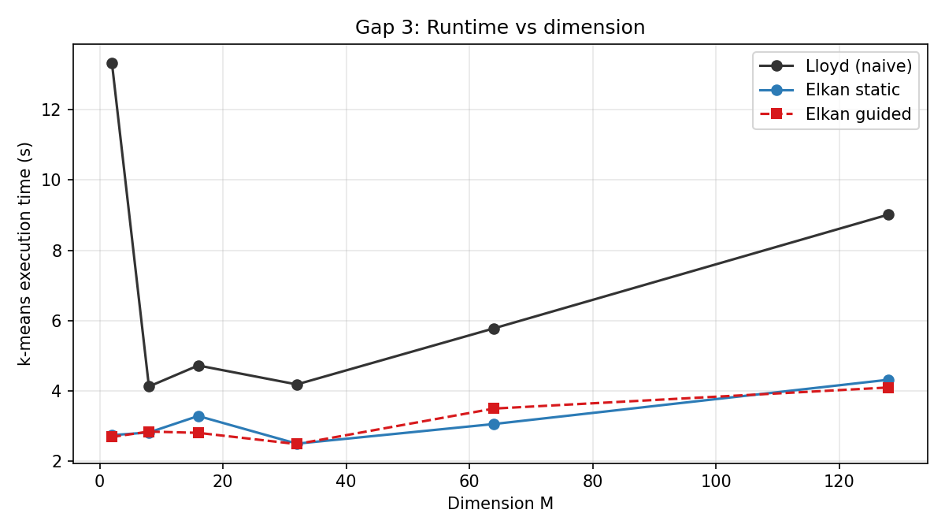
Gap 2 — Time vs dimension M

Slide 16
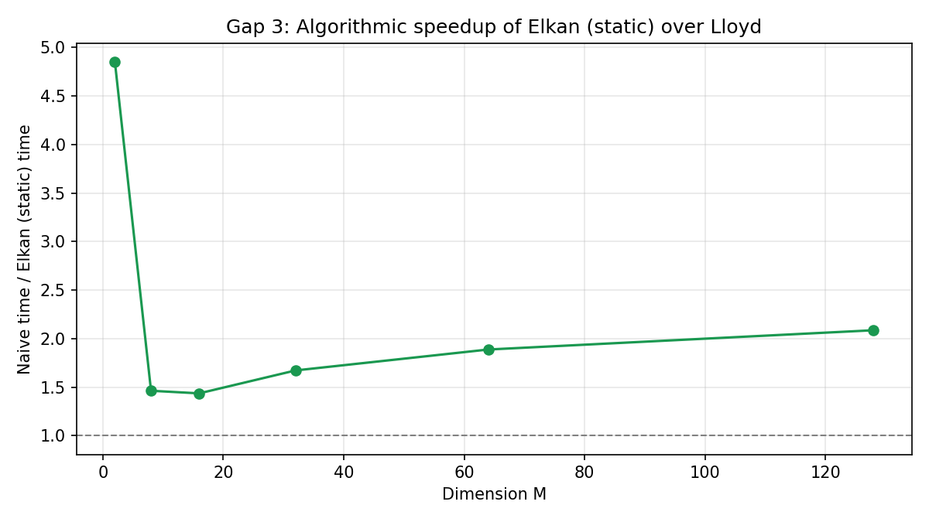
Gap 2 — Speedup: naive / Elkan (static)

Slide 17
Gap 2 — Interpretation
Avg distance calculations ratio rises with M → weaker triangle-inequality pruning.
Elkan vs naive speedup shrinks as M grows (uniform synthetic data).
Limitation: i.i.d. uniform is not clustered geometry; trend still illustrates high-D behavior.

Slide 18
Limitations & reproducibility
WSL timing noise; some runs show odd thread-clock vs wall-clock lines.
Gap 2: single run per (M, algorithm) in our matrix — medians would be stronger.
Synthetic data only; not the paper’s Tiny Images sample.
README + commit hash + scripts to regenerate logs and figures.

Slide 19

Conclusion
Scheduling effects on Elkan are thread- and comparability-dependent.
Dimensionality strongly affects pruning effectiveness (ratio) and Elkan advantage.
Future: repeated trials, clustered synthetic data, deterministic reductions, MPI scale.

Slide 20
LLM / AI assistance (course disclosure)
Used for: experiment planning, Makefile/flag explanation, scripts, report/slide structure.
All runs executed locally; results verified (iterations, SSE) where applicable.
Group members understand code paths, metrics, and plots.

Slide 21
Thank you — Questions?

