Slide 1



blinkit Data Analysis using PowerBI
View in Power BI
Developed by: Rohan Raj
Last data refresh:
18/08/2024 20:10:56 UTC
Downloaded at:
19/08/2024 06:50:33 UTC

Slide 2
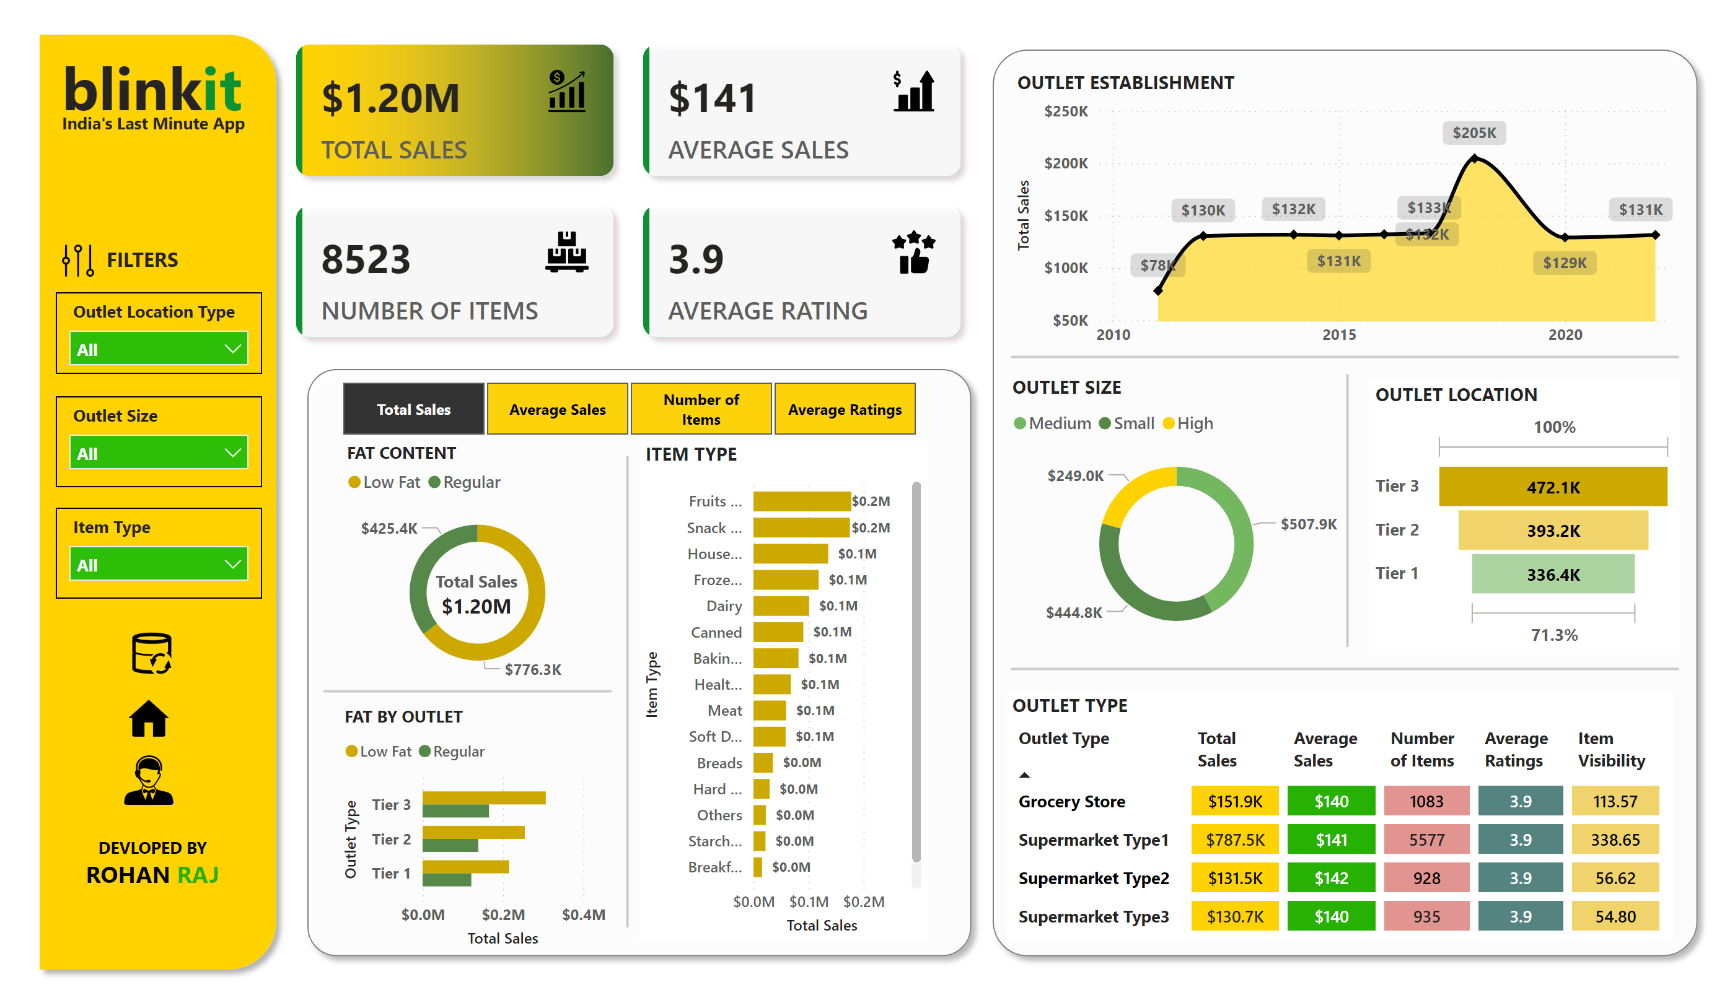
Page 1
Notes:
shape
No alt text provided
textbox
No alt text provided
textbox
No alt text provided
RE
No alt text provided
cardVisual
No alt text provided
shape
No alt text provided
slicer
No alt text provided
FAT CONTENT
No alt text provided
cardVisual
No alt text provided
FAT BY OUTLET
No alt text provided
shape
No alt text provided
shape
No alt text provided
ITEM TYPE
No alt text provided
shape
No alt text provided
OUTLET ESTABLISHMENT
No alt text provided
shape
No alt text provided
OUTLET SIZE
No alt text provided
shape
No alt text provided
shape
No alt text provided
OUTLET LOCATION
No alt text provided
OUTLET TYPE
No alt text provided
slicer
No alt text provided
slicer
No alt text provided
slicer
No alt text provided
textbox
No alt text provided
image
No alt text provided
image
No alt text provided
image
No alt text provided
textbox
No alt text provided

