Slide 1

Sentiment Analysis using Multi-Class Classification
Team 5--The Loiter Squad
Rohan Agarwal, Aliyah Lee, Tyler Mount, Sarah Stumbras, Nathan Wang
IEMS 393-1 Prof. Werwath
January 12, 2015

Slide 2








Creating a multi-class classification model for sentiment analysis requires multiple steps
Exploring, visualizing, and processing the data helps us to better understand the data
Human emotion/sentiment can be complex, requiring large datasets and advanced models to understand
Through these methods we can create the best possible solution method and post-process our results
The sheer amount of data initially can be overwhelming
Researching various solution methods helps us identify starting points
Identifying “stupid” models helps us come up with initial solutions
Notes:
2. Value Proposition (Quantified)
Market:
General Market: Sports; Health & Wellness
Specific Market: Pick-Up Sports for members of a college campus
The market currently lacks an easy, quick, reliable way to organize pick-up games. There are other applications that exist but target larger communities such as cities, or target other forms of exercise such as working out specifically
The Need for The Application:
There has to be an increase in pick-up sports on college campuses to raise the level of exercise and improve health and wellness amongst students. The decrease in pickup sports is a big reason for decline in youth’s phyiscal activity (source: https://books.google.com/books?id=SaY5Q79HLvsC&pg=PA41&lpg=PA41&dq=pickup+sports+statistics&source=bl&ots=cV6mc4Yadv&sig=N6DgYg98gHkkgKvvsD7_uJCzaIs&hl=en&sa=X&ved=0CFUQ6AEwDTgKahUKEwiU8I2dudTIAhUI0YAKHd63DFY#v=onepage&q=pickup%20sports%20statistics&f=false)
Our application’s value proposition (why are we better than other applications out there?):
Provides virtual game rooms to join that translate to real ones at the time of the game. These could be spontaneous (app sends you unfilled games going on or about to happen when you open it up), unlike other applications that try to make it too structured.
Makes use of free locations on campus that members of the campus already have access to. Further decreases barrier to entry to start and join games.
Focusing solely on a college campus allows the application to obtain support from school resources, e.g. Northwestern Athletics (look in “History of Recreational Sports” in article: “The Relationship of Participation in Recreational Sports with Retention Rates and Academic Success of First-Year College Students “)
Members in a college campus are already inherently in a community. Other applications try to target and build a sense of community, however, their target market is too broad. There is already a shared trust on college campuses as compared to big cities or neighborhoods.
Application integrates both location and people to play with
Quantifying the value proposition:
http://www.exerciseismedicine.org/support_page.php?p=17
Exercise has been positively correlated with obtaining better grades in college: http://www.nationalforum.com/Electronic%20Journal%20Volumes/Mull,%20Haley%20Physical%20Activity%20and%20Academic%20Success%20FOCUS%20V8%20N1%202014.pdf
https://conservancy.umn.edu/bitstream/handle/11299/47779/Windschitl_umn_0130E_10112.pdf?sequence=1
Pickup sports provides more motivation to workout
Time reduced in organizing a game in using open court.
Reasons why a competitor application did not work:
https://www.quora.com/Is-there-a-need-for-a-better-way-to-organize-pickup-sports
http://stewartmccoy.com/playmakers-pickup-sports-app/

Slide 3
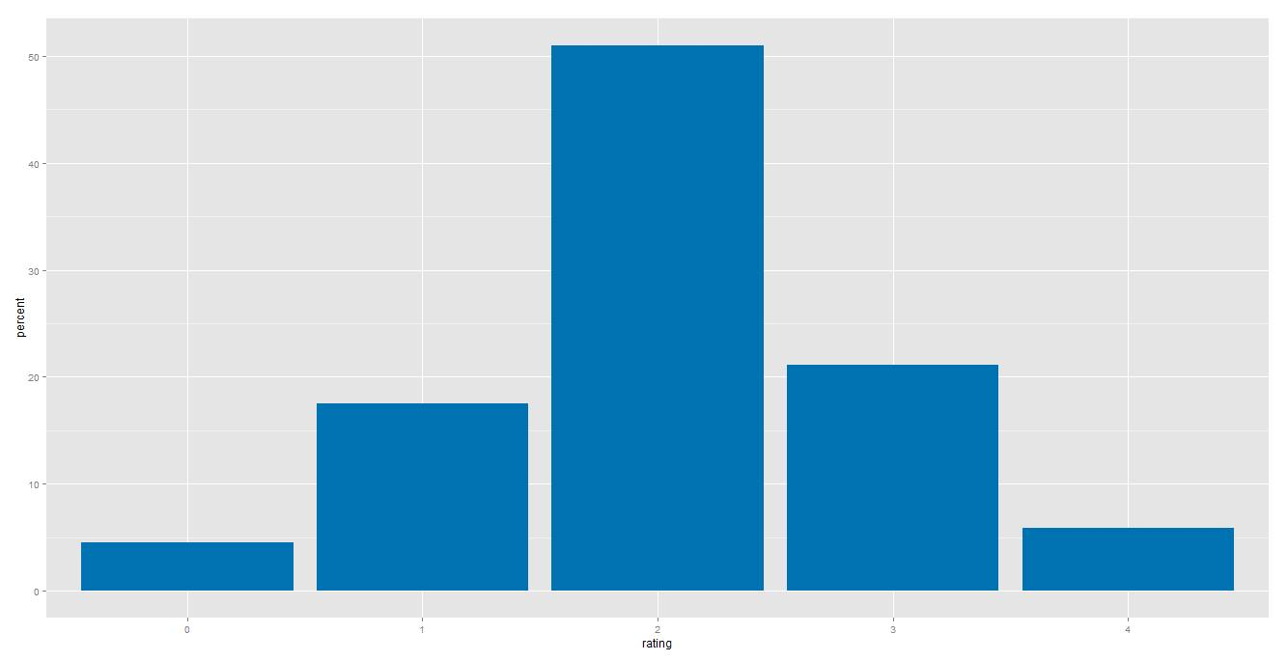
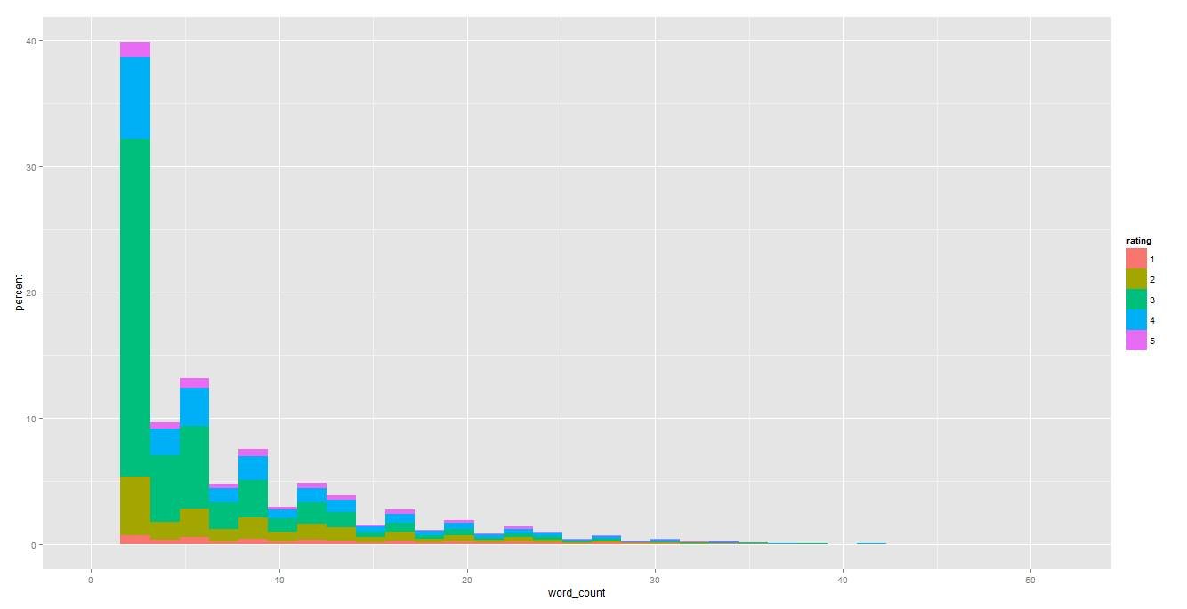
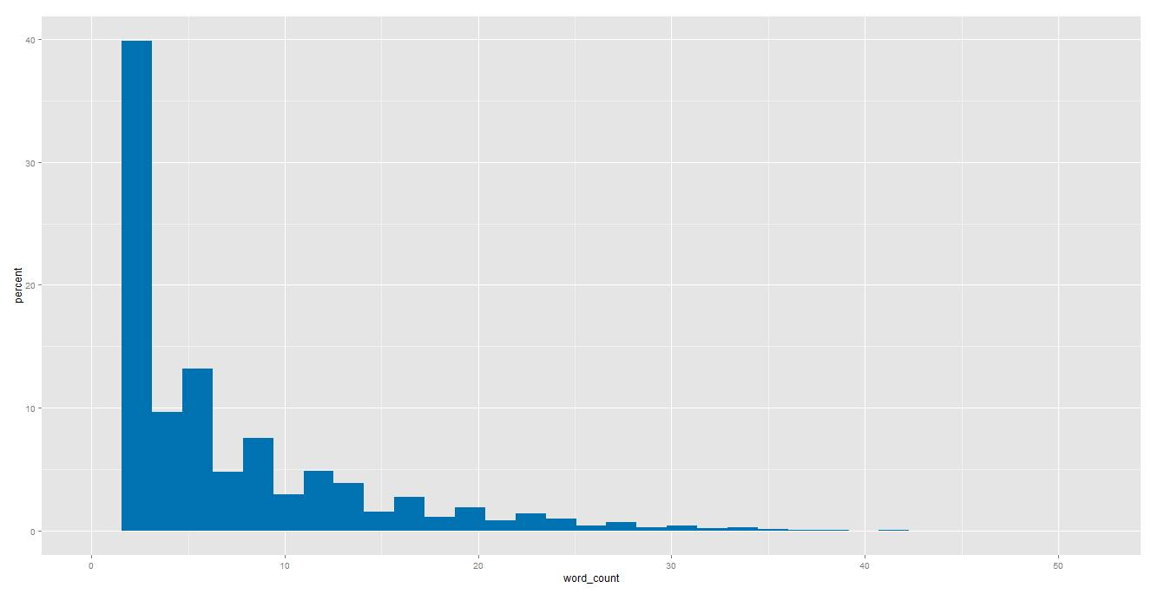
Initial data processing and exploration reveals interesting findings in the data
We find that sentiment scores have an approximately normal distribution with mean 2
This leads to the finding that increased word count is an indicator of sentiment that is deviant from the mean
More words represent a stronger opinion, positive or negative.
As word count increases there are fewer 2 ratings and a higher proportion of 4 or 0 ratings
Additionally, over 75% of comments have a word count under 10

Slide 4


Through research we discovered a key feature of a successful solution model: Hu and Liu sentiment lexicon*
Identify set of opinion adjectives using NLP method
Classify each opinion as positive or negative through a bootstrapping technique using the adjective synonym and antonym sets in Wordnet
Determine overall sentiment using their Sentence Orientation algorithm
Source: “Mining and Summarizing Customer Reviews “ Hu and Liu
Notes:
2. Value Proposition (Quantified)
Market:
General Market: Sports; Health & Wellness
Specific Market: Pick-Up Sports for members of a college campus
The market currently lacks an easy, quick, reliable way to organize pick-up games. There are other applications that exist but target larger communities such as cities, or target other forms of exercise such as working out specifically
The Need for The Application:
There has to be an increase in pick-up sports on college campuses to raise the level of exercise and improve health and wellness amongst students. The decrease in pickup sports is a big reason for decline in youth’s phyiscal activity (source: https://books.google.com/books?id=SaY5Q79HLvsC&pg=PA41&lpg=PA41&dq=pickup+sports+statistics&source=bl&ots=cV6mc4Yadv&sig=N6DgYg98gHkkgKvvsD7_uJCzaIs&hl=en&sa=X&ved=0CFUQ6AEwDTgKahUKEwiU8I2dudTIAhUI0YAKHd63DFY#v=onepage&q=pickup%20sports%20statistics&f=false)
Our application’s value proposition (why are we better than other applications out there?):
Provides virtual game rooms to join that translate to real ones at the time of the game. These could be spontaneous (app sends you unfilled games going on or about to happen when you open it up), unlike other applications that try to make it too structured.
Makes use of free locations on campus that members of the campus already have access to. Further decreases barrier to entry to start and join games.
Focusing solely on a college campus allows the application to obtain support from school resources, e.g. Northwestern Athletics (look in “History of Recreational Sports” in article: “The Relationship of Participation in Recreational Sports with Retention Rates and Academic Success of First-Year College Students “)
Members in a college campus are already inherently in a community. Other applications try to target and build a sense of community, however, their target market is too broad. There is already a shared trust on college campuses as compared to big cities or neighborhoods.
Application integrates both location and people to play with
Quantifying the value proposition:
http://www.exerciseismedicine.org/support_page.php?p=17
Exercise has been positively correlated with obtaining better grades in college: http://www.nationalforum.com/Electronic%20Journal%20Volumes/Mull,%20Haley%20Physical%20Activity%20and%20Academic%20Success%20FOCUS%20V8%20N1%202014.pdf
https://conservancy.umn.edu/bitstream/handle/11299/47779/Windschitl_umn_0130E_10112.pdf?sequence=1
Pickup sports provides more motivation to workout
Time reduced in organizing a game in using open court.
Reasons why a competitor application did not work:
https://www.quora.com/Is-there-a-need-for-a-better-way-to-organize-pickup-sports
http://stewartmccoy.com/playmakers-pickup-sports-app/

Slide 5




Initially, we identified 4 key features of a successful solution model
Hu and Liu Sentiment Lexicon
Uses adjectives to classify each opinion as positive or negative
Word Count
Through our initial observations, we determined that a larger word count corresponds with a stronger opinion.
Grammatical Structure
Intuitively predicted that underlying grammatical structures may serve as a strong predictor for the opinion of reviews
Document Term Matrix
Created a matrix of all words used in the reviews and then parsed it in three different ways,
Problem: Using these features led to an accuracy of approximately 55%. We wanted it to be higher.
Notes:
2. Value Proposition (Quantified)
Market:
General Market: Sports; Health & Wellness
Specific Market: Pick-Up Sports for members of a college campus
The market currently lacks an easy, quick, reliable way to organize pick-up games. There are other applications that exist but target larger communities such as cities, or target other forms of exercise such as working out specifically
The Need for The Application:
There has to be an increase in pick-up sports on college campuses to raise the level of exercise and improve health and wellness amongst students. The decrease in pickup sports is a big reason for decline in youth’s phyiscal activity (source: https://books.google.com/books?id=SaY5Q79HLvsC&pg=PA41&lpg=PA41&dq=pickup+sports+statistics&source=bl&ots=cV6mc4Yadv&sig=N6DgYg98gHkkgKvvsD7_uJCzaIs&hl=en&sa=X&ved=0CFUQ6AEwDTgKahUKEwiU8I2dudTIAhUI0YAKHd63DFY#v=onepage&q=pickup%20sports%20statistics&f=false)
Our application’s value proposition (why are we better than other applications out there?):
Provides virtual game rooms to join that translate to real ones at the time of the game. These could be spontaneous (app sends you unfilled games going on or about to happen when you open it up), unlike other applications that try to make it too structured.
Makes use of free locations on campus that members of the campus already have access to. Further decreases barrier to entry to start and join games.
Focusing solely on a college campus allows the application to obtain support from school resources, e.g. Northwestern Athletics (look in “History of Recreational Sports” in article: “The Relationship of Participation in Recreational Sports with Retention Rates and Academic Success of First-Year College Students “)
Members in a college campus are already inherently in a community. Other applications try to target and build a sense of community, however, their target market is too broad. There is already a shared trust on college campuses as compared to big cities or neighborhoods.
Application integrates both location and people to play with
Quantifying the value proposition:
http://www.exerciseismedicine.org/support_page.php?p=17
Exercise has been positively correlated with obtaining better grades in college: http://www.nationalforum.com/Electronic%20Journal%20Volumes/Mull,%20Haley%20Physical%20Activity%20and%20Academic%20Success%20FOCUS%20V8%20N1%202014.pdf
https://conservancy.umn.edu/bitstream/handle/11299/47779/Windschitl_umn_0130E_10112.pdf?sequence=1
Pickup sports provides more motivation to workout
Time reduced in organizing a game in using open court.
Reasons why a competitor application did not work:
https://www.quora.com/Is-there-a-need-for-a-better-way-to-organize-pickup-sports
http://stewartmccoy.com/playmakers-pickup-sports-app/

Slide 6



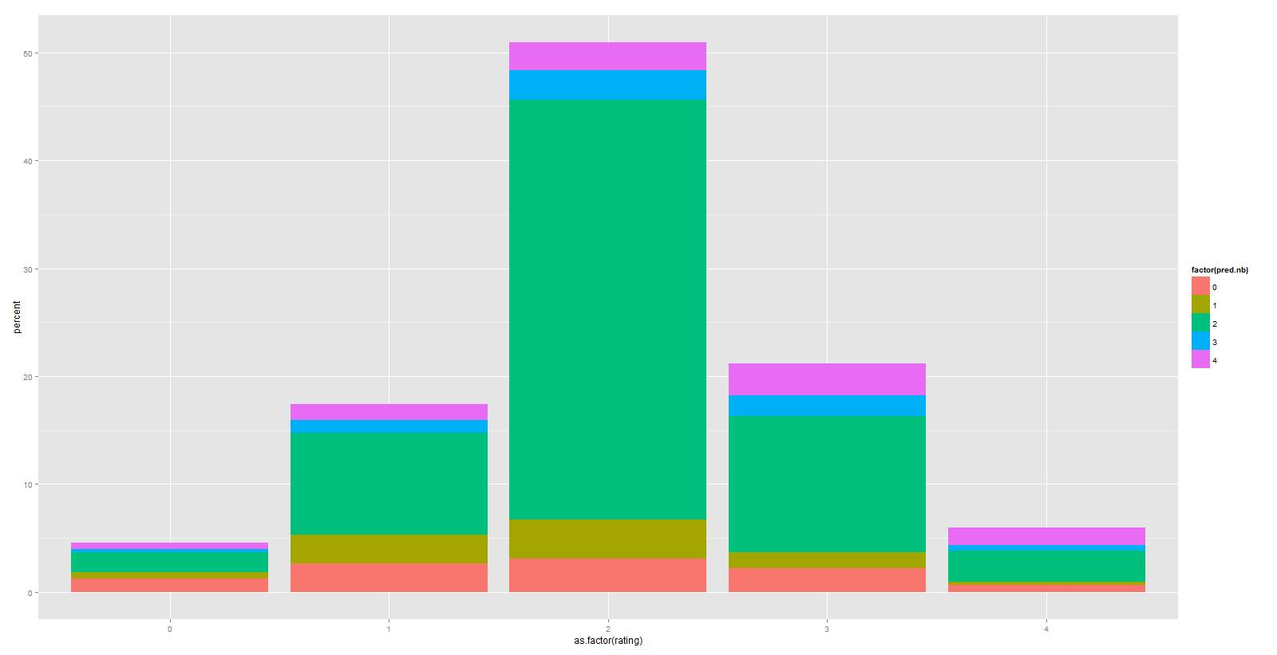
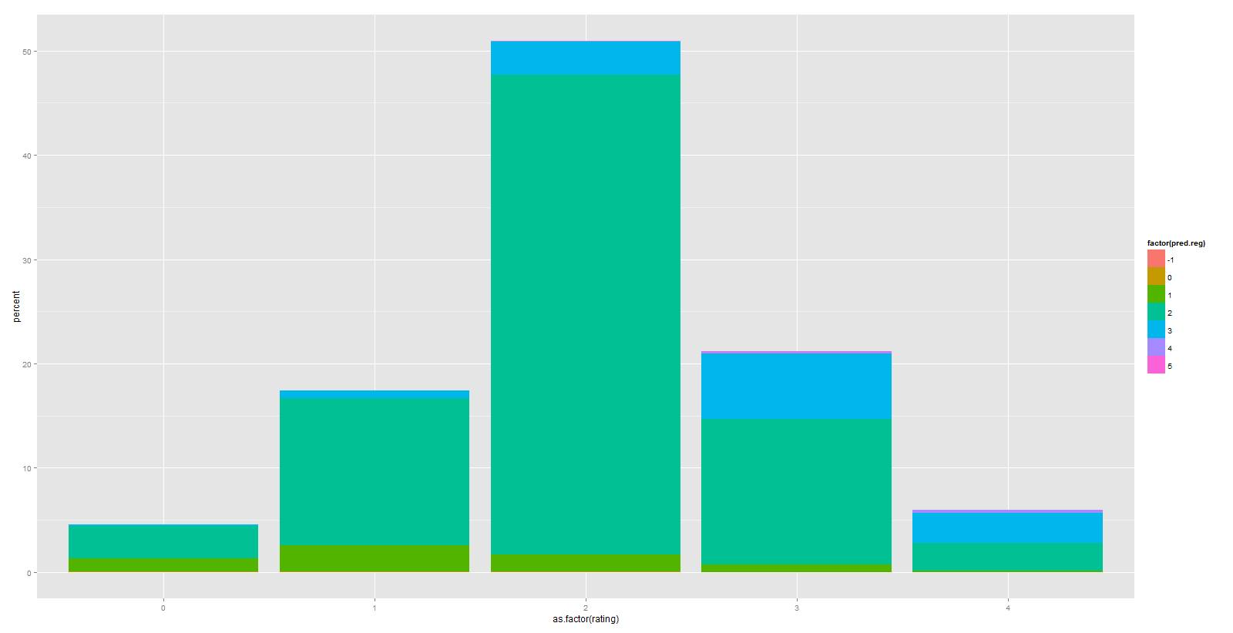
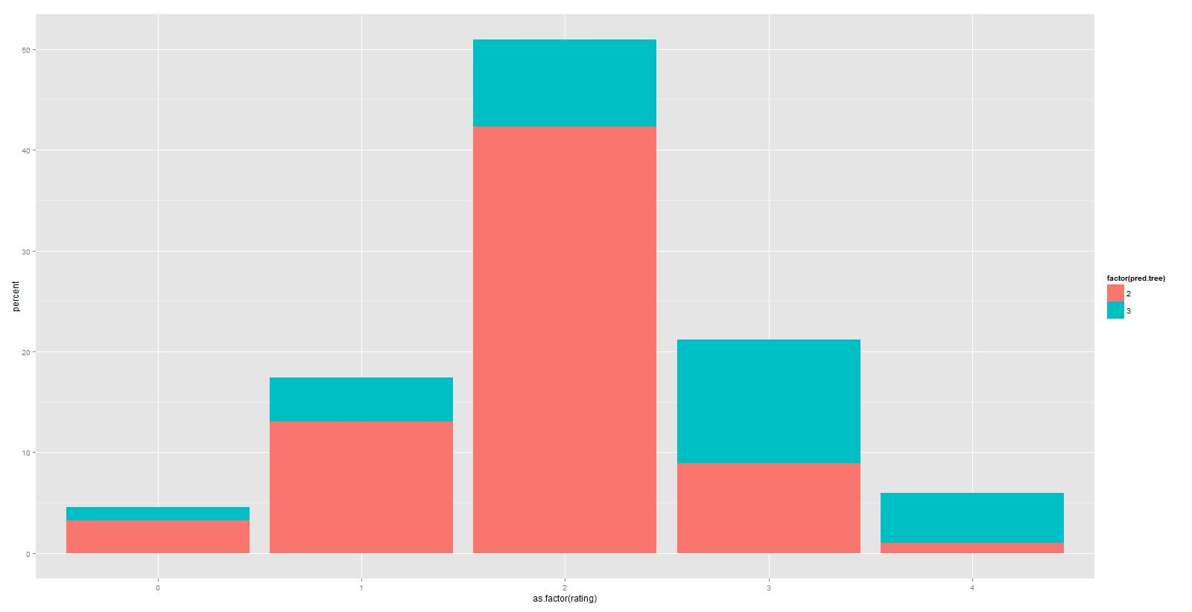
We identified several “stupid” solution methods to generate initial results, with a baseline accuracy of 50%
Naïve Bayes
Regression
Decision Tree
Wider distribution of predictions but lower accuracy (46%)
High accuracy (55%) but mostly just guessing 2 ratings
Too simple - only predicts 2 or 3 and low accuracy (46%)
Notes:
2. Value Proposition (Quantified)
Market:
General Market: Sports; Health & Wellness
Specific Market: Pick-Up Sports for members of a college campus
The market currently lacks an easy, quick, reliable way to organize pick-up games. There are other applications that exist but target larger communities such as cities, or target other forms of exercise such as working out specifically
The Need for The Application:
There has to be an increase in pick-up sports on college campuses to raise the level of exercise and improve health and wellness amongst students. The decrease in pickup sports is a big reason for decline in youth’s phyiscal activity (source: https://books.google.com/books?id=SaY5Q79HLvsC&pg=PA41&lpg=PA41&dq=pickup+sports+statistics&source=bl&ots=cV6mc4Yadv&sig=N6DgYg98gHkkgKvvsD7_uJCzaIs&hl=en&sa=X&ved=0CFUQ6AEwDTgKahUKEwiU8I2dudTIAhUI0YAKHd63DFY#v=onepage&q=pickup%20sports%20statistics&f=false)
Our application’s value proposition (why are we better than other applications out there?):
Provides virtual game rooms to join that translate to real ones at the time of the game. These could be spontaneous (app sends you unfilled games going on or about to happen when you open it up), unlike other applications that try to make it too structured.
Makes use of free locations on campus that members of the campus already have access to. Further decreases barrier to entry to start and join games.
Focusing solely on a college campus allows the application to obtain support from school resources, e.g. Northwestern Athletics (look in “History of Recreational Sports” in article: “The Relationship of Participation in Recreational Sports with Retention Rates and Academic Success of First-Year College Students “)
Members in a college campus are already inherently in a community. Other applications try to target and build a sense of community, however, their target market is too broad. There is already a shared trust on college campuses as compared to big cities or neighborhoods.
Application integrates both location and people to play with
Quantifying the value proposition:
http://www.exerciseismedicine.org/support_page.php?p=17
Exercise has been positively correlated with obtaining better grades in college: http://www.nationalforum.com/Electronic%20Journal%20Volumes/Mull,%20Haley%20Physical%20Activity%20and%20Academic%20Success%20FOCUS%20V8%20N1%202014.pdf
https://conservancy.umn.edu/bitstream/handle/11299/47779/Windschitl_umn_0130E_10112.pdf?sequence=1
Pickup sports provides more motivation to workout
Time reduced in organizing a game in using open court.
Reasons why a competitor application did not work:
https://www.quora.com/Is-there-a-need-for-a-better-way-to-organize-pickup-sports
http://stewartmccoy.com/playmakers-pickup-sports-app/

Slide 7



After more research, we realized that latent dirichlet allocation (LDA) is an extremely important feature to include
LDA allows us to break down reviews and create additional predictors by…
Automatically group words into topics
Expressing each review as a combination of different topics
Using the composition as additional predictors in our model
Notes:
2. Value Proposition (Quantified)
Market:
General Market: Sports; Health & Wellness
Specific Market: Pick-Up Sports for members of a college campus
The market currently lacks an easy, quick, reliable way to organize pick-up games. There are other applications that exist but target larger communities such as cities, or target other forms of exercise such as working out specifically
The Need for The Application:
There has to be an increase in pick-up sports on college campuses to raise the level of exercise and improve health and wellness amongst students. The decrease in pickup sports is a big reason for decline in youth’s phyiscal activity (source: https://books.google.com/books?id=SaY5Q79HLvsC&pg=PA41&lpg=PA41&dq=pickup+sports+statistics&source=bl&ots=cV6mc4Yadv&sig=N6DgYg98gHkkgKvvsD7_uJCzaIs&hl=en&sa=X&ved=0CFUQ6AEwDTgKahUKEwiU8I2dudTIAhUI0YAKHd63DFY#v=onepage&q=pickup%20sports%20statistics&f=false)
Our application’s value proposition (why are we better than other applications out there?):
Provides virtual game rooms to join that translate to real ones at the time of the game. These could be spontaneous (app sends you unfilled games going on or about to happen when you open it up), unlike other applications that try to make it too structured.
Makes use of free locations on campus that members of the campus already have access to. Further decreases barrier to entry to start and join games.
Focusing solely on a college campus allows the application to obtain support from school resources, e.g. Northwestern Athletics (look in “History of Recreational Sports” in article: “The Relationship of Participation in Recreational Sports with Retention Rates and Academic Success of First-Year College Students “)
Members in a college campus are already inherently in a community. Other applications try to target and build a sense of community, however, their target market is too broad. There is already a shared trust on college campuses as compared to big cities or neighborhoods.
Application integrates both location and people to play with
Quantifying the value proposition:
http://www.exerciseismedicine.org/support_page.php?p=17
Exercise has been positively correlated with obtaining better grades in college: http://www.nationalforum.com/Electronic%20Journal%20Volumes/Mull,%20Haley%20Physical%20Activity%20and%20Academic%20Success%20FOCUS%20V8%20N1%202014.pdf
https://conservancy.umn.edu/bitstream/handle/11299/47779/Windschitl_umn_0130E_10112.pdf?sequence=1
Pickup sports provides more motivation to workout
Time reduced in organizing a game in using open court.
Reasons why a competitor application did not work:
https://www.quora.com/Is-there-a-need-for-a-better-way-to-organize-pickup-sports
http://stewartmccoy.com/playmakers-pickup-sports-app/

Slide 8


Ultimately, we identified the following features to include in our final model
Latent Dirichlet Allocation (LDA) to break down ratings into topics
Specific Predictors for high frequency positive/negative words
Scaling all factors by word count
Tags for various parts of speech
Notes:
2. Value Proposition (Quantified)
Market:
General Market: Sports; Health & Wellness
Specific Market: Pick-Up Sports for members of a college campus
The market currently lacks an easy, quick, reliable way to organize pick-up games. There are other applications that exist but target larger communities such as cities, or target other forms of exercise such as working out specifically
The Need for The Application:
There has to be an increase in pick-up sports on college campuses to raise the level of exercise and improve health and wellness amongst students. The decrease in pickup sports is a big reason for decline in youth’s phyiscal activity (source: https://books.google.com/books?id=SaY5Q79HLvsC&pg=PA41&lpg=PA41&dq=pickup+sports+statistics&source=bl&ots=cV6mc4Yadv&sig=N6DgYg98gHkkgKvvsD7_uJCzaIs&hl=en&sa=X&ved=0CFUQ6AEwDTgKahUKEwiU8I2dudTIAhUI0YAKHd63DFY#v=onepage&q=pickup%20sports%20statistics&f=false)
Our application’s value proposition (why are we better than other applications out there?):
Provides virtual game rooms to join that translate to real ones at the time of the game. These could be spontaneous (app sends you unfilled games going on or about to happen when you open it up), unlike other applications that try to make it too structured.
Makes use of free locations on campus that members of the campus already have access to. Further decreases barrier to entry to start and join games.
Focusing solely on a college campus allows the application to obtain support from school resources, e.g. Northwestern Athletics (look in “History of Recreational Sports” in article: “The Relationship of Participation in Recreational Sports with Retention Rates and Academic Success of First-Year College Students “)
Members in a college campus are already inherently in a community. Other applications try to target and build a sense of community, however, their target market is too broad. There is already a shared trust on college campuses as compared to big cities or neighborhoods.
Application integrates both location and people to play with
Quantifying the value proposition:
http://www.exerciseismedicine.org/support_page.php?p=17
Exercise has been positively correlated with obtaining better grades in college: http://www.nationalforum.com/Electronic%20Journal%20Volumes/Mull,%20Haley%20Physical%20Activity%20and%20Academic%20Success%20FOCUS%20V8%20N1%202014.pdf
https://conservancy.umn.edu/bitstream/handle/11299/47779/Windschitl_umn_0130E_10112.pdf?sequence=1
Pickup sports provides more motivation to workout
Time reduced in organizing a game in using open court.
Reasons why a competitor application did not work:
https://www.quora.com/Is-there-a-need-for-a-better-way-to-organize-pickup-sports
http://stewartmccoy.com/playmakers-pickup-sports-app/

Slide 9
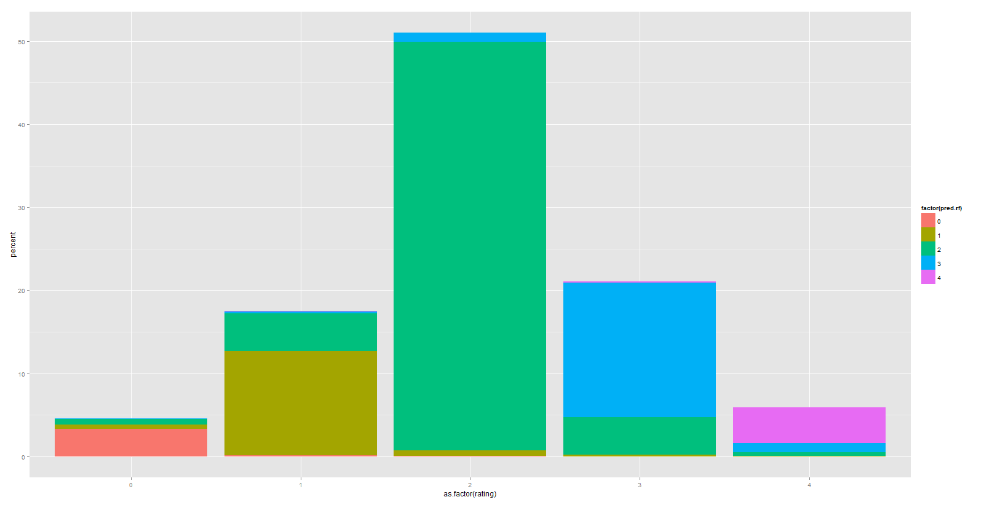
Based on our research and initial testing, we created a Random Forest model for our final solution.
We chose a random forest because it can handle both class imbalances and multi-class classifications and is the easiest to train and generally most accurate
Clearly, there is a better distribution of predictors with higher proportions in the right areas
We were able to obtain 85% accuracy with the model
Initially, we wanted to use other models but chose instead to focus on a robust model with more feature engineering.
Notes:
2. Value Proposition (Quantified)
Market:
General Market: Sports; Health & Wellness
Specific Market: Pick-Up Sports for members of a college campus
The market currently lacks an easy, quick, reliable way to organize pick-up games. There are other applications that exist but target larger communities such as cities, or target other forms of exercise such as working out specifically
The Need for The Application:
There has to be an increase in pick-up sports on college campuses to raise the level of exercise and improve health and wellness amongst students. The decrease in pickup sports is a big reason for decline in youth’s phyiscal activity (source: https://books.google.com/books?id=SaY5Q79HLvsC&pg=PA41&lpg=PA41&dq=pickup+sports+statistics&source=bl&ots=cV6mc4Yadv&sig=N6DgYg98gHkkgKvvsD7_uJCzaIs&hl=en&sa=X&ved=0CFUQ6AEwDTgKahUKEwiU8I2dudTIAhUI0YAKHd63DFY#v=onepage&q=pickup%20sports%20statistics&f=false)
Our application’s value proposition (why are we better than other applications out there?):
Provides virtual game rooms to join that translate to real ones at the time of the game. These could be spontaneous (app sends you unfilled games going on or about to happen when you open it up), unlike other applications that try to make it too structured.
Makes use of free locations on campus that members of the campus already have access to. Further decreases barrier to entry to start and join games.
Focusing solely on a college campus allows the application to obtain support from school resources, e.g. Northwestern Athletics (look in “History of Recreational Sports” in article: “The Relationship of Participation in Recreational Sports with Retention Rates and Academic Success of First-Year College Students “)
Members in a college campus are already inherently in a community. Other applications try to target and build a sense of community, however, their target market is too broad. There is already a shared trust on college campuses as compared to big cities or neighborhoods.
Application integrates both location and people to play with
Quantifying the value proposition:
http://www.exerciseismedicine.org/support_page.php?p=17
Exercise has been positively correlated with obtaining better grades in college: http://www.nationalforum.com/Electronic%20Journal%20Volumes/Mull,%20Haley%20Physical%20Activity%20and%20Academic%20Success%20FOCUS%20V8%20N1%202014.pdf
https://conservancy.umn.edu/bitstream/handle/11299/47779/Windschitl_umn_0130E_10112.pdf?sequence=1
Pickup sports provides more motivation to workout
Time reduced in organizing a game in using open court.
Reasons why a competitor application did not work:
https://www.quora.com/Is-there-a-need-for-a-better-way-to-organize-pickup-sports
http://stewartmccoy.com/playmakers-pickup-sports-app/

Slide 10
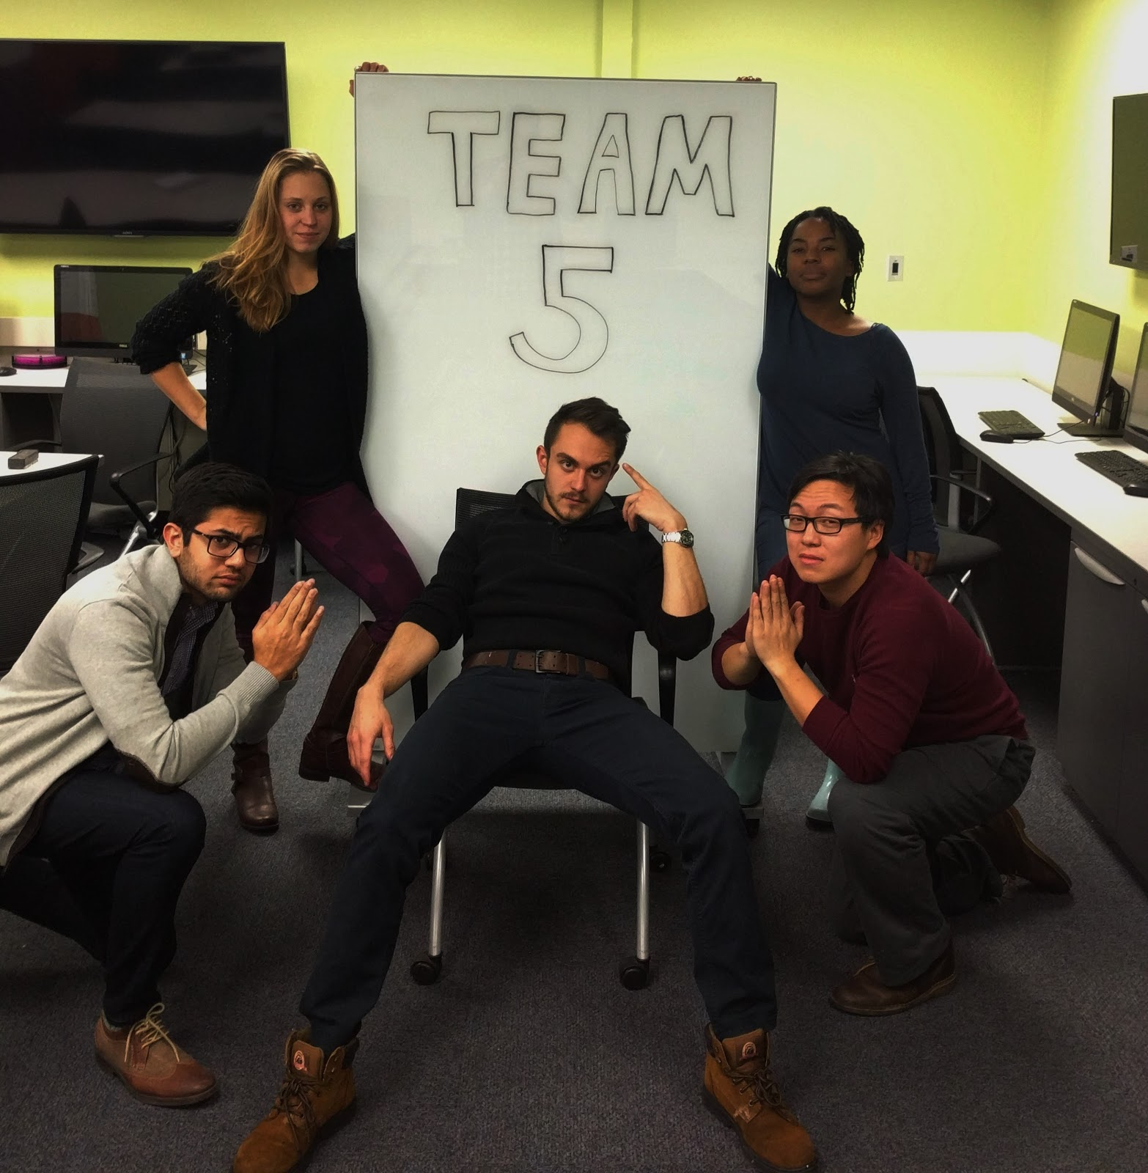
Thank you! we’d love to hear any questions and feedback

