Slide 1

Mental Health in the Digital Era-NLP Models for Depression and Suicidal Tendency Detection
Rohan C and Dr. Sapna VM
PES University

Slide 2
Outline
Motivation
Dataset Acquisition and Preparation
Proposed Method
Results
Summary
Future Work
References

Slide 3
Motivation
Digital Era Challenges: Increased focus on mental health issues on social media platforms and messages.
Current Limitations: Scalability, timeliness and stigma.
Goal: Offer a more comprehensive view of an individual’s state of well-being.

Slide 4
Limitations of Traditional Methods
Lack of Contextual Understanding
Over-Reliance on keywords
Inability to detect implicit expressions

Slide 5

Dataset Acquisition
The data required to build our model was curated using online forums by these prestigious universities:
University of Maryland
Georgetown University
Lanzhou University

Slide 6



Dataset Preparation
This process involved the following crucial steps:
Cleaning and processing the dataset.
Identifying and marking character and sentence delimiters
Eliminating non UTF-8 characters.
Omitting Emojis

Slide 7
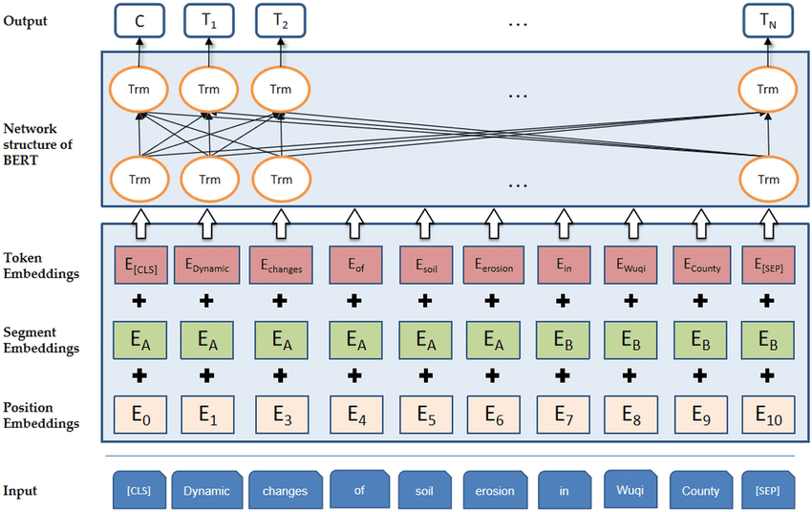
BERT Model
BERT has transformed the landscape of natural language processing with its deep bidirectional transformers. It has revolutionized the field of (NLP) due to its superior ability to understand the context of words in a sentence. Instead of looking at words in isolation, BERT examines words concerning their neighbors in both directions, leading to a much richer representation.

Slide 8
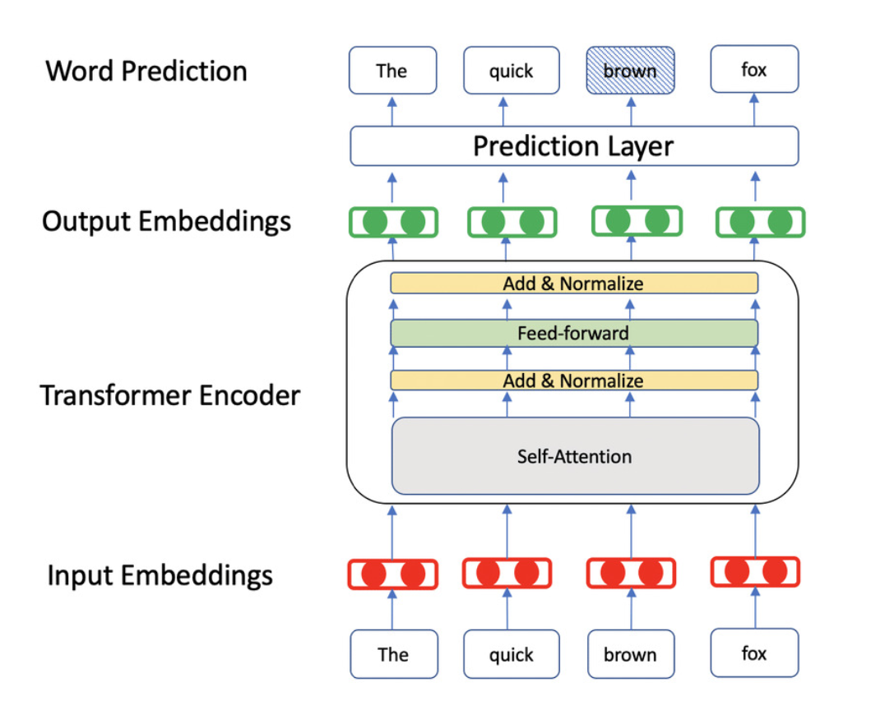
BERT Model

Slide 9
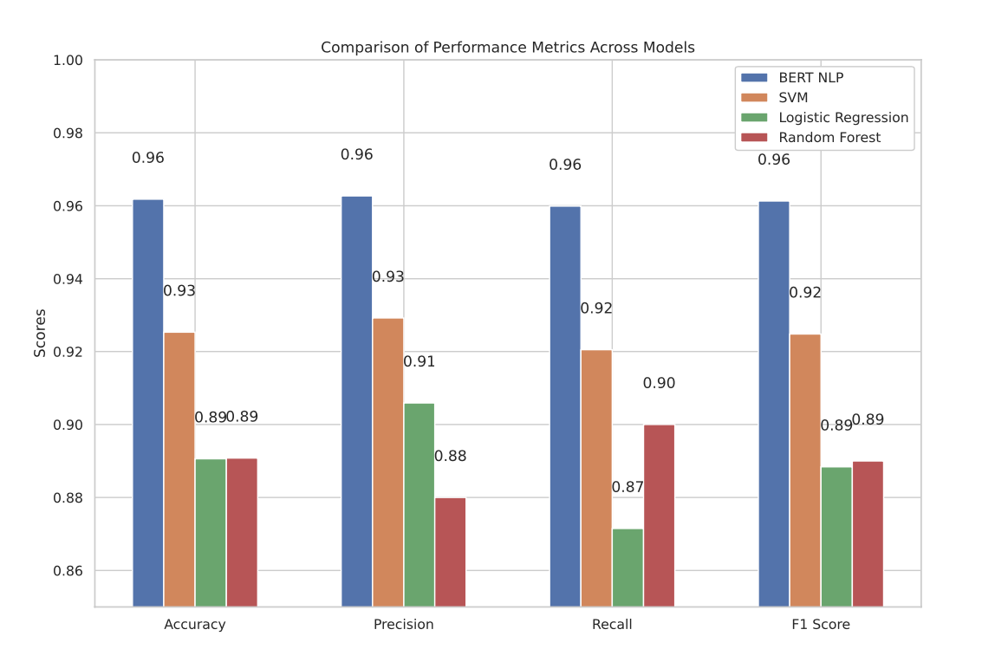
Results

Slide 10
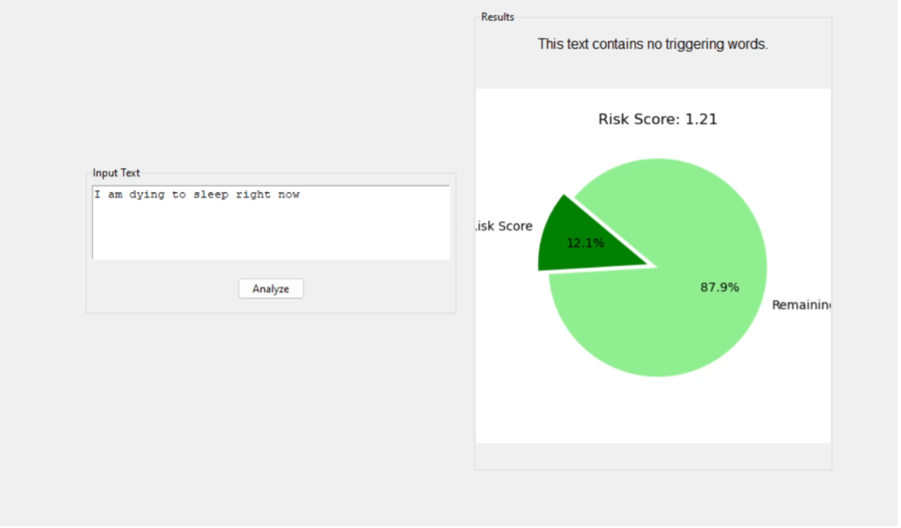
User-Interface

Slide 11
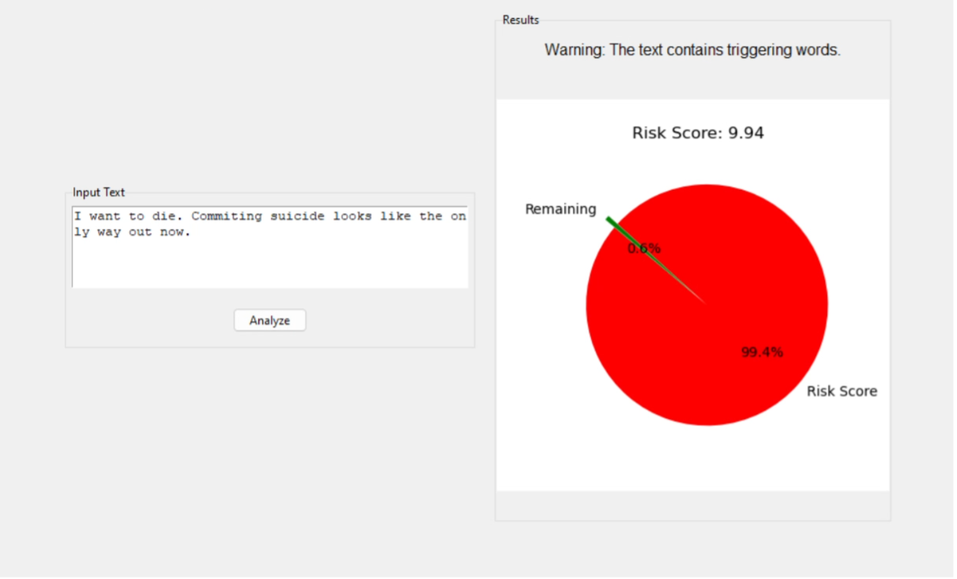
User-Interface

Slide 12
Concluding Remarks
The real value of our model is two-fold:
It is a positive sign in the advancement of technology in the field of mental health.
It works alongside existing therapeutic models to provide real-time information to therapists, caregivers, police and other law-enforcement.

Slide 13
Concluding Remarks
Even though our model shows how far we have come in using technology for mental health, we must also keep in mind ethical considerations for using social media data.
While this model allows us deep insights, it cannot replace the deep understanding and care that humans provide.

Slide 14

Future Work
The field of mental health and its associated technology is witnessing a multitude of changes.
Few of the potential features that can be integrated to our model are:
Timestamps: To provide better understanding of mood changes over time.
Security: On-device encryption allows us to protect the privacy of and data rights of individuals.

Slide 15
References
Haidt, J. and Allen, N., 2020. Scrutinizing the effects of digital technology on mental health.
Sharma, M.K., John, N. and Sahu, M., 2020. Influence of social media on mental health: a systematic review. Current opinion in psychiatry, 33(5), pp.467-475.
Saab, M.M., Murphy, M., Meehan, E., Dillon, C.B., O’Connell, S., Hegarty, J., Heffernan, S., Greaney, S., Kilty, C., Goodwin, J. and Hartigan, I., 2022. Suicide and self-harm risk assessment: a systematic review of prospective research. Archives of suicide research, 26(4), pp.1645-1665.
Castillo-Sa ́nchez, G., Marques, G., Dorronzoro, E., Rivera-Romero, O., Franco- Mart ́ın, M. and De la Torre-D ́ıez, I., 2020. Suicide risk assessment using machine learning and social networks: a scoping review. Journal of medical systems, 44(12), p.205.
Liu, D., Feng, X.L., Ahmed, F., Shahid, M. and Guo, J., 2022. Detecting and mea- suring depression on social media using a machine learning approach: systematic review. JMIR Mental Health, 9(3), p.e27244.

Slide 16

Thank You

