Slide 1
BIOMEDICAL
QA
AGENTS
as Evidence Mediators
Agentic Retrieval, DSPy Baselines,
and the Moral Cost of Binary Answers
Rohan Leekha · Daniel Gwon · Leslie Shing
MIT Lincoln Laboratory
DISTRIBUTION STATEMENT A. Approved for public release. Distribution is unlimited.
Notes:
Title slide. Paper reframes biomedical QA from a pipeline problem into a question about evidence labor and accountability.

Slide 2
THE PROBLEM
Biomedical QA is evidence labor, not a pipeline
The standard framing: retrieve from PubMed → prompt an LLM → score the answer
That framing misses the central problem — biomedical QA is evidence labor performed under time pressure
Query choices, missing items, and premature yes/no closures shape what clinicians and researchers may notice
Prior work on clinical information seeking: frequent questions, real barriers of time, access, and search skill
30M+
biomedical citations in PubMed
~28M
abstract-only documents in our index
Notes:
Set up the stakes: scale is not the only challenge — synonymy, abbreviations, entity exactness, changing evidence.

Slide 3
MOTIVATION
Retrieve once, generate once — a poor model of expert search
STATIC RAG
EXPERT EVIDENCE SEEKING
One retrieval pass, one generation
Simple and cheap
Top-k cutoff hides everything else
Can fail silently: plausible documents, fluent answer, no signal that evidence was incomplete
Tries several query formulations
Checks whether evidence is sufficient
Separates exact entity extraction from narrative synthesis
Revises conclusions when contradictions appear
Notes:
The gap between these two columns is what the agentic loop is trying to close.

Slide 4
CONTRIBUTIONS
What this paper claims
Control beats optimization
1
In BioASQ-style QA, run-time control over the evidence trajectory matters more than prompt optimization for list and factoid questions.
Not all agents are equal
2
A generic ReAct loop differs materially from a domain-governed agent with explicit sufficiency checks, answer-type policies, verification, and list-recall passes.
The contribution is sociotechnical
3
Agents are worth building when they expose and improve evidence labor — and morally hazardous when they compress uncertain evidence into unexamined yes/no outputs.
Notes:
Three claims map onto Findings, Systems Compared, and Discussion respectively.

Slide 5
TASK, DATA, EVALUATION
BioASQ Task 13b — four epistemic regimes, not one task
YES / NO
FACTOID
LIST
SUMMARY
binary closure
entity ranking
entity set completion
narrative synthesis
Factoid and list require exact entities — BioASQ explicitly discourages submitting synonyms
Yes/no demands a binary exact answer even when the evidence behind it is conditional
A system may do well in one regime and fail in another — so we report type-level results, never overall accuracy alone
Development corpus: 5,389 questions with gold evidence; retrieval over the 2025 PubMed abstract-only baseline
Metrics: yes/no macro-F1 · factoid accuracy · list F1 · ideal-answer Semantic F1
Notes:
Emphasise: the four columns in the results table are four different epistemic regimes, which is why we never collapse them.

Slide 6
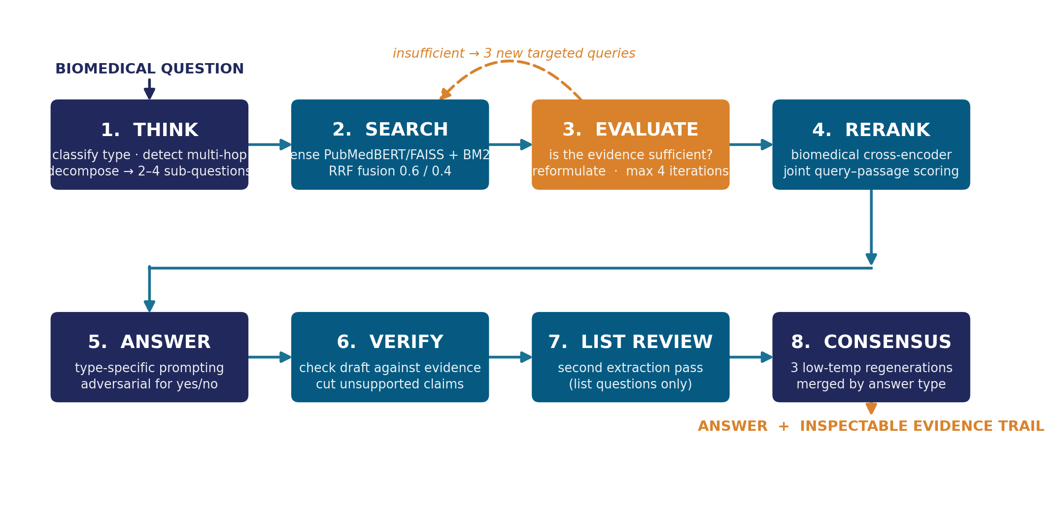
THE SYSTEM
A bounded eight-stage evidence-seeking loop
Gemma 4 31B-IT controller · retrieval bounded to four iterations · every decision left as an inspectable artifact
Notes:
Walk the loop left to right. The dashed amber arrow is the sufficiency loop — the part static RAG has no equivalent of.

Slide 7
RETRIEVAL SUBSTRATE
Hybrid retrieval: broad recall at scale, precise judgment on a small pool
DENSE
NeuML PubMedBERT embeddings, 768-dim · FAISS IVF-Flat over the PubMed 2025 baseline
SPARSE
BM25 — retained because gene symbols, drug names, and variants are exact tokens that embedding similarity softens away
FUSION
Reciprocal rank fusion at 0.6 dense / 0.4 sparse — conceptual recall plus lexical precision
RERANK
NeuML biomedbert cross-encoder scores query and passage jointly with full cross-attention
Division of labor is deliberate: FAISS and BM25 buy recall across 28M documents; the cross-encoder buys precision over a few hundred.
Notes:
Note that the DSPy baselines use this identical substrate — the retrieval stack is held constant.

Slide 8
ANSWER GENERATION
One prompt per answer type, not one prompt for all
FACTOID
YES / NO
Copy the exact biomedical entity from the evidence; do not paraphrase. Avoids the semantically-related-but-uncountable failure.
Adversarial: find evidence for both the affirmative and the negative, then state why one side is better supported.
LIST
SUMMARY
Proceed passage by passage, extract all candidate items, then normalize duplicates.
Write a concise ideal answer grounded in retrieved snippets, not a free-form biomedical explanation.
The adversarial yes/no prompt is both a fix for one-sided retrieval bias and the technical hinge of the paper's moral argument.
Notes:
Verify, list review, and consensus follow: they exist to reduce unsupported fluency rather than to add content.

Slide 9
COMPARISON DESIGN
DSPy baselines: a strong alternative view of the same problem
Rather than handcrafting prompts, DSPy builds modular LM programs and optimizes their instructions and demonstrations
Seven baselines: zero-shot, RAG, MultiHop RAG, ReAct RAG — each with and without MIPROv2 optimization
MultiHop performs four hops; ReAct exposes retrieval as a tool with up to 20 iterations
All baselines use the same retrieval substrate: PubMedBERT dense, BM25 sparse, RRF fusion, FAISS IVF-Flat, biomedical reranker
STATED UP FRONT
The DSPy programs run gpt-oss-120b; our agent runs Gemma 4 31B-IT. This is not a model-controlled head-to-head. What we compare is control-policy regimes — a domain-governed loop with sufficiency checks and answer-type obligations, against generic or prompt-optimized programs.
Notes:
Pre-empt the obvious reviewer objection by naming the asymmetry before anyone asks.

Slide 10
RESULTS
BioASQ-style validation results
System | Fact. | Y/N | List | SemF1 | Ovr.
Zero-shot Gemma 4 31B | 8.0 | 94.0 | 0.0 | 41.6 | 35.9
Agentic SQLite FTS5 | 62.0 | 88.0 | 87.0 | 49.0 | 71.5
Agentic hybrid FAISS+BM25+IVF | 69.0 | 88.0 | 96.0 | 51.0 | 76.0
Agentic SQLite FTS5, CoT | 50.0 | 82.0 | 70.0 | 49.0 | 62.75
DSPy RAG | 12.0 | 82.0 | 4.0 | 49.0 | 36.75
DSPy RAG + MIPROv2 | 27.0 | 94.0 | 13.0 | 48.0 | 45.5
DSPy MultiHop RAG | 12.0 | 76.0 | 0.0 | 49.0 | 34.25
DSPy MultiHop RAG + MIPROv2 | 27.0 | 88.0 | 13.0 | 48.0 | 44.0
DSPy ReAct RAG | 8.0 | 76.0 | 0.0 | 55.0 | 34.75
DSPy ReAct RAG + MIPROv2 | 31.0 | 94.0 | 0.0 | 55.0 | 45.0
+40.3
points overall over zero-shot,
same Gemma backbone
96.0
list F1 — every DSPy variant
scores between 0.0 and 13.0
76.0
overall, against 45.5 for the
best DSPy baseline
Notes:
Point at the zero-shot row and the yes/no column early — it sets up the moral compression argument two slides later.

Slide 11
FINDINGS
Four patterns in the table
Control policy, not model class
1
On the same Gemma backbone the agentic loop adds 40.3 points overall, 35.7 → 76.0. The cross-row gap over DSPy is consistent with this but cannot be cleanly attributed.
Gains sit in recall-sensitive regimes
2
List 96.0 and factoid 69.0. Ablating dense retrieval and the reranker gives 62.0 / 87.0; further removing type-specific generation gives 50.0 / 70.0.
Optimization aligns style, not evidence
3
MIPROv2 lifts factoid 12 → 27 and yes/no 82 → 94, yet optimized ReAct list F1 stays at 0.0. It reaches the regimes it can reach without retrieving the evidence behind them.
Yes/no and summary mislead on their own
4
Zero-shot Gemma with no retrieval at all reaches 94.0 yes/no and 41.6 SemF1 — while scoring 8.0 factoid and 0.0 list.
Notes:
Pattern four is the bridge into the discussion section.

Slide 12
DISCUSSION I
Agents earn their place by making evidence labor inspectable
Biomedical search is invisible labor: translating vague questions into queries, recalling synonyms, deciding which abstracts are worth opening, judging sufficiency
Static RAG automates one slice of that labor and hides the rest inside an initial query and a top-k cutoff
An agentic retriever turns subqueries, failed searches, sufficiency judgments, reranker decisions, verification edits, and recovery passes into inspectable artifacts
The trace also exposes failure: if second-round searches return nothing, the insufficiency signal stays visible rather than being absorbed into a premature answer
The argument is not for greater autonomy — it is for governed agency: explicit procedural commitments about how biomedical evidence should be searched, checked, revised, and represented.
Notes:
Reframe: the evidence trajectory, not the answer string, is the unit of design and evaluation.

Slide 13
DISCUSSION II
The moral cost of yes/no
A binary answer collapses evidence quality, population heterogeneity, clinical context, and uncertainty into a single token.
94.0
The yes/no column cannot distinguish a system that has read the literature from one that has read nothing.
The channel is too narrow to carry the difference — moral compression in arithmetic form.
Risks: automation bias in clinical decision support, and Elish's moral crumple zone.
yes/no — from a system that performs
no retrieval whatsoever
8.0 factoid · 0.0 list
The adversarial procedure does not make the system morally safe. It changes binary closure from a generation habit into an accountable step.
Notes:
Users should see not only yes or no, but the evidence trail, the rejected alternative, and any insufficiency flags.

Slide 14
TAKEAWAYS
Evidence mediators, not medical authorities
Technical finding
A domain-governed agentic loop improves recall-sensitive and exact-answer regimes over static and generic agentic baselines.
Computational social science finding
The value of agents lies in making evidence labor visible and governable, not in raising a benchmark number.
Design principle
Accountable hand-off, not human replacement: provenance for retrieved documents, a recorded search path, exposed sufficiency decisions, calibrated abstention.
Open limitation
Different backbones across systems, so the table reads as a comparison of control-policy regimes. Future work must test whether traces actually improve human judgment.
Rohan Leekha · Daniel Gwon · Leslie Shing · MIT Lincoln Laboratory
Notes:
Close on the reframing: agents are worth building when they expose evidence labor, hazardous when they compress it.

