Slide 2
Gaps
Gaps in current research
Contextual counter-influencing operations currently do not exist in current approaches
Current existing multi-modal meme classification methods rely on simply concatenating feature vectors of different modalities. However, they ignore the potential common information between the modalities.
Currently, social media
Current research does not identify “why” a meme has potential to radicalize audience and “what” visual and textual characteristics make memes associative of radicalization
Currently no work focuses on identifying multimodal

Slide 3
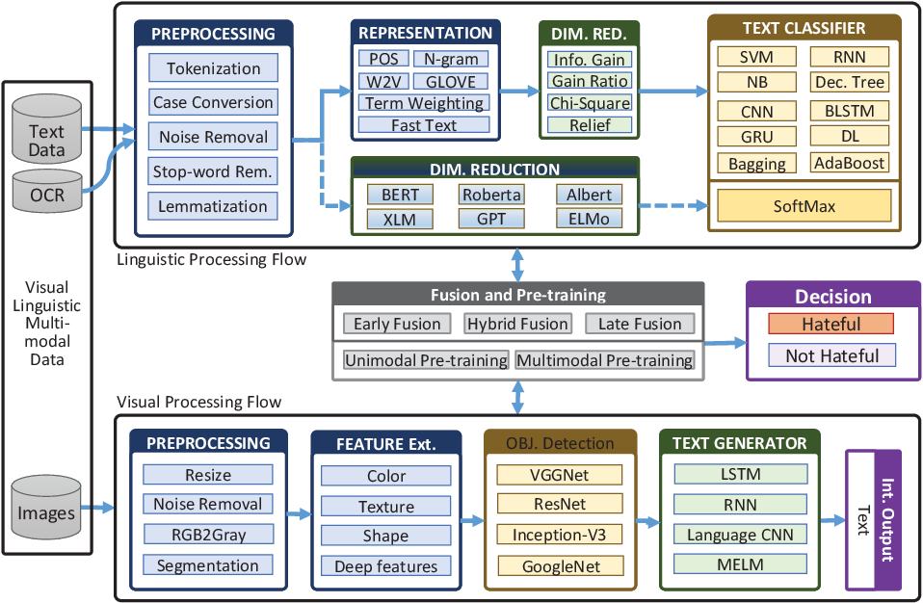

Slide 4
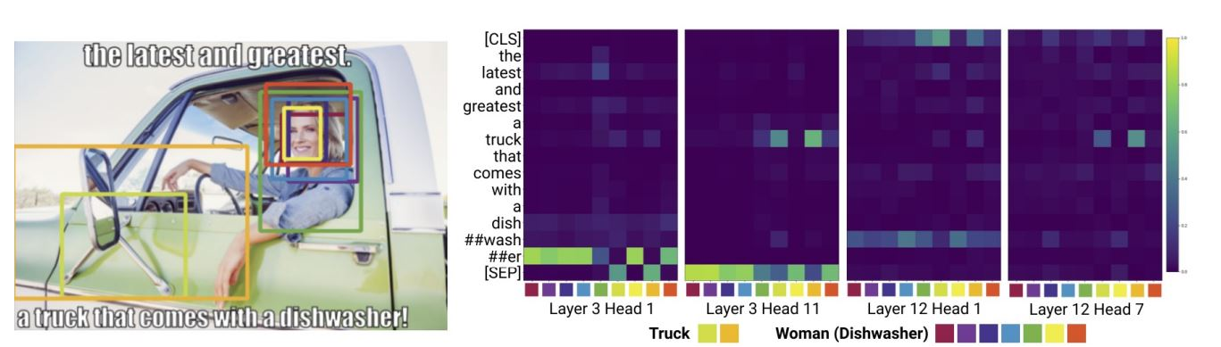

Slide 5
